Slide 1
Hub, ECR, Fargate
LECTURE 06 · READ THIS DECK · 75 MIN
Same notes-api image as lecture 5.
Push it. Run it without SSH. Then delete it.

Slide 2
How this class works
Theory — about 12 minutes
Demo — about 63 minutes
The path: build → Hub → ECR → Fargate.
Tag l6 vs latest.
Docker Hub vs Amazon ECR.
Azure and GCP names for the same two jobs.
Fargate = no SSH. Public IP. Money and cleanup.
lec-06/codebase/hub-ecr-fargate-lab-instructions.txt
EC2: docker build, docker run, curl /health.
Hub: push :l6.
ECR: push :l6.
Fargate: curl /health from Windows.
Delete service, cluster, ECR, EC2 before you leave.
Assignment: lec-06/assignment.md
Lecture 6 · Plan

Slide 3
Clock — do not add extra demos
When | What | Done when
0–12 | These slides + pictures | Students can say Hub / ECR / ACR / Cloud Run / Fargate
12–25 | EC2 + build + run | curl 127.0.0.1:8080/health on the EC2
25–38 | Docker Hub push | Hub shows tag l6
38–50 | ECR create + push | ECR shows tag l6
50–68 | Fargate + curl from Windows | {"status": "ok"} from the task IP
68–75 | Cleanup | No cluster, no ECR repo, EC2 terminated
If the clock slips: skip Hub pull-proof. Do not skip ECR, Fargate curl, or cleanup.
Lecture 6 · 75 minutes

Slide 4
Today vs later
We do today | Not today
docker build / run on one practice EC2 | Docker Desktop on Windows
Push :l6 to Docker Hub and to ECR | Docker Compose (one service — skip)
Fargate: 1 task, public IP, curl from Windows | ALB, NAT, two AZs, autoscaling
Say Azure ACR / Container Apps and GCP Artifact Registry / Cloud Run | Click Azure or GCP consoles
Delete the stack the same day | Lecture 11 project (still one EC2 + GitHub Actions)
Lecture 6 · Scope

Slide 5
Where each command runs
1. Browser
2. EC2 (after SSH)
3. Your Windows Git Bash
Key, SSH security group, IAM role, Launch instance.
ECR repository.
ECS cluster, task definition, service.
Cleanup buttons.
sudo docker build -t notes-api:l6 .
sudo docker run -p 8080:8080 …
curl 127.0.0.1 on this box.
docker login Hub.
docker push Hub and ECR.
ssh / scp only, until Fargate is up.
Then curl http://FARGATE_IP:8080/health
from the laptop — not from the EC2.
Lecture 6 · Machines

Slide 6
One image. Four places it can live
Build on the EC2 → Hub → ECR → Fargate pulls ECR.

Slide 7
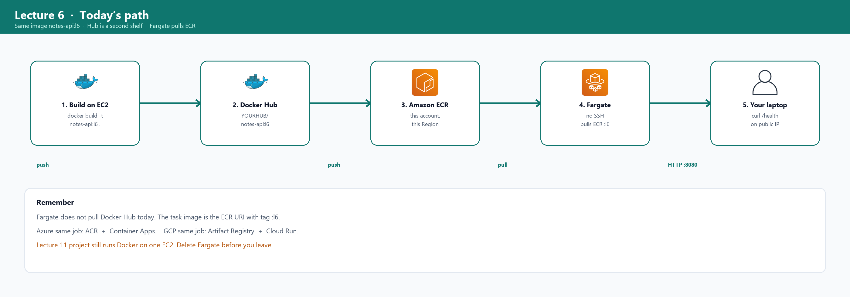
Picture — today’s path
Fargate pulls ECR, not Hub. Hub is so you have done a real docker push before AWS’s version.
Lecture 6 · Path picture

Slide 8
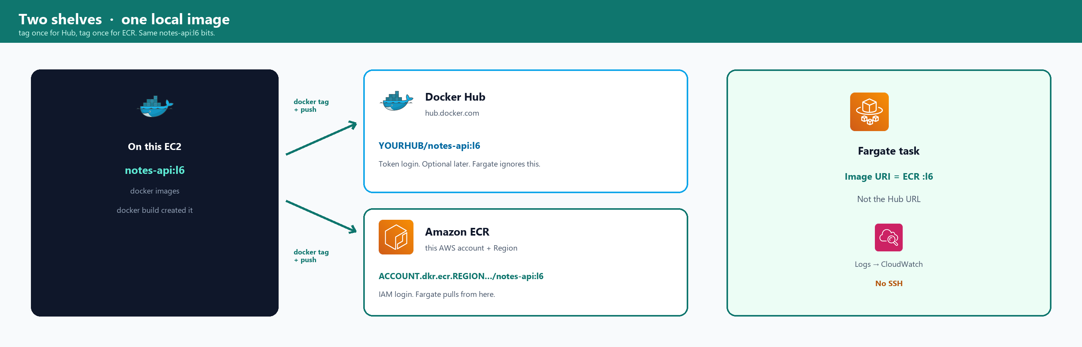
Two shelves, one local image
docker tag does not copy files twice. It adds a second name to the same bits, then push sends layers to that shelf.
Lecture 6 · Hub vs ECR picture

Slide 9
Hub vs ECR in words
Docker Hub
Amazon ECR
Docker’s website. Any laptop can docker pull if the repo is public (or you log in).
Good for sharing and for FROM python:3.12-slim (that pull is Hub).
Token in docker login. Never put the token in a Dockerfile.
A private shelf inside YOUR account and Region.
IAM decides who may push/pull.
Fargate in this account pulls from here with the execution role — no Hub password on AWS.
Lecture 6 · Hub vs ECR

Slide 10
Same two jobs. Different product names
We click AWS today. These names are for interviews.

Slide 11
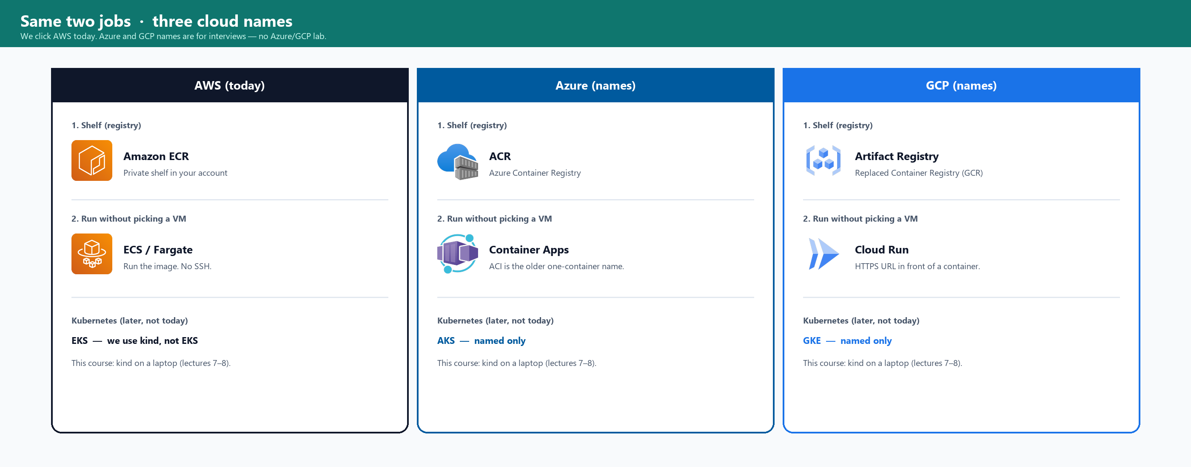
Picture — AWS, Azure, GCP
Job 1 = store the image. Job 2 = run it without you picking a VM. Kubernetes is a third job — kind later, not EKS/AKS/GKE.
Lecture 6 · Three clouds picture

Slide 12
Say these names out loud
Job | AWS (we click) | Azure (name) | GCP (name)
Shelf for images | ECR | ACR (Container Registry) | Artifact Registry
Run a container, little VM work | ECS / Fargate | Container Apps | Cloud Run
Older / extra name | — | ACI (one container) | GCR (old registry name)
Kubernetes | EKS — we use kind | AKS — named only | GKE — named only
Different / watch
Interview: “ECR is AWS’s ACR. Fargate is AWS’s Cloud Run / Container Apps.” Then: “The course project still uses one EC2 so it stays on Free Tier.”
Lecture 6 · Three clouds table

Slide 13
Azure — what each name means
ACR
Container Apps (ACI is older)
Azure Container Registry.
Same job as ECR: a private shelf of images in your subscription.
docker login to an *.azurecr.io address, then docker push.
We do not open the Azure portal today.
Run the image. You do not SSH a VM.
Container Apps = the current “put a container on the internet” product.
ACI = Azure Container Instances, the older one-container name.
Same idea as Fargate / Cloud Run.
Lecture 6 · Azure

Slide 14
GCP — what each name means
Artifact Registry
Cloud Run
GCP’s shelf for images (and other packages).
Replaced Container Registry, often still called GCR.
Same job as ECR / ACR.
We do not open the GCP console today.
You give GCP a container image. GCP gives you an HTTPS URL.
You do not pick a VM size. You do not SSH in.
Closest GCP cousin of Fargate for this class.
GKE is Kubernetes — later we use kind, not GKE.
Lecture 6 · GCP

Slide 15
Pin the version. Do not pack secrets
l6 is a name we chose. latest is a name people over-trust.

Slide 16
What a tag is
notes-api:l6 is two parts. notes-api = repository name. l6 = tag. A tag points at one image id (a hash). You can move the tag later. That is why “always pull latest” is unsafe.
You type | Meaning
notes-api:l6 | Our class pin. Fargate uses this.
notes-api:latest | Just another tag. Docker fills latest if you omit the tag. We do not omit it.
YOURHUB/notes-api:l6 | Same image, Hub’s namespace.
ACCOUNT.dkr.ecr.REGION.amazonaws.com/notes-api:l6 | Same image, ECR’s address.
Lecture 6 · Tags

Slide 17
Why Fargate must not use latest
If the task says :latest
If the task says :l6
Next week someone pushes a broken build and also calls it latest.
Fargate pulls again and the API changes without a review.
You cannot say which bits ran.
You pushed one digest today.
The task definition names that tag.
To change it you push l7 (or a git sha) and edit the task. That is a deliberate step.
Lecture 6 · Pin

Slide 18
Secrets never go in the image
Whatever you COPY is in every Hub/ECR pull forever — even if you delete the file on the EC2 later.
Keep out | How
.pem, .env, Hub access token, AWS keys | .dockerignore + never COPY . blindly
Passwords in Dockerfile ENV | Use the task env later — not the Dockerfile
docker login token in a file | Type docker login on the EC2. Do not commit the token
Different / watch
HOST and PORT are config, not secrets. A database password would be a secret — do not put it in the file you push.
Lecture 6 · Secrets

Slide 19
Non-root USER (in our Dockerfile)
After COPY, before EXPOSE
RUN useradd --create-home --uid 10001 appuser \
&& chown appuser:appuser /app/notes-api.py
USER appuser
The process is not root. Port 8080 does not need root.
If someone abuses the app, they are not already uid 0 inside the container.
Multi-stage builds shrink images (a second FROM that copies only the result). We name it. We skip the demo so the clock reaches Fargate.
Lecture 6 · USER

Slide 20
Run the image. Do not SSH the box
You still need a VPC, a subnet, a security group, and a role.

Slide 21
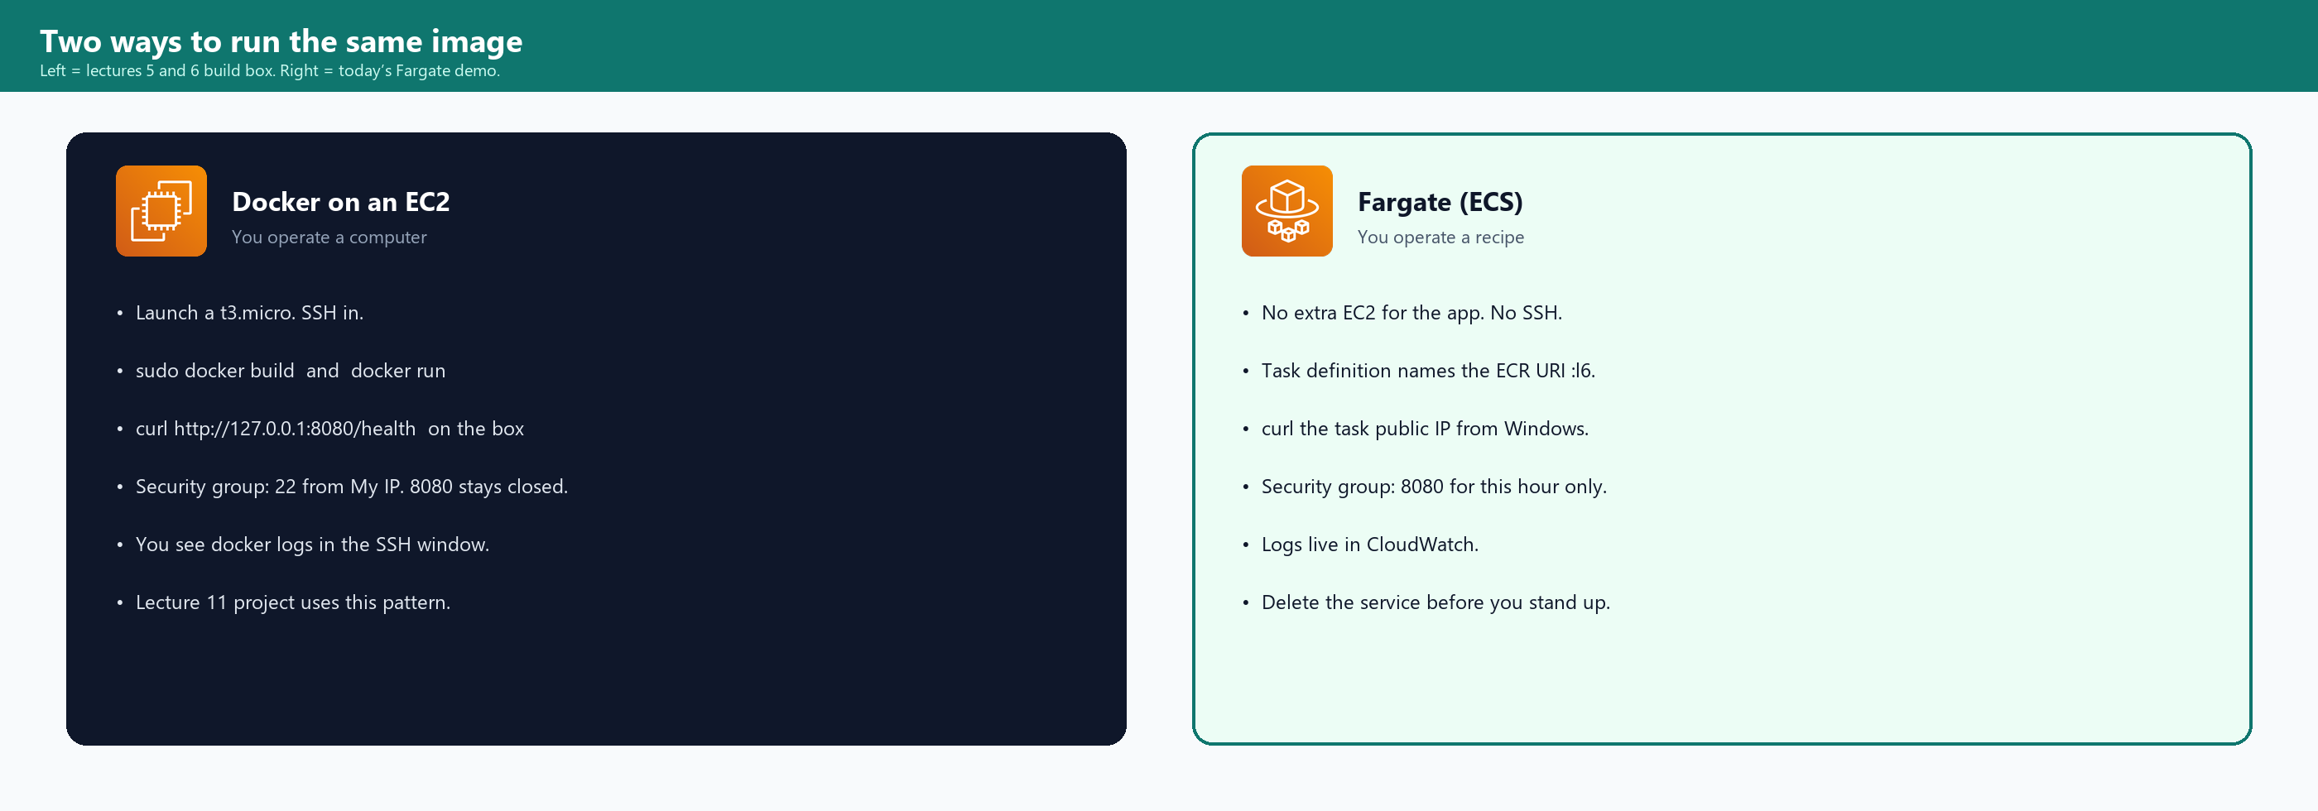
Picture — EC2 Docker vs Fargate
Left is how you build today (and how lecture 11 still runs). Right is the showcase: same :l6, no SSH.
Lecture 6 · Contrast picture

Slide 22
Three ECS words
1. Cluster
2. Task definition
3. Service
A named home in ECS.
Today: lec06-cluster.
Fargate: AWS supplies the computers. You do not list EC2 instances here.
The recipe: image URI:l6, CPU 0.25, memory 0.5 GB, port 8080, env HOST/PORT, log group, execution role.
Keep N copies of that recipe running.
Today N = 1.
If the task dies, the service starts another.
Lecture 6 · Words

Slide 23
Execution role — why a role at all
The task is not you. It cannot use your console login. AWS gives it a role so it may pull the image and write logs.
Role | Attached to | Allows
lec06-ec2-ecr | The practice EC2 | docker push to ECR
ecsTaskExecutionRole | The Fargate task (execution) | ecr pull + CloudWatch logs
Task role (none today) | The app inside | Would be for S3 from Python. We skip it.
Console “Create new role” on the task definition is enough for class. Do not paste access keys into the container.
Lecture 6 · IAM

Slide 24
Public subnet + public IP — skip NAT
Lecture 4 NAT was for a private subnet that still needed the internet. NAT is billed. Today the Fargate task sits in a default public subnet with Assign public IP ON.
Need | How we get it without NAT
Task pulls ECR | Public IP + internet gateway on the default VPC
Your laptop curls /health | Same public IP, SG inbound 8080
SSH to Fargate | You do not. There is no SSH.
Different / watch
If public IP is off and there is no NAT: CannotPullContainerError. Turn public IP on. Do not create a NAT for this demo.
Lecture 6 · Network

Slide 25
Security groups — two different doors
lec06-docker-ssh (the EC2)
lec06-fargate-8080 (the task)
Inbound: 22 from My IP only.
8080 is NOT open.
You curl on the EC2 itself (127.0.0.1).
Same idea as lecture 5.
Inbound: 8080 from 0.0.0.0/0 for class.
That is the whole internet on the API.
Acceptable for one hour of /health.
Delete the service and this SG before you leave.
Lecture 6 · SG

Slide 26
Money — cents if you delete today
Thing | Free Tier note | If you forget it
t3.micro EC2 a few hours | Usually Free Tier hours | Terminate
ECR one small image | Cheap at class size | Delete the repository
Fargate 0.25 vCPU / 0.5 GB | Not a long Free Tier holiday | Delete the service first — that stops the burn
CloudWatch logs | Tiny today | Delete the log group
Lecture 4 NAT / ALB leftovers | NAT is the expensive one | Delete those if they are still running
Different / watch
Cleanup is on the clock (minute 68). A Fargate service left for a week is how a student gets a bill.
Lecture 6 · Cost

Slide 27
Follow the lab file, in order
lec-06/codebase/hub-ecr-fargate-lab-instructions.txt

Slide 28
Before SSH — console checklist
Step | You click | Write down
CLI-0 | Same Region as lectures 4–5 | REGION, 12-digit ACCOUNT
CLI-1 | Key pair (reuse lec05 or lec06) | KEYFILE path, chmod 400
CLI-2 | SG lec06-docker-ssh, 22 My IP | 8080 is not on this SG
CLI-2b | IAM role lec06-ec2-ecr for EC2 | ECR PowerUser
CLI-3 | Amazon Linux 2023 t3.micro, Default VPC, public IP, that SG, that IAM profile | PUBLIC IPv4 after 2/2
Two Git Bash windows. ssh twice. Do not use browser Instance Connect.
Lecture 6 · CLI-0 to 3

Slide 29
CLI-4 / CLI-5 — Docker and files
On the EC2 (window 1)
sudo dnf install -y docker git
sudo systemctl enable --now docker
sudo docker version → Client AND Server
Then put notes-api on the box: git clone the course repo, or scp from Windows.
ls ~/notes-api → notes-api.py Dockerfile .dockerignore
Read the Dockerfile. USER appuser is new vs lecture 5. Do not invent a new file.
Lecture 6 · Install

Slide 30
Demo A — build notes-api:l6
Demo
cd ~/notes-api
sudo docker build -t notes-api:l6 .
Wait for: Successfully tagged notes-api:l6
sudo docker images
Look for notes-api l6
Same build as lecture 5. New tag: l6. New USER in the Dockerfile.
Lecture 6 · Demo A

Slide 31
Demo B — run and /health on the EC2
Demo
Window 1:
sudo docker run --rm -p 8080:8080 --name notes-l6 notes-api:l6
Wait for: API is running at http://0.0.0.0:8080
Window 2:
curl http://127.0.0.1:8080/health → {"status": "ok"}
curl http://127.0.0.1:8080/notes
LEFT 8080 = this EC2. RIGHT 8080 = inside. Name in use? sudo docker rm -f notes-l6
Lecture 6 · Demo B

Slide 32
Demo C — you should see tag l6
Window 2
sudo docker images
Look for: notes-api l6
That is what we will tag for Hub and for ECR.
latest may also appear if someone omitted a tag — we still push :l6.
Tick: image exists before anyone logs in to Hub.
Lecture 6 · Demo C

Slide 33
Demo D — Docker Hub push
Browser on Windows: hub.docker.com → create repo notes-api. Account → Security → New Access Token (Read/Write). Copy once.
Demo
On the EC2:
HUB=your-hub-username
sudo docker login -u $HUB # paste ACCESS TOKEN, not Hub password
sudo docker tag notes-api:l6 $HUB/notes-api:l6
sudo docker push $HUB/notes-api:l6
Browser: repository → Tags → l6.
If the clock is past 38 min, skip rmi + pull proof. Move to ECR.
Lecture 6 · Demo D Hub

Slide 34
Demo D — login failures
Symptom | Cause | Fix
unauthorized / denied | Password instead of token, or wrong username | Hub username (not email). New token.
repository does not exist | You never created notes-api on Hub | Create the repo, then push again
token pasted in Slack | Secret leak | Revoke token on Hub. Never commit it
Different / watch
Hub is Docker’s shelf. Fargate will not use this URL today. Azure’s shelf is ACR. GCP’s shelf is Artifact Registry.
Lecture 6 · Demo D watch

Slide 35
Demo E — create ECR (console)
Demo
Elastic Container Registry → Repositories → Create
Visibility: Private
Name: notes-api
Create
Copy the URI:
ACCOUNT.dkr.ecr.REGION.amazonaws.com/notes-api
URI must be this Region. A repo in another Region is a different shelf.
Write URI on the lab sheet next to ACCOUNT and REGION.
Lecture 6 · Demo E console

Slide 36
Demo E — login and push ECR
On the EC2 — same REGION / ACCOUNT as CLI-0
aws sts get-caller-identity
Account must match. If AccessDenied → instance IAM role is missing.
Console: instance → Actions → Security → Modify IAM role → lec06-ec2-ecr
aws ecr get-login-password --region $REGION | sudo docker login --username AWS --password-stdin $ACCOUNT.dkr.ecr.$REGION.amazonaws.com
sudo docker tag notes-api:l6 $URI:l6
sudo docker push $URI:l6
Console: ECR → notes-api → image tag l6.
Lecture 6 · Demo E push

Slide 37
Demo E — ECR vs Hub vs ACR vs Artifact Registry
 | Docker Hub | Amazon ECR | Azure / GCP
Login | docker login -u HUB + token | aws ecr get-login-password | az acr login / gcloud auth
Address | HUB/notes-api:l6 | …dkr.ecr.REGION…/notes-api:l6 | *.azurecr.io / Artifact Registry
Fargate today | Not used | Task image URI :l6 | We do not run those
You tagged the SAME local image twice. Two shelves. One Dockerfile.
Lecture 6 · Demo E recap

Slide 38
Demo F1 — ECS cluster
Demo
Search ECS → Clusters → Create cluster
Name: lec06-cluster
Infrastructure: AWS Fargate (serverless)
Create
You are not launching another t3.micro here.
Fargate’s computers are AWS’s. You will never SSH them.
Azure cousin: Container Apps environment. GCP cousin: Cloud Run (no cluster click).
Lecture 6 · Demo F cluster

Slide 39
Demo F2 — task definition
Field | Set this
Family | notes-api
Launch type | Fargate, Linux, X86_64
CPU / memory | 0.25 vCPU / 0.5 GB
Task role | None
Execution role | Create new role (ecsTaskExecutionRole)
Container name | notes
Image URI | paste $URI:l6 — include the tag
Port | 8080 TCP
Environment | HOST=0.0.0.0 PORT=8080
Logs | CloudWatch on
Lecture 6 · Demo F task

Slide 40
Demo F3 — service (the easy-to-miss clicks)
Demo
Cluster → Services → Create
Launch type Fargate. Family notes-api. Service name notes-svc. Desired tasks 1.
Networking:
VPC = Default VPC
Subnets = default (public) subnets
New SG lec06-fargate-8080 inbound Custom TCP 8080 0.0.0.0/0
Public IP = TURNED ON
Load balancer = None
Create
Wait until running count = 1. “latest” on the service is the task-def revision, not the image tag.
Lecture 6 · Demo F service

Slide 41
Demo F3 — if the task is STOPPED
Stopped reason | Typical cause | What to do
CannotPullContainerError | Public IP off, bad URI, missing :l6, execution role cannot ECR | Fix URI / public IP / role. New service.
ResourceInitializationError | No route to ECR or logs (same network story) | Public IP ON. Default VPC. No private-only subnet.
Essential container exited | App crashed. Wrong bind. Missing file | Task → Logs. Need 0.0.0.0:8080
Different / watch
Do not add lecture 4 NAT to “fix” a pull error. Public IP is the class fix. NAT is money.
Lecture 6 · Demo F stopped

Slide 42
Demo F4 — curl from Windows
Cluster → Tasks → the running task → Network → Public IP. That is FARGATE_IP. A Git Bash that is NOT ssh:
On your laptop
curl http://FARGATE_IP:8080/health
curl http://FARGATE_IP:8080/notes
Same JSON as docker run on the EC2.
Different computer: Windows → internet → Fargate public IP → container 8080.
Hang = wrong IP (EC2 vs Fargate) or SG missing 8080. Refused = task not RUNNING.
Lecture 6 · Demo F curl

Slide 43
Demo F5 — logs instead of SSH
Where
Why this matters
Same task → Logs
or CloudWatch → Log groups → /ecs/notes-api (name may vary).
You should see: API is running at http://0.0.0.0:8080
and the curl lines.
docker logs needed SSH + a container name.
Fargate has neither.
Cloud Run / Container Apps are the same idea: you read a log pane, you do not SSH.
Lecture 6 · Demo F logs

Slide 44
Demo G — say the path out loud
Place | Name you should see
This EC2 | docker images → notes-api:l6
Docker Hub | YOURHUB/notes-api:l6
Amazon ECR | URI:l6
Fargate | pulled URI:l6 — curl from Windows worked
Azure / GCP (words only) | ACR + Container Apps / Artifact Registry + Cloud Run
Lecture 11 still runs Docker on one project EC2 with GitHub Actions.
Lecture 6 · Demo G

Slide 45
Demo H then I — stop the container, then delete AWS
Demo
EC2 window 1: Ctrl+C ( --rm removes notes-l6 )
Console, in this order:
1. Service desired 0 → delete notes-svc
2. Delete cluster lec06-cluster
3. Deregister task definition notes-api
4. Delete ECR repo notes-api (including images)
5. Terminate instance lec06-docker
6. Delete SGs lec06-fargate-8080 and lec06-docker-ssh
7. Delete the CloudWatch log group
8. Delete IAM role lec06-ec2-ecr
Leaving the service running is the bill. Do this in class.
Lecture 6 · Cleanup

Slide 46
If something fails
Symptom | Typical cause
ssh times out | SG not My IP, or status check not 2/2
port already allocated | sudo docker rm -f notes-l6 then run again
ECR AccessDenied on the EC2 | IAM instance profile not lec06-ec2-ecr
ECR repository does not exist | Repo in another Region, or never created
Fargate CannotPullContainerError | Public IP off, or image URI / :l6 wrong
curl Fargate hangs | Used EC2 IP, or Fargate SG has no 8080
Lecture 6 · Debug

Slide 47
Say it, then write the assignment
File: lec-06/assignment.md — cleanup is on the grade.

Slide 48
Spoken answers
Question | Say this
8080:8080? | Left = host. Right = inside the container.
Why not latest? | latest moves. Pin l6 so you know what ran.
Hub vs ECR? | Hub is Docker’s website. ECR is AWS’s registry. Fargate pulled ECR.
Azure / GCP? | ACR + Container Apps. Artifact Registry + Cloud Run.
What is Fargate? | ECS runs the image. No SSH. Still need VPC, SG, execution role, logs.
Why public IP? | Pull ECR and curl /health without a billed NAT. Delete the same day.
Project Fargate? | No. Lecture 11 is one EC2 + GitHub Actions. Today was the showcase.
Lecture 6 · Interview

Slide 49
Assignment ticks
lec-06/assignment.md
Paste EC2 curl and Windows Fargate curl.
Explain Hub vs ECR, Azure/GCP names, tags, public IP, secrets, USER.
Tick every cleanup box: service, cluster, task def, ECR, EC2, both SGs, log group, IAM role.
Lecture 7: Kubernetes ideas, then kind on a machine — not EKS.
Lecture 6 · Homework

Slide 50
Build once. Push. Run without SSH
END OF LECTURE 6
Hub and ECR hold :l6. Fargate proved the pull.
Azure ACR / GCP Artifact Registry — names only. Delete before you stand up.

