Slide 1

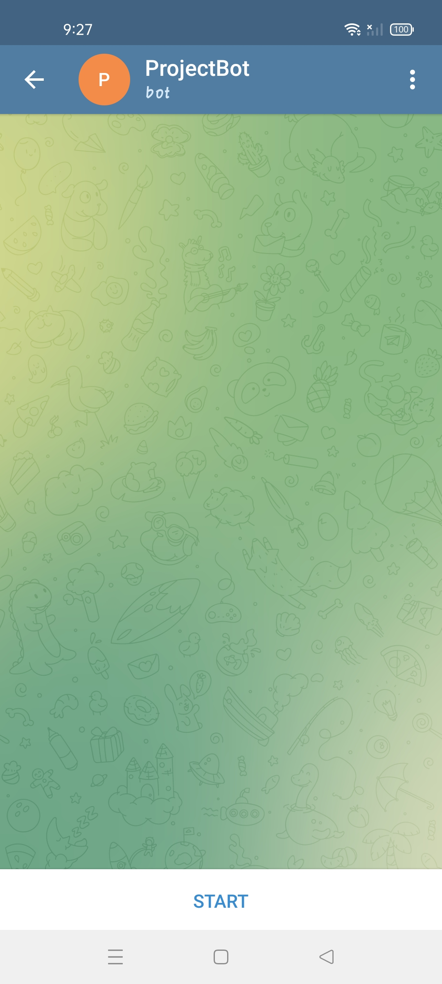
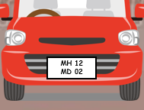

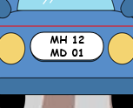




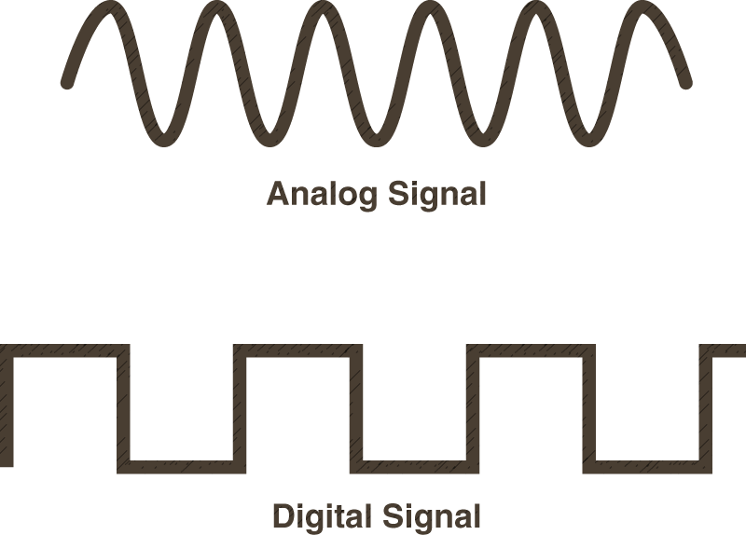

It captures the photo of car and sends directly to telegram app
When there is a RED light our 1st device will activate
Solar Powered
PIR sensor
ESP 32 – cam
circuit
MH 12 MD 01

Slide 2





Second device will warns the pedestrian by blowing siren if any pedestrian tries to cross road in green or yellow signal
When there is a GREEN Or YELLOW light our 2nd device will activate
PIR sensor
MH 12 MD 02
MH 12 MD 01

