Slide 1
Introduction to Networking Hardware
Overview of Networking Hardware Components
Modem: Stands for modulator-demodulator; it enables a computer or network to transmit data over telephone or cable lines by converting digital computer information into analog waves and vice versa.
Router: A critical device used to share an internet connection between multiple devices and networks, operating at Layer 3 of the OSI model.
Switch: A networking device that channels incoming data from any input port to the specific output port toward its destination using physical MAC addresses. It operates as a Layer 2 device, functioning as a unicast device that is faster and recognizes MAC addresses.
Access Point (WAP): Allows wireless devices to connect to a wired network using radio or infrared signals, offering wireless local area network (WLAN) communication over short distances.
Network Cable: Acts as the physical transmission media (such as copper twisted-pair, coaxial, or fiber optics) over which electrical signals or light pulses travel between networking devices.

Slide 2
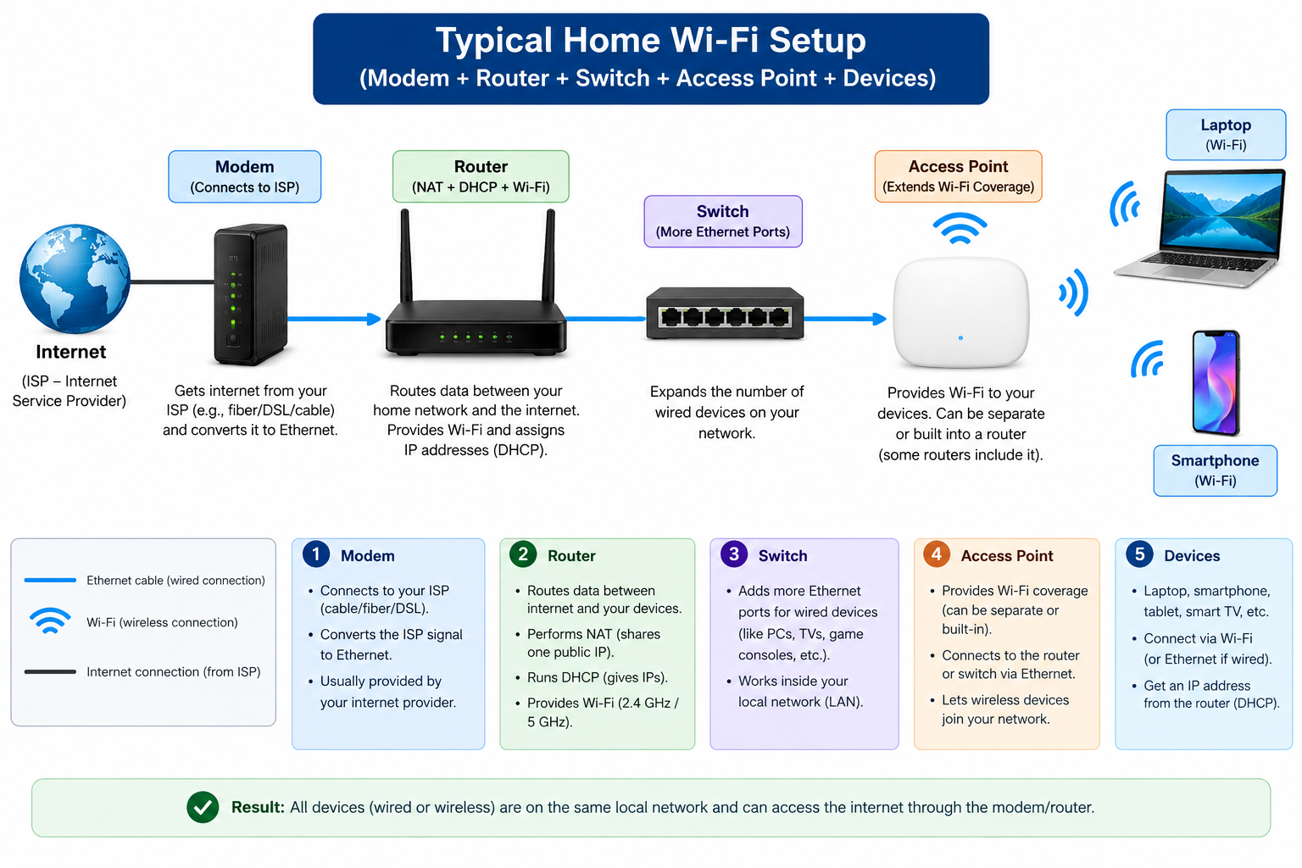

Slide 3
Main Functions and Real-Life Examples of Networking Devices
Modem:
  Main Function: Converts digital data from a computer into analog signals for transmission over telephone or cable lines, and vice versa.
  Real-Life Example: Used at home to connect your household network to your Internet Service Provider (ISP) via a broadband cable or telephone line.
Router:
  Main Function: Forwards data packets and shares a single internet connection across multiple devices and networks (Layer 3 device).
  Real-Life Example: Used at home or in an office to share internet access among computers, smart TVs, and mobile phones.
Switch:
  Main Function: Channels incoming data frames directly to the intended destination port within a Local Area Network (LAN) using MAC addresses (Layer 2 device).
  Real-Life Example: Used in a corporate office or school computer lab to interconnect multiple desktop computers and network printers together.
Access Point:
  Main Function: Extends a wired network by providing a wireless connection point (Wi-Fi) for wireless client devices.
  Real-Life Example: Used in a hotel lobby, campus, or large office building to provide wireless internet coverage to users roaming with laptops and smartphones.
Network Cable:
  Main Function: Provides the physical transmission pathway for electrical or optical data signals to move between networking devices.
  Real-Life Example: An Ethernet cable used to plug a desktop PC directly into a network router or wall port.

Slide 4
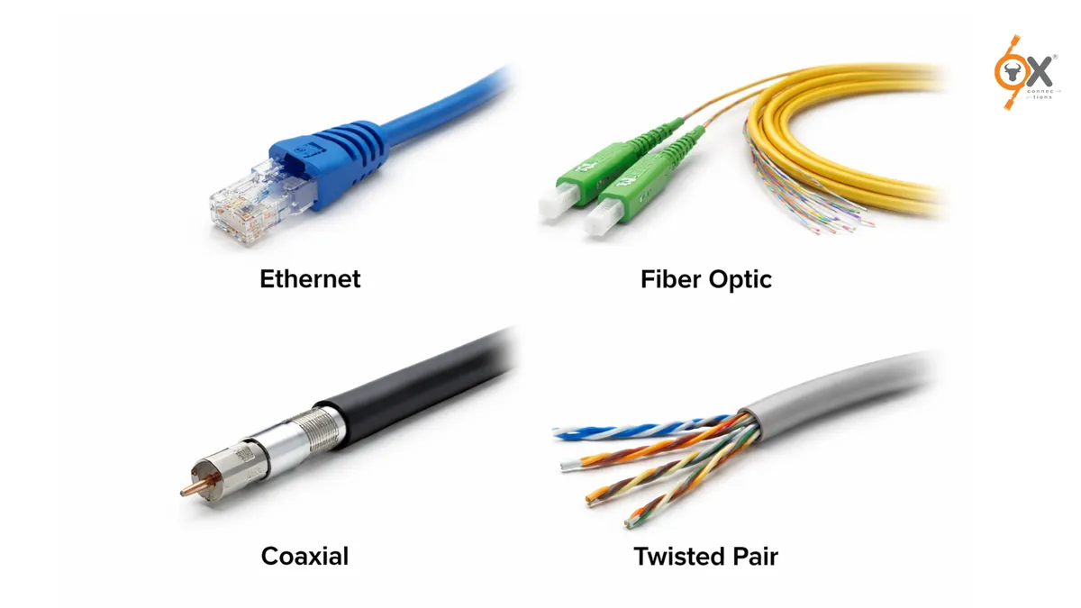
Types of network cables

Slide 5
Types of Network Cables, Source References, and Common Uses
Coaxial Cable (Coax):
  Description / Source Reference: Used in the transmission of audio, video, and broadband communication with high bandwidth and greater transmission capacity.
  Common Use: Commonly used for cable television (CATV) delivery and legacy broadband internet connections.
Twisted-Pair Cable (e.g., UTP / Cat5e / Cat6):
  Description / Source Reference: Consists of insulated copper wires twisted together to cancel out electromagnetic interference (EMI); acts as the de facto standard for Ethernet LAN wiring.
  Common Use: Commonly used for connecting computers to switches, routers, and wall jacks in local area networks (LANs).
Fiber Optic Cable:
  Description / Source Reference: A fast information transmission medium that carries communication signals using pulses of light generated by lasers or LEDs.
  Common Use: Commonly used for high-speed, long-distance data transmission across Wide Area Networks (WANs) and Metropolitan Area Networks (MANs).

Slide 6
Comparison Table — Router vs. Switch
Feature / Criteria | Router | Switch
Main Use & Function | Connects multiple disparate networks together and manages routing of data packets between them. | Connects multiple devices together within a single Local Area Network (LAN) to share resources.
OSI Layer | Operates at Layer 3 (Network Layer) of the OSI model. | Operates at Layer 2 (Data Link Layer) of the OSI model.
How Data is Handled | Uses IP addresses to forward packets across different networks and determine optimal routing paths. | Uses MAC addresses contained in data frames to forward traffic directly to the specific target port (unicast).
Typical Location | Positioned at the boundary between a local network and the outside internet (or between major network segments). | Positioned inside the local network infrastructure to link workstations, printers, and servers together.

