Slide 1
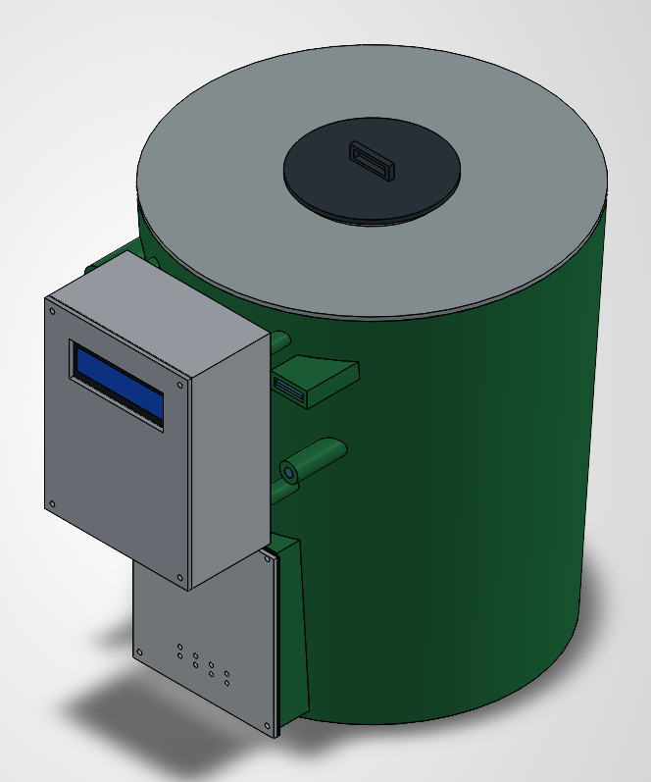
ENGINEERING PROJECT
Smart Composting System
SMART
COMPOSTING
SYSTEM
Arduino-based monitoring
and motor-assisted mixing
10 L BUCKET • SENSORS • DC MIXER
SMART COMPOSTING SYSTEM / PROJECT PRESENTATION
01
Notes:
Project presentation prepared from the user-provided hardware list, team details, and 18 supplied CAD illustrations. The user states a nominal 10 L bucket. CAD illustrations are conceptual and their physical scale is not verified; do not infer manufacturing dimensions from them. No measured results or firmware were supplied.

Slide 2
01 / TEAM
Meet the project team
Four members working on an Arduino-based smart composting project.
01
Mayur Santosh Darekar
02
Sairaj Hon
PRN 2126UMEM1024
PRN 2126UMEM1012
03
Abhinav Bothe
04
Pratik Bankar
PRN Not provided
PRN 2126UMEM1022
SMART COMPOSTING SYSTEM / PROJECT PRESENTATION
02
Notes:
Names and PRNs follow the user message, with capitalization corrected. Sairaj Hon is interpreted from the supplied text "sairaj honprn". Abhinav Bothe's PRN was not supplied and has not been invented.

Slide 3
02 / PROBLEM & OBJECTIVES
Why smart composting?
Help users monitor a small organic-waste batch and reduce manual mixing effort.
01
02
03
The problem
The objective
The scope
Unmonitored moisture and limited airflow can make a small compost batch difficult to manage.
Combine temperature and moisture sensing with Arduino-based control and powered mixing.
A compact 10 L bucket prototype for household-scale learning and demonstration.
Composting still depends on suitable feedstock, air, moisture and time—not electronics alone.
SMART COMPOSTING SYSTEM / PROJECT PRESENTATION
03
Notes:
Background reference: US EPA, Composting At Home, https://www.epa.gov/recycle/composting-home . These are project goals, not measured improvements in compost quality or processing time.

Slide 4
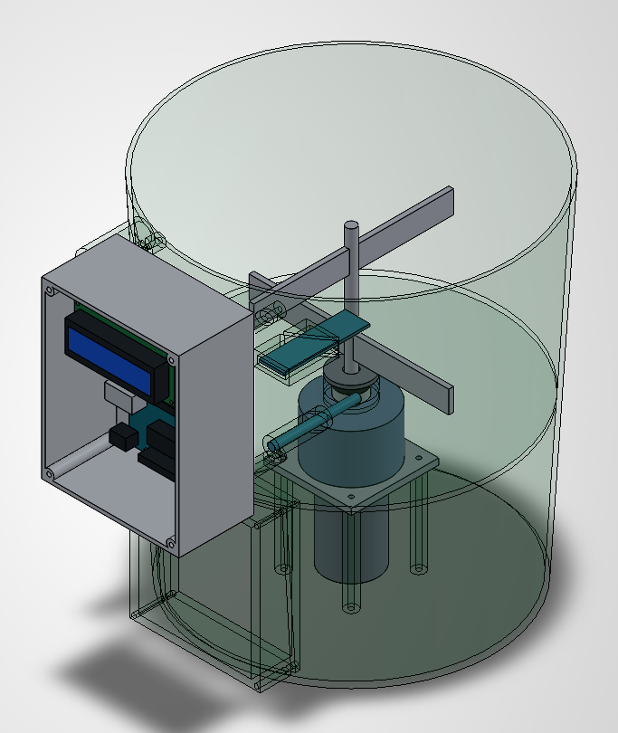
03 / SYSTEM CONCEPT
The system at a glance
A composting chamber, a lower drive area and an external electronics enclosure.
Sense
DHT11 and soil moisture sensor provide local condition readings.
Control
Arduino Uno reads inputs and sends commands to the L298N driver.
Mix
A 775 DC motor drives the proposed shaft-and-paddle assembly.
Transparent CAD view showing the proposed internal arrangement
SMART COMPOSTING SYSTEM / PROJECT PRESENTATION
04
Notes:
Hardware choices are supplied by the user. The operating scheme is an explanatory concept because firmware and wiring were not provided. CAD drawings are illustrative, not a dimensionally verified 10 L design. The LCD is visible in CAD but is not confirmed in the user's used-hardware list.

Slide 5
04 / COMPONENTS
Hardware used in the project
The following components were specified by the project team.
Arduino Uno
12 V / 2 A adapter
Central controller for sensor input and motor commands
Specified DC power supply; load suitability unverified
DHT11 sensor
Voltage regulator
Local air temperature and relative humidity sensing
Regulated electronics supply; model/output unspecified
Soil moisture sensor
10 L bucket
Relative wetness sensing; calibration required
Nominal container volume for the composting prototype
L298N motor driver
Partition plate
Interface between Arduino control signals and motor
Separates the upper chamber and lower drive space
775 DC motor
Jumper wires
Proposed source of rotation for the mixing mechanism
Low-current signal and prototype interconnections
The shaft, paddles, enclosure and display are shown in CAD; exact build details were not supplied.
SMART COMPOSTING SYSTEM / PROJECT PRESENTATION
05
Notes:
The ten component types above come from the user. Quantities, costs, regulator type/output, exact motor variant, sensor-module type and material specifications were not provided. Jumper wires must not be assumed suitable for motor load current.

Slide 6
05 / ARCHITECTURE
Functional block diagram
Conceptual signal and power paths—not a pin-level wiring diagram.
Sensors
Arduino Uno
L298N
775 motor
DHT11 + soil moisture
Read inputs • run logic
Motor control stage
Shaft + mixing paddles
Regulated supply
for controller/sensors
Regulator
12 V / 2 A adapter
Green: signal / control
Amber: conceptual power
Verify output and rating
Power source specified
Common signal ground is required. Never power the motor from an Arduino I/O pin.
SMART COMPOSTING SYSTEM / PROJECT PRESENTATION
06
Notes:
Uno R3 logic is 5 V. Confirm a safe regulated supply arrangement and board-specific power entry before wiring. The motor and logic supplies on an L298N module have different roles; module jumpers and regulator settings are not specified here. Check the exact module documentation. The diagram does not establish that the adapter, L298N and motor are compatible. Sources: https://docs.arduino.cc/hardware/uno-rev3/ and https://www.st.com/resource/en/datasheet/l298.pdf .

Slide 7
06 / WORKING PRINCIPLE
Proposed working sequence
An explanatory operating cycle; actual firmware timing and thresholds were not supplied.
01
02
03
04
05
Load
Sense
Evaluate
Mix
Review
Add suitable organic waste and dry carbon-rich material.
Read temperature and relative moisture conditions.
Apply programmed timing and check sensor validity.
Run a controlled mixing cycle with the lid secured.
Log observations and manually adjust moisture or feedstock.
No pump, heater, fan or wireless module was specified; those functions are not claimed as implemented.
SMART COMPOSTING SYSTEM / PROJECT PRESENTATION
07
Notes:
This is a proposed functional description, not a claim that firmware or lid interlocking has been implemented. Operating intervals and safe speed/torque must be established in testing. Temperature and soil-moisture readings do not automatically determine compost maturity.

Slide 8
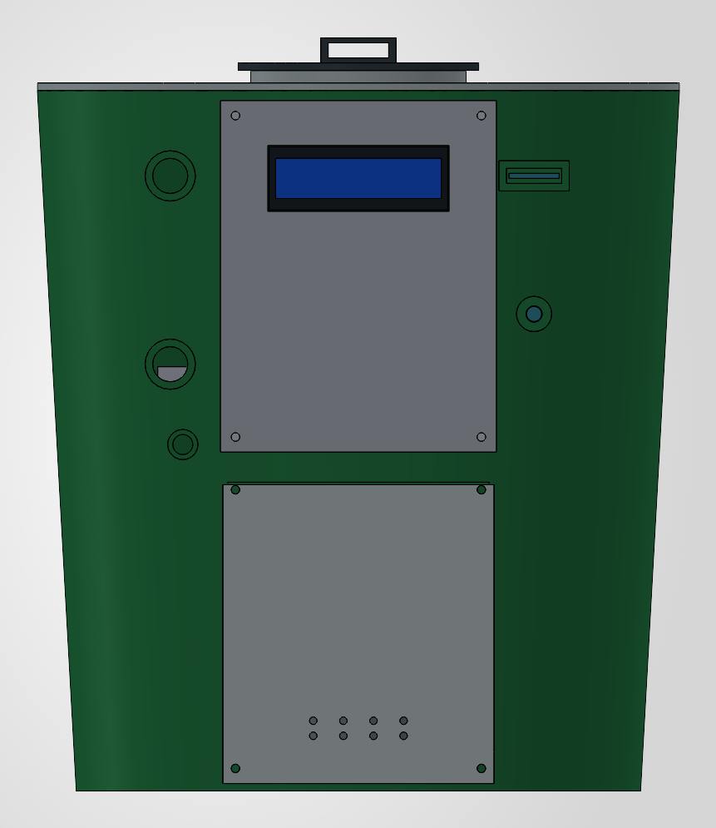
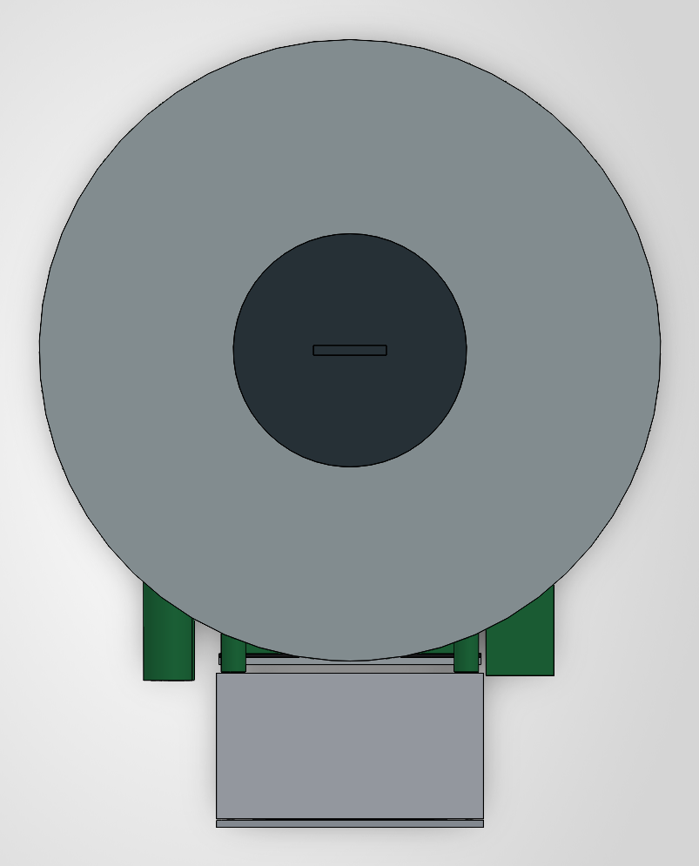
07 / CAD DESIGN
Complete assembly: front and top
Conceptual CAD views—not to verified 10 L scale. Vessel, lid, electronics box and lower access cover.
Front view • control enclosure and lower access cover
Top view • main lid and central access hatch
SMART COMPOSTING SYSTEM / PROJECT PRESENTATION
08
Notes:
User-supplied CAD images 02 and 05. These illustrate geometry only. The display is shown in CAD; it is not confirmed in the supplied hardware list. The lower cover is interpreted as access to the drive area, not as a verified compost outlet.

Slide 9
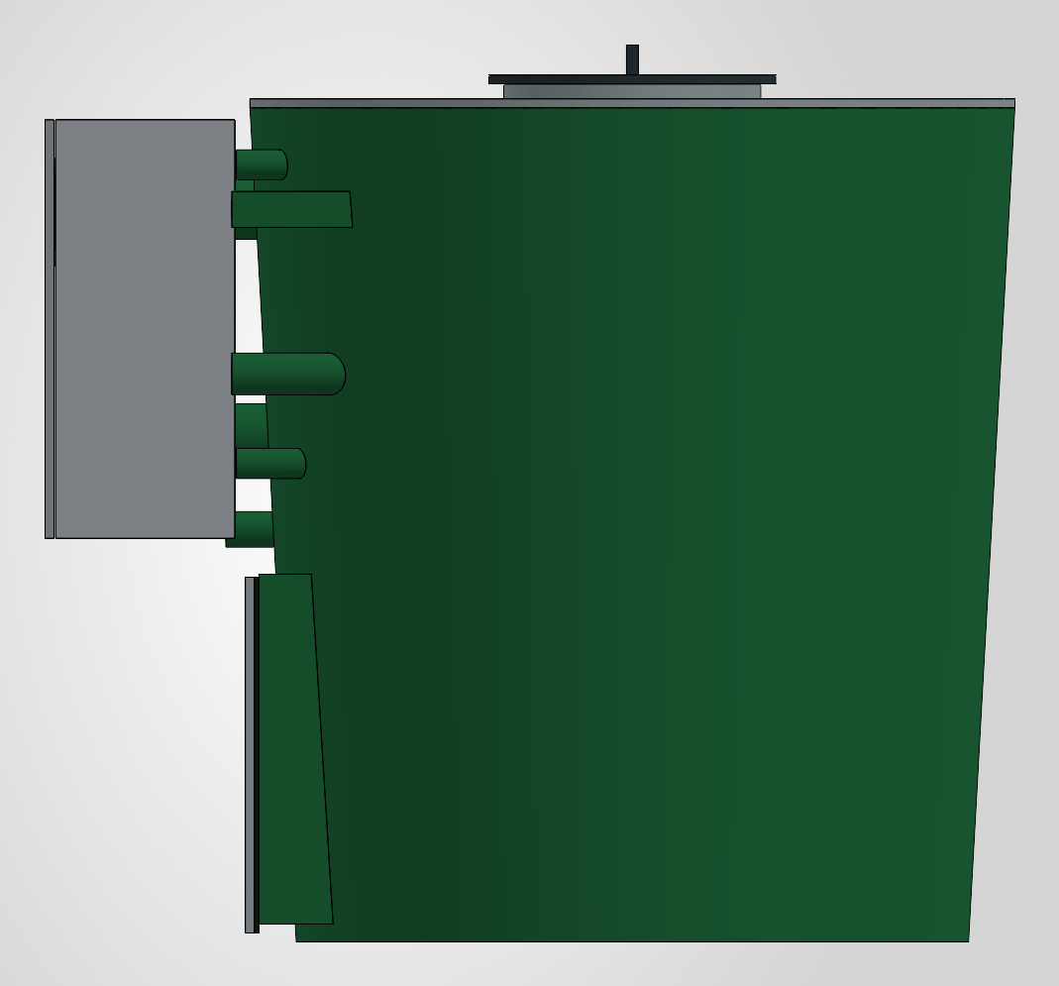
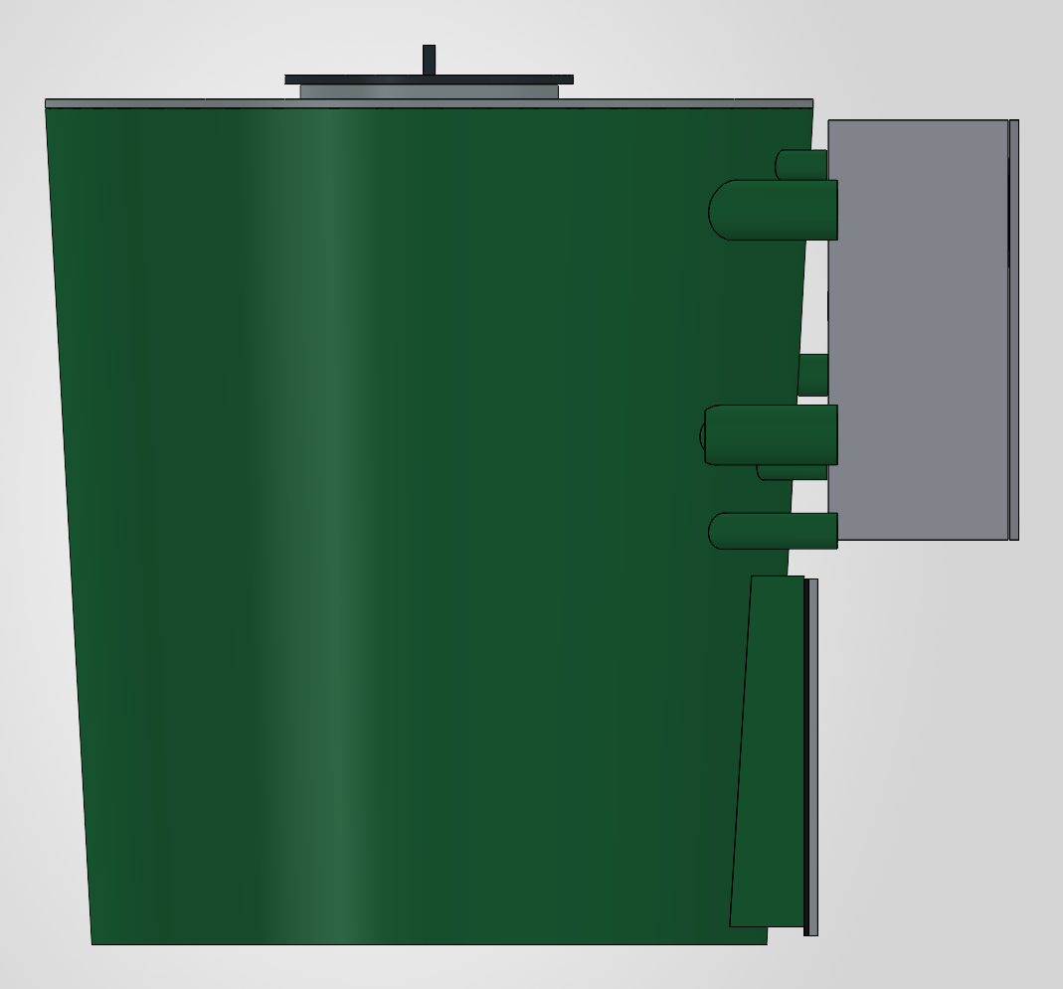
08 / CAD DESIGN
External side views
Both sides show enclosure projection, side penetrations and maintenance access.
Right-side CAD view
Left-side CAD view
SMART COMPOSTING SYSTEM / PROJECT PRESENTATION
09
Notes:
User-supplied CAD images 03 and 04. Do not assign specific wiring, airflow or drain performance to the visible side features without the detailed design. No dimensions, clearances or manufacturing tolerances have been checked for this presentation.

Slide 10
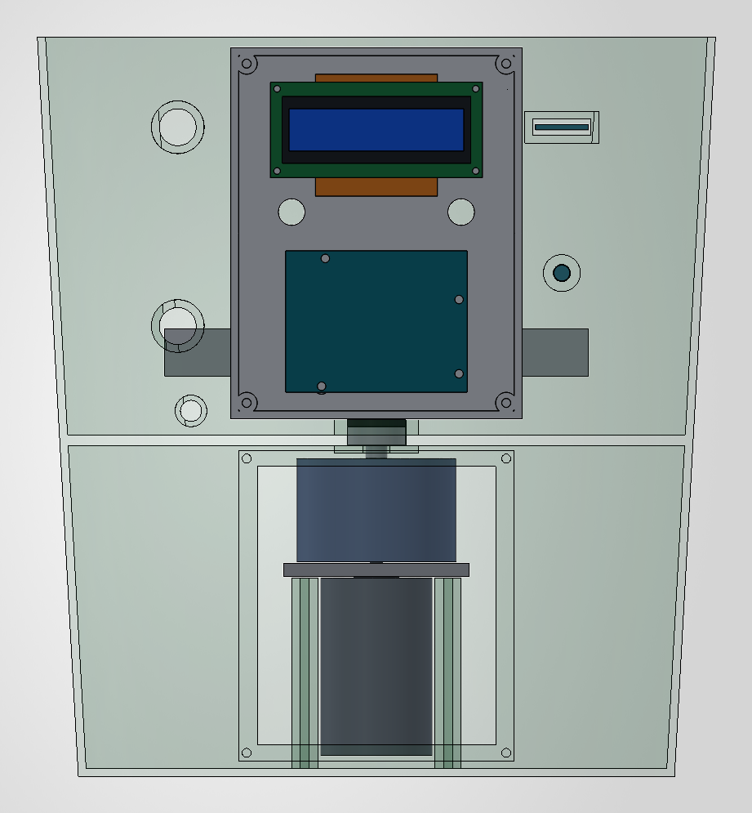
09 / CAD DESIGN
Internal arrangement
Transparent views expose the relationship between the mixer, partition and drive area.
Isometric view • mixer and electronics layout
Front view • upper chamber and lower motor region
SMART COMPOSTING SYSTEM / PROJECT PRESENTATION
10
Notes:
User-supplied CAD images 06 and 07. This layout is conceptual. A partition by itself does not establish waterproof separation; the shaft pass-through requires appropriate bearing support and sealing. Usable compost volume must be measured.

Slide 11
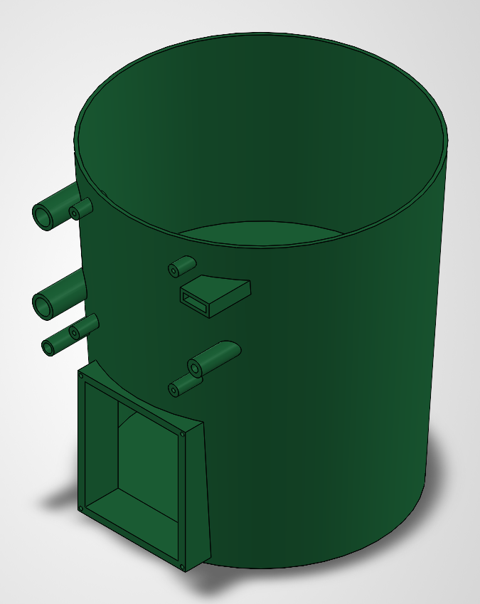
10 / MECHANICAL CONSTRUCTION
Bucket body and partition
Nominal bucket size: 10 L, as specified by the project team.
Upper space holds the organic material being processed.
The partition separates the compost chamber from the proposed drive region.
Side features accommodate the illustrated interfaces and enclosure mounting.
Usable compost volume is less than nominal bucket capacity.
Bucket body with the internal partition shown in CAD
SMART COMPOSTING SYSTEM / PROJECT PRESENTATION
11
Notes:
User-supplied CAD image 10. The 10 L value comes from the user rather than the CAD scale. Usable volume is reduced by the partition, mechanism and operating freeboard. Container material, wall thickness, partition attachment, leachate management and seal construction were not provided and are not validated here.

Slide 12
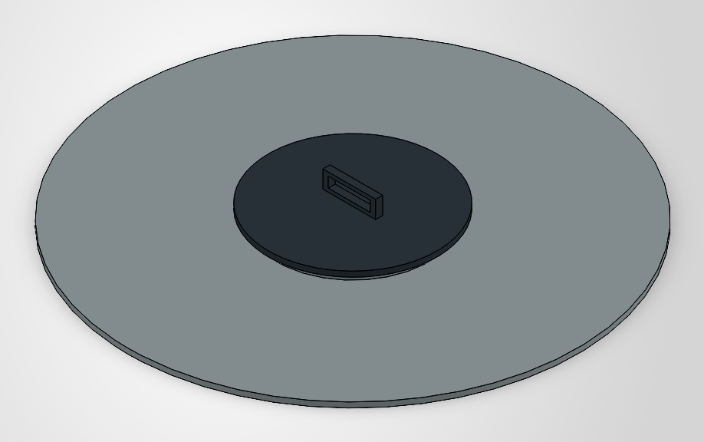
11 / MECHANICAL CONSTRUCTION
Removable lid and access hatch
The top closure supports loading, inspection and cleaning of the chamber.
Removable main lid provides access to the vessel.
A handled central hatch is visible in the supplied design.
Keep hands clear and disconnect power before opening or servicing.
CAD detail • lid and central handled hatch
A lid interlock is a recommended improvement; it was not listed among the installed components.
SMART COMPOSTING SYSTEM / PROJECT PRESENTATION
12
Notes:
User-supplied CAD image 11. No lid seal, lock, interlock or safety rating is claimed. Air exchange requirements must be considered separately from the removable closure.

Slide 13
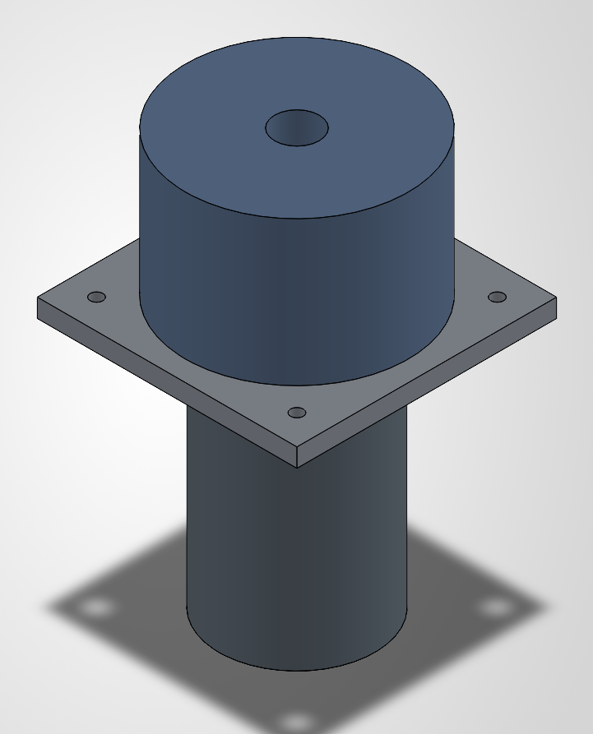
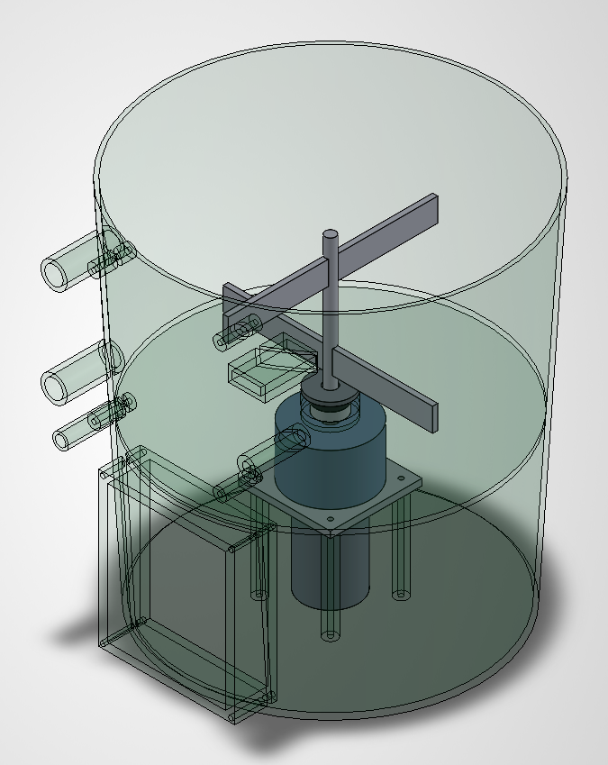
12 / MECHANICAL CONSTRUCTION
Motor, mounting and drive space
The 775 DC motor is intended to rotate the internal mixing assembly.
Motor/mount CAD detail • simplified envelope geometry
Drive area positioned below the partition
Required speed, torque, reduction ratio and start/stall current remain to be verified.
SMART COMPOSTING SYSTEM / PROJECT PRESENTATION
13
Notes:
User-supplied CAD images 12 and 09. The geometry includes space above the motor that may represent a reducer envelope; an actual gearbox or its ratio was not specified by the user and must not be described as installed. "775" does not uniquely identify motor voltage, current, speed or torque. Validate the exact motor variant and transmission.

Slide 14

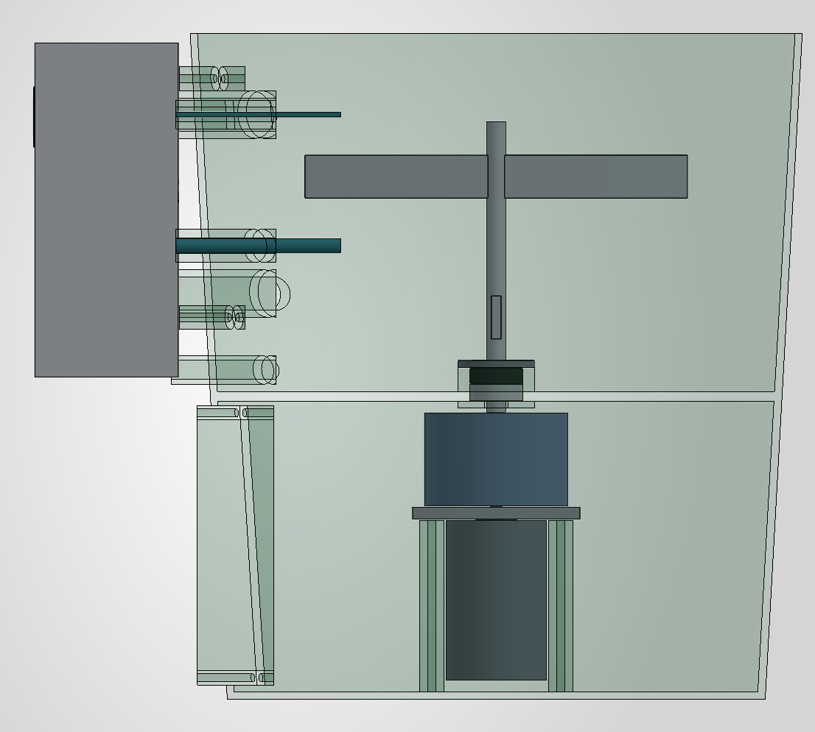
13 / MECHANICAL CONSTRUCTION
Mixer shaft and paddles
The illustrated mechanism distributes mixing action across two heights.
Shaft-and-paddle assembly with a lower coupling/seal detail
Transparent side view • vertical drive alignment
Check paddle clearance, shaft support, attachment strength and leakage before loaded operation.
SMART COMPOSTING SYSTEM / PROJECT PRESENTATION
14
Notes:
User-supplied CAD images 13 and 08. Mixing is intended to redistribute material and assist aeration but does not replace an airflow path. No stress analysis, torque calculation, interference check or proof of sealing has been supplied. Material and operating speed remain unspecified.

Slide 15

14 / SENSING LAYOUT
Sensors and service access
Sensor-like geometry and the removable lower cover are shown as simplified CAD features.
DHT11: measures local air temperature and relative humidity.
Soil moisture sensor: indicates relative wetness after calibration.
Protect electronics from wet waste, condensation and moving paddles.
Remove power before opening the lower service cover.
Access cover and simplified sensor representations
SMART COMPOSTING SYSTEM / PROJECT PRESENTATION
15
Notes:
User-supplied CAD image 14. The simplified sensor shapes do not confirm the exact DHT11 package or soil-moisture module. DHT11 is not a waterproof immersion probe and its humidity output is not a measurement of moisture content inside solid compost. Source: https://learn.adafruit.com/dht/overview .

Slide 16
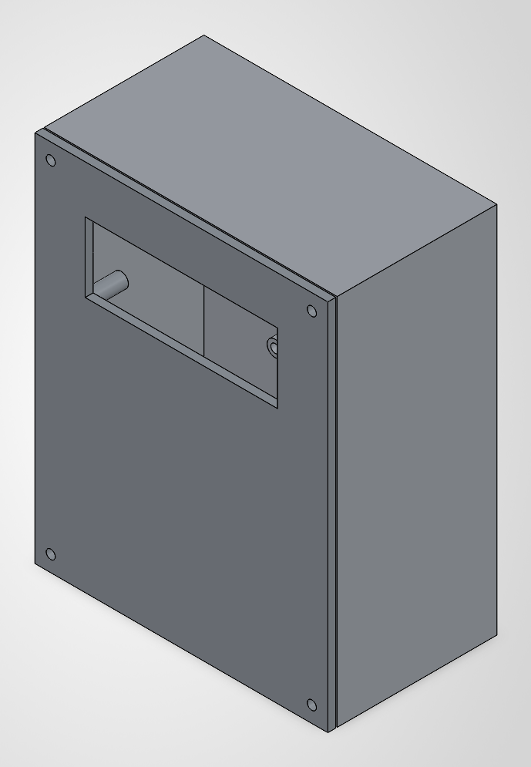
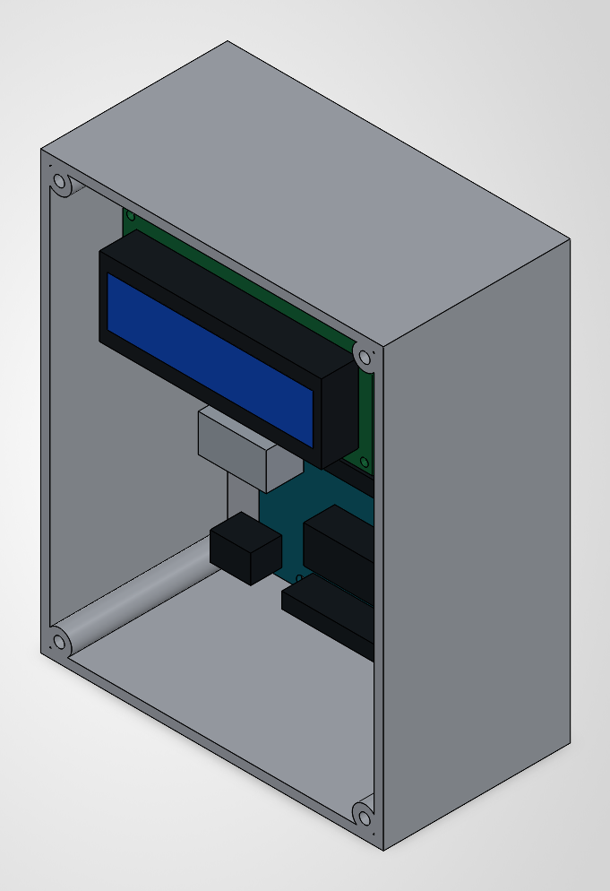
15 / ELECTRONICS PACKAGING
Electronics enclosure
The enclosure organizes the control electronics outside the composting chamber.
Closed enclosure • front-panel display opening
Open enclosure • illustrated electronics arrangement
SMART COMPOSTING SYSTEM / PROJECT PRESENTATION
16
Notes:
User-supplied CAD images 15 and 18. A closed housing is not proof of an IP protection rating. Provide insulation, mounting stand-offs, cable strain relief, splash protection and suitable heat management when building. No final enclosure material was specified.

Slide 17
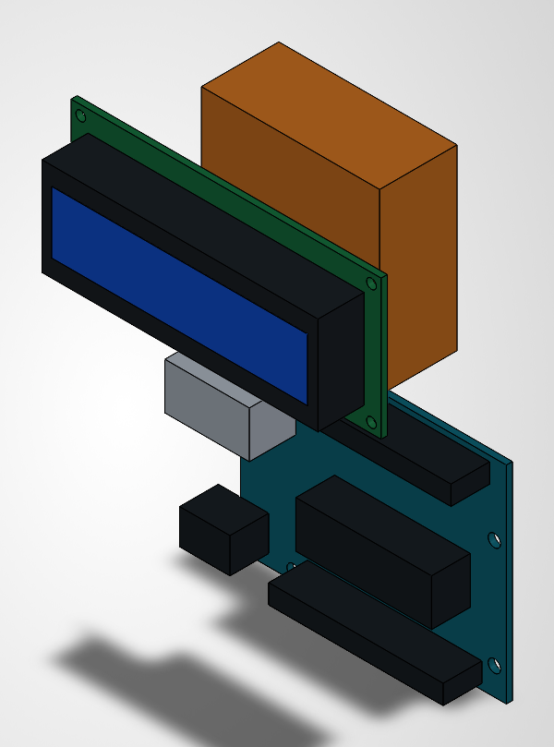
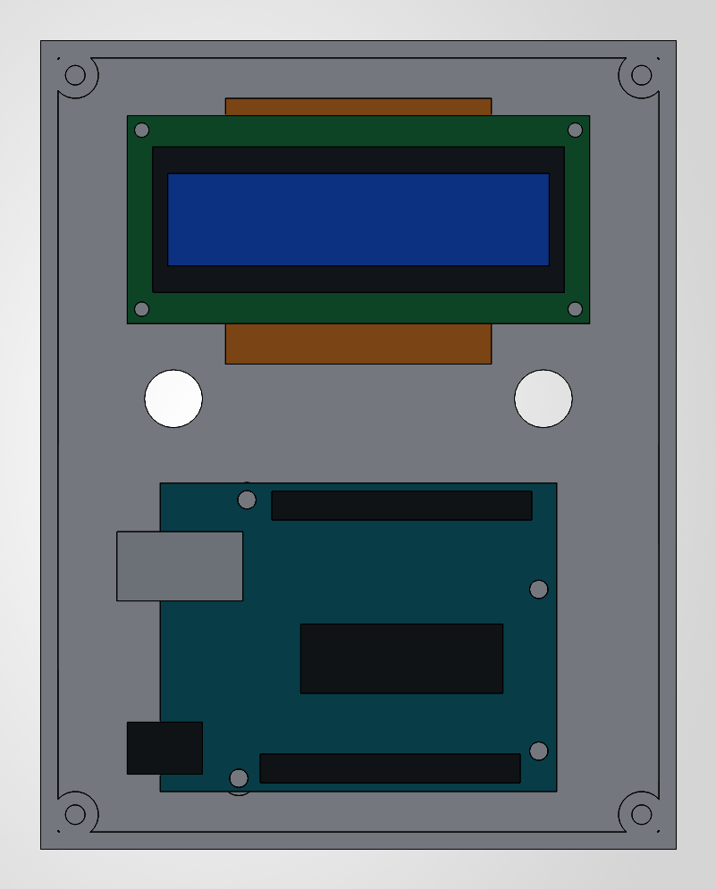
16 / ELECTRONICS PACKAGING
Controller and display layout
Simplified CAD boards show placement rather than a verified circuit or PCB design.
Board/display subassembly • simplified CAD geometry
Front view of the electronics inside the enclosure
LCD display: visible in CAD, but not confirmed in the team’s supplied hardware list.
SMART COMPOSTING SYSTEM / PROJECT PRESENTATION
17
Notes:
User-supplied CAD images 16 and 17. Arduino Uno is confirmed by the user. The display is visible in the supplied illustrations but its type, connection and physical installation were not stated. Do not treat the simplified colored blocks as a verified L298N module, regulator, schematic or pin assignment.

Slide 18
17 / TECHNICAL LIMITS
What the sensors can—and cannot—tell us
Measurements need calibration, correct placement and interpretation.
01
02
03
DHT11
Soil moisture
Arduino control
Typical range: 0–50 °C and 20–80% RH.
Keep dry and protected. It is not a waterproof compost-core probe.
Relative wetness only.
Calibrate with the actual material; raw readings are not exact water content.
Can read sensors and command mixing.
No Wi-Fi, automatic watering or automatic heating hardware was specified.
A small 10 L unit is not guaranteed to reach thermophilic conditions or sanitize compost.
SMART COMPOSTING SYSTEM / PROJECT PRESENTATION
18
Notes:
DHT11 specifications are typical values from the Adafruit DHT sensor guide; check the exact device datasheet for a particular sensor. Active compost can exceed the sensor temperature range and may be condensing. Local air temperature is not necessarily bulk compost temperature. Soil sensor type is unspecified; if resistive, corrosion and drift may be concerns. Sources: https://learn.adafruit.com/dht/overview and https://www.epa.gov/recycle/composting-home .

Slide 19
18 / BEFORE LOADED OPERATION
Power compatibility and safety
The listed motor, driver and adapter are not yet a verified compatible power system.
Motor current
L298N heating
Check the exact 775 motor’s starting, running and stall current against the supply and driver.
Allow for driver voltage drop and heat. Module current capability depends on cooling and duty.
Regulator and wiring
Wet and moving parts
Verify regulated output, polarity and heat. Use load-rated motor wiring and appropriate protection.
Guard the mixer, isolate wet areas and stop power before access. Confirm shaft sealing and support.
Do not assume a 12 V / 2 A adapter or common L298N module can safely start every 775 motor.
SMART COMPOSTING SYSTEM / PROJECT PRESENTATION
19
Notes:
The ST L298 datasheet gives device limits and saturation-voltage/thermal behavior. The module may have different practical limits depending on heat sinking, board design and current path. The supply rating is given by the user, not an actual measured available motor current under starting load. Never infer suitability from matching voltage alone. Motor load tests need a guarded, current-limited arrangement and appropriately rated instrumentation; do not deliberately stall an unprotected motor. Source: https://www.st.com/resource/en/datasheet/l298.pdf .

Slide 20
19 / TESTING
Validation plan
No measured performance results were supplied. The following checks are proposed.
CHECK
METHOD
RECORD
Temperature
Compare with a suitable reference thermometer.
Error and repeatability
Moisture response
Compare repeatable dry, damp and wet samples.
Raw readings and calibration
Mixer operation
Use guarded empty and progressively loaded runs.
Mixing, clearance and jams
Electrical loading
Measure safe start/run current and supply voltage.
Voltage sag and thermal rise
Partition / enclosure
Check for leakage, splash entry and loose fittings.
Observed issues and fixes
Composting trial
Log batch inputs, conditions and maturation over time.
Trends—not assumed results
Only report composting time, energy use, reliability or compost quality after actual measurement.
SMART COMPOSTING SYSTEM / PROJECT PRESENTATION
20
Notes:
This is a test plan, not a result sheet. No data on composting duration, fertilizer quality, waste reduction, temperature history, electrical power or efficiency was supplied. Safety and compatibility checks should precede loaded operation. Water-entry checks must be carried out without exposing energized electronics to liquid.

Slide 21
20 / PROJECT VALUE
Expected benefits and applications
Potential advantages to evaluate through prototype testing—not established performance claims.
More visible conditions
Less manual mixing
Sensor readings can help the user identify changing temperature and moisture conditions.
Motor-assisted stirring is intended to reduce the effort needed for batch mixing.
Compact demonstration
Integrated engineering
A 10 L bucket format suits student laboratories and household-scale learning.
The project connects mechanical construction, embedded control and organic-waste management.
SMART COMPOSTING SYSTEM / PROJECT PRESENTATION
21
Notes:
Benefits are framed as expected outcomes. There is no evidence yet for faster composting, odor elimination, validated fertilizer quality, energy savings or maintenance-free operation. The nominal bucket size does not establish commercial processing capacity.

Slide 22
21 / DEVELOPMENT ROADMAP
Future improvements
Upgrade only after the basic sensing, mixing and electrical system are validated.
Reliable sensing
Use a suitable protected temperature probe and calibrate the moisture measurement.
01
Matched drive system
Select motor reduction, driver and power supply from measured torque/current needs.
02
Safer access
Add lid interlocking, overload protection and improved sealing around the shaft.
03
Data and automation
Add local logging or wireless monitoring; consider watering only with suitable hardware.
04
SMART COMPOSTING SYSTEM / PROJECT PRESENTATION
22
Notes:
All items on this slide are future development proposals. No current implementation of wireless connectivity, water pump, interlock, current sensing or over-temperature control is claimed. The right sensor and drive components depend on measured operating conditions.

Slide 23
22 / SOURCES
References and project evidence
Primary documentation supports the technical descriptions and stated limitations.
Arduino UNO R3 documentation
Controller overview and 5 V logic
https://docs.arduino.cc/hardware/uno-rev3/
STMicroelectronics — L298 datasheet
Driver ratings, voltage drop and thermal considerations
https://www.st.com/resource/en/datasheet/l298.pdf
Adafruit — DHT sensor guide
DHT11 measurement ranges and sensor characteristics
https://learn.adafruit.com/dht/overview
US EPA — Composting At Home
Feedstock, moisture and aeration fundamentals
https://www.epa.gov/recycle/composting-home
Project evidence: team details, stated hardware and all 18 supplied CAD images. No test data supplied.
SMART COMPOSTING SYSTEM / PROJECT PRESENTATION
23
Notes:
All 18 original supplied CAD images are embedded in the editable presentation. Images are illustrations, not verified 10 L manufacturing drawings. No dimensions from the existing CAD file name were adopted. The user specified a 10 L bucket. A display is depicted but was not included in the stated hardware list. Abhinav Bothe's PRN remains unprovided. No college, guide name, budget or results were invented.

Slide 24
23 / CONCLUSION
A practical step toward smarter composting
Monitor conditions. Assist mixing. Validate the system.
Small prototype.
Clear engineering goals.
Arduino Uno integrates sensing and motor commands.
The 10 L bucket concept combines a partition and mixing assembly.
Next step: verify safe operation and measure composting performance.
THANK YOU / QUESTIONS?
SMART COMPOSTING SYSTEM / PROJECT PRESENTATION
24
Notes:
Conclude by distinguishing the project concept and stated hardware from measured validation. No manufacturing readiness, electrical compatibility or compost quality certification is implied. The project team can add real test results after safe trials.

