Slide 1
Airline Passenger Satisfaction To predict the satisfaction level of passengers and study the impact of various factors on passenger satisfaction.
Name: Mayur Dilip Taware

Slide 2
PROBLEM STATEMENT:
An airline company wants to study various parameters affecting passenger satisfaction, get insights from the data and predict passenger satisfaction with the help of survey taken by the company. Due to growing competition, company wants to focus on improving their service and make future plans accordingly.
BUSINESS GOAL:
To predict passenger satisfaction based on various factors and determine important factors that improve passenger satisfaction. The insights from the data can help to focus on improving the important factors. Company will be able to use men, money and material on the most important factors rather than using it on less significant factors thus improving the passenger satisfaction and also preventing the wastage of money.

Slide 3
DATASET CONTENT:
This dataset contains an airline passenger satisfaction survey of
103904 Passengers in train and 25976
22 features are listed below:
Gender : Gender of the passengers (Female, Male)
Customer Type : The customer type (Loyal customer, disloyal customer)
Age : The actual age of the passengers
Type of Travel : Purpose of the flight of the passengers (Personal Travel, Business Travel)
Class : Travel class in the plane of the passengers (Business, Eco, Eco Plus)
Flight distance : The flight distance of this journey
Inflight Wi-Fi service : Satisfaction level of the inflight wifi service (0:Not Applicable;1-5)
Departure/Arrival time convenient : Satisfaction level of Departure/Arrival time convenient (0-5)
Ease of Online booking : Satisfaction level of online booking (0-5)
Gate location : Satisfaction level of Gate location (0-5)
Food and drink : Satisfaction level of Food and drink (0-5)

Slide 4
Online boarding : Satisfaction level of online boarding (0-5)
Seat comfort : Satisfaction level of Seat comfort (0-5)
Inflight entertainment : Satisfaction level of inflight entertainment (0-5)
On-board service : Satisfaction level of On-board service (0-5)
Leg room service : Satisfaction level of Leg room service (0-5)
Baggage handling : Satisfaction level of baggage handling (0-5)
Check-in service : Satisfaction level of Check-in service (0-5)
Inflight service : Satisfaction level of inflight service (0-5)
Cleanliness : Satisfaction level of Cleanliness (0-5)
Departure Delay in Minutes : Minutes delayed when departure (0-5)
Arrival Delay in Minutes : Minutes delayed when Arrival (0-5)
Target Variable: (Categorical)
Satisfaction : Passenger satisfaction level(Satisfaction, neutral or dissatisfaction)

Slide 5
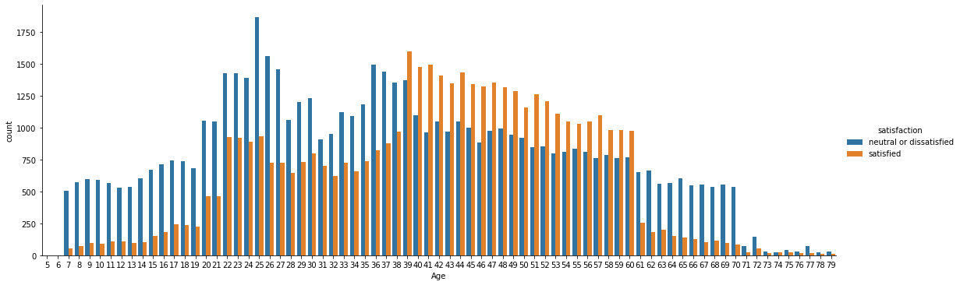
INSIGHTS DROM DATA:
AGE VS PASSENGER SATISFACTION:
Passengers with age 7- 38 and 61-80 are hugely dissatisfied as compared to satisfied passengers while passengers with age 38-60 are more satisfied as compared to dissatisfied passengers.

Slide 6
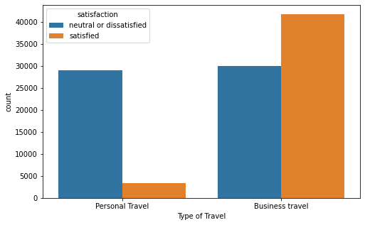
2) TYPE OF TRAVEL VS PASSENGER SATISFACTION:
Passengers who travel for personal reasons are mostly dissatisfied while passengers who travel for business are more satisfied.

Slide 7
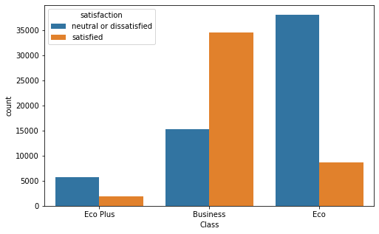
3) CLASS VS PASSENGER SATISFACTION:
Most of the passengers who travel in Business class are satisfied while a majority of passengers are dissatisfied who travel in Eco Class.

Slide 8
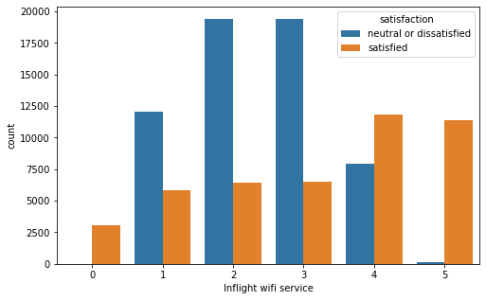
4) INFLIGHT WIFI SERVICE VS PASSENGER SATISFACTION:
Most of the passengers have given rating between 2-3, thus increasing the count of dissatisfied passengers.

Slide 9
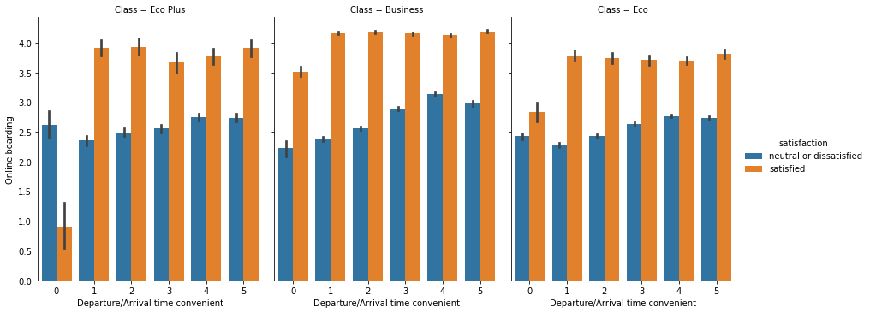
5) DEPARTURE/ARRIVAL TIME CONVENIENT VS ONLINE BOARDING VS PASSENGER SATISFACTION:
Here we can see that in Eco Plus class a lot of people are dissatisfied due to poor departure/arrival time even when online boarding is moderate.

Slide 10
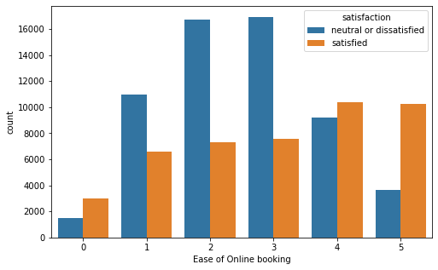
6) EASE OF ONLINE BOOKING VS PASSENGER SATISFACTION:
Here most of the people have rated online booking as 2-3, thus increasing the number of dissatisfied people.

Slide 11
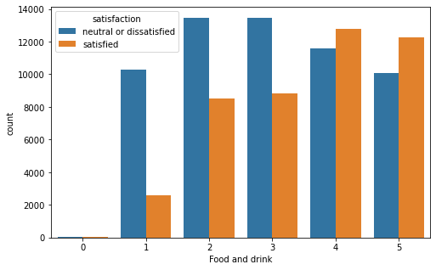
7) FOOD AND DRINK VS PASSENGER SATISFACTION:
Huge count of passengers rated food and drink as 2-3, thus leading to high count of dissatisfied passengers.

Slide 12
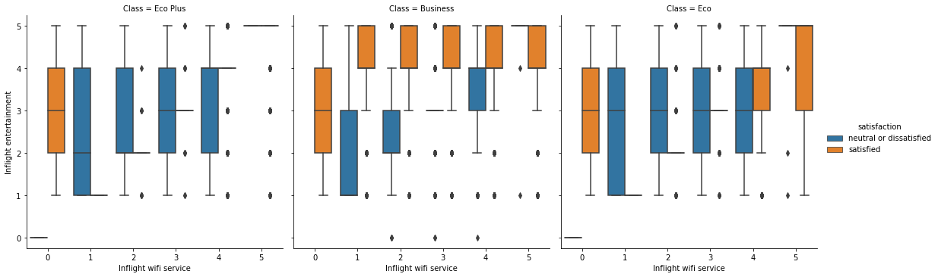
8) INFLIGHT WIFI SERVICE VS INFLIGHT ENTERTAINMENT VS PASSENGER SATISFACTION:
Surprising to find out that passengers in Eco Plus are satisfied even when there is no inflight wifi service but some inflight entertainment rating from 2-4. While in business class passengers are only satisfied when the inflight wifi service and inflight entertainment is good (i.e from 4-5)

Slide 13
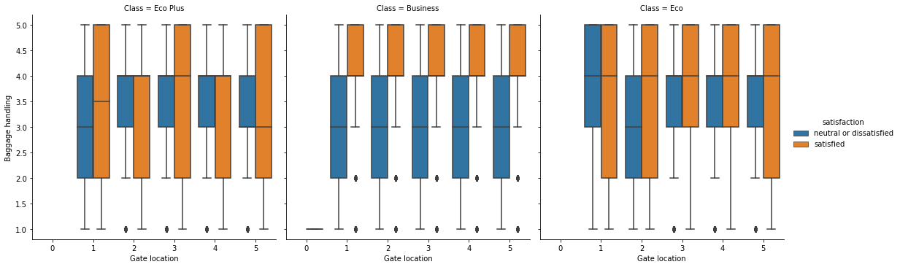
9) GATE LOCATION VS BAGGAGE HANDLING VS PASSENGER SATISFACTION:
From the above plot we can see that in business class, passengers are only satisfied when the baggage are handled properly. In Eco Plus and Eco class mostly baggage are handled in mediocre way (i.e from 2-4) but still passengers are satisfied.

Slide 14
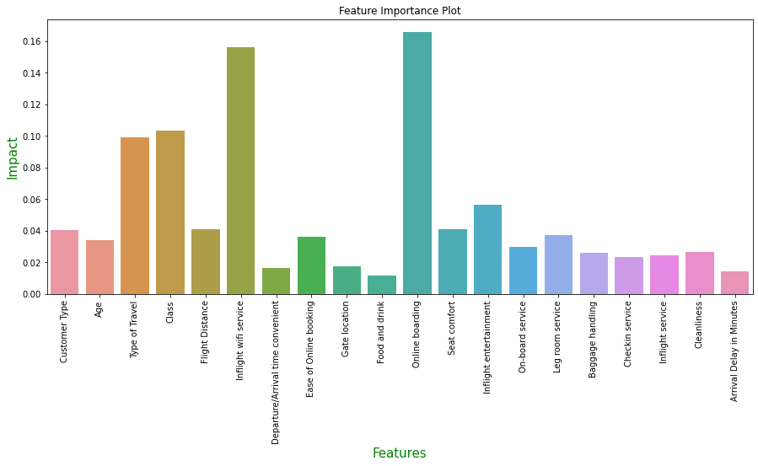
FEATURE IMPORTANCE:
Here we can see that top important factors are:
Online banking, 2) Inflight Wi-Fi Service, 3) Class, 4) Type of Travel, 5) Inflight Entertainment
Company should focus on these factors to improve passenger satisfaction.

Slide 15
ALGORITHMS USED:
LOGISTIC REGRESSION
DECISION TREE
RANDOM FOREST
NAÏVE BAYES
SVM
ADABOOST

Slide 16
MODEL COMPARISON:
 | Algorithm | Accuracy | Tpr | Fpr | Precision | F1 Score | AUROC
0 | Logistic Regression | 83.855445 | 0.815836 | 0.143857 | 0.814489 | 0.815162 | 0.835865
1 | Decision Tree | 94.952120 | 0.941553 | 0.044310 | 0.942696 | 0.942124 | 0.948745
2 | Random Forest | 96.376498 | 0.940119 | 0.017929 | 0.975959 | 0.957704 | 0.965441
3 | Naive Bayes | 62.051874 | 0.554146 | 0.328097 | 0.566644 | 0.560326 | 0.613633
4 | SVM | 41.735239 | 0.414094 | 0.580125 | 0.355924 | 0.382812 | 0.418310
5 | Adaboost | 94.778885 | 0.941442 | 0.047298 | 0.939061 | 0.940250 | 0.946819

Slide 17
CONCLUSION:
After comparing the performance matrices of the all algorithms, we can see that Decision Tree, Random Forest and Adaboost give the best performance.
These three algorithms have high Accuracy, high TPR, low FPR, high Precision, high F1 score and high AUROC curve.
For Airline Passenger Data, company should mainly focus on false positives (i.e. dissatisfied passengers predicted as satisfied passengers as the company’s aim is to improve their services.
Here Random Forest gives best precision score among all algorithms and also best scores in other parameters.
So, I would choose Random Forest for this dataset.

