Slide 1

BookNest
Presented By:-
Akash Vispute
Mayuresh Suryavanshi

Slide 2
Introduction
BookNest is a web-based application that allows users to browse, search, and purchase books online. It provides a user-friendly interface for customers to explore the bookstore's catalog, add items to their cart, and complete transactions securely. Additionally, the system offers administrative capabilities for managing inventory, processing orders, and monitoring sales.

Slide 3
Technology Used
We used Java Spring-Boot, Spring JPA, MySQL for database
Spring-Boot :–
The main goal of the Spring Boot framework is to reduce overall development time and increase efficiency. React has become the first choice for frontend because it gives developers the ability to work with a virtual browser (more friendly than the real browser). Also, a JavaScript developer can become a productive developer in a few hours because there is a small API to learn, a few functions, and how to use them.

Slide 4


User Classes
User
Admin
In this module Admin can manage overall books in store, view orders, add, update and delete books.
In this module a user will be able to view, add books to cart, order them and can get confirmation email.

Slide 5
OBJECTIVE
Develop a responsive and intuitive web application for managing bookstore operations Implement secure authentication and authorization mechanisms to protect sensitive data.
Provide an extensive catalog of books with robust search and filtering capabilities.
Enable customers to add items to their shopping cart, proceed to checkout, and make payments securely.
Empower administrators with tools for managing inventory, processing orders, and generating reports.
Ensure scalability and maintainability of the system to accommodate future growth and enhancements.

Slide 6
User Module
After loading the User can
Search for New books available.
Can edit his cart and order quantity.
Proceed given order with confirmation.
Can maintain a cart for reference.

Slide 7
Admin Module
The Admin can
Add, Update, Delete books details.
He /she can see User details and orders.
Manage account and overall store data.

Slide 8
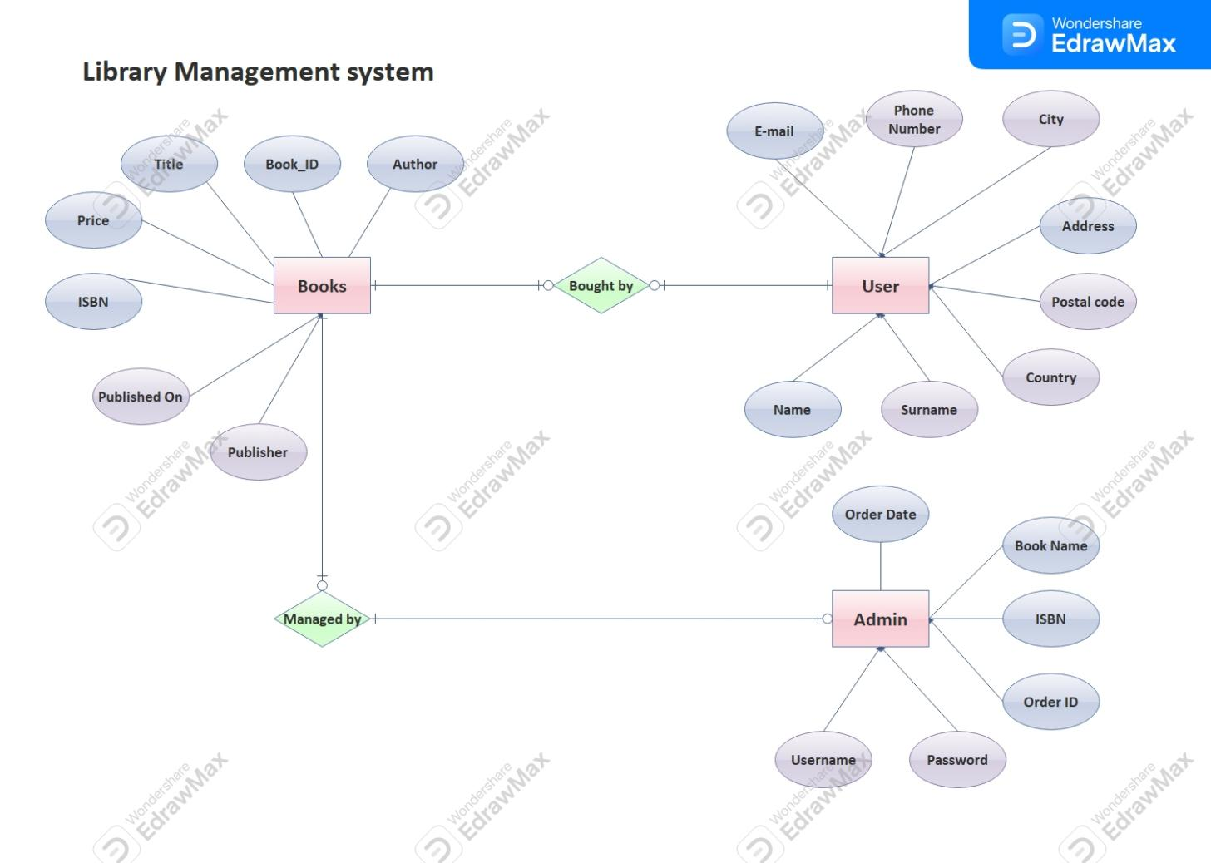
Use Case

Slide 9
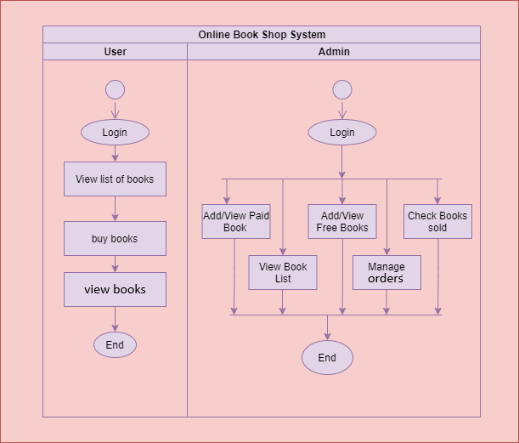
Activity Diagram : Admin & User

Slide 10
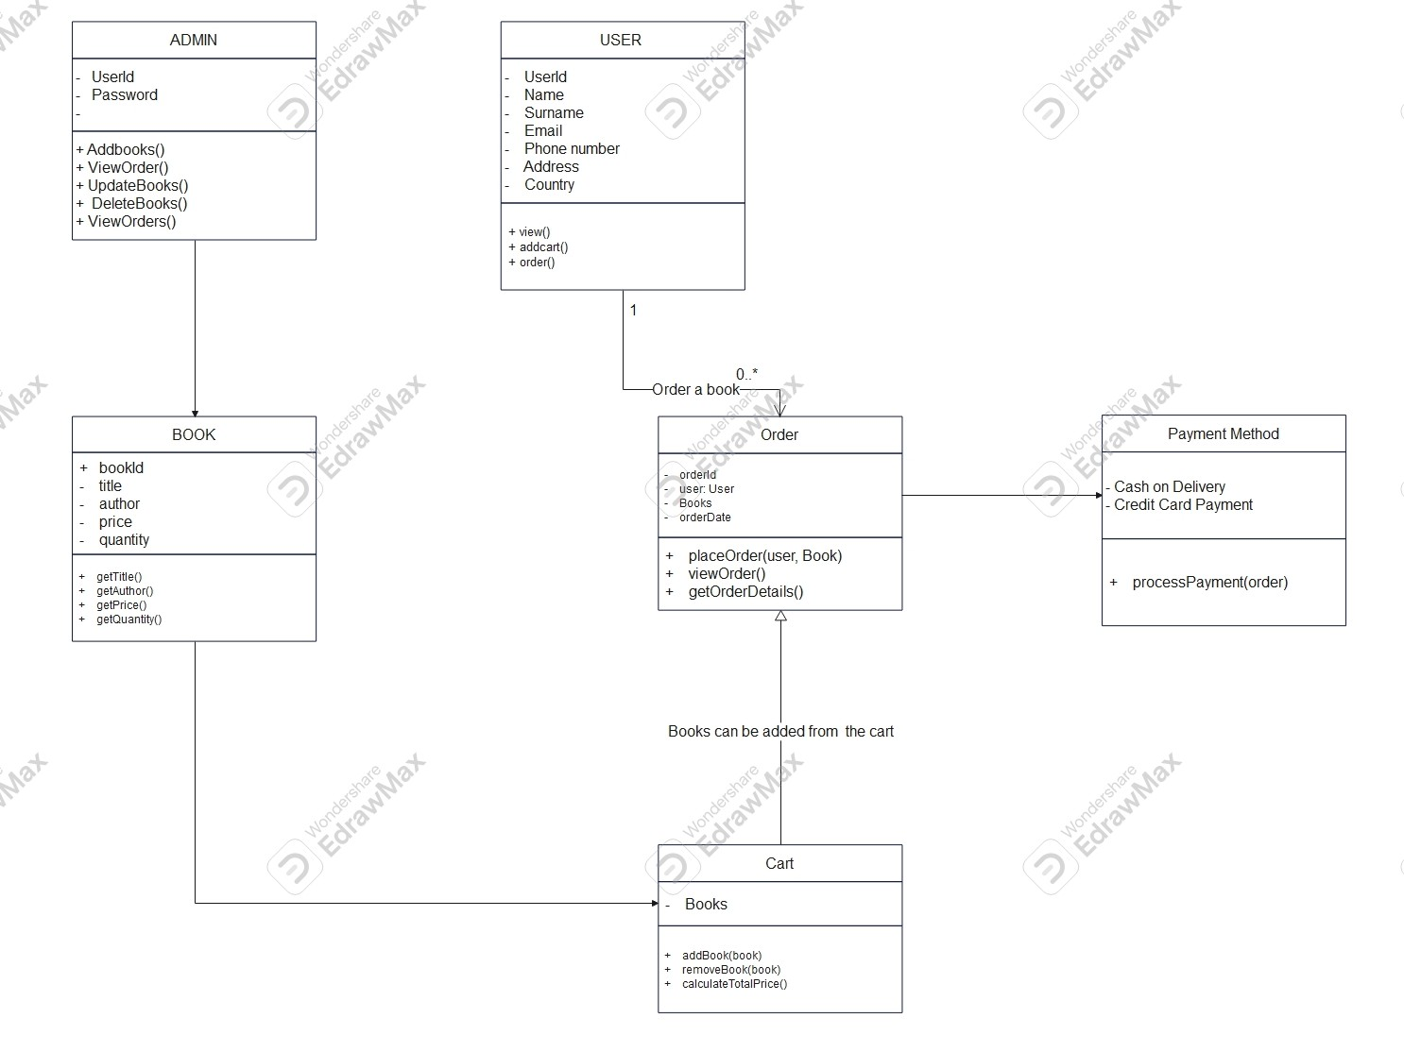
Class Diagram :

Slide 11
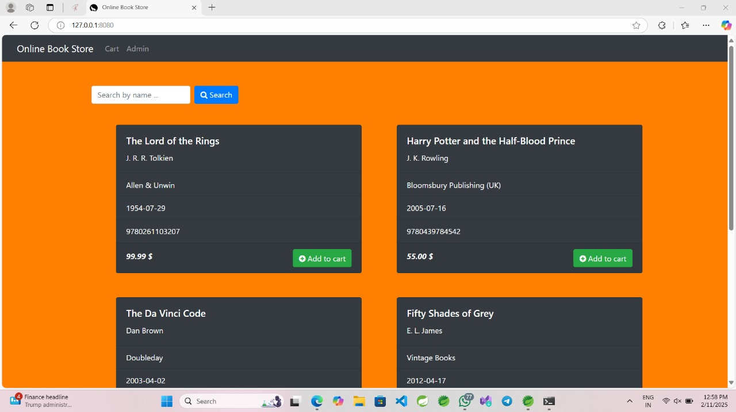

Slide 12
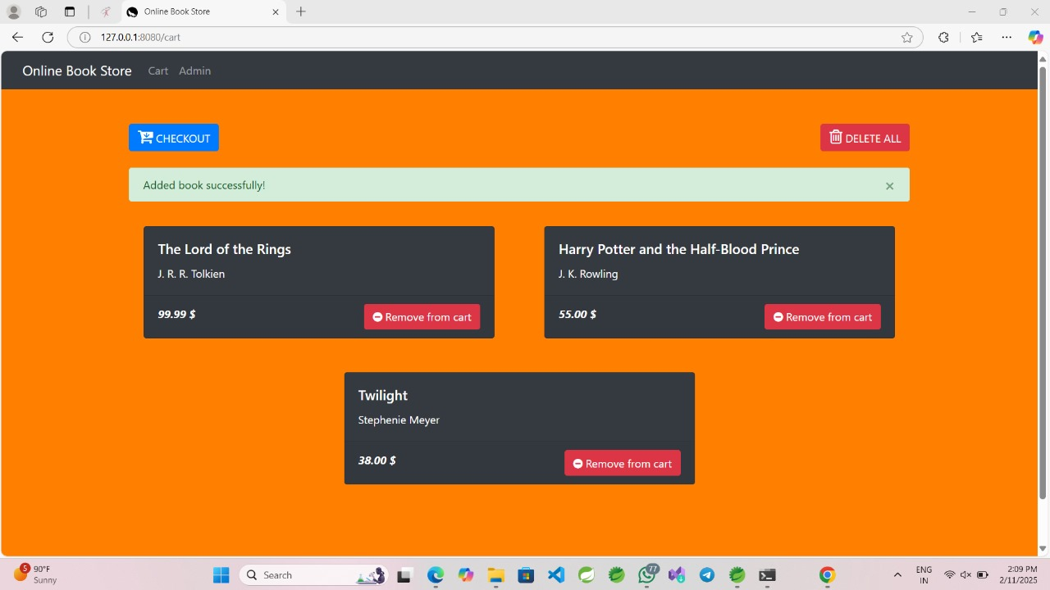

Slide 13
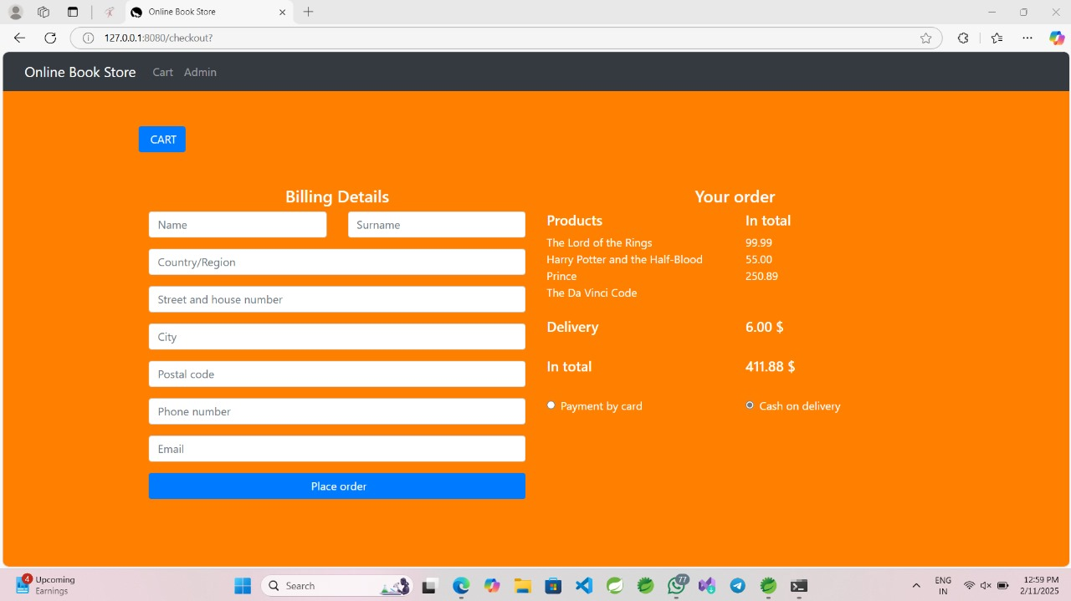

Slide 14
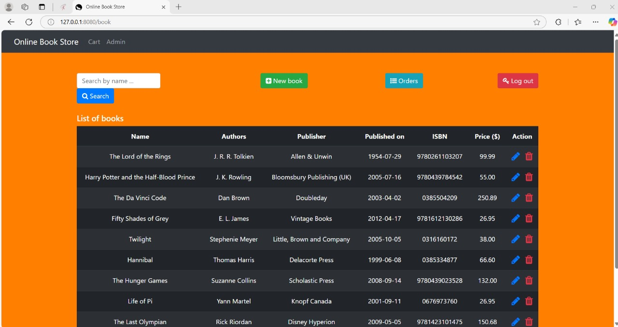

Slide 15
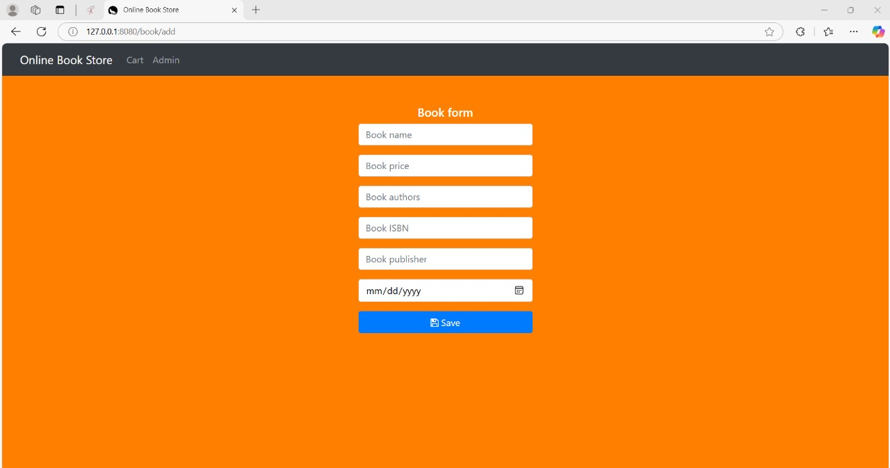

Slide 16
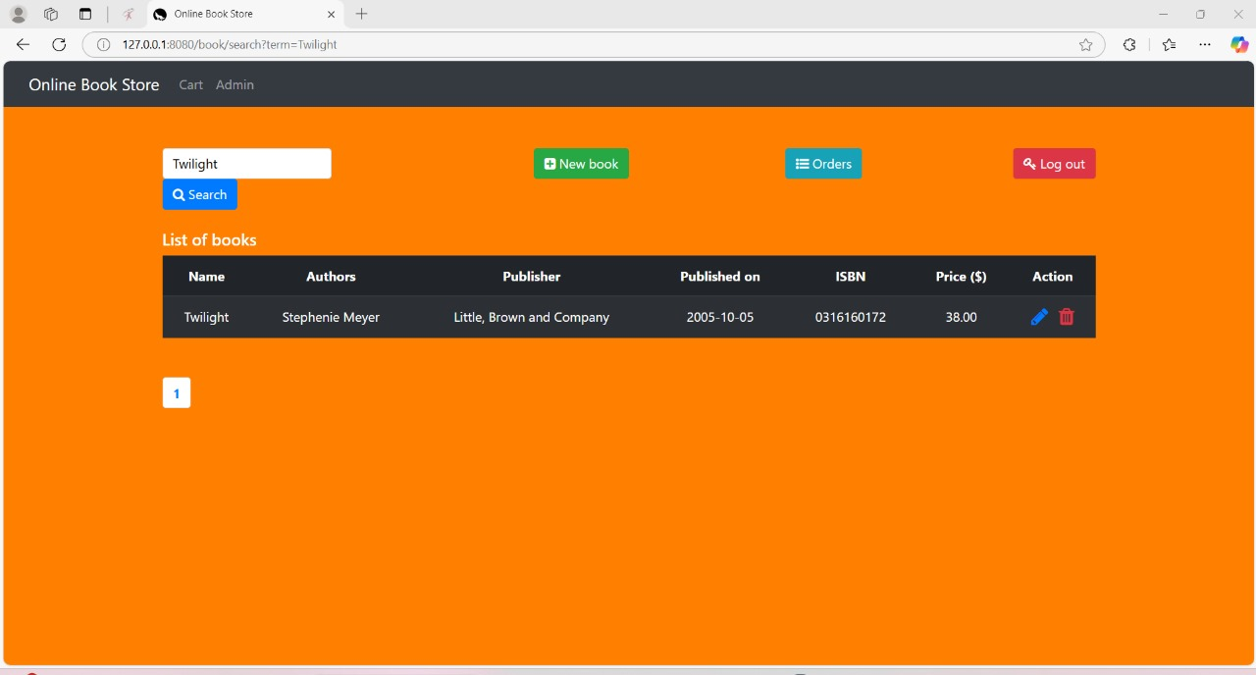

Slide 17
Thank You

