Slide 1


DATA EXTRACTION,DATA TRANSFORMATION,DATA PROCESSING AND DATA INGESTION FOR BIGDATA USING SPRAK.
Group No-05
Under Guidance of Mr. Akshay Tilekar
Presented By
Anushka Jadhav -223311
Mayuresh Patil - 223328
Centre Coordinator Mr. Prashant Karhale.

Slide 2
About Project
ETL, which stands for Extract, Transform, and Load, is the process data engineers use to extract data from different sources in different formats.
Transform the data into a usable and trusted resource, and load that data into the systems end-users can access and use downstream to solve business problems.
After extraction of uncleaned data from different sources, like email attachments, Kaggle, and various other sources.
First step of the pipeline is to clean the data. In the transformation part, certain irrelevant attributes were removed from the original data, as well as some necessary attributes were generated from the original data.
Finally, this usable format of data is stored on HDFS for application use.

Slide 3
WORK FLOW
DATA EXTRACTION
DATA CLEANING
Kaggle
MongoDB
Gmail attachment
Filtering columns
Data Processing
LOADING DATA
FINAL SCHEMA FORMATION

Slide 4
DATA EXTRACTION
In the ETL pipeline, the first stage is Data Extraction.
According to the requirement of this use case, data is extracted from different sources.
Data was extracted from MongoDB, Email Attachment file, kaggle.
Data of various file format like csv,xlsx,json is extracted and stored at local system.

Slide 5
Block Diagram Of Data Extraction
Kaggle
.CSV
MongoDB
.JSON
Local File System
PySpark
Email
Attachment
.XLSX

Slide 6
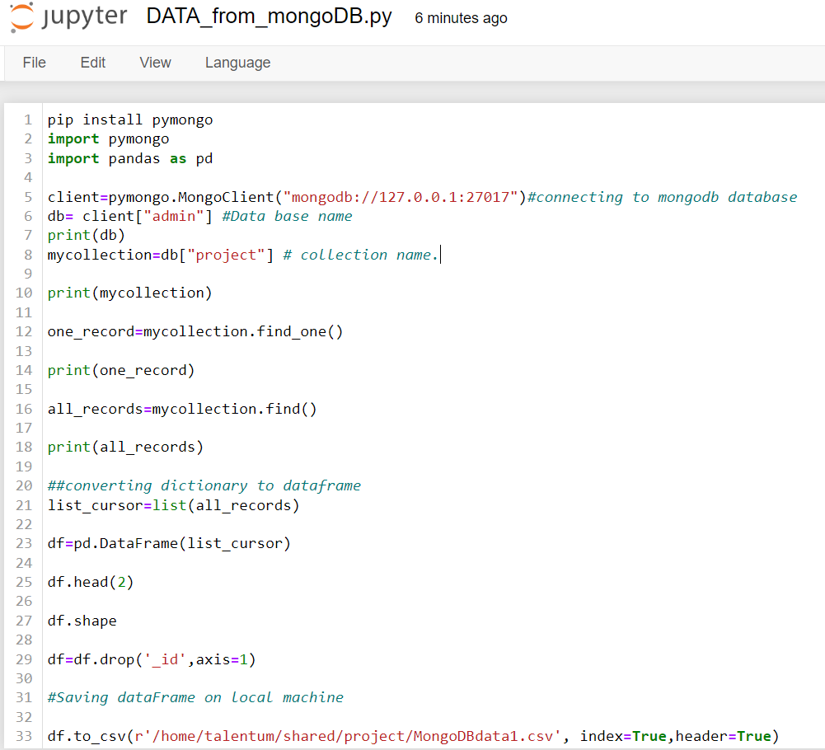
Data Extraction From MongoDB
Used Pandas pymongo library
Through pymongo.MongoClient function mongoDb data access
Mycollection.find() function of pymongo used to read all records of collection
These records assign to make data frame .
Created DataFrame save at local file system.

Slide 7
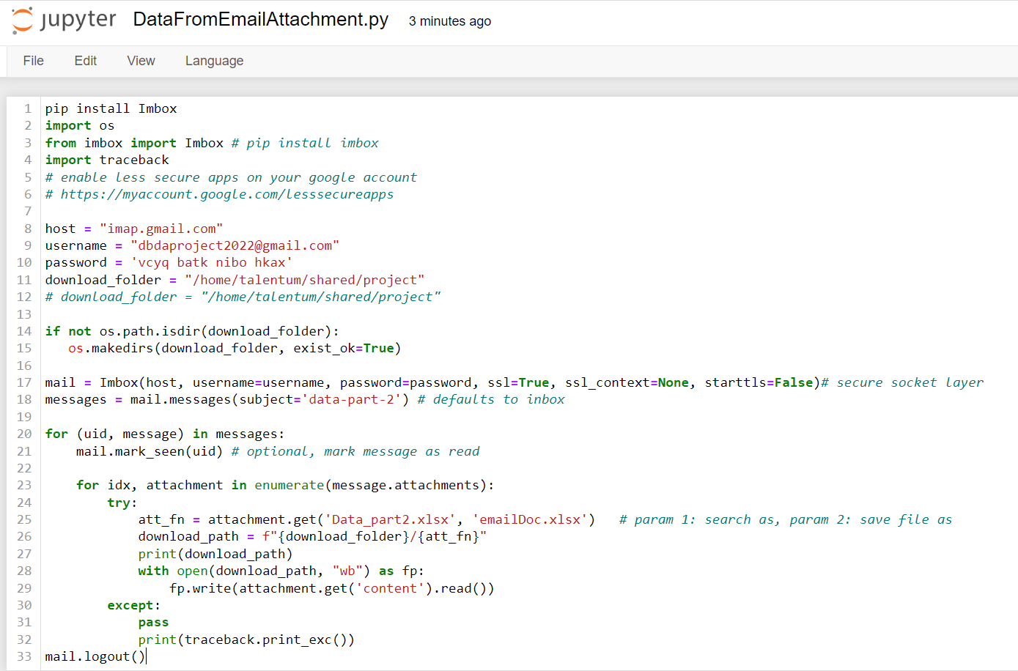
Data Extraction From Email Attachment file
Pandas Imbox library used for programming
Email account 2step verification ON and set app password to access email files.
To connect Gmail account Used Imbox function in which pass parameter like username and password.
Giving specific subject name and file name
Giving download path to save gmail file.

Slide 8
Data Extraction From kaggle website.
The data file is downloaded from kaggle website save at local file
The data set download link https://www.kaggle.com/datasets/stackoverflow/stackoverflow?select=users
Data Extraction files saved at local file system .

Slide 9
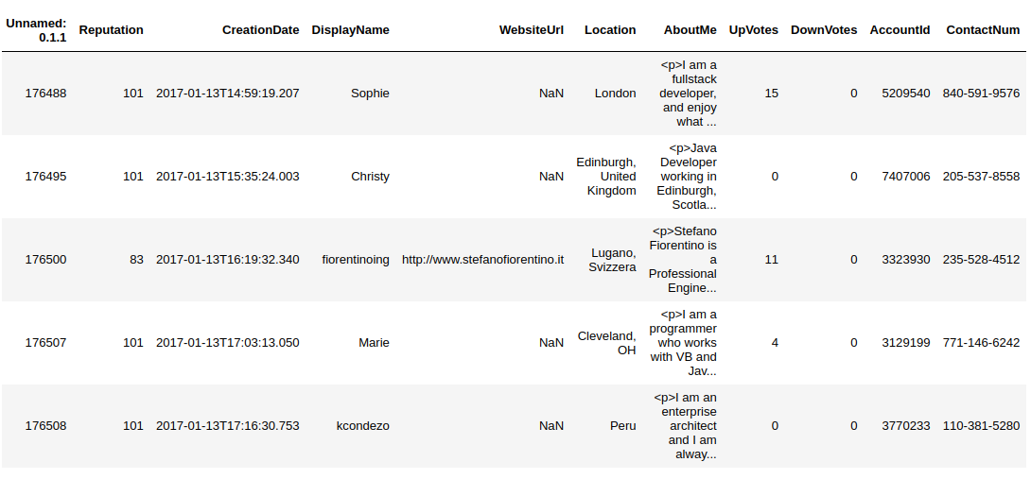
Extracted Data format

Slide 10
DATA CLEANING
After data extraction, the data is in raw format and uncleaned
So data cleaning is very important part.
In data cleaning phase filtering column and data processing task done.

Slide 11
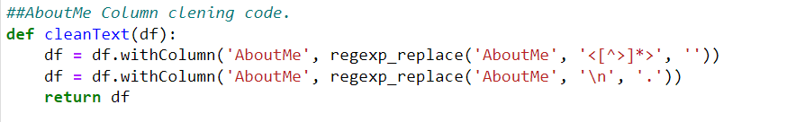
About me column cleaning
Spark sql regexp_replace function used for removing unwanted charcters from text
Simple tags and href attributes “<[^>]*>” with “ ”
To identify the line separator, we are replacing “\n” with “.”

Slide 12
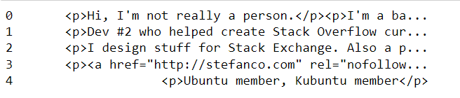
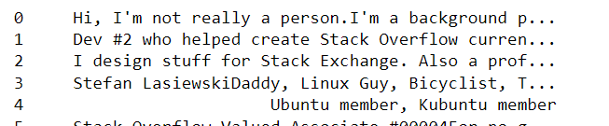
Result About me column cleaning
Before
After

Slide 13
DATA PROCESSING
In data processing we are generating meaning full address from raw location column.
Also we generate city, country, state and zip code attributes from address.
For such processing application pandas geopy library used.

Slide 14
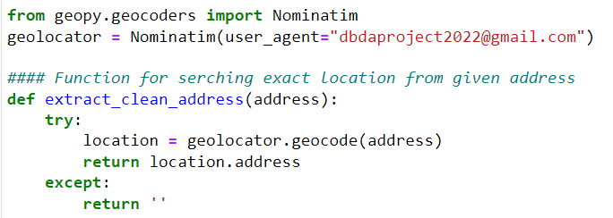
Function to generate clean address
Nominatim is geocoding library written in Python
Nominatim which is a free service and is hosted on many private servers.
Help to get address from various locations.

Slide 15
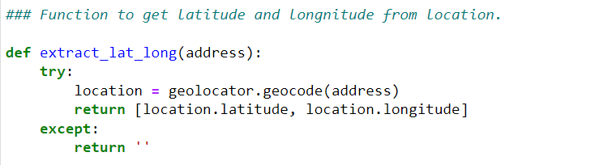
Function to generate latitude and longitude
In this function the latitude and longitude are generated .
The main purpose of this is to get accurate position of location in geographical map

Slide 16
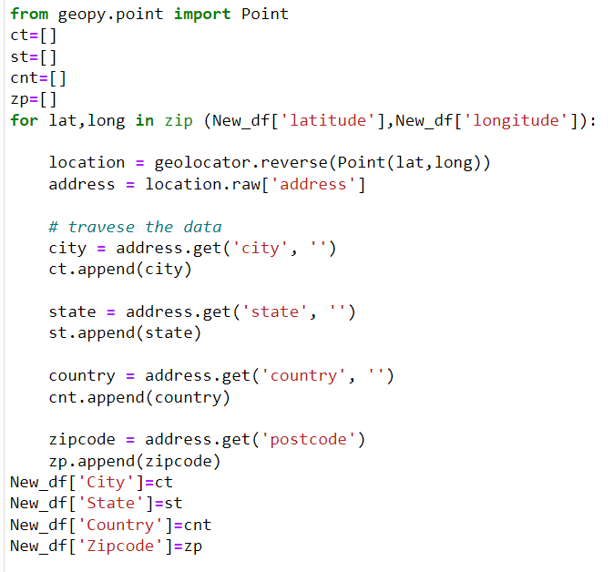
Program to generate city, state, country and zip code
Return latitude and longitude form extract_lat_long function are pass to Nominatim reverse function to get city, state, country and zip code values.
A reverse method, which resolves a pair of coordinates to an address.
Generated values are append to empty list .
That list assign to new column in data frame.

Slide 17

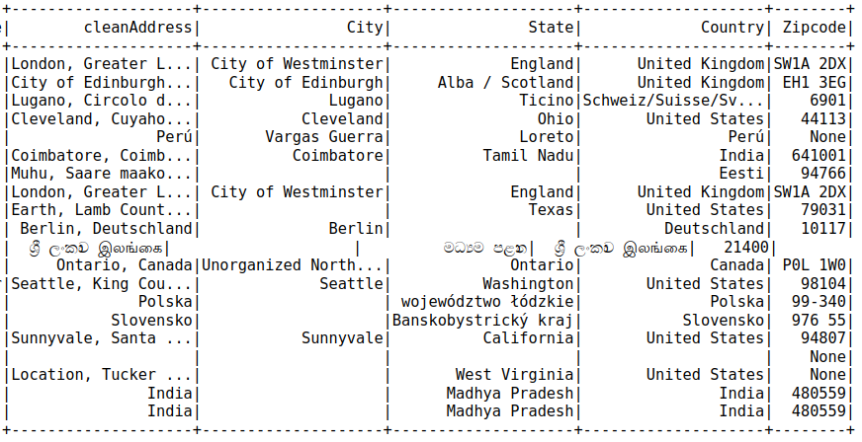
Result of Data process
Before
After

Slide 18
Final Schema Design
After cleaning and data processing , unwanted column drops from the data frame
And made final clean structured data frame.

Slide 19
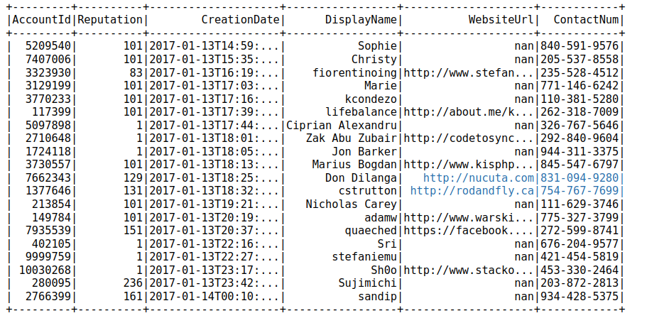
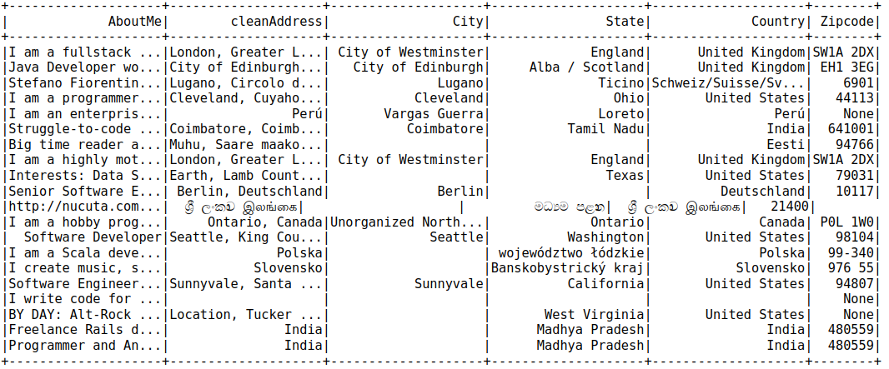
Output After Data Cleaning Process

Slide 20
Data Loading Process
In this process, we load clean data into HDFS . Which further used for entity resolution and analysis purpose.
Command used for it is .

Slide 21
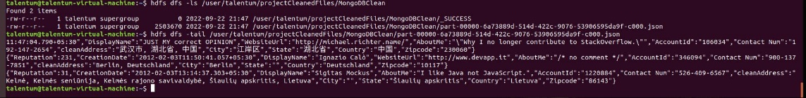
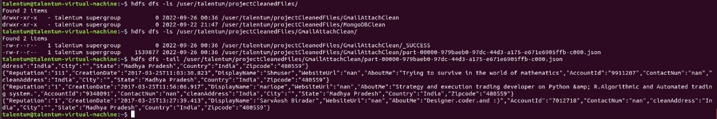
Files present at HDFS

Slide 22
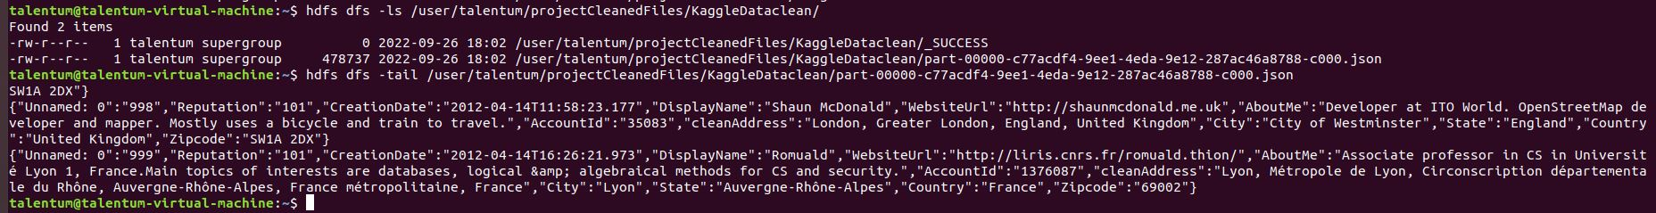

Slide 23
Feature Scope
1) Making location function more efficient
2) Automate the ETL process by using Apache Airflow.
Github Code link
https://github.com/mayuresh051998/DBDA_ETL_Project.git

Slide 24
Limitations
Python's geopy library is used for finding out the country,state,city from raw address. But it's not efficient for big data usecase.
.csv and .xlsx formats were not able to read by spark.read api, hence they were read with pandas and then converted to spark dataframes.
We were not able to write data into csv format properly because of commas and quotes in the data.

Slide 25
References
pyspark documentation 3.0 -
https://spark.apache.org/docs/latest/
geopy -
https://pypi.org/project/geopy/
imbox -
https://pypi.org/project/imbox/
BeautifulSoup -
https://pypi.org/project/beautifulsoup4/
Spark MongoDB Connector Python Guide -
https://www.mongodb.com/docs/spark-connector/current/python-api
Kaggle -
https://www.kaggle.com/datasets/stackoverflow/stackoverflow?select=users

Slide 26
Thank You

