Slide 1
The Movies DB
Prathamesh Malekar (VU1F2021127)
Sahil Dhuri (VU1F2021129)
Mayuresh Ovhal (VU12021130)
Mohit Parmar (VU1F2021140)
Kinjal Dhumal (VU1F2021136)

Slide 2
Introduction
The Movie DB is a web app only used for information purpose.
Where user can get information about any movie/series he/she desires.
User can also view movie/series based on their popularity.
One can search any movie/series that has every been produced and view information such as: plot, nominations, awards, release date, imdb Rating, etc.

Slide 3

Javascript
JavaScript is a cross-platform, object-oriented scripting language used to make webpages interactive (e.g., having complex animations, clickable buttons, popup menus, etc.).
There are also more advanced server side versions of JavaScript such as Node.js, which allow you to add more functionality to a website than downloading files (such as realtime collaboration between multiple computers).
Inside a host environment (for example, a web browser), JavaScript can be connected to the objects of its environment to provide programmatic control over them
Our entire application is based on a popular javascript framework know as React.js

Slide 4

React.js
React makes it painless to create interactive UIs. Design simple views for each state in your application, and React will efficiently update and render just the right components when your data changes.
Build encapsulated components that manage their own state, then compose them to make complex UIs.
Since component logic is written in JavaScript instead of templates, you can easily pass rich data through your app and keep state out of the DOM
React don’t make assumptions about the rest of your technology stack, so you can develop new features in React without rewriting existing code.

Slide 5

API
API is the acronym for Application Programming Interface, which is a software intermediary that allows two applications to talk to each other. Each time you use an app like Facebook, send an instant message, or check the weather on your phone, you're using an API
There are two different API’s called in this application. TMDB and OMDB API.
TMDB API:
This API is used to fetch movies/series based on their popularity and filter them by their genre etc.
OMDB API:
The OMDB API is a RESTful web service to obtain movie information, all content and images on the site are contributed and maintained by our users

Slide 6
Javascript fetch() function
To pull API requests from the API’s which were mentioned we use built-in fetch() method in javascript.
The fetch() method in JavaScript is used to request to the server and load the information in the webpages. The request can be of any APIs that returns the data of the format JSON or XML. This method returns a promise.
Syntax:
fetch(url, options)
Parameters: This method accept two parameters as mentioned above and described below:
URL: It is the URL to which the request is to be made.
Options: It is an array of properties. It is an optional parameter.
Return Value: It returns a promises whether it is resolved or not. The return data can be of the format JSON or XML. It can be the array of objects or simply a single object.

Slide 7
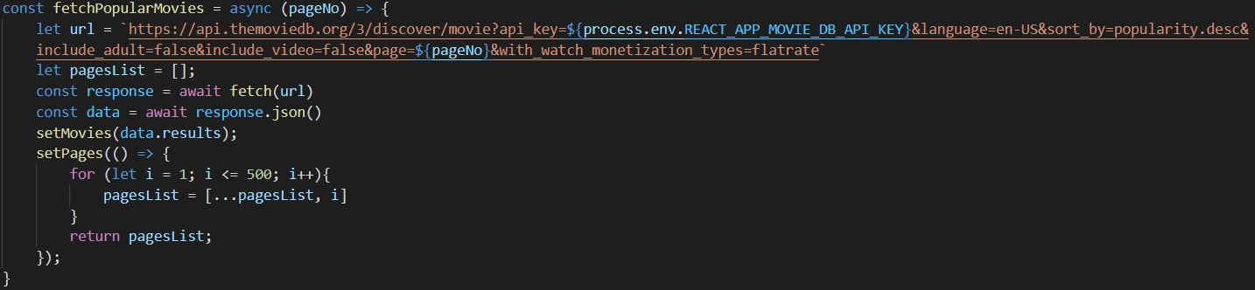
Example:

Slide 8
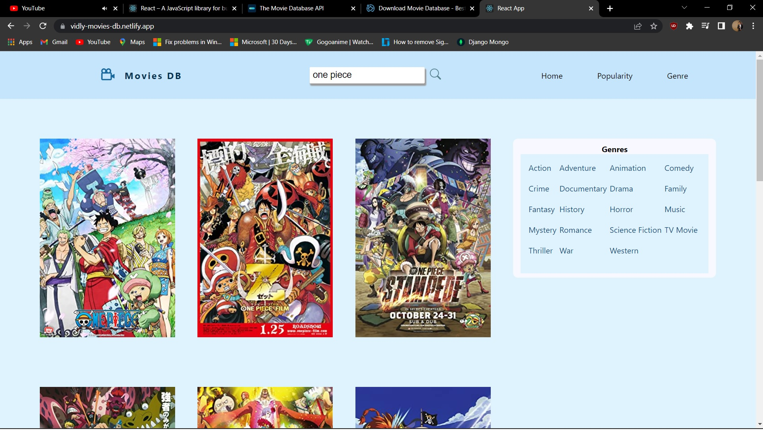
Screenshots

Slide 9
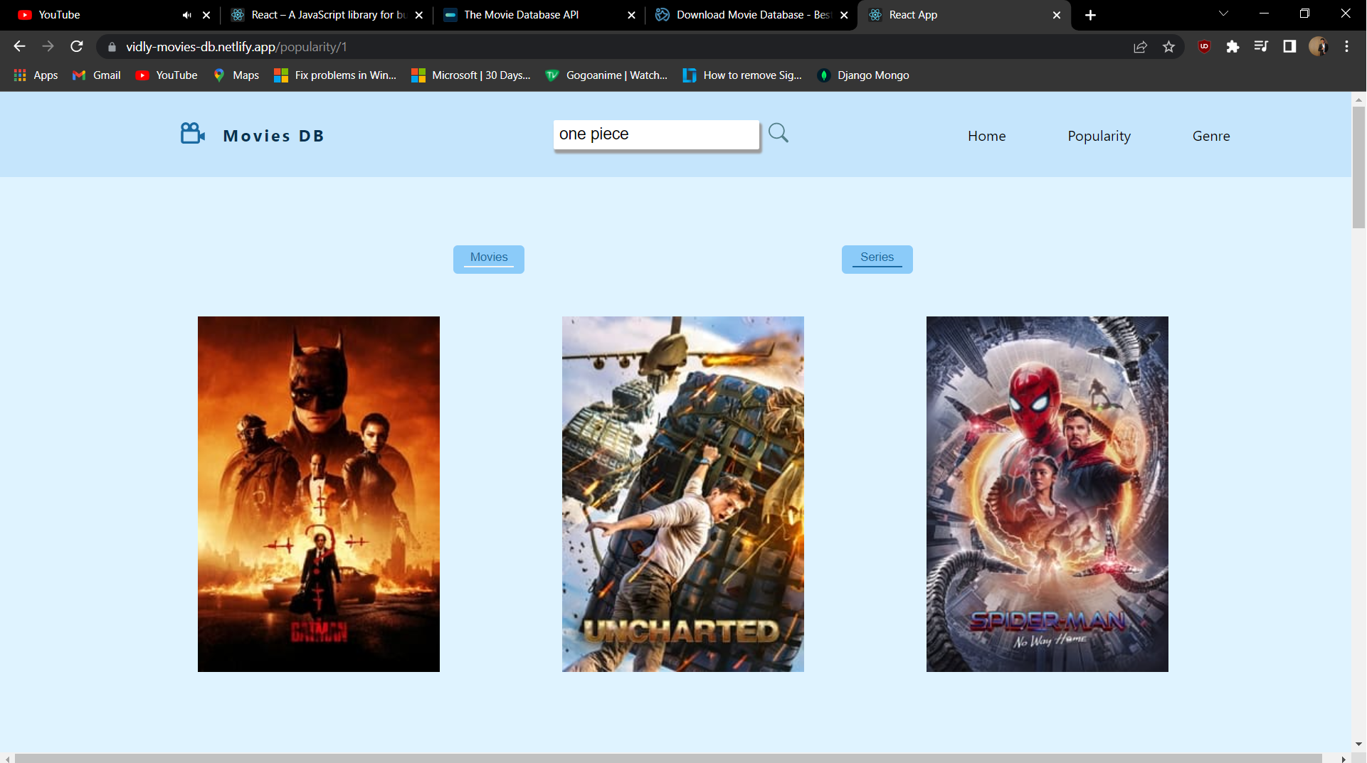

Slide 10
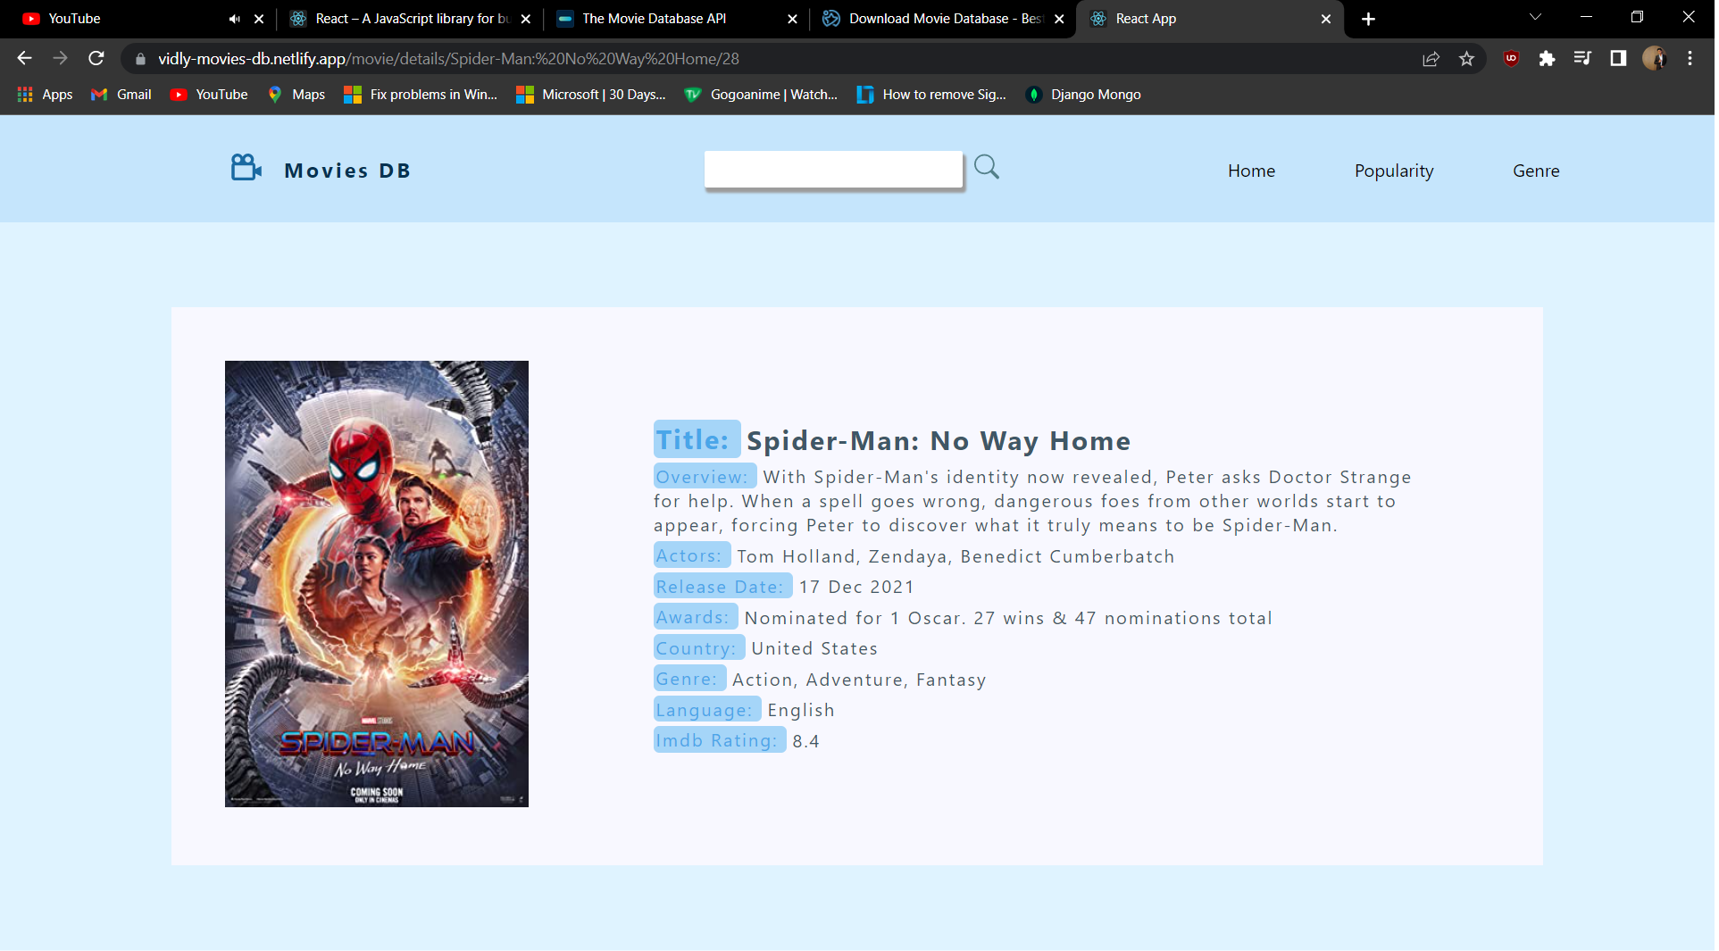

Slide 11
Deployment
For deployment we used netlify services.
First we create an user account on netlify and create a new project.
Then we just drag and drop our projects output/build folder where it is specified to do so.
And if our project build has no error our project will be deployed to the link provided by netlify.

Slide 12
Applications
Movies DB is used for seeing details of the movies/series which one might be interested in
Free Online Software to Track Popular Movies and Programs
This movie database contain basic information on the movie, its actors, genre, directors and awards.
Allows the user to perform a number of queries on the database to extract information.

Slide 13
Referrences
[1] https://github.com/mayuresh1606/react-projects
[2] https://reactjs.org/tutorial/tutorial.html
[3] https://www.themoviedb.org/documentation/api
[4] https://www.omdbapi.com/

Slide 14
Thank You

