Slide 1
CAR POOL ANDROID APP

Slide 2

Department Of Computer Science
FOR ACADEMIC YEAR 2022-2023
Made By : Mayuresh Sulakhe
Nale Amit
Guided By : Prof. R. Korpal

Slide 3
Overview
Carpooling is the sharing of car journeys so that more than one person can travel in a car, and prevents the need for others to have to drive to a location themselves.
This Mobile App connects driver and passenger willing to travel together between cities and share the cost of the journey.
It shows a medium for available passengers to pick up them on the interest of car owner with time and capacity.

Slide 4
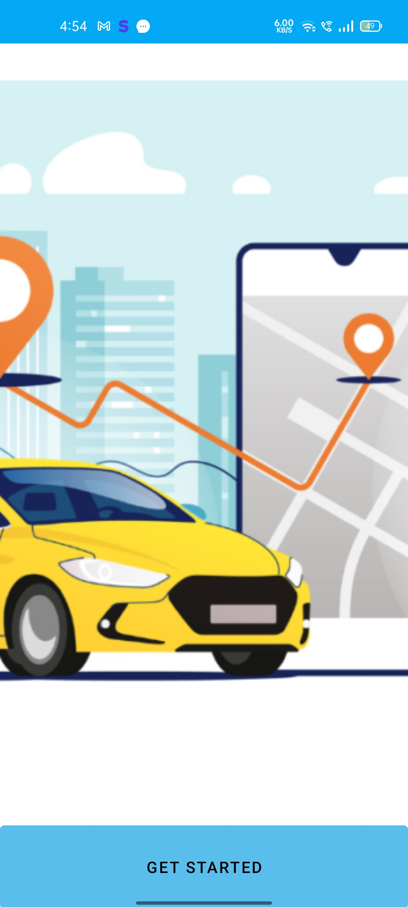
Workflow:
Starting Page :
This is the first page view of the app.
The user can proceed by clicking on ‘Get Started’ button.

Slide 5
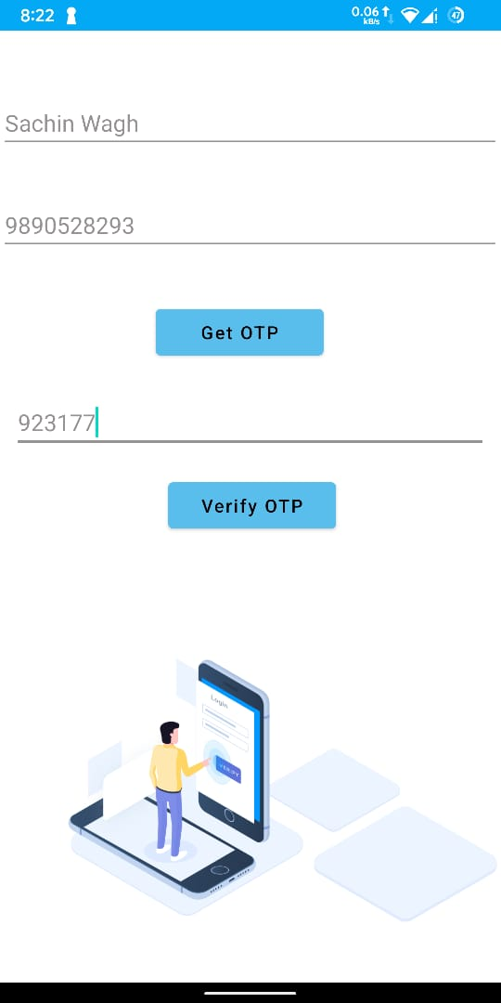
Flow Of App
1) Registration Page :
We have built mobile number verification in the app by using Firebase authentication.
Once authenticated, it stores user information in the database like as user's name and mobile number.

Slide 6
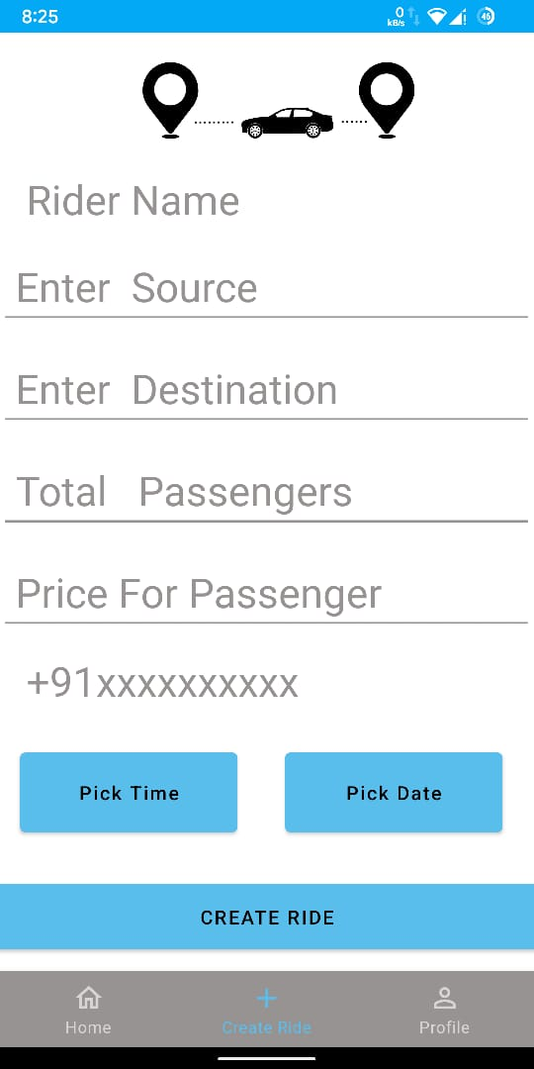
Flow Of App:
2) ‘Create Ride’ Page :
A rider can create ride for source and destination.
Ride details are stored in firebase database & are accessible for other users as well.
A rider can post multiple rides on the app.

Slide 7
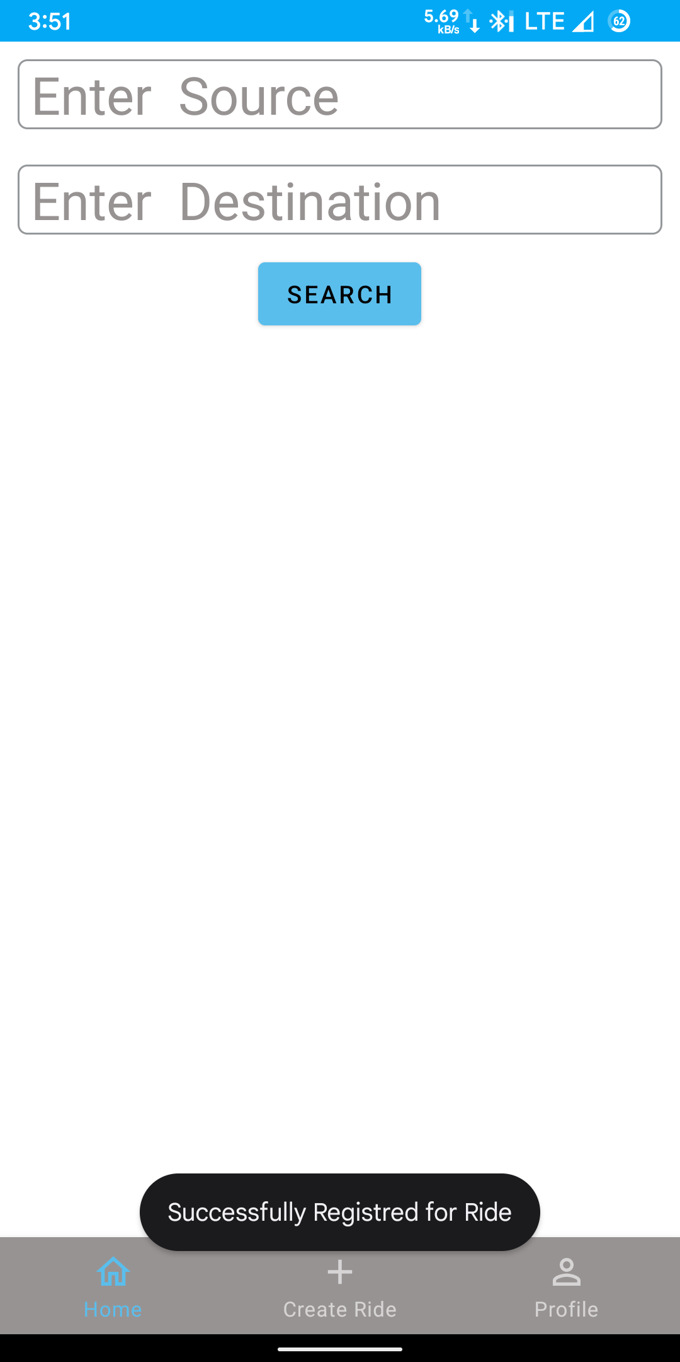
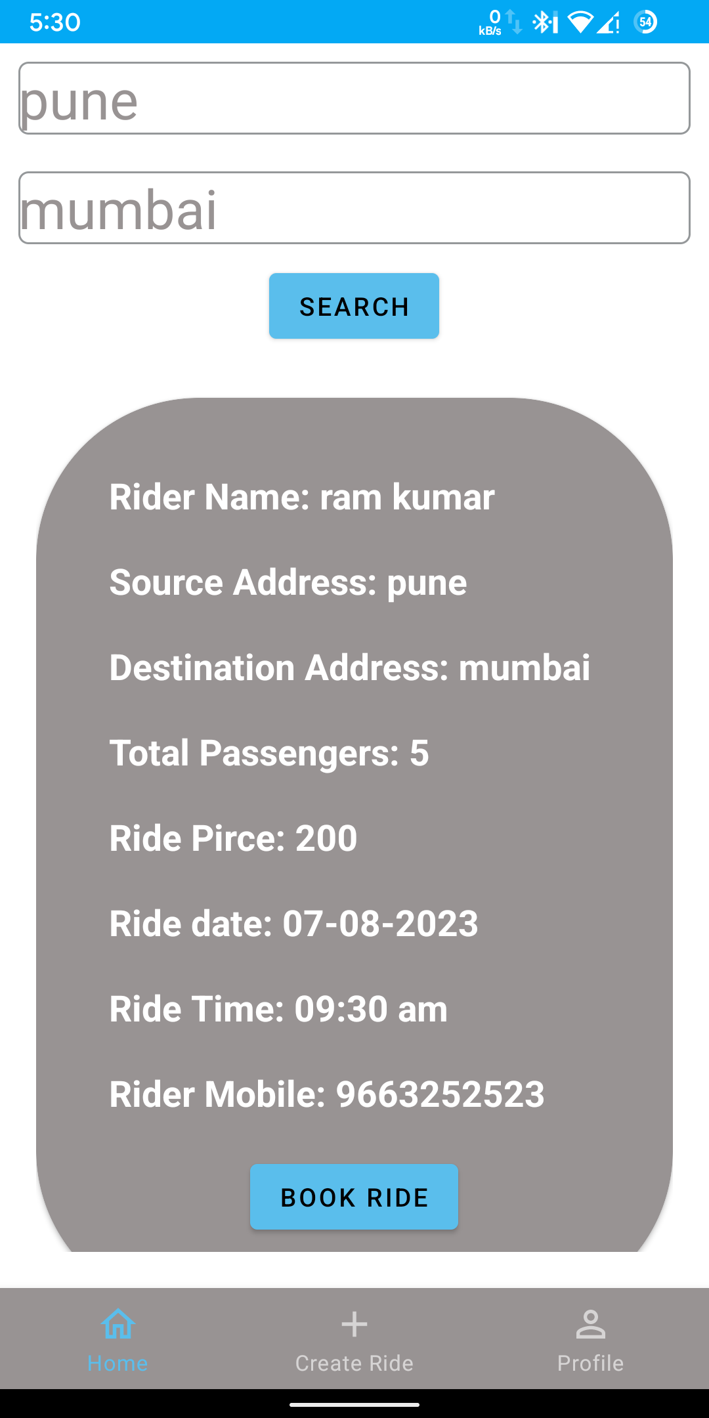
Flow of App
3) ‘Search Ride’ Page :
A passenger can book a ride here.
A passenger needs to input the source and destination and in the backend it searches rides for that source and destination in the firebase database.

Slide 8
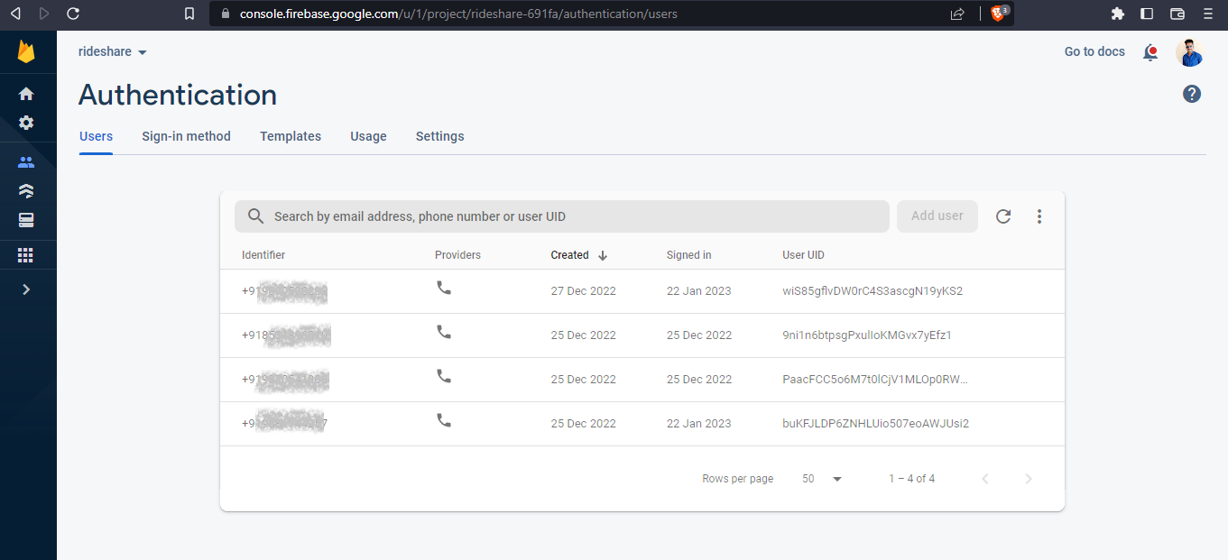
Firebase Authentication :
User authentication is done here and it will store login in user data.

Slide 9
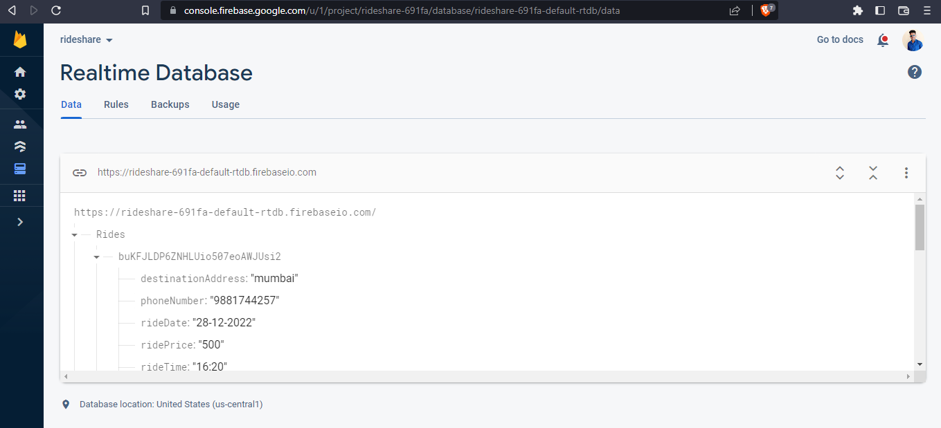
Firebase Realtime Database
User details and Ride details are stored in firebase realtime database

Slide 10
THANK YOU

