Slide 1
ClosureCopilot
A Multi-Agent Backend Closure Copilot for RTL
It decides WHERE each fix belongs — RTL · SDC · UPF

Slide 2
The problem: PPA closure doesn't scale
Power, Performance & Area (PPA) closure is the biggest schedule risk in silicon.
Run backend tools → wait hours → face thousands of lines of reports.
The bottleneck is judgment, not reading: is a timing violation a real RTL bug, or a missing constraint? Is high clock power a hotspot, or unrealized UPF intent?
That expertise lives only in senior engineers' heads — and doesn't scale.
ClosureCopilot · Mayuresh Piske · © 2026 Microsoft

Slide 3
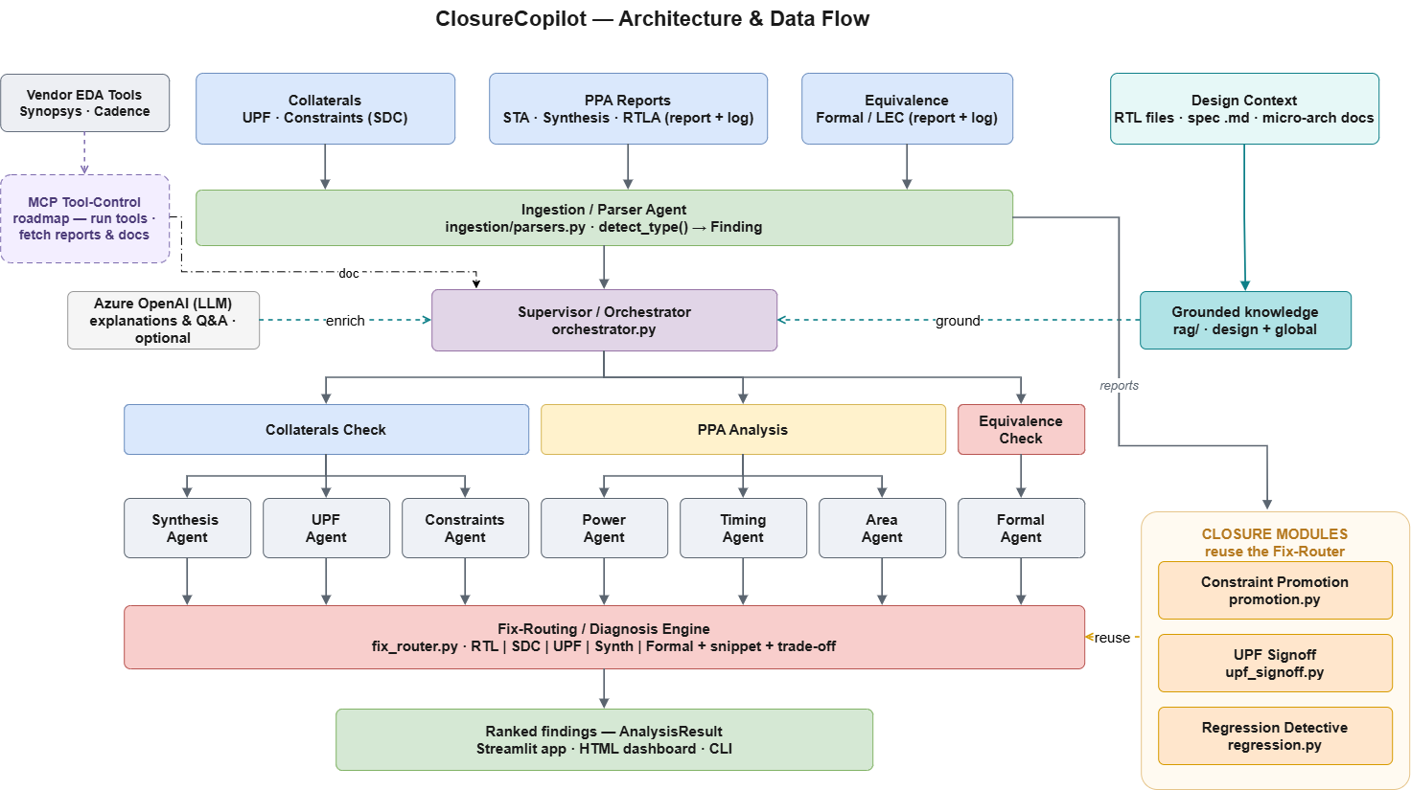
One copilot · 9 agents · any backend report
ClosureCopilot · Mayuresh Piske · © 2026 Microsoft

Slide 4
The core idea: Fix-Layer Routing
For every issue, it decides WHERE the fix belongs — RTL · SDC · UPF · synthesis-setup.
Example 1 — fix in SDC (not RTL)
Config path cfg_reg → status_reg fails setup.
Diagnosis: quasi-static, sampled once per write.
→ set_multicycle_path -setup 2 …
Example 2 — fix in RTL
Deep combinational cone at alu.sv:210.
Diagnosis: genuine logic depth, single cycle.
→ pipeline the datapath (timing ✓, area +2%)
Every fix ships with a corrected, copy-paste snippet + a cross-domain PPA trade-off.
ClosureCopilot · Mayuresh Piske · © 2026 Microsoft

Slide 5
Five capabilities, one dashboard
PPA Analyzer —
Ranks issues and routes each fix to RTL / SDC / UPF with a snippet + trade-off.
Constraint Promotion —
Reconciles IP → top constraints; generates corrected top-level SDC.
UPF Signoff —
Checks isolation, retention & clock-gating intent; emits corrected UPF.
Regression Detective —
Compares two runs; finds what regressed and the change behind it.
Formal Equivalence (LEC) —
Routes LEC non-equivalence to a Formal-setup fix vs a genuine RTL bug.
ClosureCopilot · Mayuresh Piske · © 2026 Microsoft

Slide 6
Grounded — and always-on
Dual-RAG knowledge
① Global PPA knowledge
Low-power / timing / area methodology, tool-report semantics, fix patterns.
② Design Context Memory
A persistent memory of YOUR chip — specs, micro-arch, clocking, prior runs.
→ Feedback reflects your design intent, and improves each iteration.
Built to run anywhere
Python · multi-agent orchestration
Azure OpenAI for reasoning
Streamlit product dashboard
Deterministic OFFLINE mode
Runs reliably with or without credentials — the demo never breaks.
ClosureCopilot · Mayuresh Piske · © 2026 Microsoft

Slide 7
Why it wins
Unique
It combines fix-layer routing + IP→top constraint promotion + run-to-run regression
attribution for the RTL owner — a combination no existing point tool brings together.
Impact
Hours of manual, expert-only triage → minutes of ranked, grounded, copy-paste fixes.
Puts senior-level closure judgment in every RTL designer's hands.
Catches unrealized intent and lost constraints before the next costly backend run.
ClosureCopilot · Mayuresh Piske · © 2026 Microsoft

Slide 8
ClosureCopilot
Close faster. Fix smarter.
github.com/mayureshpiske19/ClosureCopilot

