Slide 1
SPEC-RTL SENTINEL
Design Intent Auditor
Agentic RAG that catches spec-to-silicon drift before it becomes a bug.
HAS
→
MAS
→
Decisions
→
RTL
Mayuresh Piske
Spec-faithful RTL verification, grounded in design intent

Slide 2
THE PROBLEM
Specs and silicon drift apart
RTL is built from a MAS, which refines a HAS.
But real decisions — “widen the bus to 64-bit”, “move STATUS to 0x08” — live in reviews, chats, and meeting notes.
They rarely make it back into the formal specs.
Manual clause-by-clause cross-checking is slow, inconsistent, and dropped under schedule pressure.
Hours
per block, manual spec review
1
missed mismatch = silicon bug or security hole
4 sources
HAS · MAS · decisions · RTL to reconcile
spec-rtl-sentinel · © 2026 Microsoft

Slide 3
THE INSIGHT
The tribal layer nobody indexes
Formal specs capture the plan. The decisions that actually change the design live in the conversation around it — and no lint or spec-check tool reads that layer.
HAS
Top-level intent — performance, concept, security
the WHY
MAS
Micro-architecture detail — registers, widths, FSM
the WHAT
Decisions / Reviews / Meetings
Amendments that override or reinforce the specs
the AS-AGREED
RTL
The implementation
the AS-BUILT
spec-rtl-sentinel · © 2026 Microsoft

Slide 4
WHAT IT DOES
One audit across every layer of intent
Sentinel ingests all four layers into a RAG store, reconciles conflicts by authority, and checks RTL against the resolved intent — producing a clause-by-clause drift report.
1
2
3
4
Ingest
Reconcile
Trace
Report
HAS + MAS + decisions + RTL into a grounded RAG store
Authority resolver settles spec-vs-decision conflicts by seniority + recency
HAS → MAS → RTL; flag requirements never refined (gaps)
Verified / drift / missing / conflict / gap — each citing its source
spec-rtl-sentinel · © 2026 Microsoft

Slide 5
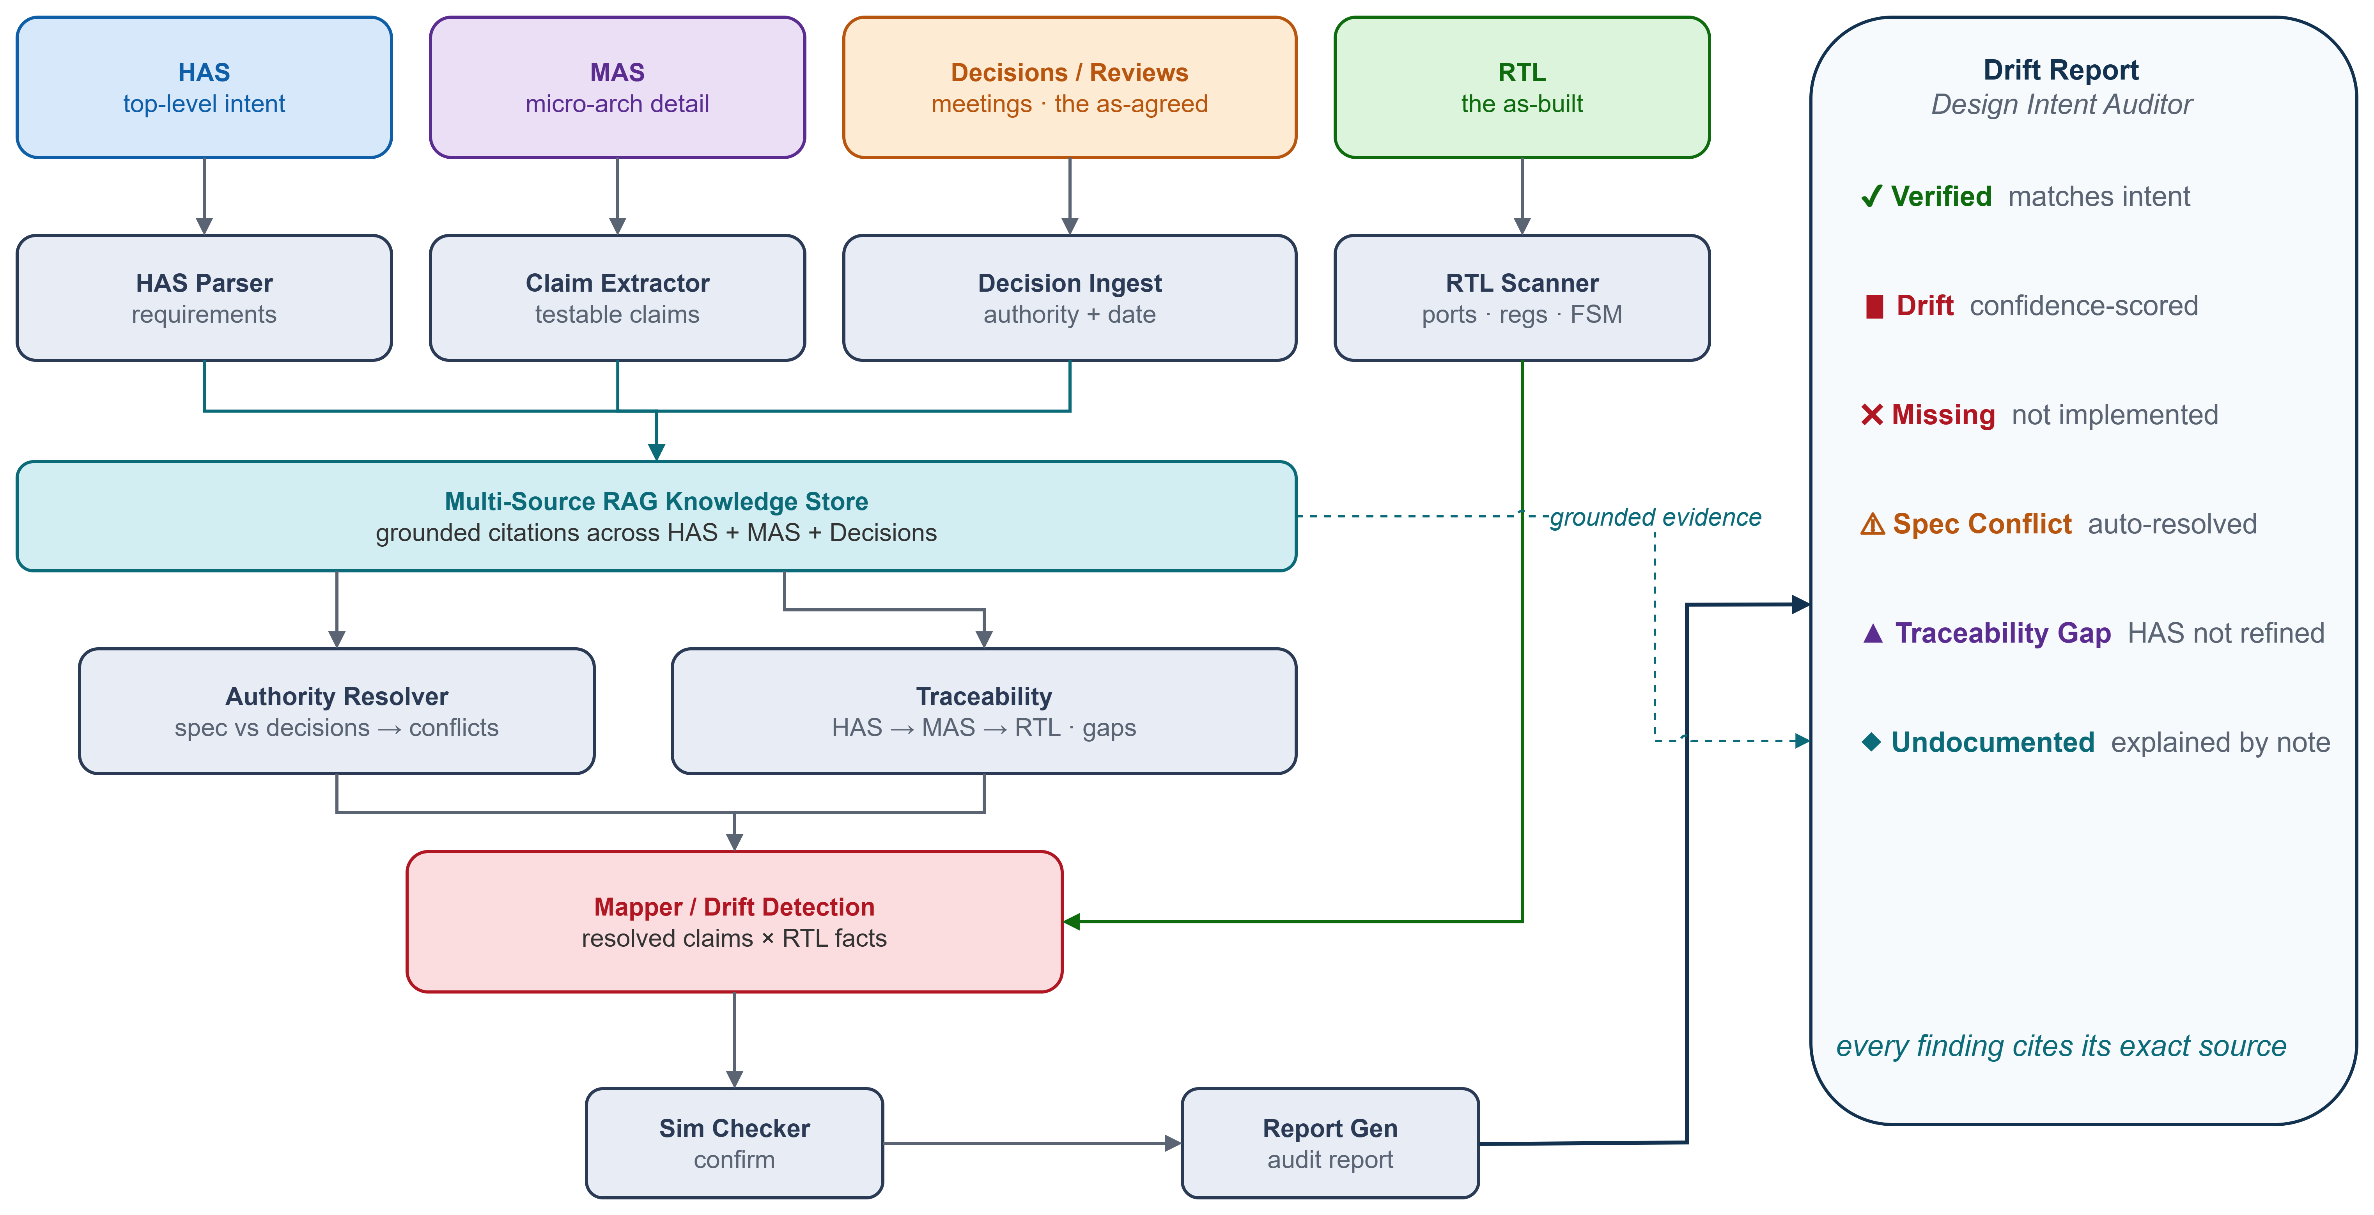
ARCHITECTURE
Multi-agent RAG pipeline
spec-rtl-sentinel · © 2026 Microsoft

Slide 6
THE AGENTS
A pipeline of specialised agents
HAS Parser
Claim Extractor
Decision Ingest
Extracts top-level requirements
MAS → testable claims, traced to HAS
Reviews/meetings w/ authority + date
RTL Scanner
Authority Resolver
Traceability
Ports, CSR map, FSM states
Reconciles spec vs decisions
HAS→MAS→RTL coverage + gaps
Mapper / Diff
Sim Checker
Report Generator
Resolved claims × RTL facts
Confirms dynamic claims
Layered drift report
All grounded in a dependency-free multi-source RAG store — runs fully offline.
spec-rtl-sentinel · © 2026 Microsoft

Slide 7
LIVE DEMO
What it catches — in seconds
🟥 Drift · high confidence
m_axi_wdata is 32-bit; MAS and the Aug-28 arch review both require 64-bit
ZEPHYR COSS
🚨
❌ Missing · 0.5
Control FSM lacks the WRITE_OUT state required by MAS §4.1
DRIFT
DETECTED
❌ Missing · 0.8
PERF_MISS performance counter (MAS §3.3) not implemented
⚠ Spec conflict · auto-resolved
25 verified · 1 drift
2 missing · 1 conflict
1 gap · 1 undocumented
INT_STATUS: MAS 0x054 vs Sep-02 review 0x058 — RTL follows the review
🟡 Undocumented · explained
DBG_SCRATCH in RTL — an Aug-20 meeting flagged it as a temporary hook
▲ Traceability gap
28 claims · one command · zero API keys
HAS-09 (multi-clock CDC) was never refined into a MAS claim
spec-rtl-sentinel · © 2026 Microsoft

Slide 8
MILESTONE GATES
Is the RTL 0.1-clean? 0.5-clean?
HAS is the golden reference — never flagged. MAS and RTL are checked against it milestone by milestone, so each stage only checks what should be done by then.
Boundary — interface ports + CSR registers
🚨 FAIL
0.1
Cumulative gates
m_axi_wdata 32-bit vs 64-bit drift
Each milestone re-checks everything below it.
A gate passes only when every in-scope claim is verified — no drift, no gap.
+ Functional behavior (FSM, datapath)
🚨 FAIL
0.5
control FSM missing WRITE_OUT state
+ Errors, DFT, perf counters, debug
🚨 FAIL
0.8
PERF_MISS counter not implemented
Overall / integration — everything
🚨 FAIL
1.0
HAS-09 multi-clock CDC gap
RTL isn't even 0.1-ready yet.
spec-rtl-sentinel · © 2026 Microsoft

Slide 9
WHY IT'S DIFFERENT
Grounded. Traceable. Trustworthy.
✓
✓
✓
Indexes the tribal layer
Resolves source conflicts
Cites every finding
The only tool that reads the decisions in reviews and meetings — not just one static spec.
Reconciles spec-vs-decision by authority + recency before ever touching the RTL.
Each result links to the exact HAS/MAS clause or decision it is grounded in. No hallucinations.
spec-rtl-sentinel · © 2026 Microsoft

Slide 10
IMPACT
From hours of review to seconds
seconds
100%
0
to audit RTL against 4 intent layers
of findings source-cited
API keys — runs fully offline
Who benefits
Design & verification engineers — stop hand-diffing specs against RTL
Architects — see which top-level requirements are actually implemented
Leads & PMs — a living drift metric per commit, not a one-time review
Security IP teams — catch key/register drift before tapeout
spec-rtl-sentinel · © 2026 Microsoft

Slide 11
ROADMAP
Built offline today — Azure OpenAI RAG tomorrow
Swap the TF-cosine index for Azure OpenAI embeddings + ChromaDB / FAISS
LLM claim extraction from free-form spec prose (documented hook)
Real HDL parsing at scale (pyslang / pyverilog)
Live decision sources — Teams, ADO review comments, meeting transcripts
Try it: python examples/run_demo.py
github.com/mayureshpiske19/mas-rtl-sentinel
Spec-RTL Sentinel — catching spec-to-silicon drift before it becomes a bug.
spec-rtl-sentinel · © 2026 Microsoft

