Slide 1
BIKE RENTAL SYSTEM

Slide 2

Bike Rental System
A PROJECT ON
PrEsented By
Purvi Dubey
MCA I Year,
JSCOE Pune.
Guided By
Prof. Swayam Shah

Slide 3
ABSTRACT
Bike Rental System is the application which is designed to help the customers to take bikes or two-wheelers for rent. Using this system vehicle owners can register as sellers and customers who want to take bikes on rent can register themselves as renters and can take any bike on rent.

Slide 4
INTRODUCTION
Bike Rental System is the application which is designed to help the customers to take bikes or two-wheelers for rent.
Using this system vehicle owners can register as sellers and customers who want to take bikes on rent can register themselves as renters and can take any bike on rent.
Proofs like license, pan card, and identity card are compulsory so that no one could run taking the bike. Any customer whose proofs are not uploaded and are not valid will not be allowed to take any bike on rent.
This has one admin account that verifies the registering user and two types of user account. One for bike sellers and one for customers who take the bike on rent.
The individual who needs a bike must contact a rental bike company and contract out for a vehicle. This system increases customer retention and simplify vehicle and staff management.
This system has only one admin account and cannot have more than one admin account. Admin can verify and register the user who is registering. If the admin does not verify, the user cannot register.

Slide 5
SCOPE OF PROJECT
This project was designed to investigate and related different functional, operational and technical requirement of a dedicated web application for online bike rental system.
The system equipped to answer customer’s inquiries about the availability and rental fee of various types of bikes for certain dates in the future.
The system process a bike pick up. Customer walks in and supplies either the confirmation number or name. The system should pull up all the reservation information about this customer. The customer is then asked to supply a driver’s license.
Bike rental system gives bike rental service for both foreign as well as local customers. This organization carries out its daily work by providing; their service to the customer using this system.

Slide 6
HARDWARE / SOFTWARE DETAIL
The Software Requirement deal with defining software resource requirements and prerequisites that needs to be installed on a computer to provide optimal functioning of an application.
Front End
User interface : HTML/CSS/JavaScript
Operating System : Microsoft Windows 7 or above
Web Browser : Chrome, Internet Explorer
Back End
Database : My SQL
Application Server : XAMPP server(v3.2.2) for Apache server(localhost)
PHP (v7.2.10) for server side scripting
Sublime3 (Source Code Editor)

Slide 7
OBJECTIVES
To produce a web-based system that allow customer to register and reserve a bike online and for the company to effectively manage their bike rental business.
To ease customer’s task whenever they need to rent a bike.
Availability of vehicle round the clock.
Wide range of vehicles.
Maintaining record of each booking history.
Online payment option
Login and account generation

Slide 8
SYSTEM DESIGN
Table Description
E-R Diagram
Use case diagram
Class Diagram
Activity Diagram

Slide 9
1. DATA DICTIONARY
Database Contains Following Table:
Admin
User
Bike
Payment

Slide 10
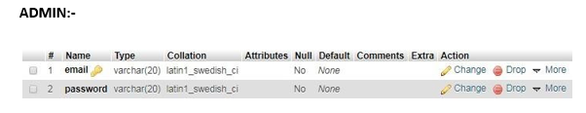
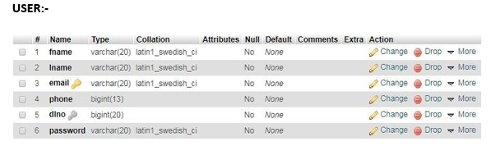
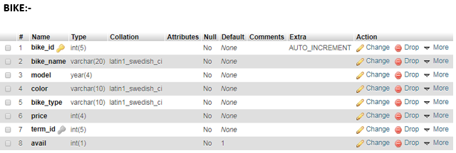
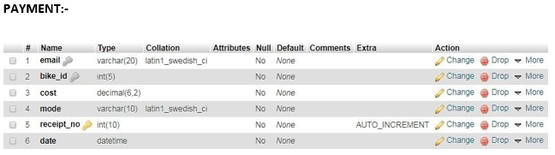
1. Table Description:

Slide 11
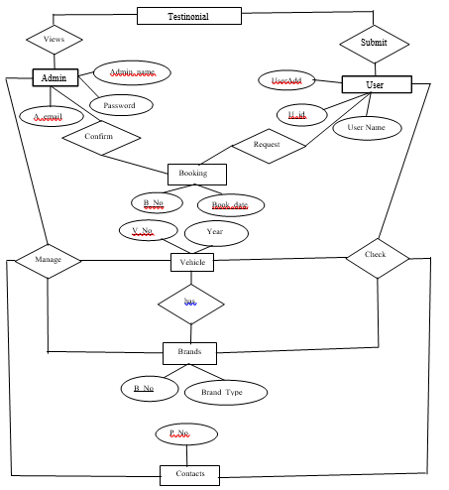
1. ER Diagram:

Slide 12
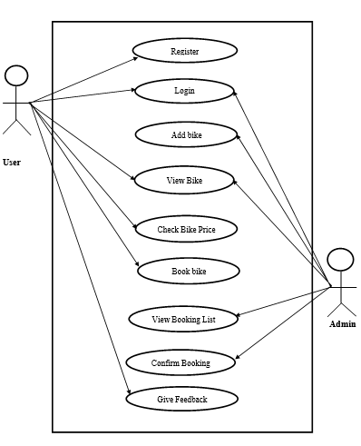
2. Use case Diagram:

Slide 13
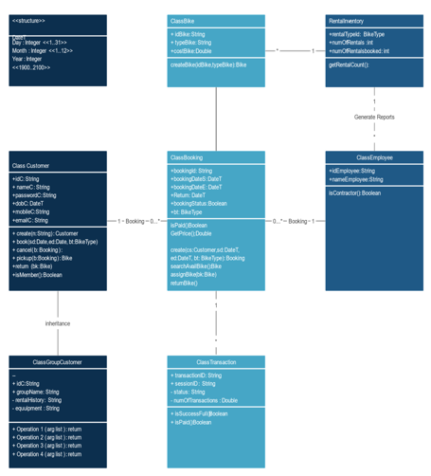
3. Class Diagram:

Slide 14
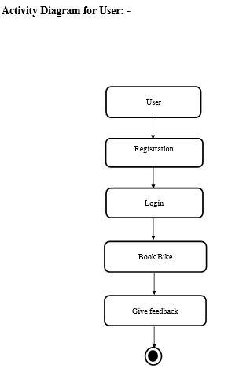
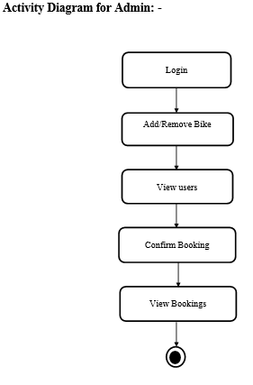
4. Activity Diagram:

Slide 15
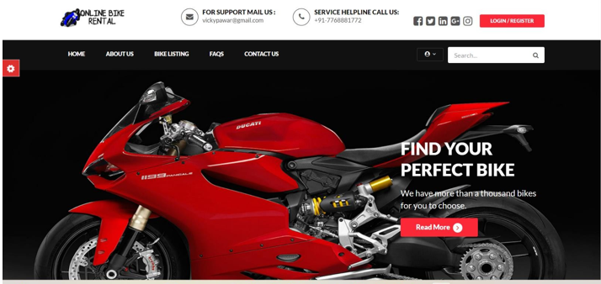
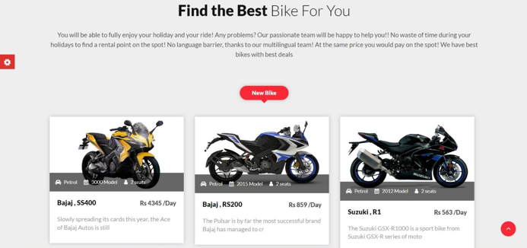
IMPLEMENTATION
Home Page:

Slide 16
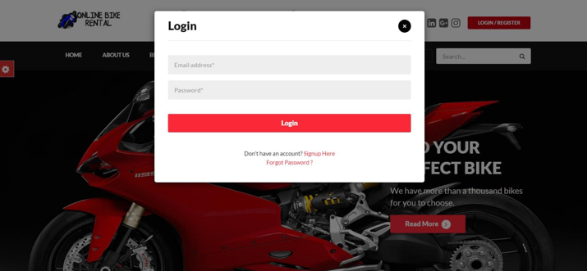
Login Page:

Slide 17
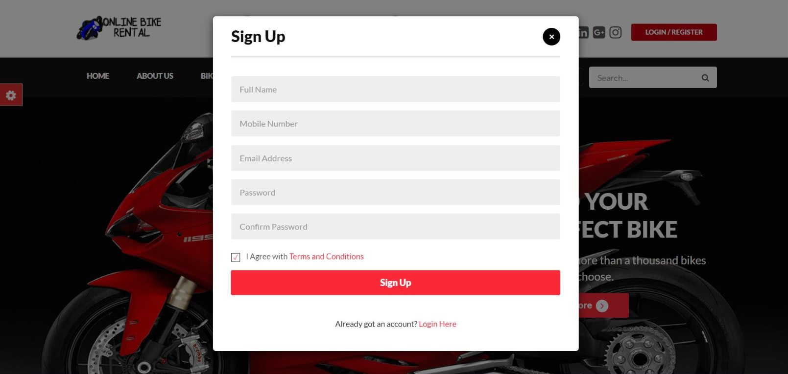
Registration Page:

Slide 18
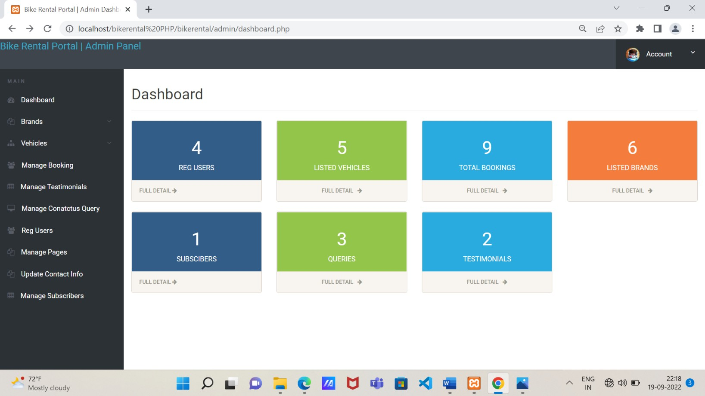
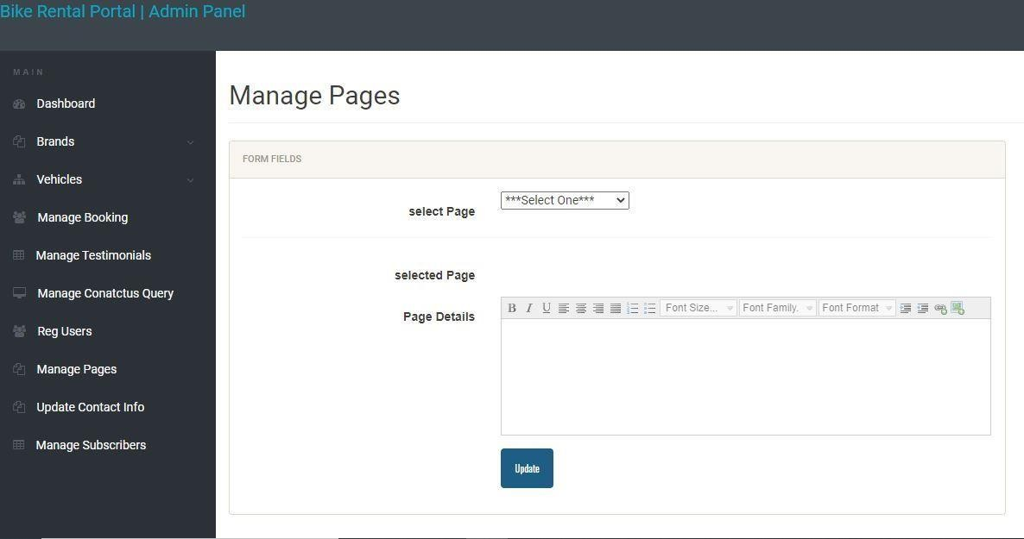
Admin:

Slide 19
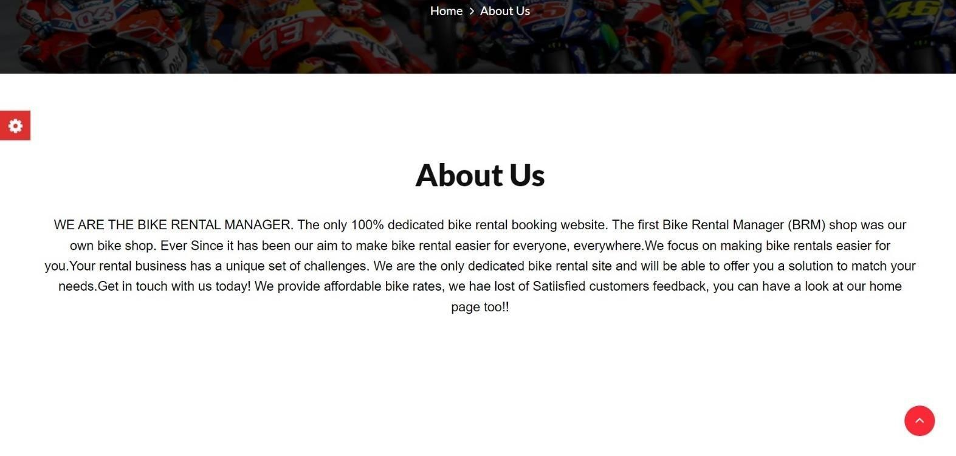
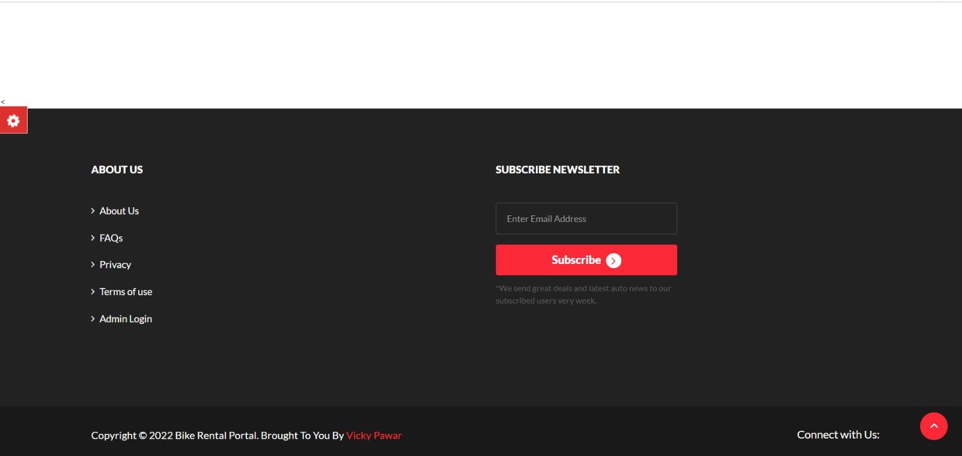
About us Page:

Slide 20
CONCLUSION
Bike Rental System is a web application and it is restricted to only limited type of users. In this application, Admin have been given access rights and are restricted up to certain functionalities, so that the data is maintained securely and redundant data is prevented. As the Data is stored electronically, it is necessary to have a Computer and Network connection to access the Application. It is a software which helps the user to rent bike base on their need. This software reduces the amount of manual data entry and gives greater efficiency. The User Interface of it is very friendly and can be easily used by anyone. It also decreases the amount of time taken to write details and other modules. At the end, this software can perform all the tasks accurately and can do the work for which it is made.

Slide 21
Thank You

