Slide 1



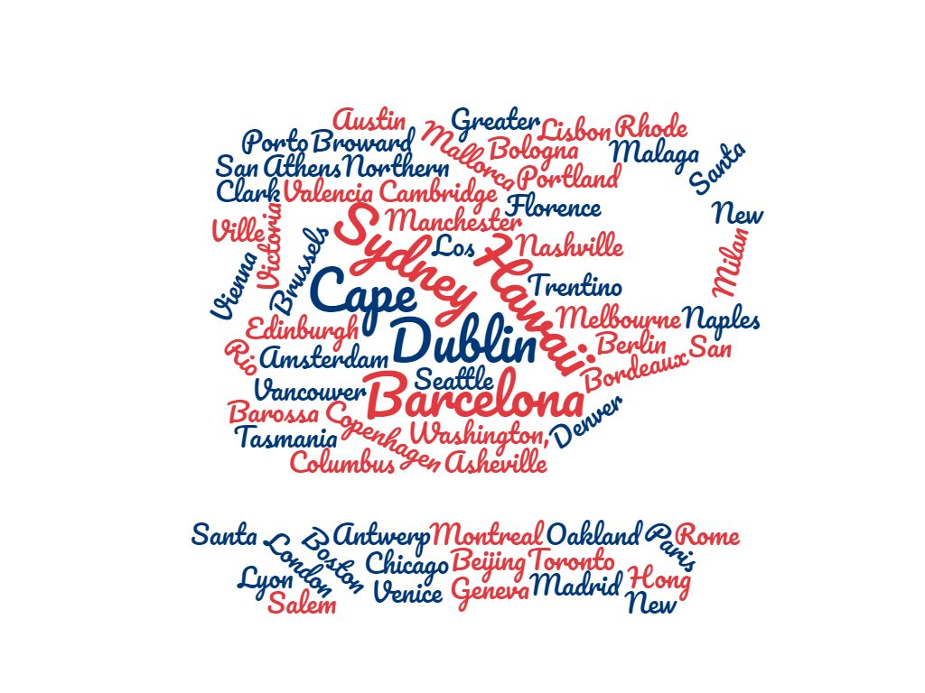

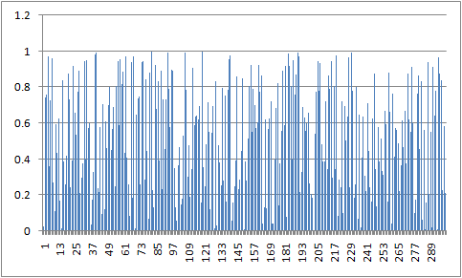
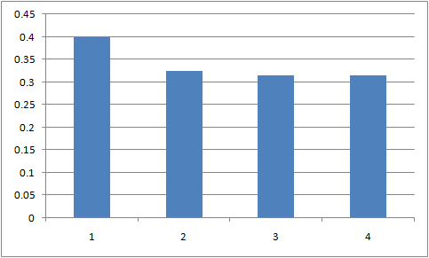
Bon Voyage - A Trip Recommendation System
Ankit Garg, Harmeet Sethi, Mayuresh Hooli, Praveen Venugopal
Department of CSE, Texas A&M University
Which city we are planning this year ?
Ahh! Again… Let’s see.. this is gonna take some time...
INTRODUCTION
TRAVEL - a respite for people from their exhausting jobs; an adrenaline rush to those stuck in a cycle of monotony. You need it. But not all places are ideal destinations for all types of people. Preferences vary for us and so does our idea of an ideal vacation. While travel advisors and trip planners, provide a suite of suggestions for places to visit, they do not recommend modest yet reliable accommodations. On the other hand, companies like Airbnb, provide such suggestions but restrict the options to a particular city. In our project, we give a unique solution addressing both issues.
OBJECTIVES
PHASE II
PHASE I
Recommend prospective travel destinations, not yet visited by user, based on his/her vacation history.
Suggest viable accommodation within those destination cities which are congruent with user’s living style.
TfidfVectorizer + Cosine Similarity
Extract preferences (Expense_category and StayLength) from user history and filter Airbnb housings w.r.t. those preferences
Choose a random housing from filtered list.
“Summary” or “Description” for each housing contains descriptive text. Remove stopwords from text and use Tf-Idf to vectorize this text.
Use Cosine similarity score on this vector representation to find similar housings - Return top four.
User-based Collaborative Filtering
Prior history consists of multiple Vacation vectors for each user.
Extract tags from vacations and create User Vector from weighted sum of tags.
Use Cosine similarity score to determine similar users.
Create a suggestion pool of cities from the history of the similar users, which were not visited by target user.
Return top 5 cities to target user.
SIMULATED HISTORY
Randomly populate vacations and extract thematic users from the random pool
Vacation vector denotes a single vacation for a specific user.
Travel History for user u_{i} is a collection of vacation vectors v₁ ,v₂ …v_{n}
[San Francisco, Beach, Summer, 3 days]
[Mallorca, Beach, Summer, 1 week]
[Rio Janeiro, Beach, Winter, 2 week]
Housing in Dublin
** Same color indicates similar travel preference
User Vector for ui
Extract Tags
Housing in Hawaii
Extract Preferences
Housing in Barcelona
User Vector 9
Cosine Similarity comparison
with other users
User Travel History
Housing in Sydney
User Vector 11
User Vector 11
Housing in Cape Town
User Vector 141
User Vector 29
Top 5 cities
User Vector 144
User Vector 121
Filtered Data
User Vector 250
User Vector 250
Airbnb Housing
Name | Description | Price | Max Stay
User Vector N
Suggestion Pool
EVALUATION- PHASE I
EVALUATION- PHASE II
Dublin
Recommending 4 products similar to Spacious City Centre Apartment
Description: Ideally located in one of Dublins most popular areas, this home is a pleasant stroll into the main streets. The neighbourhood is perfectly located to provide you wit...
---
Recommended: Georgian Luxury
Description: Georgian Period 3 bed home in central zone of Dublin..walk everywhere. Nestled on a historical leafy street in Dublin, this traditional Georgian home is a pleasant s...
(score:0.3995059096180262)
Recommended: Central Penthouse Apartment along the River Liffey
Description: Our apartment is in a great location as the city centre is on your door step, and is only a few minutes walk to all the major sights including Guinness Storehouse, T...
(score:0.32391805845147104)
Recommended: Stylish and Modern Two Bedroom Dublin Apartment
Description: My lovely and modern 2 bedroom apartment in Fitzwilliam Quay, Dublin 4, is the perfect place for a group of between 2 and 4 to stay whilst visiting this beautiful c...
(score:0.31491069768084357)
Recommended: Central location next to St. Stephen's Green
Description: The neighbourhood is perfectly located to provide you with all you need particularly those great “local” feels that many of us seek while abroad. It's the ideal plac...
(score:0.3141840138813951)
FIG 1: Similarity score between selected user and all other users in the Database
Target user history
['Vienna', 'San Francisco', 'Berlin','Vancouver']
Recommended user's histories
['Vienna','Geneva','Dublin','Melbourne']
['Copenhagen','Dublin','Brisbane','Paris']
['Sydney','Mallorca','Berlin','San Francisco']
['Sydney','Hawaii','Mallorca','Dublin']
['Tasmania','Dublin','Cape Town','Milan']
['Hawaii','Cape Town','Berlin','Canberra','Dublin']
FIG 2: The above barplot shows the recommended score for top 4 housing
Programmatic results : Suggestion pool contains multiple occurrences of Dublin
Programmatic results : Dublin is fed to Phase Two , which yields top 4 housings in that city
LINKS
CONCLUSION
FUTURE WORK
Github:
https://github.tamu.edu/razorvine/bon_voyage
Dataset: http://insideairbnb.com/get-the-data.html
Kaggle:
https://www.kaggle.com/rdaldian/airbnb-content-based-recommendation-system
Our primary objective to design a one stop recommender for both destinations and accommodation for novice travel planners was successfully accomplished.
Fruitful attempts were made to simulate Vacation history for 300 users with emerging theme for each user. Thematically similar users for a suggestion pool of cities
Airbnb dataset was available for 66 cities. But the conjoined code implementation is generic and scalable for any number of cities and users
.
Include factors such as Circumambience, family size, gender etc while recommending Housing
Cold start problem in Phase 1 can be fixed by implementing Item based CF. But this would increase tags
Include GIS data to provide location of the housing and its distance from Airport

