Slide 1
Algo Arena: Interview Preparation Platform
Presented By:
Aaron Prasad (260245920001)
Aishwarya Chaudhari (260245920006)
Akash Patel (260245920008)
Mayuri Changan (260245920016)
Himanshu Maurya (260245920026)

Slide 2
Contents
Introduction
Objectives
Scope
Features / Functionality
Project Outcomes
Technology Stack
Block Diagram

Slide 3
Introduction
Algo Arena is a full-stack web application that provides a unified platform for computer science interview preparation.
The platform enables users to practice coding problems, access structured learning resources, and prepare for technical interviews through an integrated dashboard.

Slide 4
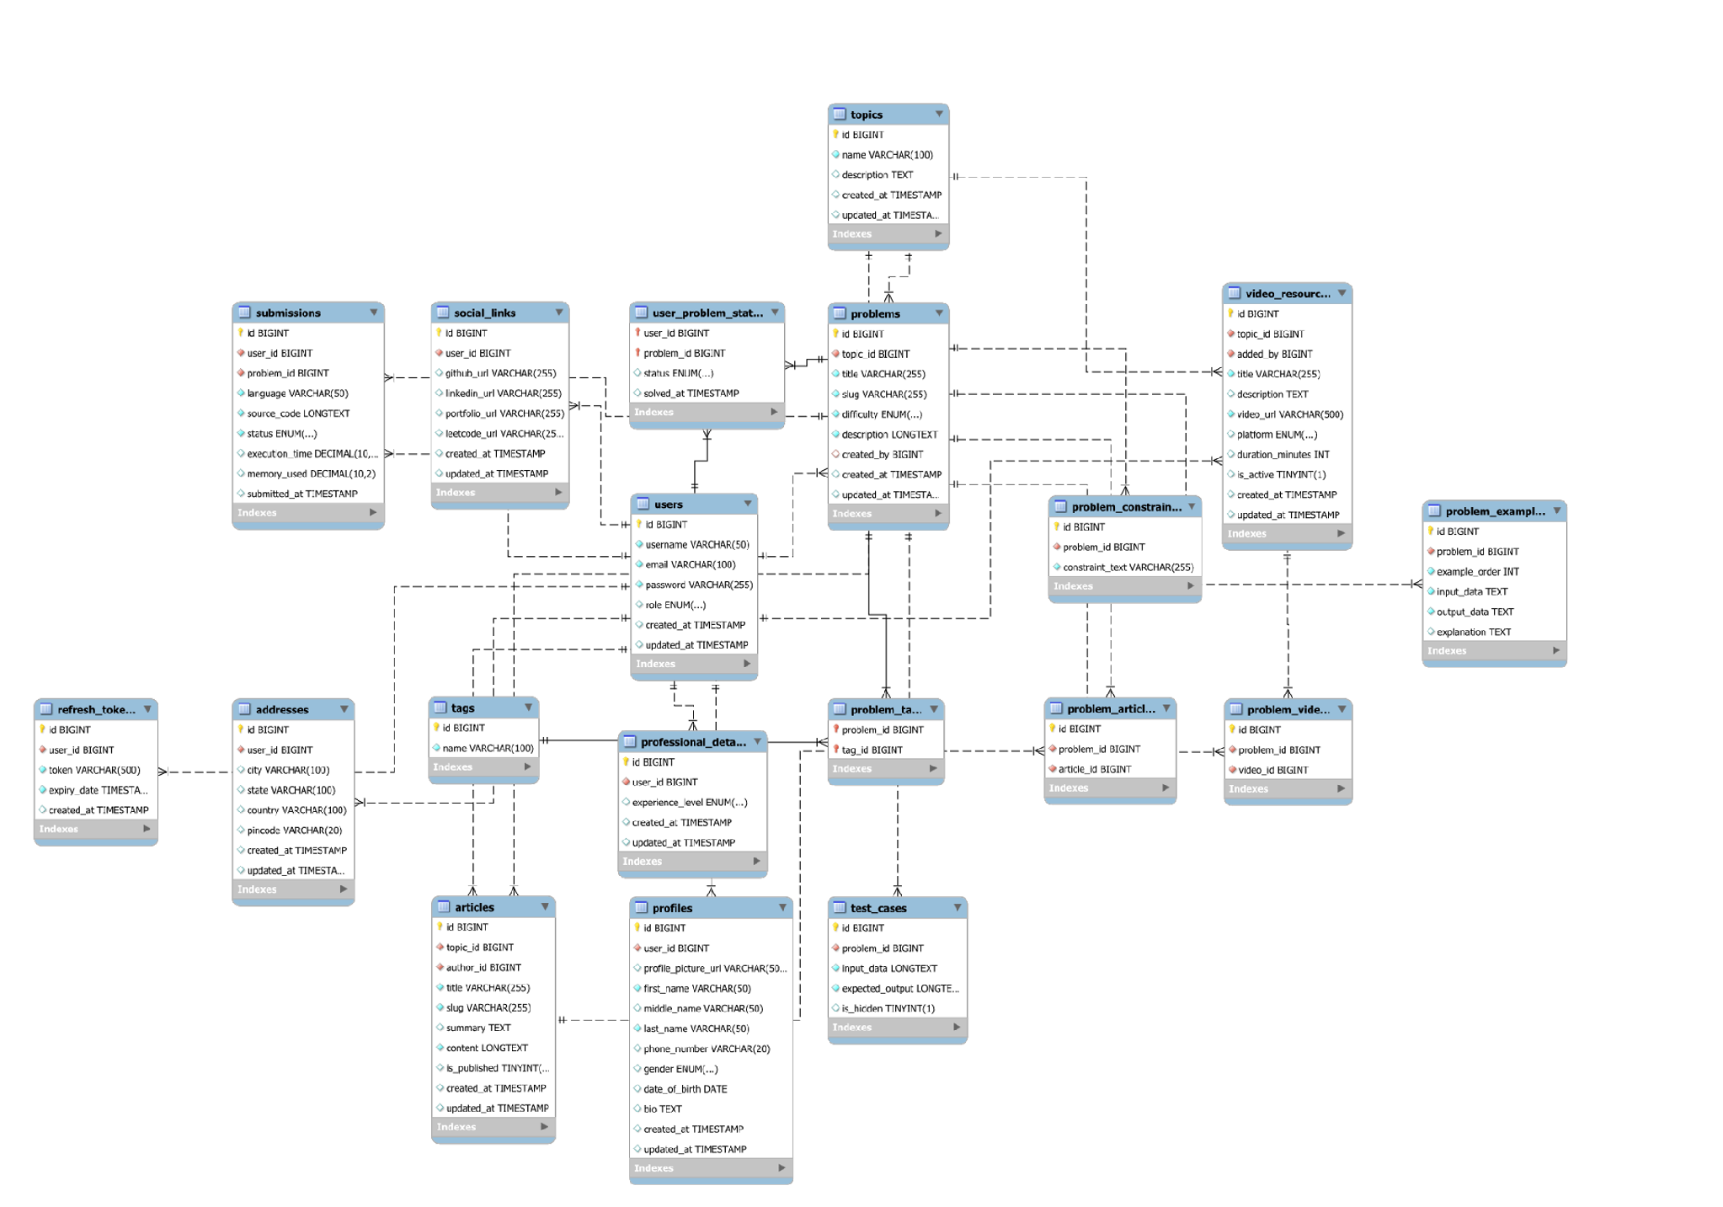
ER Diagram

Slide 5
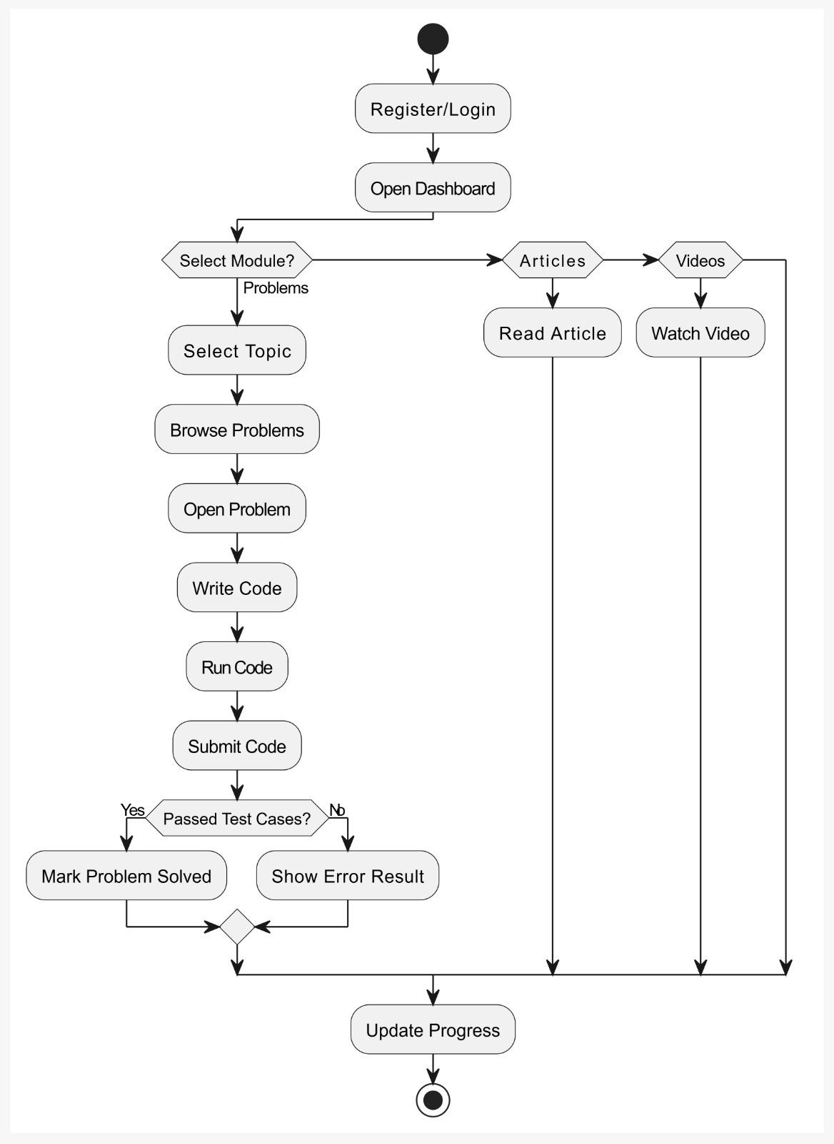
Flow Diagram

Slide 6
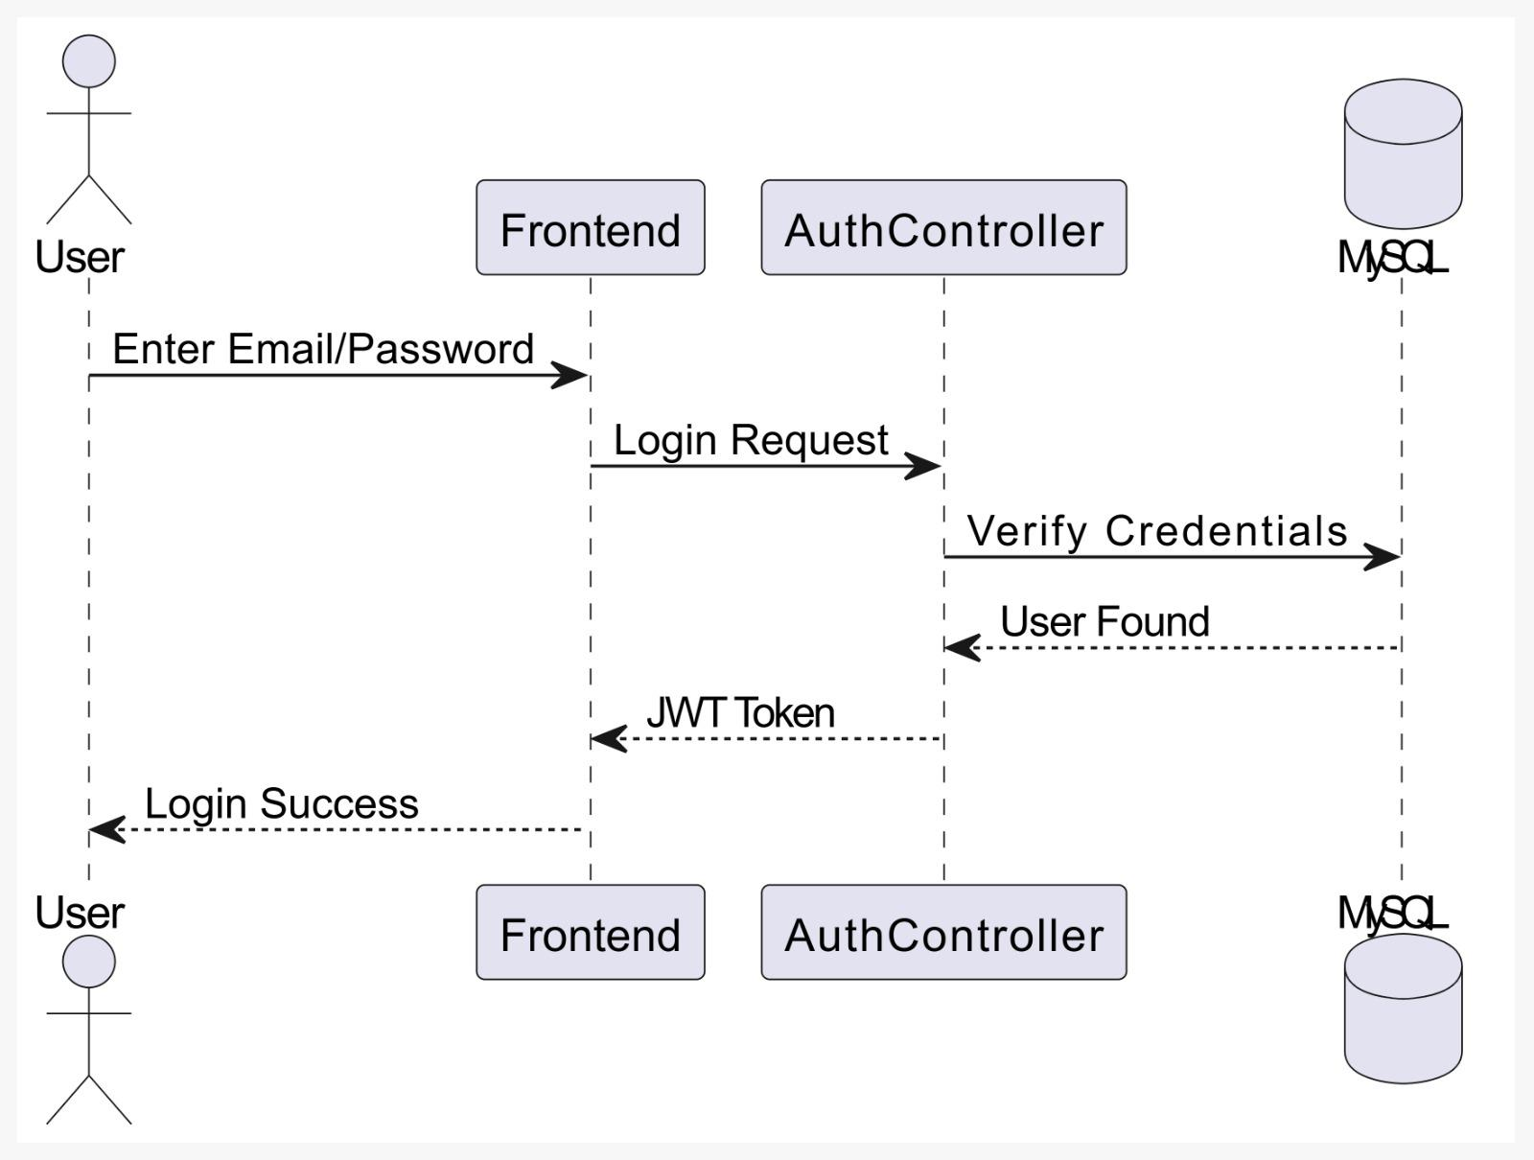
Sequence
Diagram
Login

Slide 7
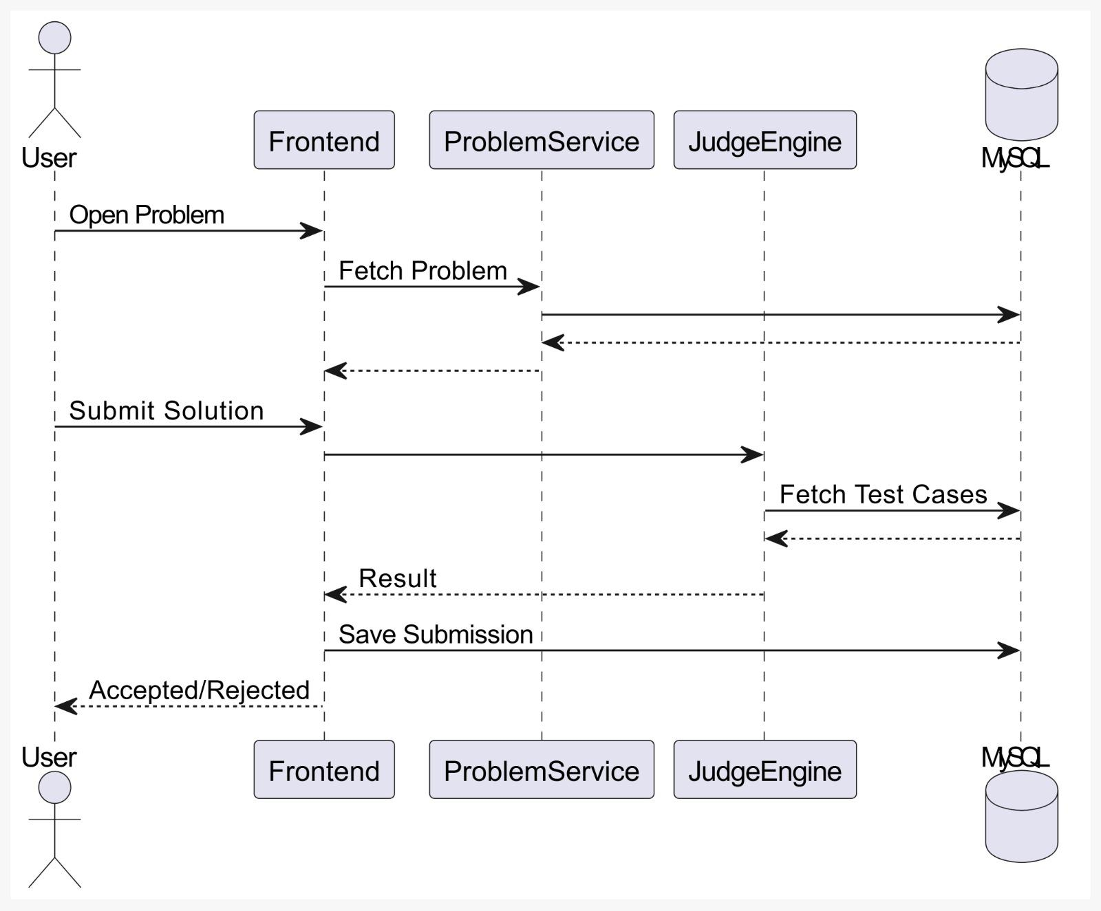
Sequence
Diagram
Problem Submission

Slide 8
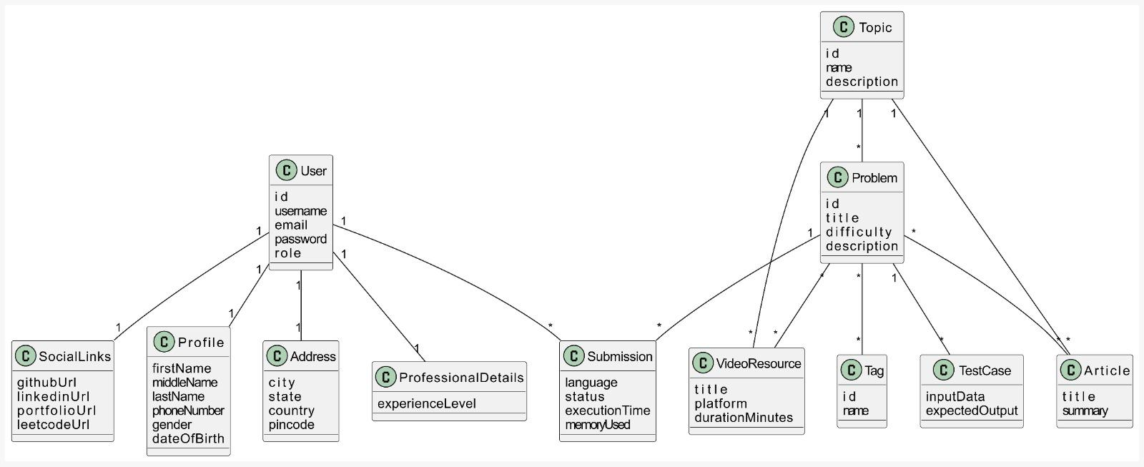
Class Diagram

Slide 9
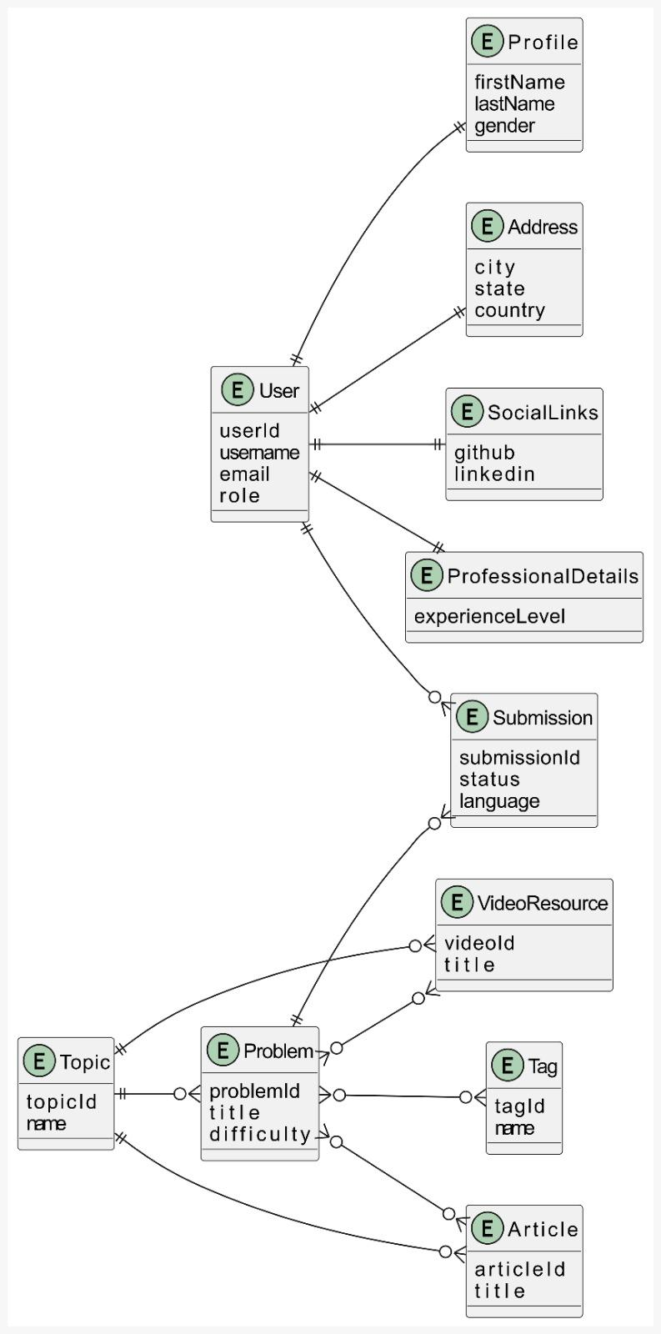
Entity Diagram

Slide 10
Technology Stack
React
Spring Boot + .Net
MySQL

Slide 11
Thank You!!!!!

