Slide 1
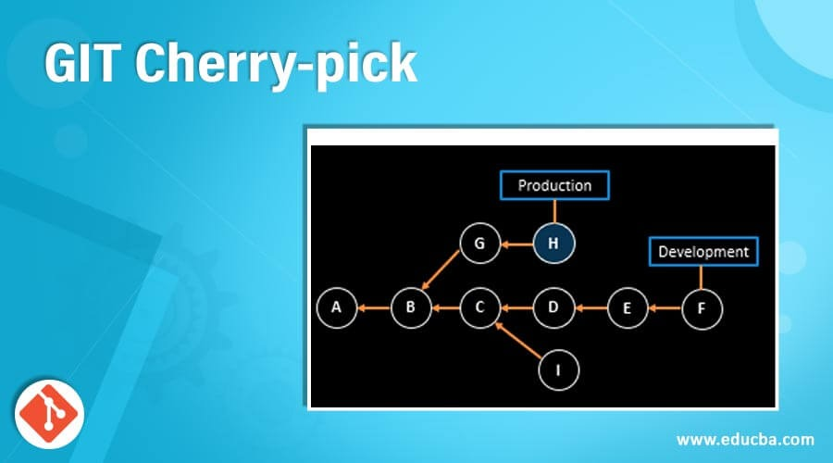
GIT Cherry-pick

Slide 2
Content
About GIT Cherry-Pick
Syntax Cherry-Pick
SEQUENCER SUBCOMMANDS
Usage of Cherry Pick
Description
Options
Examples

Slide 3

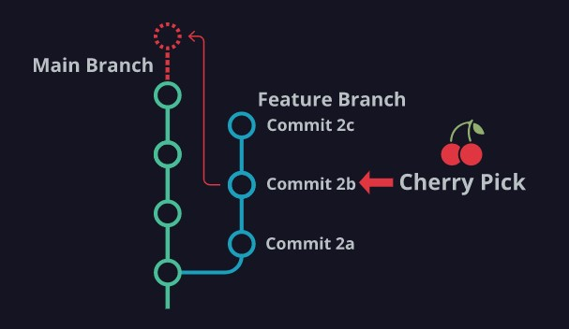
About GIT Cherry-Pick
Cherry-picking in Git stands for applying some commit from one branch into another branch. In case you made a mistake and committed a change into the wrong branch, but do not want to merge the whole branch. You can revert the commit and apply it on another branch.
The main motive of a cherry-pick is to apply the changes introduced by some existing commit. A cherry-pick looks at a previous commit in the repository history and update the changes that were part of that last commit to the current working tree. The definition is straight forward, yet it is more complicated when someone tries to cherry-pick a commit, or even cherry-pick from another branch.

Slide 4
Syntax
git cherry-pick <commit id>
git cherry-pick [--edit] [-n] [-m parent-number] [-s] [-x] [--ff]
[-S[<keyid>]] <commit>…​
git cherry-pick (--continue | --skip | --abort | --quit

Slide 5
SEQUENCER SUBCOMMANDS
--continue
Continue the operation in progress using the information in .git/sequencer. Can be used to continue after resolving conflicts in a failed cherry-pick or revert.
--skip
Skip the current commit and continue with the rest of the sequence.
--quit
Forget about the current operation in progress. Can be used to clear the sequencer state after a failed cherry-pick or revert.
--abort
Cancel the operation and return to the pre-sequence state.

Slide 6
Usage of cherry-pick
It is a handy tool for team collaboration.
It is necessary in case of bug fixing because bugs are fixed and tested in the development branch with their commits.
It is mostly used in undoing changes and restoring lost commits.
You can avoid useless conflicts by using git cherry-pick instead of other options.
It is a useful tool when a full branch merge is not possible due to incompatible versions in the various branches.
The git cherry-pick is used to access the changes introduced to a sub-branch, without changing the branch.

Slide 7
Description
Given one or more existing commits, apply the change each one introduces, recording a new commit for each. This requires your working tree to be clean (no modifications from the HEAD commit).
When it is not obvious how to apply a change, the following happens:
The current branch and HEAD pointer stay at the last commit successfully made.
The CHERRY_PICK_HEAD ref is set to point at the commit that introduced the change that is difficult to apply
Paths in which the change applied cleanly are updated both in the index file and in your working tree.
For conflicting paths, the index file records up to three versions, as described in the "TRUE MERGE" section of git-merge[1]. The working tree files will include a description of the conflict bracketed by the usual conflict markers <<<<<<< and >>>>>>>.
No other modifications are made.

Slide 8
--Options
<commit>…​
Commits to cherry-pick. For a more complete list of ways to spell commits, see gitrevisions[7]. Sets of commits can be passed but no traversal is done by default, as if the --no-walk option was specified, see git-rev-list[1]. Note that specifying a range will feed all <commit>…​ arguments to a single revision walk (see a later example that uses maint master..next).
-e | --edit
With this option, git cherry-pick will let you edit the commit message prior to committing.
--cleanup=<mode>
This option determines how the commit message will be cleaned up before being passed on to the commit machinery. See git-commit[1] for more details. In particular, if the <mode> is given a value of scissors, scissors will be appended to MERGE_MSG before being passed on in the case of a conflict.

Slide 9
Conti…
-x
When recording the commit, append a line that says "(cherry picked from commit …​)" to the original commit message in order to indicate which commit this change was cherry-picked from. This is done only for cherry picks without conflicts. Do not use this option if you are cherry-picking from your private branch because the information is useless to the recipient.
-r
It used to be that the command defaulted to do -x described above, and -r was to disable it. Now the default is not to do -x so this option is a no-op.
-m parent-number | --mainline parent-number
Usually you cannot cherry-pick a merge because you do not know which side of the merge should be considered the mainline. This option specifies the parent number (starting from 1) of the mainline and allows cherry-pick to replay the change relative to the specified parent.
-s
--signoff
Add a Signed-off-by trailer at the end of the commit message.

