Slide 1

PROJECT TITLE : SMART PARKING
ONE – LINE IDEA : “Smart Parking Slot Allocator: An intelligent DAA-based system that finds the right parking slot faster using Priority Queue, Binary Search, and Greedy algorithms.”
TEAM MEMBERS :
A.KAVERI – 25MVCSMR0096
B.AKSHITHA REDDY - 25MVCSMR0107
R.PRAVALLIKA - 25MVCSMR0168
V.MAYURI- 25MVCSMR0183
The problem domain of the above project is:
Smart Parking Management / Intelligent Transportation Systems (ITS)
It focuses on automating and optimizing parking slot allocation based on factors such as:
Vehicle size
Distance from the entrance
Slot availability
Priority of vehicles
Fast slot searching
In one line:
Problem Domain: Smart Parking Management using Data Structures and Design & Analysis of Algorithms (DAA).

Slide 2
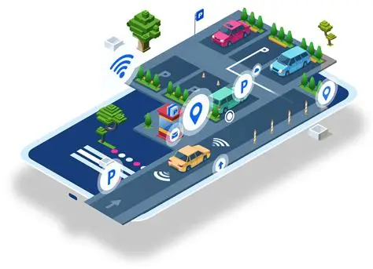
THE CHALLENGE
Real-World Problem
Drivers often spend significant time searching for available parking spaces.
Parking slots may not match the size of the vehicle.
The nearest or most suitable slot may be difficult to identify quickly.
Manual parking allocation can lead to inefficient use of available spaces.
Why It Matters
Reduces parking search time and unnecessary vehicle movement.
Makes better use of limited parking space.
Improves the overall parking experience and efficiency.
Helps prioritize vehicles and allocate suitable slots automatically.
Key Challenges Faced
Handling multiple vehicles and parking slots simultaneously.
Selecting slots based on size, distance, availability, and priority.
Finding suitable slots quickly as the number of slots increases.
Balancing fast searching with efficient allocation.
Updating the system whenever a slot becomes occupied or free.
“The challenge is to quickly and intelligently assign the most suitable available parking slot to each vehicle while considering size, distance, availability, and priority.”

Slide 3
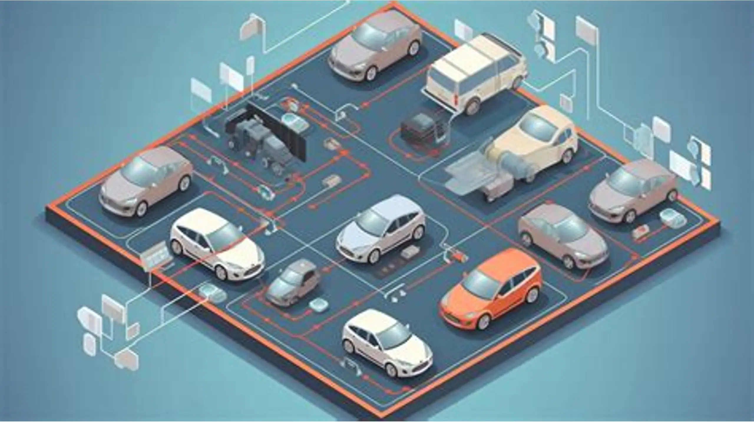
OUR INNOVATION
What Makes Our Solution Different
Core Idea
An algorithm-driven parking system that intelligently finds and allocates the most suitable parking slot based on multiple factors instead of simply choosing the first available slot.
Key Features
Vehicle-size matching – assigns slots suitable for the vehicle.
Distance-based selection – considers how close the slot is.
Availability tracking – identifies only currently free slots.
Priority handling – gives preference to high-priority vehicles.
Fast searching – uses Binary Search on sorted slot data.
Priority Queue – processes vehicles according to defined priority.
Greedy allocation – selects the best feasible slot at each step.
Decision visibility – displays why a particular slot was selected.
Unique Approach
Combines Priority Queue, Binary Search, and Greedy Strategy to make parking allocation faster, more organized, and explainable.
“Not just finding a parking slot — finding the right slot, for the right vehicle, at the right time.”

Slide 4
HOW IT WORKS
FLOW CHART:
START
↓
Enter Vehicle Details
↓
Check Available Slots
↓
Filter by Vehicle Size
↓
Priority Queue
↓
Binary Search
↓
Greedy Selection
↓
Best Slot Identified
↓
Assign Parking Slot
↓
Display Result
↓
END
USER JOURNEY:
Enter Vehicle Details
→ Size, priority, and entry location
2. System Checks Slots
→ Identifies available and suitable slots
3. Algorithms Process the Data
→ Priority Queue + Binary Search + Greedy
4. Best Slot is Selected
→ Based on size, distance, availability, and priority
5. User Gets the Result
→ “Slot A12 assigned – 25 m from entrance.”

Slide 5
TECHNOLOGY AND ALGORITHM
TECH STACK:
Component | Technology
Frontend | HTML, CSS, JavaScript
Backend / Logic | Python
Data Structures | Arrays/Lists, Priority Queue, Sorted Lists
Algorithms | Priority Queue, Binary Search, Greedy Strategy
Development Environment | VS Code
Main Algorithms
1. Priority Queue
Selects the vehicle with the highest priority first.
Useful when multiple vehicles are waiting for parking.
2. Binary Search
Searches sorted parking-slot data efficiently.
Quickly finds slots based on criteria such as distance or size.
3. Greedy Strategy
Selects the best currently available slot according to a defined rule.

Slide 6
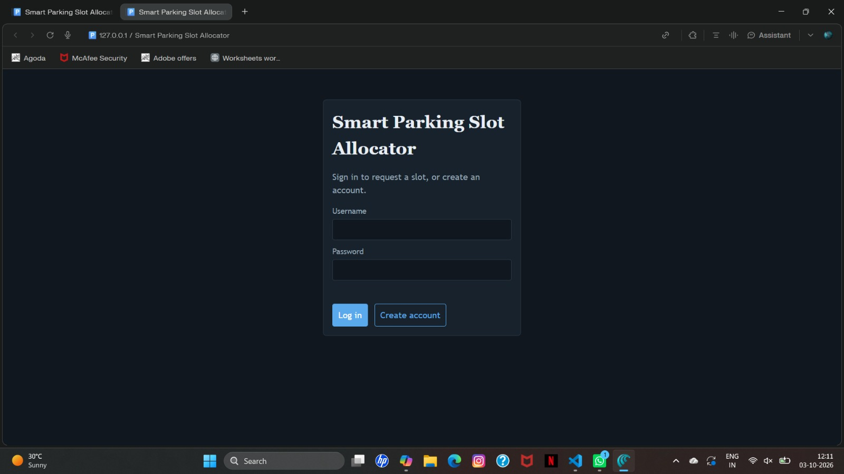
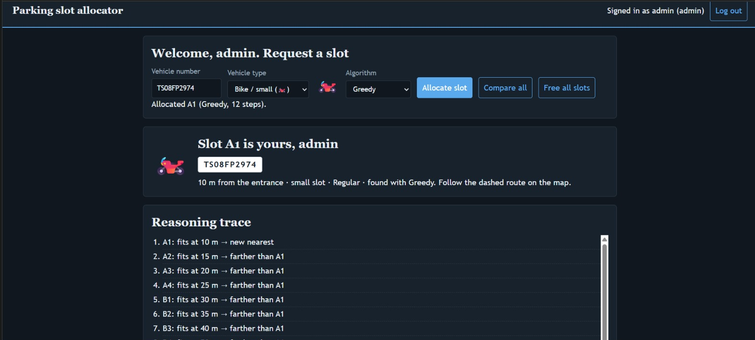
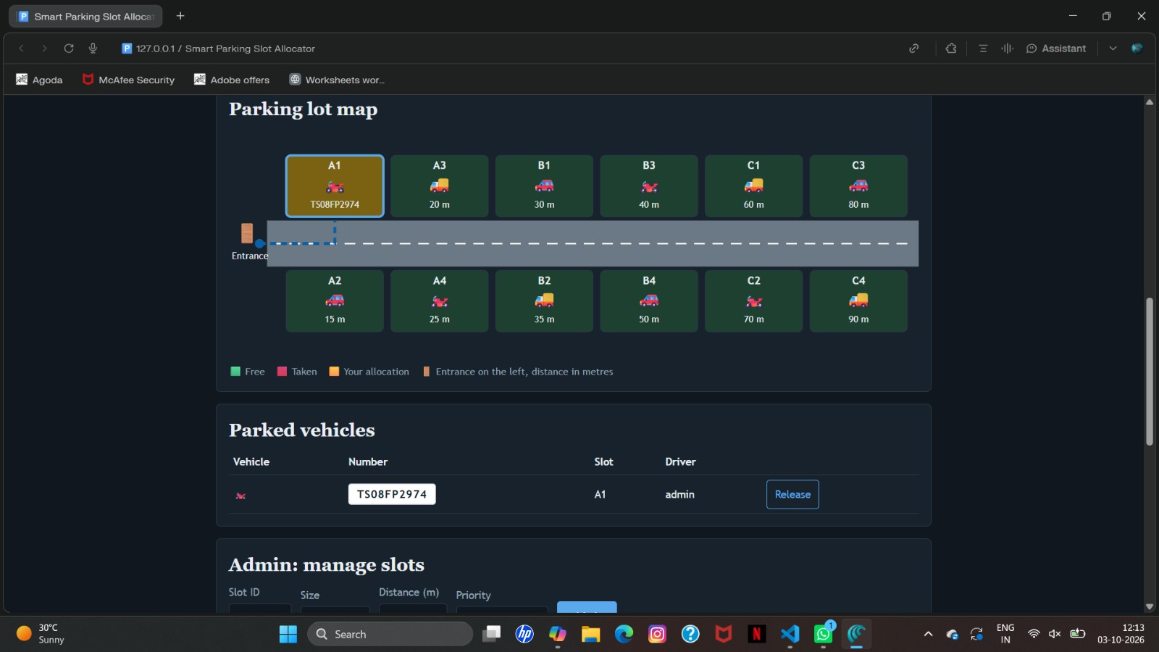
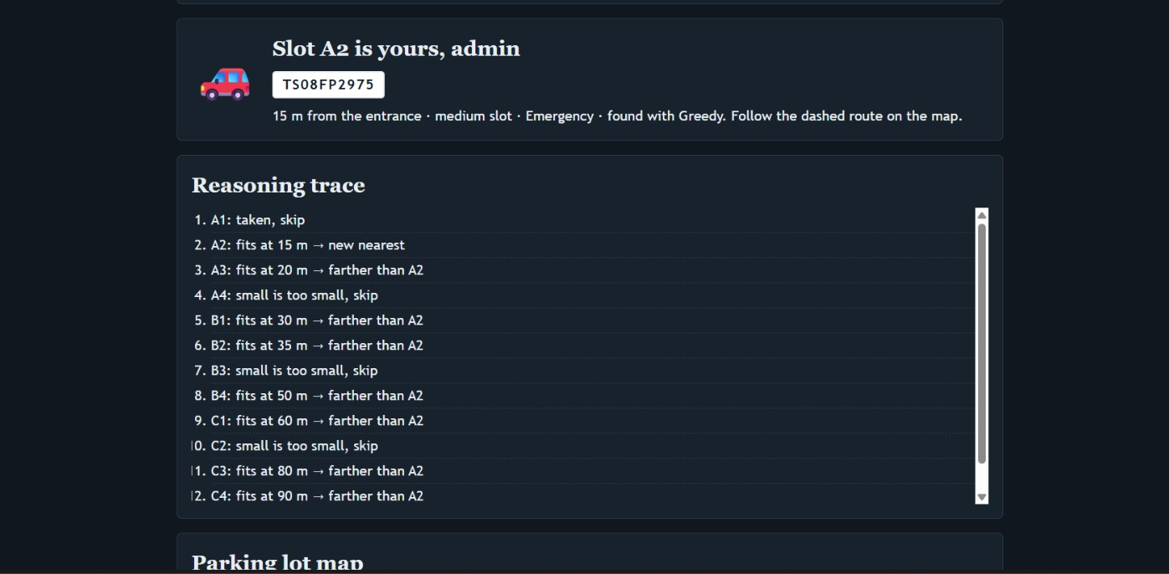
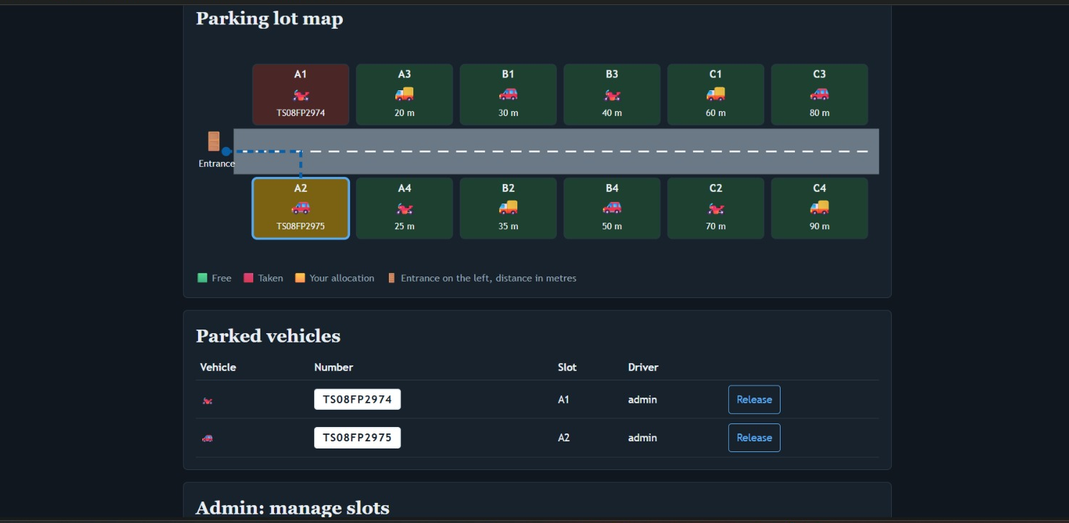
DEMO & IMPACT
LOGIN
BIKE SLOT ALLOCATION IN PROCESS
BIKE SLOT ALLOCATED
CAR SLOT ALLOCATION IN PROCESS
CAR SLOT ALLOCATED

Slide 7
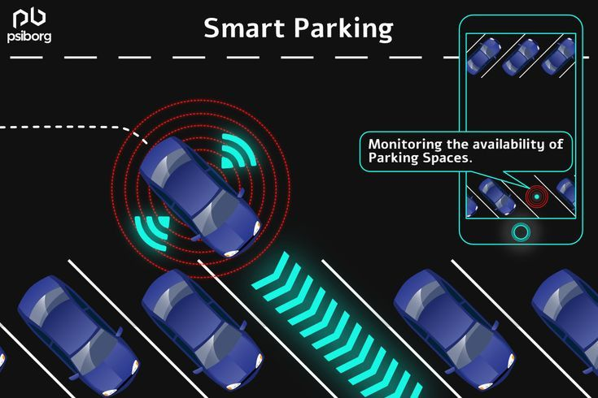
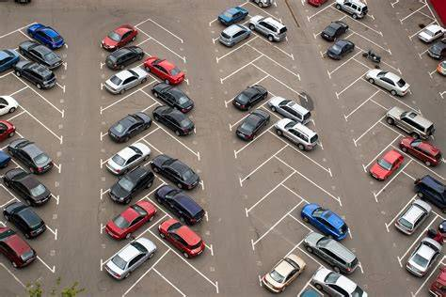
FUTURE VISION
Current Achievement
Successfully developed a smart parking slot allocation prototype.
Uses Priority Queue to handle vehicles based on priority.
Uses Binary Search for faster slot searching.
Uses a Greedy approach to select the nearest suitable slot.
Displays allocation decisions, search steps, and total parking distance.
Future Improvements
Add real-time parking availability using IoT sensors.
Integrate GPS and navigation for route guidance.
Support online parking reservations.
Add dynamic pricing based on demand and availability.
Use machine learning to predict parking demand..
Final Takeaway
Smart Parking Slot Allocator provides fast and systematic parking allocation.
Combines Priority Queue, Binary Search, and Greedy algorithms.
Reduces parking search time and improves slot utilization.
The approach can be expanded into a real-world intelligent parking system.

