Slide 1


Console App
Bank Operations
Mayuri Bajbalkar
Emp.Id 200613

Slide 2

CONTENT
01
Python and it’s Implementation
02
SCOPE OF PROJECT
03
Class Design 1
04
Class Design 2
05
Requirement Framing
06
Operating Environment
07
Summary of Application
Mayuri Bajbalkar
Emp.Id 200613

Slide 3


Python
Python and it’s Implementation
High-level programming language
Web, Software, Game Development
AI and ML
Mayuri Bajbalkar
Emp.Id 200613

Slide 4

SCOPE OF PROJECT
Banking operating system
Deposit Money
Withdraw Money
Fund Transfer
Balance Enquiry
Mayuri Bajbalkar
Emp.Id 200613

Slide 5
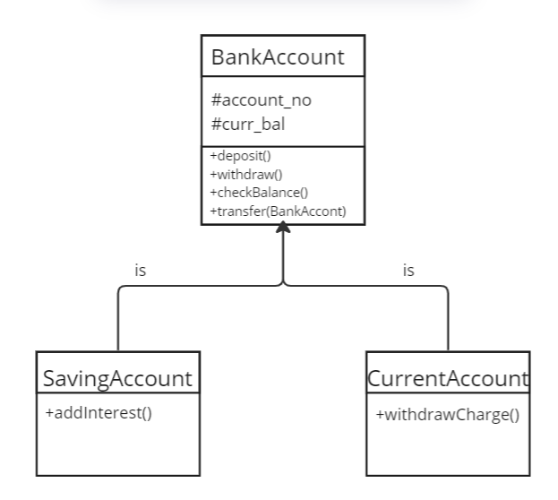
Class Design -Individual Classes
Mayuri Bajbalkar
Emp.Id 200613

Slide 6
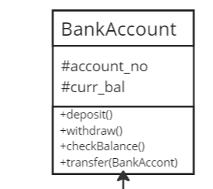
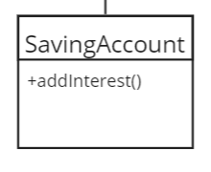
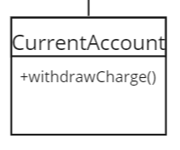

Class Design – On a Single Canvas
Mayuri Bajbalkar
Emp.Id 200613

Slide 7
Functional Requirements of App
Mayuri Bajbalkar
Emp.Id 200613

Slide 8
Requirement ID | Requirement CATEGORY | Requirement TYPE | PRIORITY | HIERARCHY | REF
R001 | FUNCTIONAL | STATED | HIGH
Requirement DESCRIPTION | Windows OS, Pycharm
SCOPE | Deposit money, Withdraw money, Transfer money from one account to another account
METHODOLOGICAL DETAILS of Requirement | The money should be consistent through out the process Deposited and withdraw money should be reflected in the corresponding account In code, the methods should have Single Responsibility each The methods should be reused
Mayuri Bajbalkar
Emp.Id 200613

Slide 9


OPERATING ENVIRONMENT
01
02
03
04
Windows Linux Mac Docker
Mayuri Bajbalkar
Emp.Id 200613

Slide 10
SUMMARY OF APPLICATION
OOP Concepts
Modularity
BankAccount
CurrentAccount
SavingAccount)
Single Responsibility
Mayuri Bajbalkar
Emp.Id 200613

Slide 11

THANK YOU
Mayuri Bajbalkar
By :
Mayuri Bajbalkar
Emp.Id 200613

