Slide 1
MetricMind
Month 1 Project Presentation
Governed Conversational Business Intelligence
1

Slide 2
The business problem
Unrestricted text-to-SQL can hallucinate joins and formulas
Different teams can receive different answers for the same KPI
Finance and sales need transparent, repeatable, governed metrics
2

Slide 3
The solution
Natural language is converted into a structured intent
Only approved metrics, dimensions, and filters are allowed
The UI exposes the semantic payload used to generate the answer
3

Slide 4
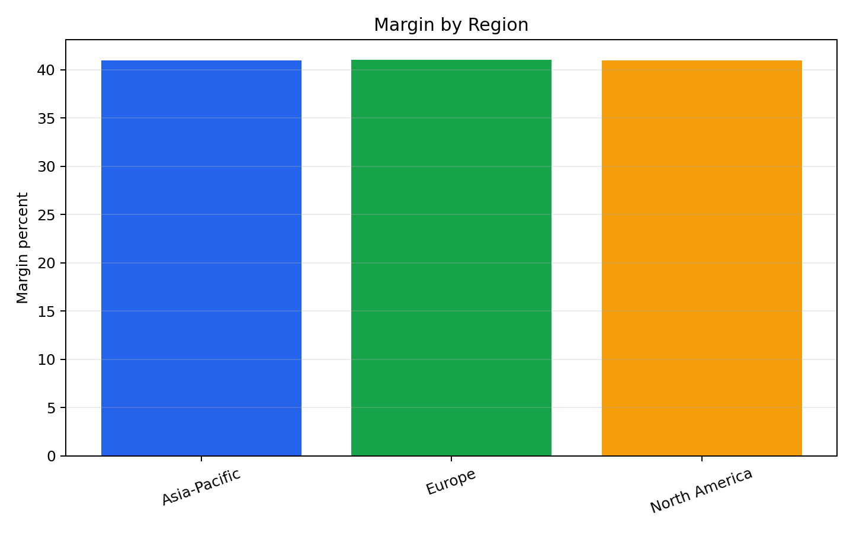
Architecture
Synthetic CSV data
YAML semantic layer
Deterministic intent parser
Python semantic query engine
Streamlit and Plotly interface
JSONL audit log and automated tests
4

Slide 5
Month 1 scope
Revenue, cost, profit, and margin metrics
Quarter, region, country, product, and channel dimensions
Summary KPI queries
Regional and country breakdowns
Margin root-cause analysis by cost driver
5

Slide 6
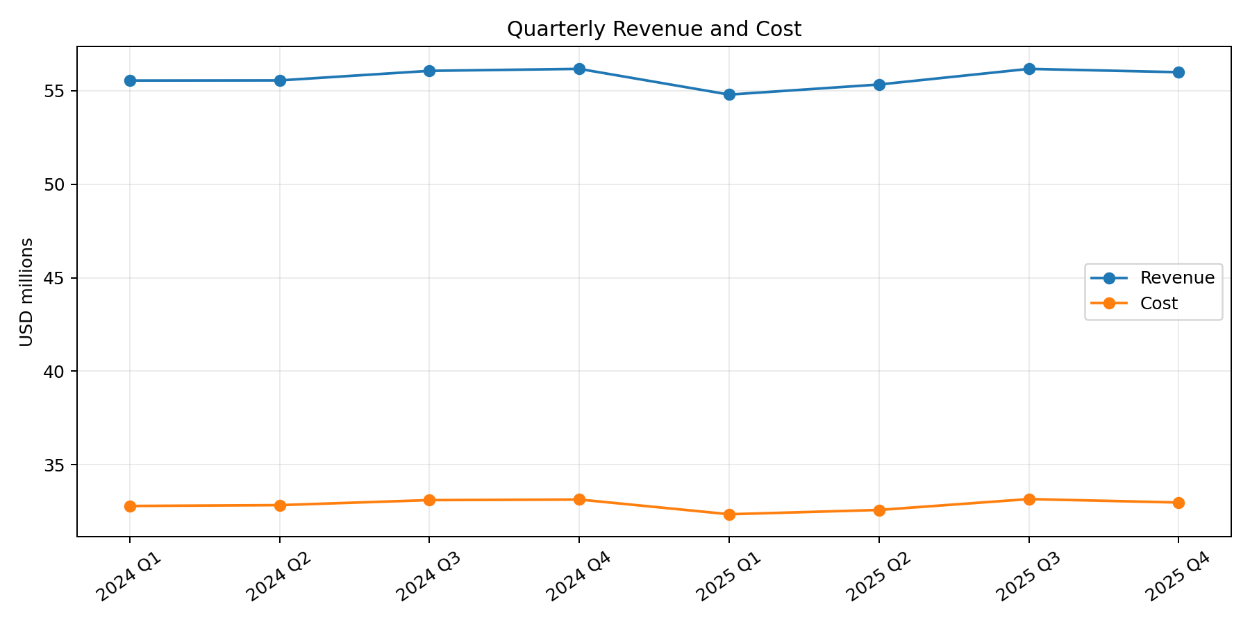
Data and results
24,123 synthetic daily sales records
$445,617,932 total revenue
$182,653,545 total profit
41.0% overall margin
6

Slide 7
Governance controls
Approved metric definitions in metrics.yml
Allowed filters and maximum row limit
No arbitrary SQL generation
Audit event written for every query
Repeatability verified with automated tests
7

Slide 8
Validation
3 automated tests passed
Repeated Q3 revenue queries return the same value
European country breakdown applies the correct region filter
Margin output is validated to remain between 0 and 1
8

Slide 9
Demo questions
Show Q3 2025 revenue
Show European sales by country
Why did European margins drop last quarter?
Compare revenue by region in Q4 2025
9

Slide 10
Roadmap
Month 2 — Cube or dbt Semantic Layer and FastAPI
Month 3 — LLM function calling with schema constraints
Month 4 — database audit store and user authentication
Month 5 — Docker deployment and production monitoring
10

Slide 11
Conclusion
MetricMind makes analytics more trustworthy by governing the metric layer first
The Month 1 MVP is reproducible, testable, and GitHub-ready
The architecture can grow into an enterprise conversational BI product
11

