Slide 1

Seasonal Agriculture Performance Data Analytics
Mayuri Sonawane JSPM Narhe Technical Campus
AICTE STU ID: STU6a6a3f875925b1785347975

Slide 2

PROBLEM STATEMENT
• Agricultural performance can vary across seasons because environmental conditions, farming practices, resource availability and economic conditions differ.
• This project analyzes farm-level agricultural records to identify seasonal differences in yield, production, profitability and resource usage.
• The analysis focuses on descriptive, univariate, bivariate and multivariate techniques to derive evidence-based insights.
• The objective is to support better understanding of seasonal performance without making unsupported causal claims.
2/14

Slide 3
PROJECT DESCRIPTION
• Dataset contains 4,000 farm-level records and 28 variables covering location, crop, season, environmental conditions, farming practices, production, economics and water use.
• Data preparation included structural checks, missing-value analysis, duplicate checks and numerical/categorical variable review.
• Missing values were identified in Rainfall, Soil Moisture and Yield; numerical missing values were treated using median imputation, leaving 0 remaining missing values.
• Seasonal comparisons were performed for yield, production, profit and water usage, followed by crop-season comparisons and multivariate exploration.
3/14

Slide 4

WHO ARE THE END USERS?
• Farmers and farm managers — to understand seasonal performance and resource-use patterns.
• Agricultural analysts — to compare crops, seasons and economic outcomes.
• Agricultural planners and researchers — to identify patterns that may guide further investigation.
• Students and data professionals — as an example of evidence-based agricultural data analysis.
4/14

Slide 5

TECHNOLOGY USED
• Python — core programming and analysis environment
• Pandas — data loading, cleaning, grouping and aggregation
• NumPy — numerical operations
• Matplotlib — data visualization
• Seaborn — statistical and categorical visualizations
• Analysis techniques — descriptive statistics, univariate, bivariate, multivariate and correlation analysis
5/14

Slide 6
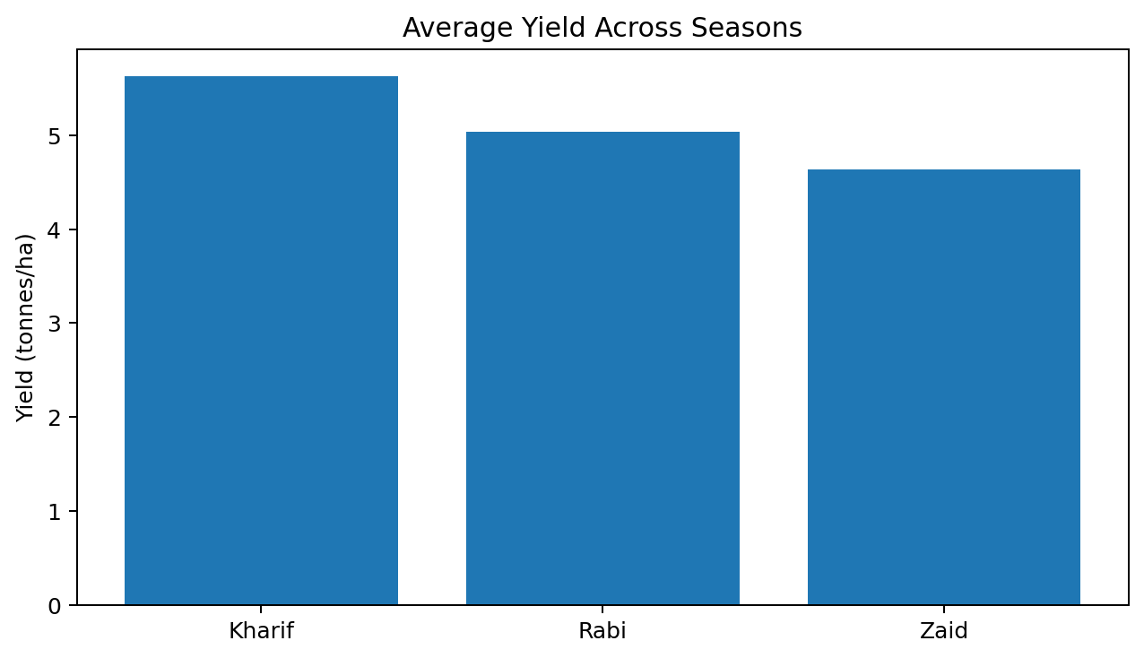
RESULTS
RECORDS
4,000
VARIABLES
28
DUPLICATES
0
MISSING AFTER CLEANING
0
Data Quality & Seasonal Overview
• Dataset contains 4,000 records across 28 variables.
• No duplicate rows were found.
• Missing values were present in Rainfall (48), Soil Moisture (40) and Yield (32).
• After numerical median imputation, remaining missing values were 0.
• Kharif has the largest number of records (1,779).
6/14

Slide 7
RESULTS
Seasonal Yield Comparison
Key finding
• Kharif has the highest average yield at 5.63 tonnes/ha.
• Rabi follows with 5.04 tonnes/ha.
• Zaid has the lowest average yield at 4.64 tonnes/ha.
• Total production is also highest in Kharif: 82,387.61 tonnes.
• These results describe observed seasonal differences; they do not by themselves establish causation.
7/14

Slide 8
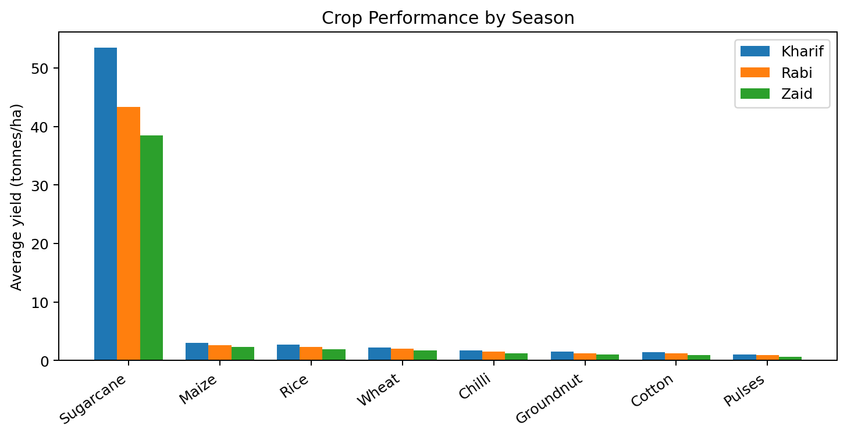
RESULTS
Crop Performance by Season
Key finding
• Sugarcane has the highest average yield in all three seasons.
• Sugarcane averages 53.46 tonnes/ha in Kharif, 43.29 in Rabi and 38.42 in Zaid.
• Among the remaining crops, Maize has the highest average yield in each season.
• Crop performance varies substantially by season and crop type.
8/14

Slide 9
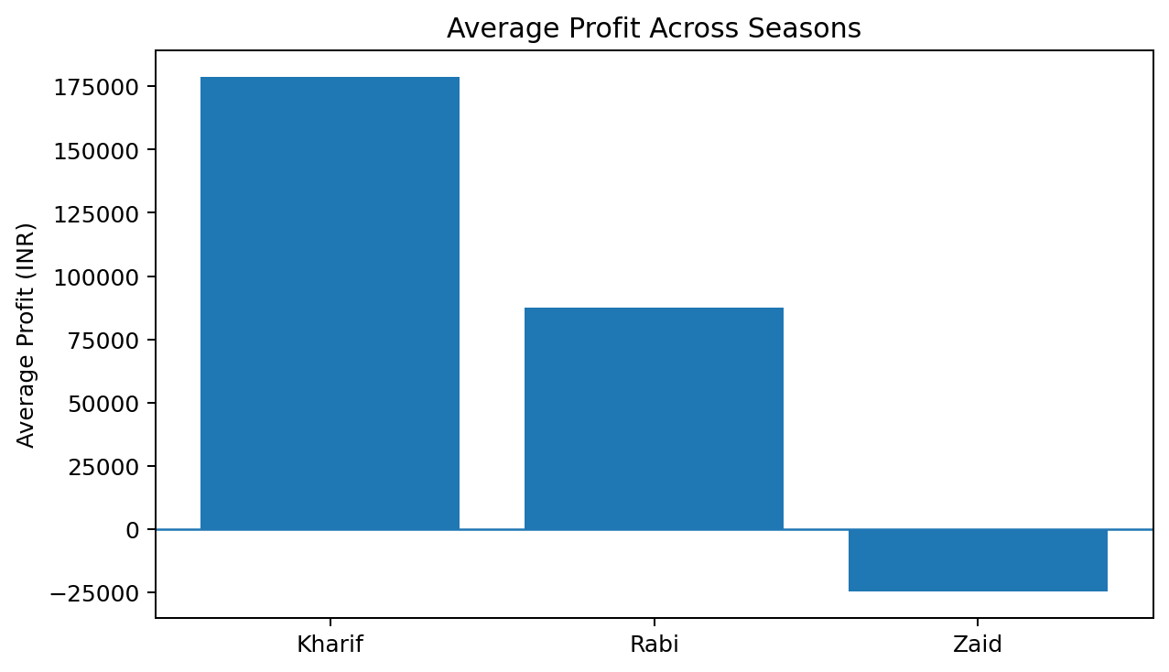
RESULTS
Profitability Analysis
• Kharif shows the highest average profit: INR 178,914.65.
• Rabi has an average profit of INR 87,689.47.
• Zaid records a negative average profit of INR -24,804.82.
• Total profit is positive for Kharif and Rabi, while Zaid shows a total loss of INR 14.73 million.
• Profitability varies strongly across seasons and should be interpreted alongside crop and cost differences.
9/14

Slide 10
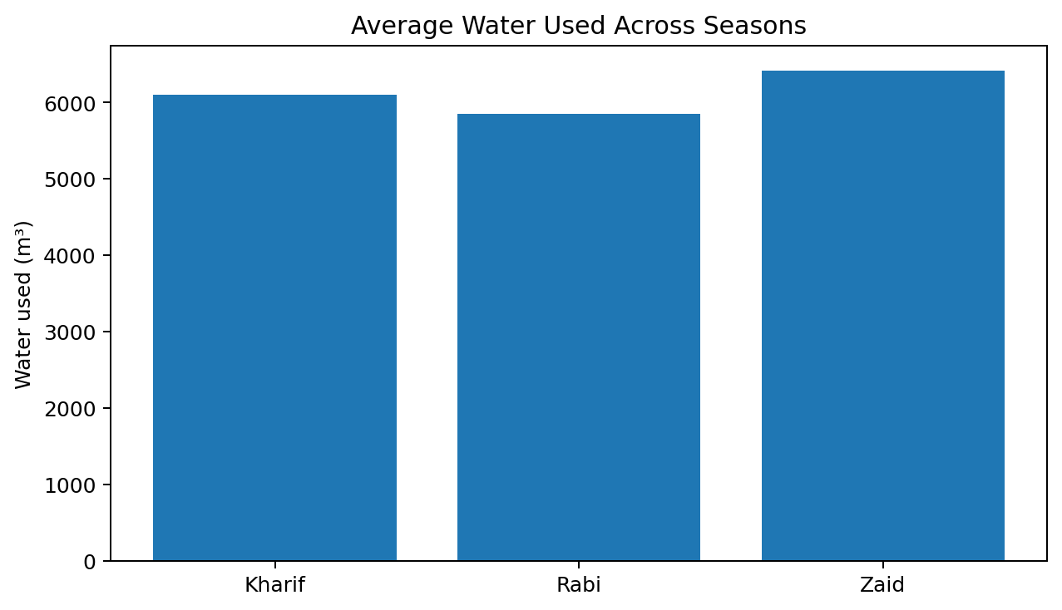
RESULTS
Resource & Efficiency View
• Average water use is highest in Zaid at 6,419.89 m³.
• Kharif averages 6,102.20 m³, while Rabi averages 5,846.99 m³.
• The notebook also evaluates water efficiency by crop and season.
• The combination of yield, profit and water-use measures provides a broader view of agricultural performance.
• Resource-use patterns should be investigated further at crop and irrigation-method level.
10/14

Slide 11
FUTURE SCOPE
• Extend the analysis with more years of real-world agricultural records.
• Add district-level and regional comparisons to identify localized patterns.
• Study crop-specific relationships between environmental conditions, inputs, yield and profitability.
• Analyze irrigation methods and water-efficiency patterns in greater detail.
• Develop an interactive dashboard in a future phase if required.
• Use predictive modelling in future work only after establishing a suitable validated dataset and modelling objective.
11/14

Slide 12
GITHUB REPOSITORY
Seasonal Agriculture Performance Data Analytics
Repository link: https://github.com/mayuri2256/Seasonal-Agriculture-Performance-Analysis
Recommended repository contents: • Seasonal Agriculture Performance Data Analytics.ipynb • Dataset CSV • Project PPT • README.md
12/14

Slide 13

VOIS COURSE COMPLETION CERTIFICATE
Course: Data Visualization
13/14

Slide 14
THANK YOU
.
.

