Slide 1
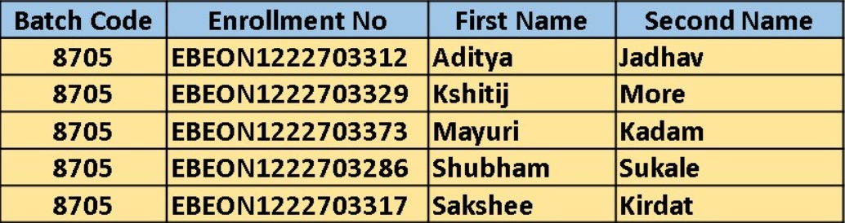
Grocery Delivery Application
Team Leader: Aditya Jadhav
Enrollment No. : EBEON1222703312
Guided by
Varadharajan sir

Slide 2
Grocery Delivery Application
Login Module
Admin Module
Home Page
Add to cart/ Order module
View Products module
Payment module
Stock Management Module
About us, Contact us

Slide 3
Module 1
1)Stock Management Module:
Stock maintenance is a process of managing and optimizing the inventory of goods and products . The stock management system includes different modules and features for adding, editing, viewing, and deleting items in the system database.
It can be used by any small to mid-sized stores to easily maintain and manage an inventory of all their-
Products
Customers
Suppliers
Users
Transactions
Supports two user types:
Administrator
Employee

Slide 4
Module 1
1)Stock Management Module:
Login Page :
The login page takes in the credentials entered by the user and verifies with the database.
Products :
The products section allows the user to add, edit and delete products from the store's .
Current Stock :
The current stock section allows the user to check the availability of every item.
Suppliers :
Here, the user can manage and manipulate the record of all the suppliers associated with the store.
Customers :
Allows user to add new customers or update/delete existing customers in the database.

Slide 5
Module 1
1)Stock Management Module:
Sales :
This section is where users can sell a product and manage all the sales transactions. The user only needs to enter the customer and product code and the software will handle the rest, showing all the necessary details like available stock and selling price of the product.
Purchase :
This section is where users can view purchase logs and enter new purchase transactions. Similar to the sales section, this section only requires the user to enter the product code and the details that are already available in the database will immediately be displayed in the respective spaces.
Users :
This section is only available to ADMINISTRATORS. It allows them to view, add and delete any users.
User Logs :
Stores and shows the administrator a log of all the users that have previously logged in, including their login time and logout time.

Slide 6
Module 2
2) Contact us :
Contact form: A form that allows users to submit their queries, feedback, or complaints. It usually includes fields for name, email address, subject, and message.
Map: If the Grocery Shop has a physical address, a map can be included to show the location and help users find the location easily.
Support options: support options such as phone support, email support, this can be listed on the page to help users choose the most suitable option for their needs.

Slide 7
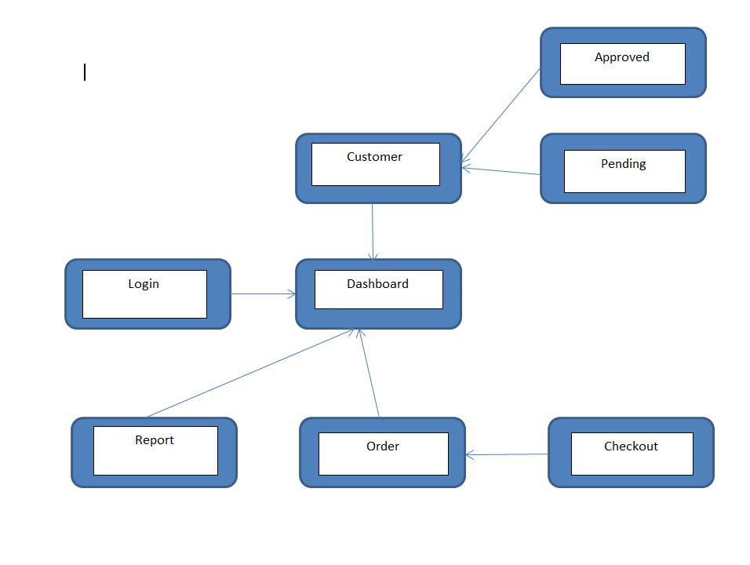
Project overview

Slide 8
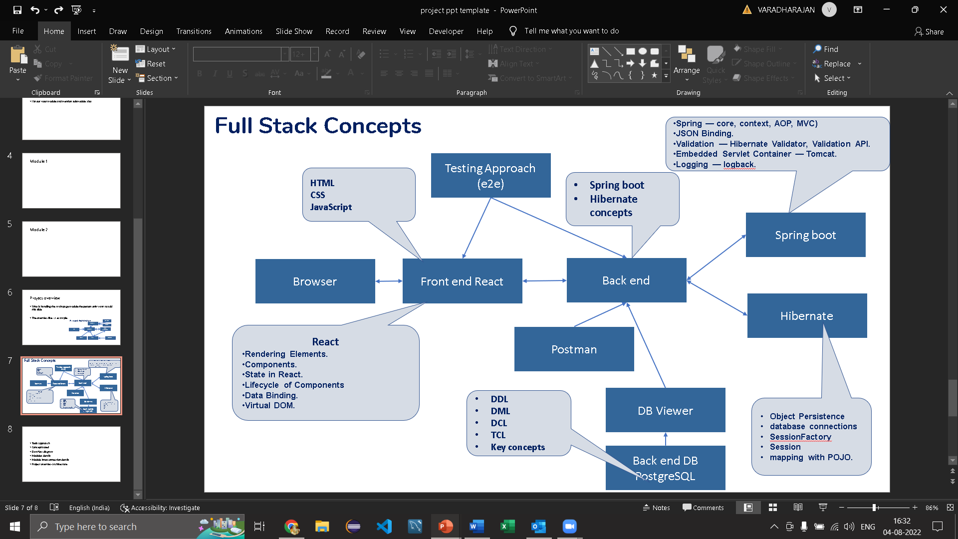
Tech architecture

Slide 9
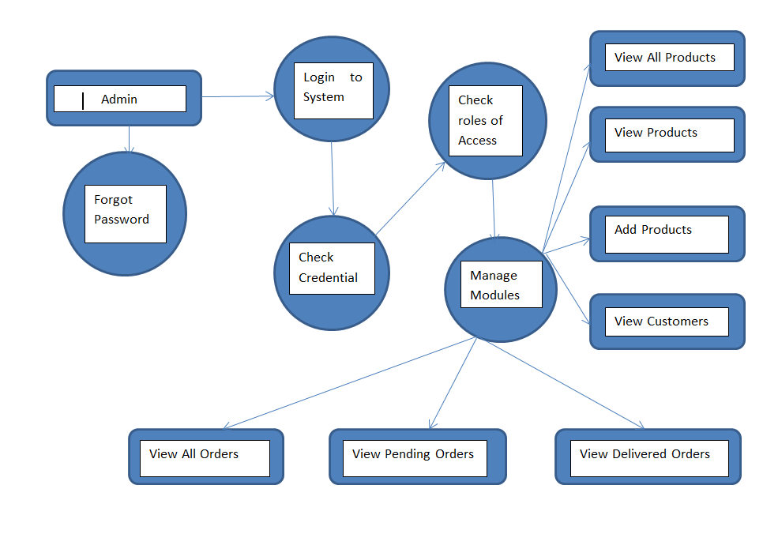
Dataflow diagram

Slide 10
Challenging issues
1) While running project port no. problem
2) wrong dependencies added
3) Changes made in code are not reflected into live project

Slide 11
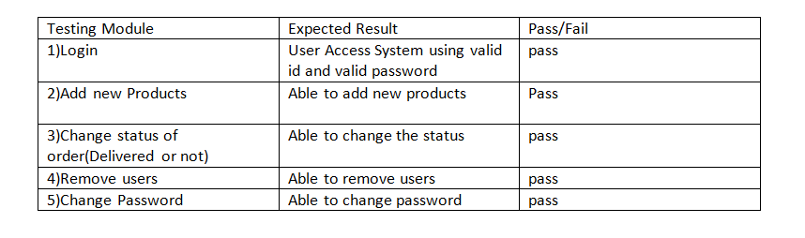
Testing

Slide 12
Future enhancement
Integration with virtual assistants: Integrate the website with virtual assistants like Google Assistant or Amazon Alexa, enabling customers to easily place orders through voice commands.
Smart recommendations: Utilizing data analytics and machine learning techniques to suggest products based on customer’s buying history, browsing history and preferences
Live customer support: Offering live chat support and personalized customer service to ensure customer satisfaction and resolve any issues that may arise.

Slide 13
Conclusion
Online grocery delivery websites are becoming increasingly popular due to their convenience and time-saving features.
This project is made in such a way that it is easy to use/ handle for new users
Person with little technical knowledge can also use/ interact with this project

