Slide 1

GlobeTrotter
Personalized Travel Planning
Team Code Crackers · Dalal Mayuri · Gupta Anshu · Gohil Twinkle
Notes:
1

Slide 2

Introduction
Personalized Planning
Multi-City Trips
All-in-One Hub
A travel platform built around your preferences and travel style.
Plan and manage complex, multi-destination journeys seamlessly.
Destinations, activities, dates, and budget — all in one place.
Notes:
2

Slide 3

Problem Statement
Complex to Plan
Multi-city trip planning is time-consuming and mentally overwhelming.
Hard to Track
Managing dates, activities, and expenses across stops is a constant challenge.
No Central Platform
Travelers need one organized, centralized tool — but none exists today.
Notes:
3

Slide 4

Objectives
Custom Trips
Manage Activities
Budget Tracking
Create fully customized multi-city travel plans.
Organize destinations and activities with efficiency.
Estimate and monitor travel expenses in real time.
Visualize Itinerary
Share & Inspire
See your journey through timeline and calendar views.
Share travel plans with friends and the community.
Notes:
4

Slide 5


PLATFORM OVERVIEW
Main Features
1
Login / Signup
Secure user authentication for your account.
2
Dashboard
Central hub for trips, updates, and travel inspiration.
3
Itinerary Builder
Add cities, dates, and activities with ease.
4
City & Activity Search
Discover destinations and unique experiences worldwide.
Notes:
5

Slide 6
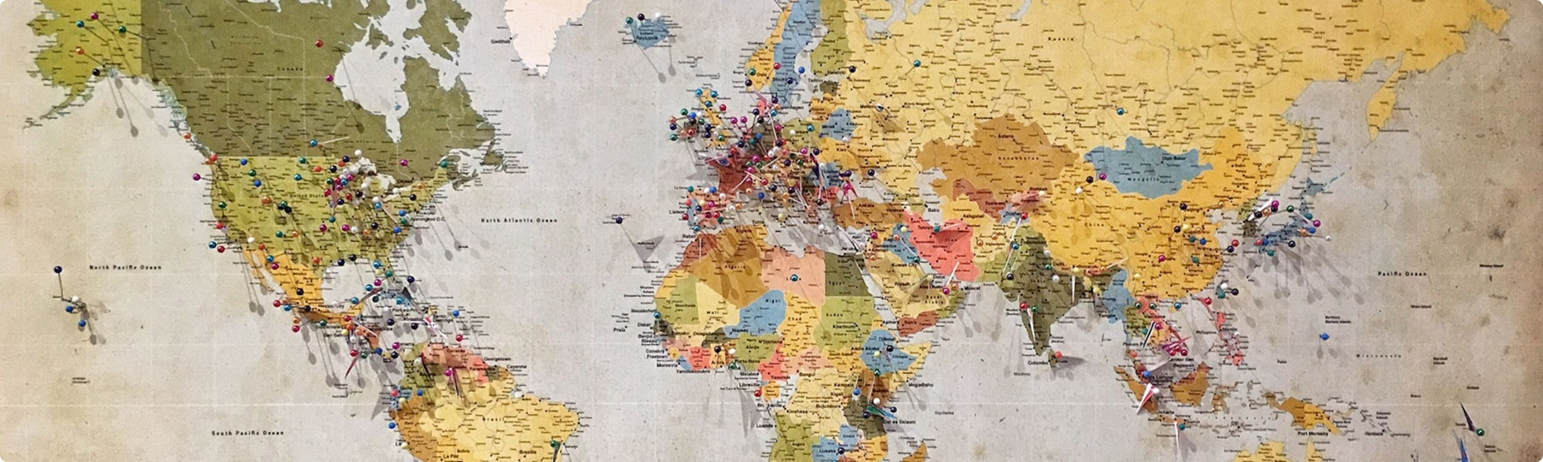
Trip Planning
Add Cities
Set Dates
Build your multi-city route stop by stop.
Select travel dates for each destination.
Plan Activities
Reorder & Adjust
Add experiences and create day-wise timelines.
Rearrange stops and fine-tune dates any time.
Notes:
6

Slide 7

Budget & Calendar
Track transport, stay, activities, and meal costs
View estimated total budget breakdown at a glance
Calculate average daily cost per destination
Visualize your journey with calendar and timeline views
Smart budgeting means fewer surprises — and more adventures.
Notes:
7

Slide 8

Sharing & Profile
🔗 Public Links
👥 Share with Friends
Generate shareable itinerary links for anyone to view.
Send trip plans to friends and family in an instant.
📋 Copy Trip
👤 User Profile
Clone any public itinerary as inspiration for your own journey.
Manage your account with customizable personal settings.
Notes:
8

Slide 9
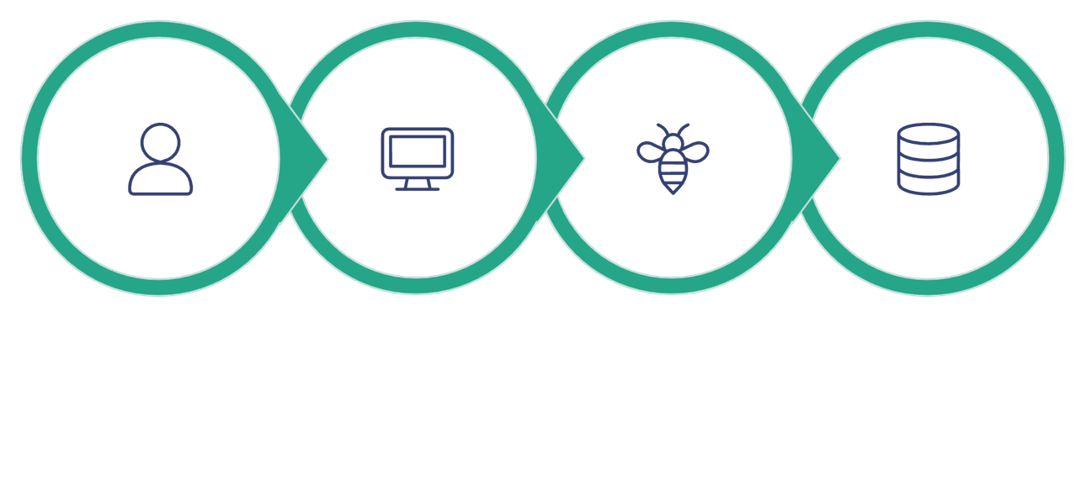
Technology & Architecture
Frontend
HTML · CSS · JavaScript
Backend
Node.js — robust server-side logic
User Request
Frontend UI
API Processing
Backend DB
Database
Relational Database for structured data storage
A clean, layered architecture ensures fast performance, scalable data handling, and a smooth experience from first click to final itinerary.
Notes:
9

Slide 10

Conclusion
Easy Multi-City Planning
Personalized Organization
Powerful trip building at your fingertips, no matter how complex your route.
Every itinerary tailored to your travel style and preferences.
Smart Budget & Timeline
Collaborative Sharing
Visual tools for smarter decisions before and during your journey.
Share, inspire, and explore together with friends and the community.
THANK YOU · Team Code Crackers
Notes:
10

