Slide 1
Customer Engagement & Product Utilization Analytics for Retention Strategy
Submitted By: Mayuri Gunjal
Unified Mentor | The European Central Bank
June 2026
Customer Engagement & Product Utilization Analytics

Slide 2
Project Overview
• Analyze customer engagement and product utilization.
• Identify retention drivers and high-risk customers.
• Support data-driven customer retention strategies.
Customer Engagement & Product Utilization Analytics

Slide 3
Problem Statement
• Banks lack engagement-driven retention insights.
• Generic retention strategies increase churn risk.
• High-value customers may silently churn.
Customer Engagement & Product Utilization Analytics

Slide 4
Project Objectives
• Evaluate engagement and churn relationship.
• Measure product utilization impact.
• Identify at-risk premium customers.
Customer Engagement & Product Utilization Analytics

Slide 5
Dataset Description
European Bank Customer Dataset
10,000 customer records and 14 variables.
Customer Engagement & Product Utilization Analytics

Slide 6
Analytical Methodology
• Data Validation
• Exploratory Data Analysis (EDA)
• Customer Segmentation
• KPI Development
• Dashboard Development
Customer Engagement & Product Utilization Analytics

Slide 7
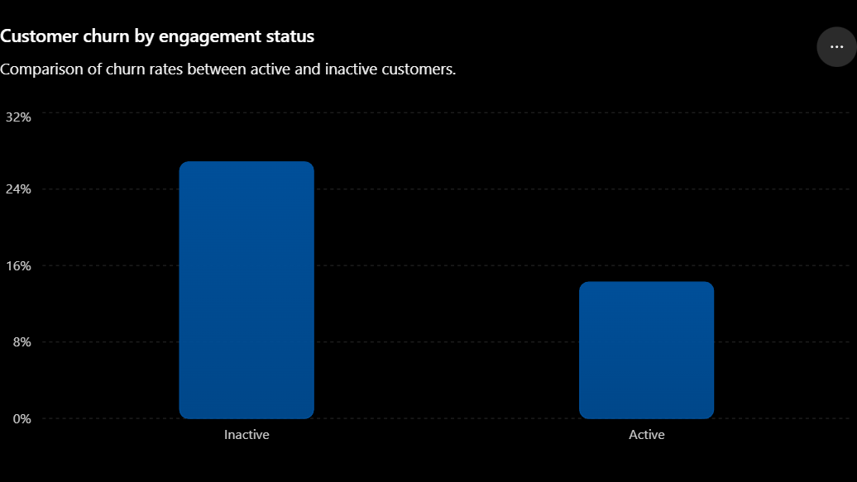
Customer Engagement Analysis
Active Customer Churn Rate: 14.27%
Inactive Customer Churn Rate: 26.85%
Customer Engagement & Product Utilization Analytics

Slide 8
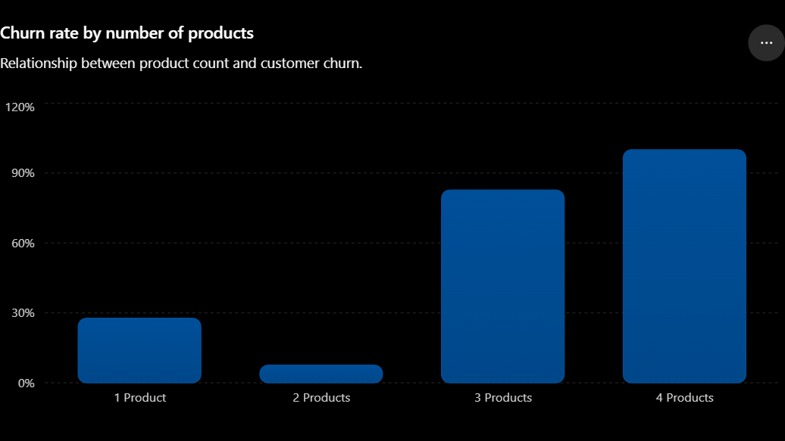
Product Utilization Analysis
Product 1 : 28% churn
Products2 : 8% churn
Products3 : 83% churn
Products4 : 100% churn
Customer Engagement & Product Utilization Analytics

Slide 9
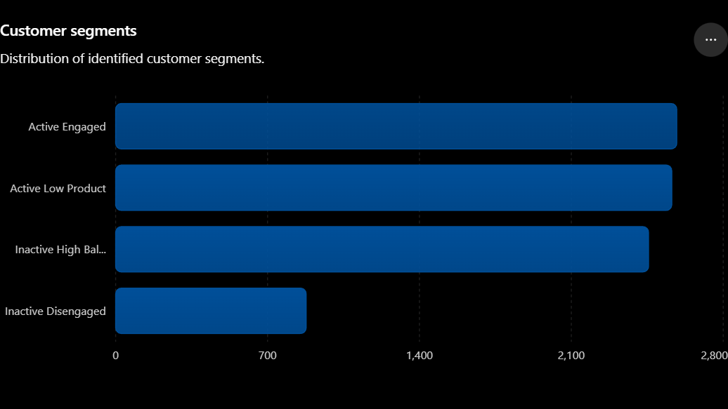
Key Performance Indicators
• Engagement Retention Ratio
• Product Depth Index
• Credit Card Stickiness Score
• Relationship Strength Index
Customer Engagement & Product Utilization Analytics

Slide 10
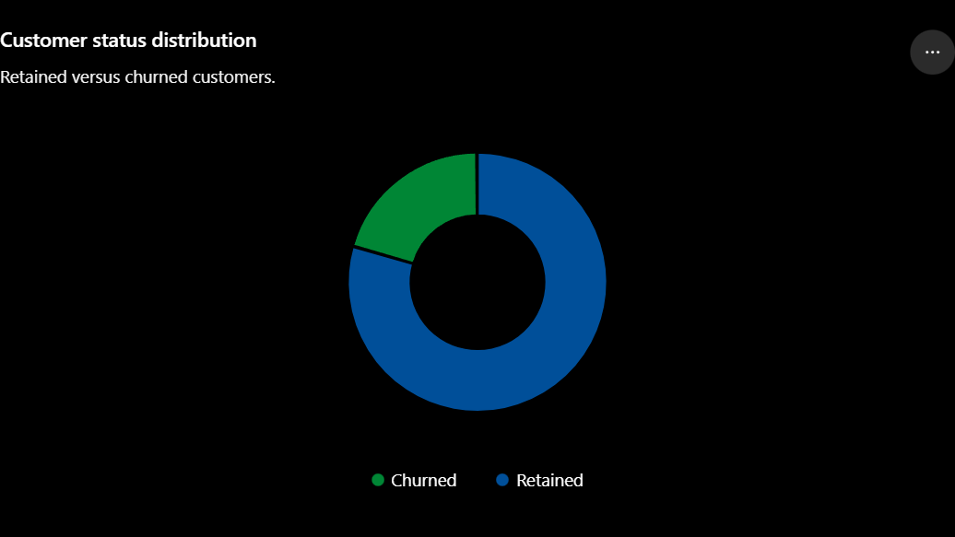
Customer Segmentation
• Active Engaged Customers: 2,588
• Active Low Product Customers: 2,563
• Inactive High Balance Customers: 2,456
• Inactive Disengaged Customers: 878
Customer Engagement & Product Utilization Analytics

Slide 11
Key Findings
• Customer engagement strongly impacts retention.
• High balance does not guarantee loyalty.
• Product depth significantly influences churn.
Customer Engagement & Product Utilization Analytics

Slide 12
Recommendations
• Increase engagement initiatives.
• Target inactive premium customers.
• Improve cross-selling strategies.
• Personalize retention campaigns.
Customer Engagement & Product Utilization Analytics

Slide 13
Conclusion
Behavioral analytics and product utilization provide strong indicators of customer retention and long-term loyalty.
Customer Engagement & Product Utilization Analytics

Slide 14
Thank You
Questions & Discussion
Customer Engagement & Product Utilization Analytics

