Slide 1
DengAI: Visualizing Disease Spread

Slide 2
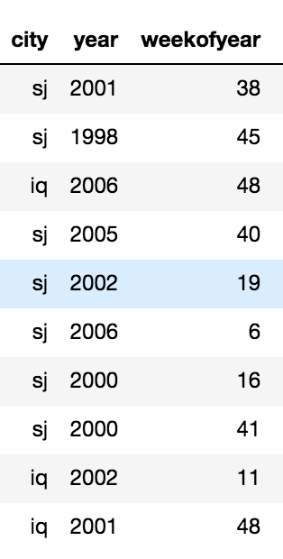
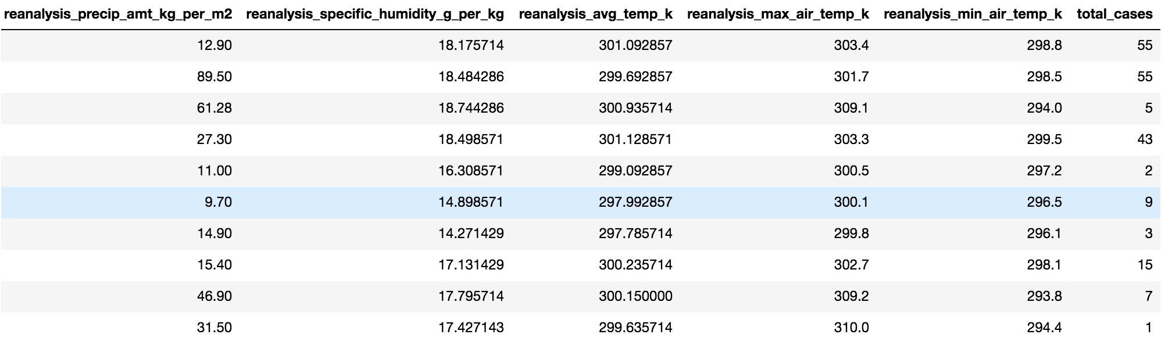

Data set Description:
Meta Data:
city – Two cities namely sanjuan and Iquitos
year- Years from 1998 to 2006
weekofyear – 52 weeks per year
reanalysis_precip_amt_kg_per_m2- precipitation amount
reanalysis_specific_humidity_g_per_kg- humidity amount
reanalysis_avg_temp_k. - average air temperature
reanalysis_max_air_temp_k- Max air temperature
reanalysis_min_air_temp_k- Min air temperature
total_cases- Total cases recorder per every week.
How?
The data has taken from drivenData.org, it was released as a part of their competition DengAI .
Why?
An understanding of the relationship between climate and dengue dynamics can improve research initiatives and resource allocation to help fight life-threatening pandemics.

Slide 3

questions??
Can you predict the number of dengue fever cases reported each week in each city cities for the given years based on environmental variables describing changes in temperature, precipitation and humidity?
Input : city,year,weeks and environmental variables (columns mentioned in previous slide)
Output : Predicted total cases and mean absolute error metric

Slide 4
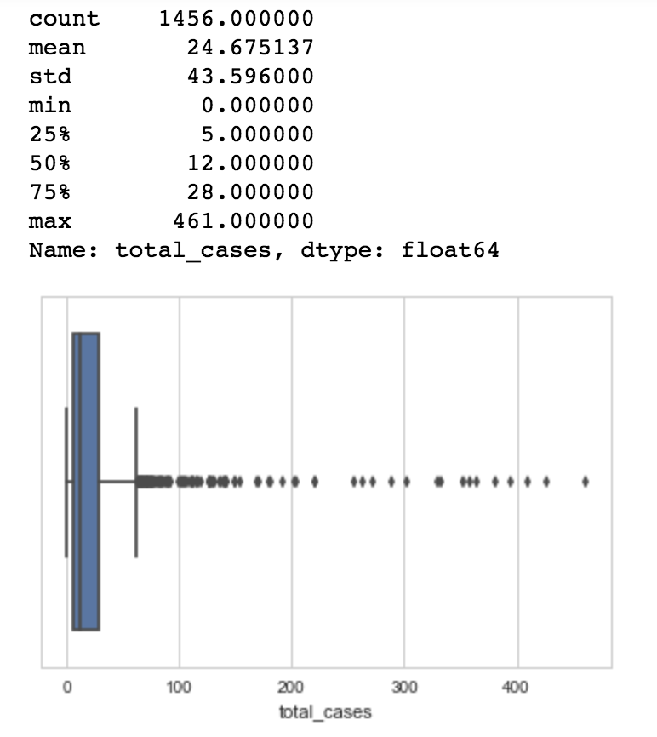
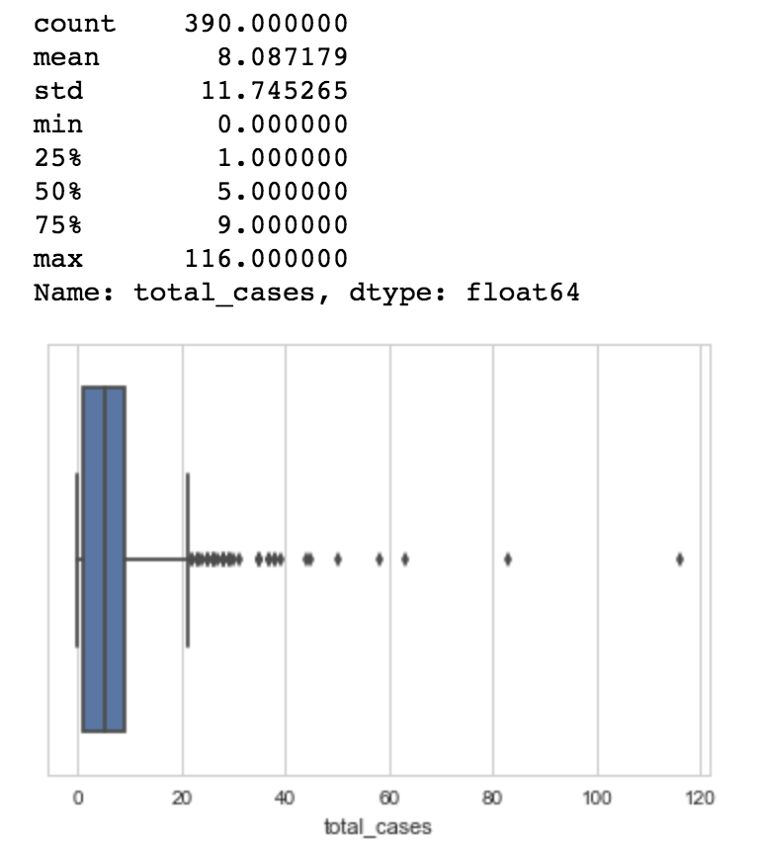
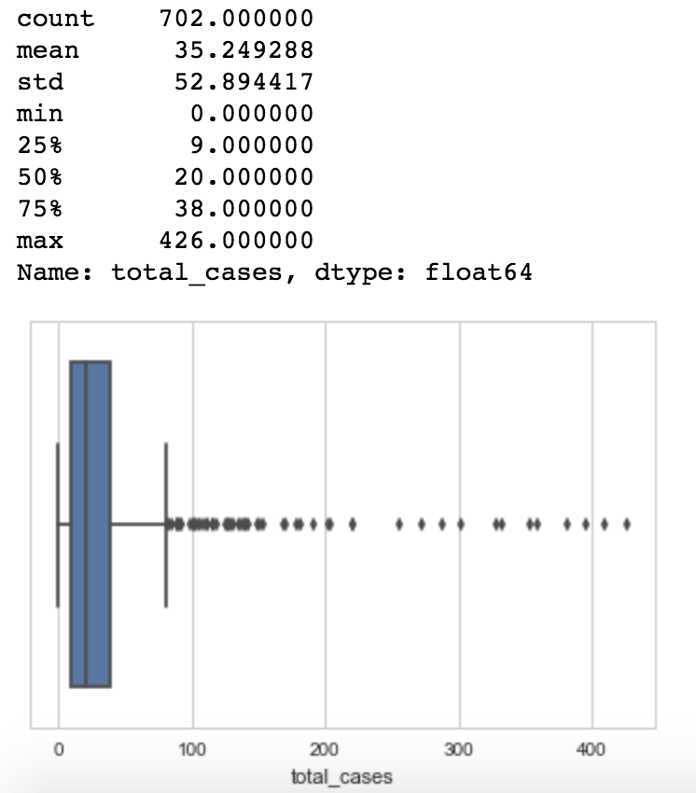
Data munging, statistical summary and visualization
Filled null values using ffill method.
Statistics of Total cases of both cities
Statistics of Total cases of Sanjuan
Statistics of Total cases of Iquitos
We can see that total cases of Dengue per Week have mean value of 24.6, max value as 461 and min value as 0 , From this data we can see that this distribution is highly skewed.
There are so many outliers and mean of the data is 35.24 for train data and median of the data is having 20 cases of sanjuan city.
For iquitos, we can see that total cases are very low when compared to sanjuan city and
mean is 8 cases median of the cases is 5.

Slide 5
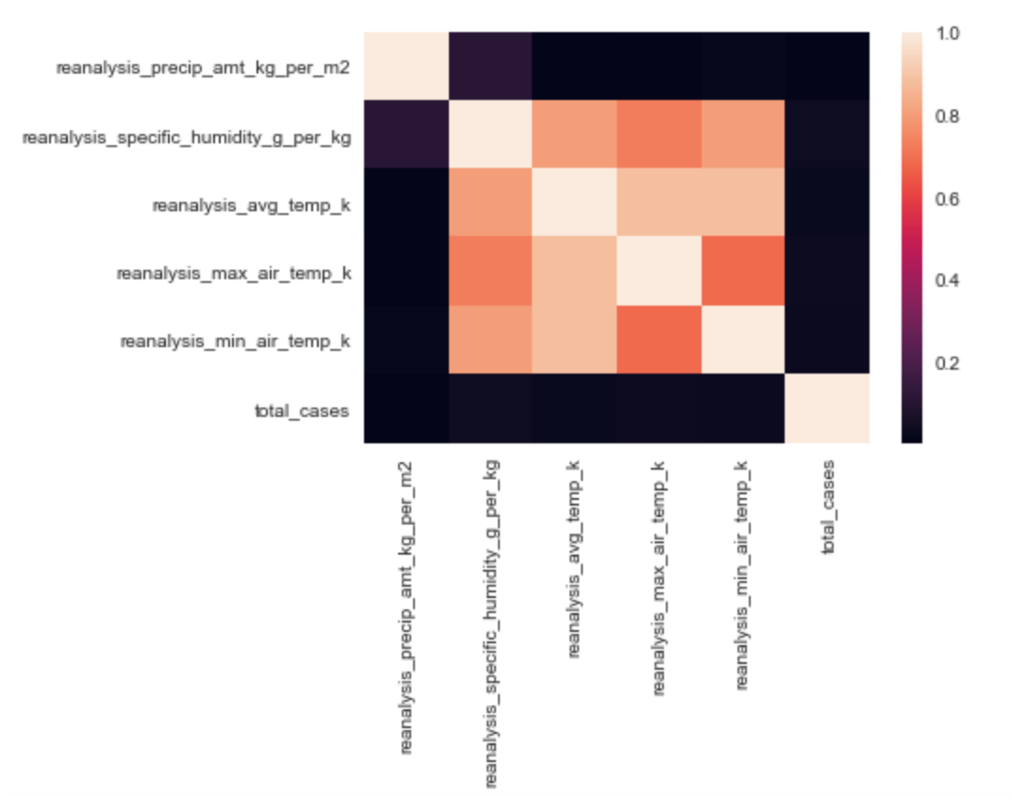
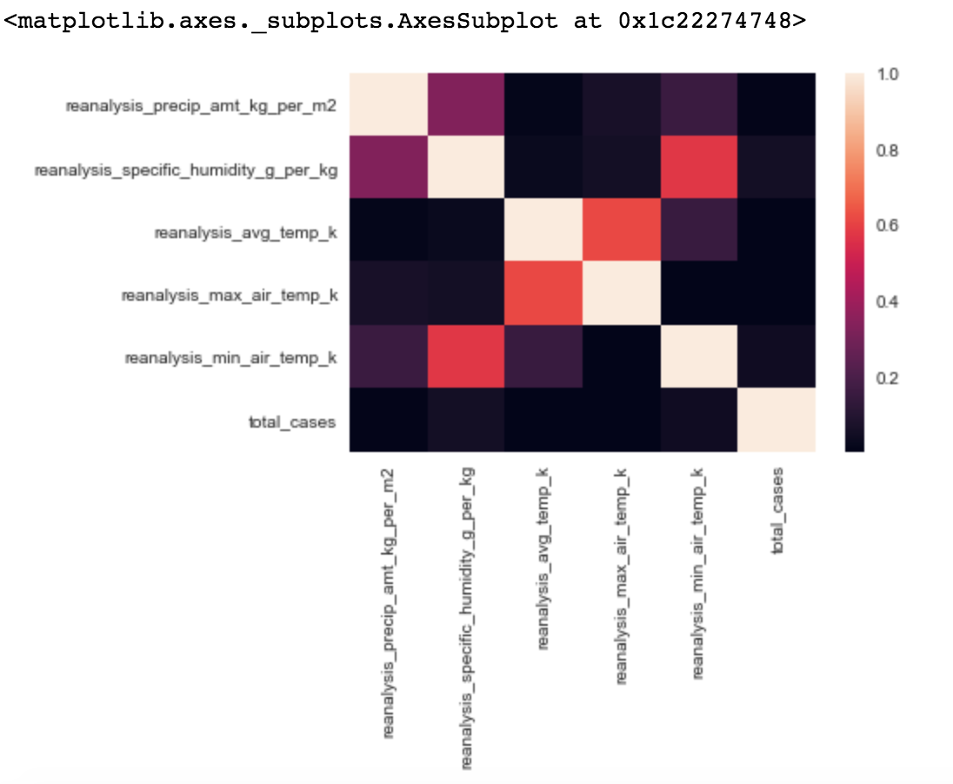
Cont….
Correlation graph for Sanjuan: Correlation graph for Iquitos
We can see that total Cases does not correlate to any specific feature individually in both cities.
The temperature variables (reanalysis_avg_temp_k,reanalysis_min_air_temp_k ,reanalysis_max_air_temp_k)and humidity are correlated in San Juan, but not in Iquitos.

Slide 6
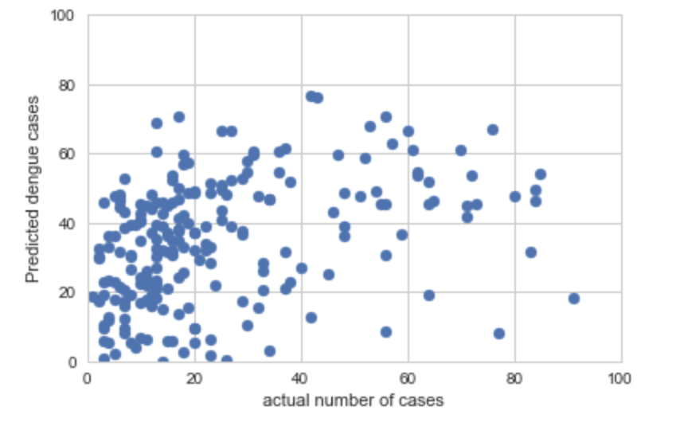
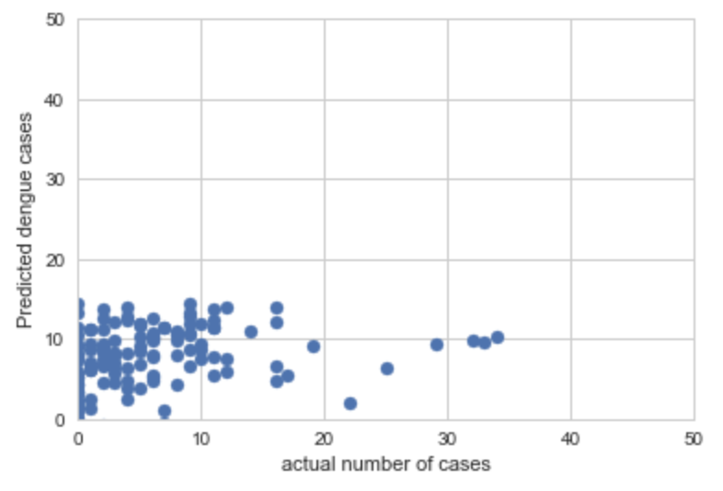
Modelling activity/evaluation
BASELINE MODEL : Used Linear Regression as Baseline Model and found that there is no linear relation
between actual and predicted values for both cities.
Sanjuan City
Iquitos City

Slide 7
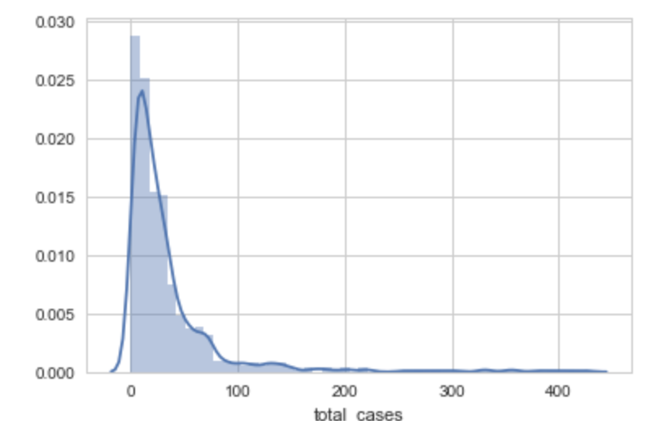
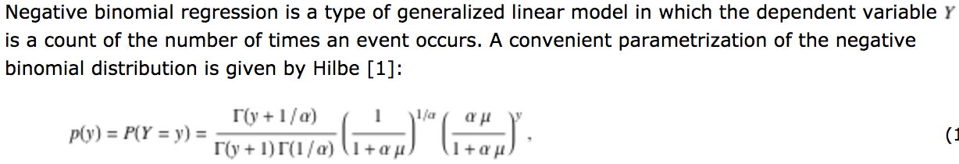
Model we Choose : negative binomial regression model
Motivation to use Negative Binomial Regression Model:
Data is highly skew distributed.
Model is use to Predict the count when variance is higher than mean.It suits to our data.
We can tune alpha Parameter.
Conclusion:
Using this model, we found that evaluation metric i.e Mean Absolute Error is less when compared
To Baseline models and predicted total cases.

Slide 8
THANK YOU

