Slide 1
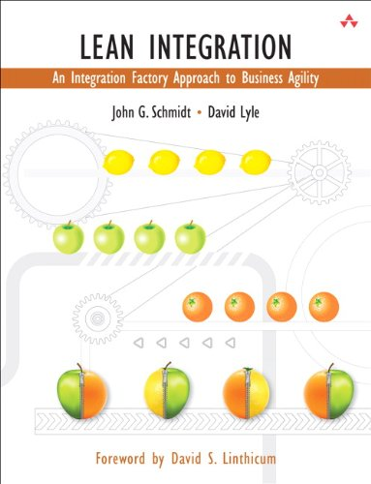
Lean Integration:
An Integration Factory Approach
to Business Agility
Author: John G. Schmidt; David Lyle / O’ Reilly
Presented by: Mayuri Pandey

Slide 2
Lean Integration :
What?
Why?
History?
Fig 1: Lean Basics

Slide 3
Lean Implementation practices:
Lean Principles
Focus on the customer and Eliminate waste.
Continuously improve.
Automate Processes and Deliver Fast.
Empower the Team.
Plan for Change and Mass Customization
Optimize the whole.
Built Quality in.
Fig 2: Lean Principles

Slide 4


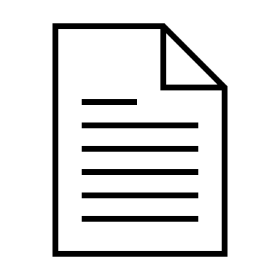


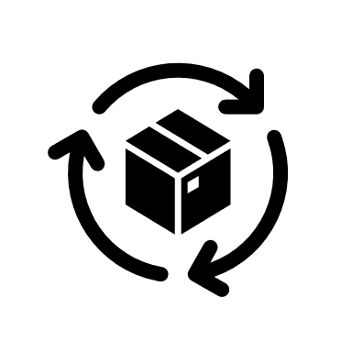

Implementation Practices:
Financial Management
Business Process Management
Integration Systems
MetaData Management
Information Architecture
Integration Methodology
Modeling Management

Slide 5
References:
[1] David Lyle; John G. Schmidt, Lean Integration: An Integration Factory Approach to Business Agility., 2010.

