Slide 1
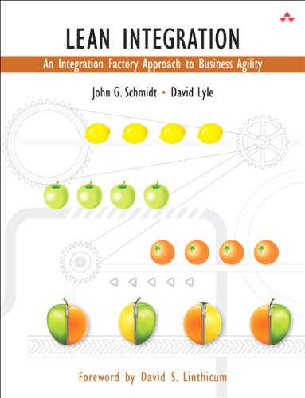
Startfolie
Lean Integration:
An Integration Factory Approach
to Business Agility
Author: John G. Schmidt; David Lyle / O’ Reilly
Presented by: Mayuri Pandey

Slide 2
Folgefolie
What?
Why?
History?
Lean Integration :

Slide 3
Lean Fundamentals:

