Slide 1
Mayur Jain
hive

Slide 2
What is Hive
Hive is a data warehouse infrastructure tool to process structured data in Hadoop. It resides on top of Hadoop to summarize Big Data, and makes querying and analyzing easy.
Initially Hive was developed by Facebook, later the Apache Software Foundation took it up and developed it further as an open source under the name Apache Hive. It is used by different companies. For example, Amazon uses it in Amazon Elastic MapReduce.

Slide 3
Features of Hive
It stores schema in a database and processed data into HDFS.
It is designed for OLAP.
It provides SQL type language for querying called HiveQL or HQL.
It is familiar, fast, scalable, and extensible.

Slide 4
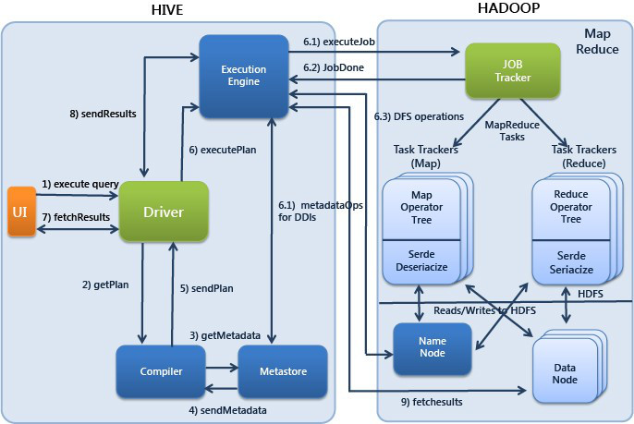
Working of Hive

Slide 5
Installation of hive
i)tar –xvzf apche-hive-2.3.3-bin.tar.gz
ii)sudo mv apache-hive-2.3.3 /user/local/hive
iii)sudo gedit ~/.bashrc
export HIVE_HOME=/usr/local/hive export PATH=$PATH:$HIVE_HOME/bin
iv) source ~/.bashrc
v) schematool initSchema –dbType derby
If failed then:$ mv metastore_db metaStore_db.tmp

Slide 6
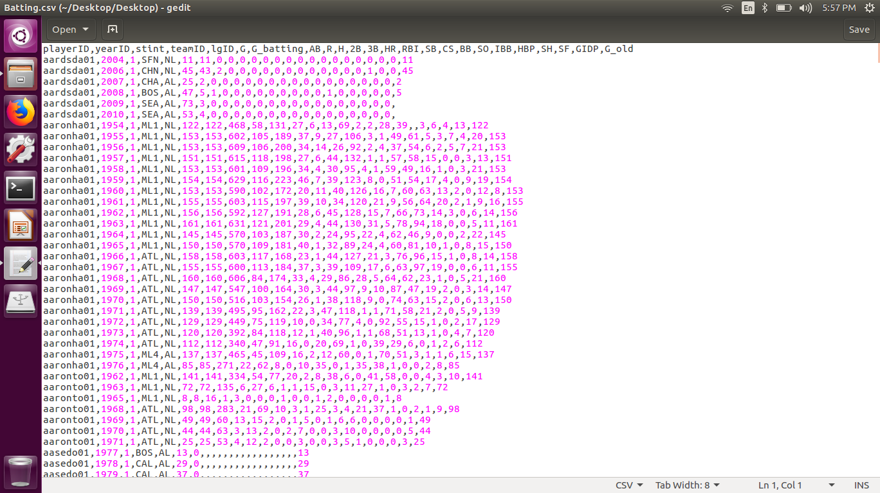
Hive example
load file : batting.csv

Slide 7
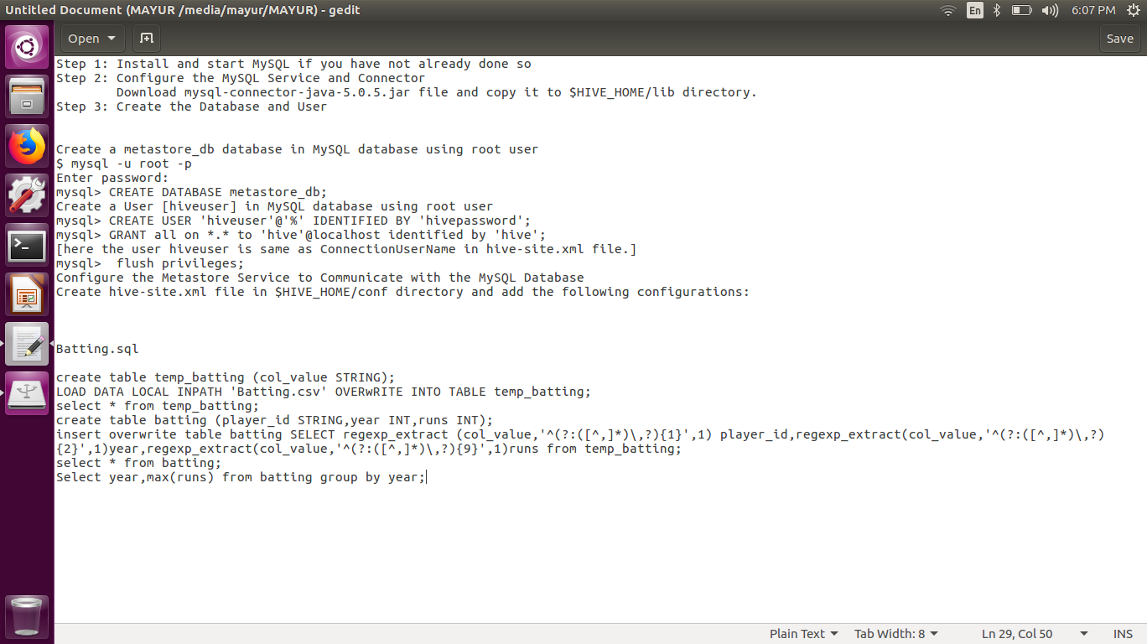
Hive example

Slide 8
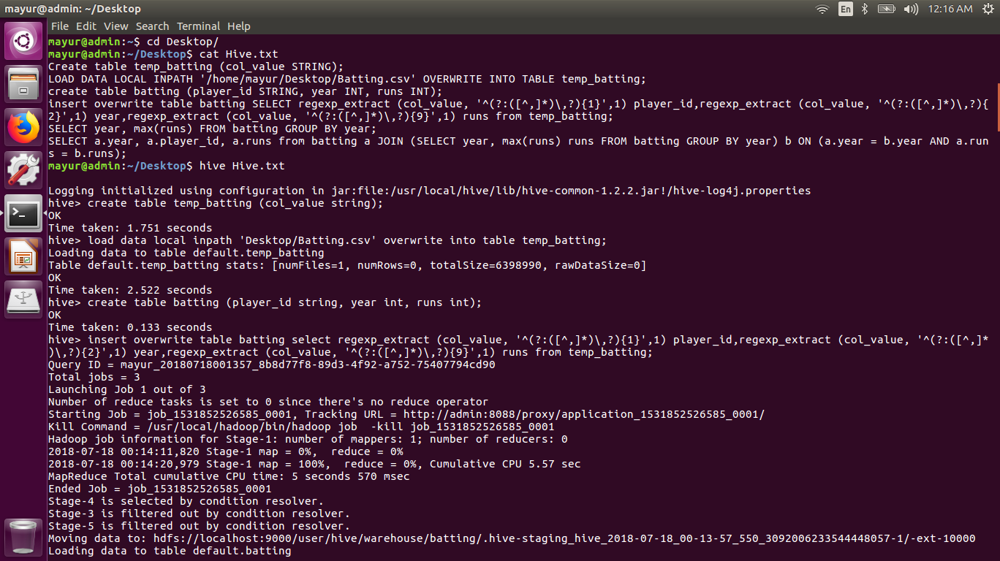

Slide 9
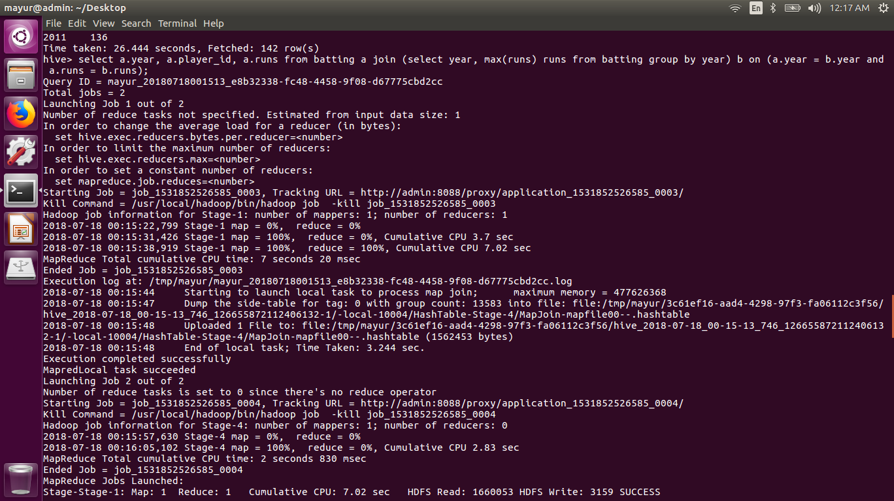

Slide 10
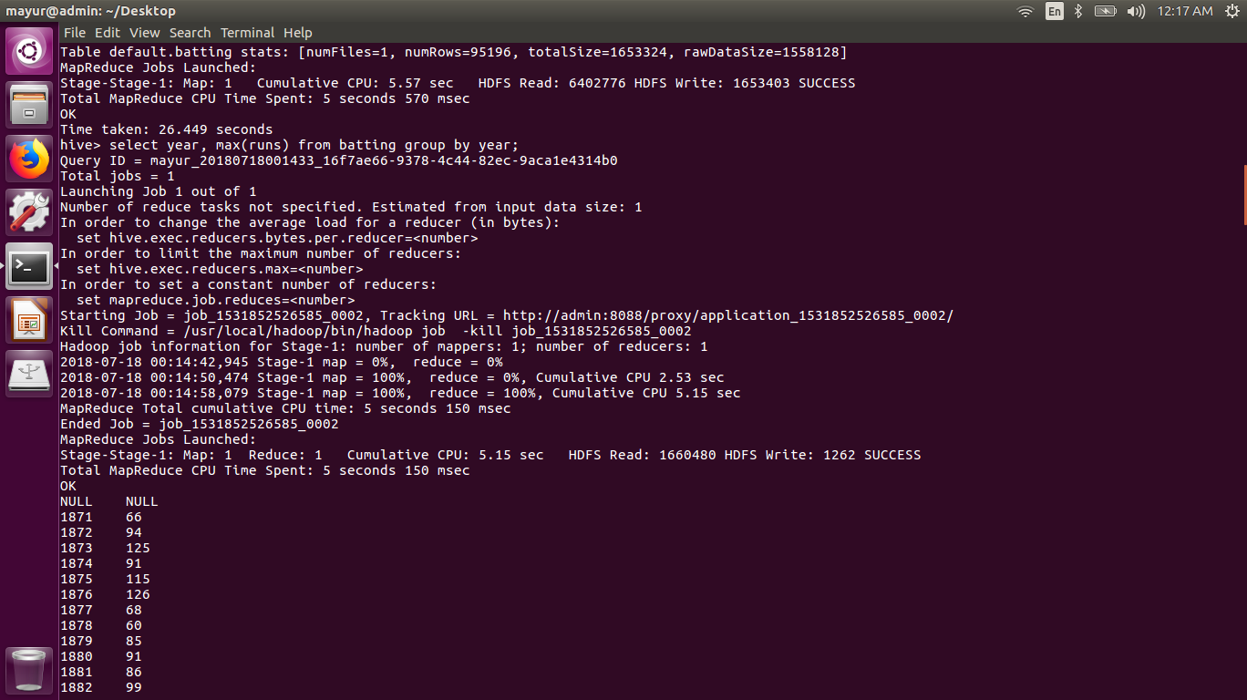

Slide 11
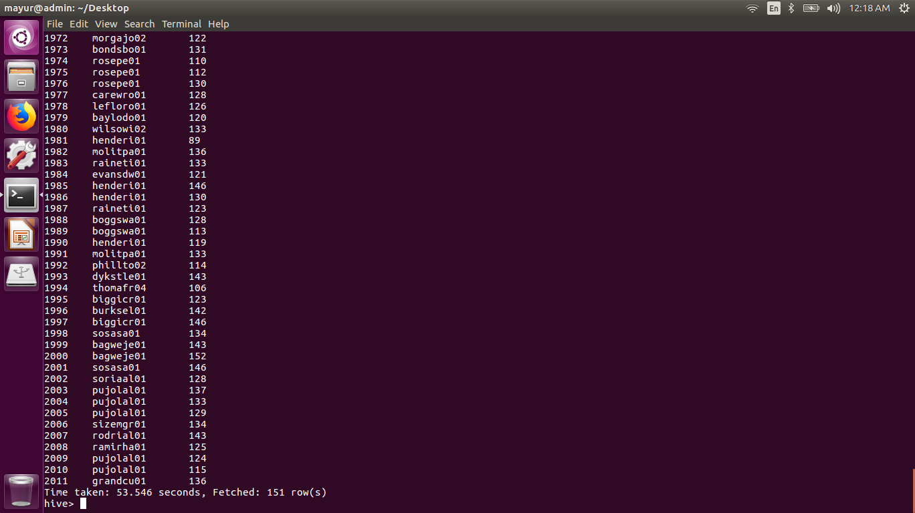

Slide 12


