Slide 1




Slide 2
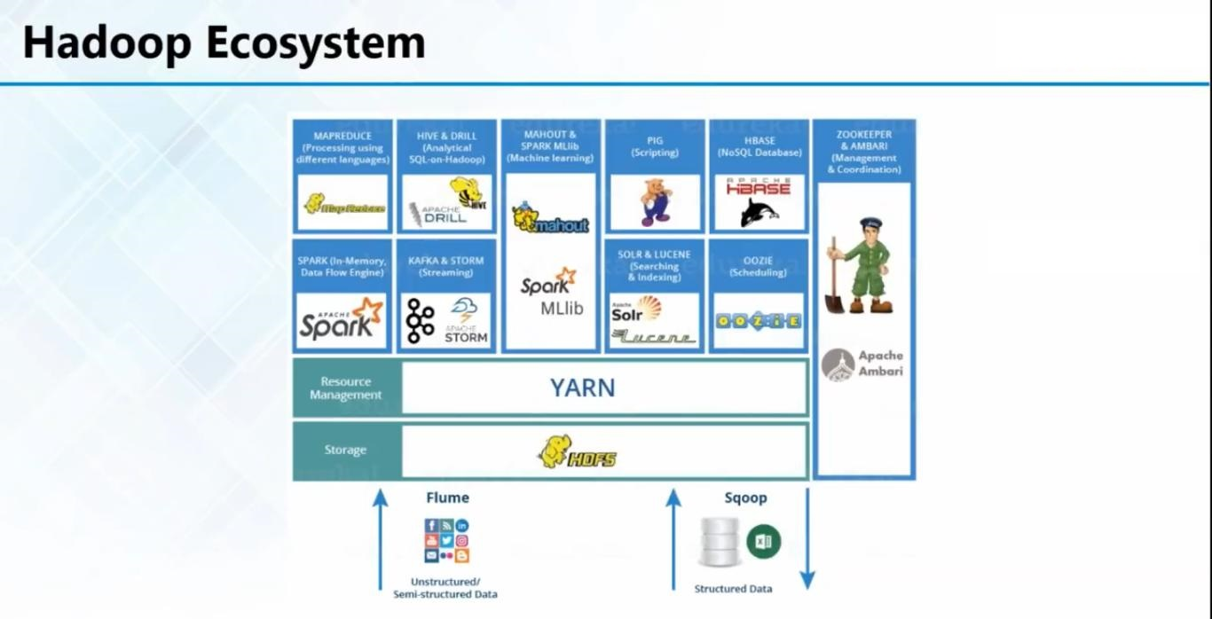

Slide 3
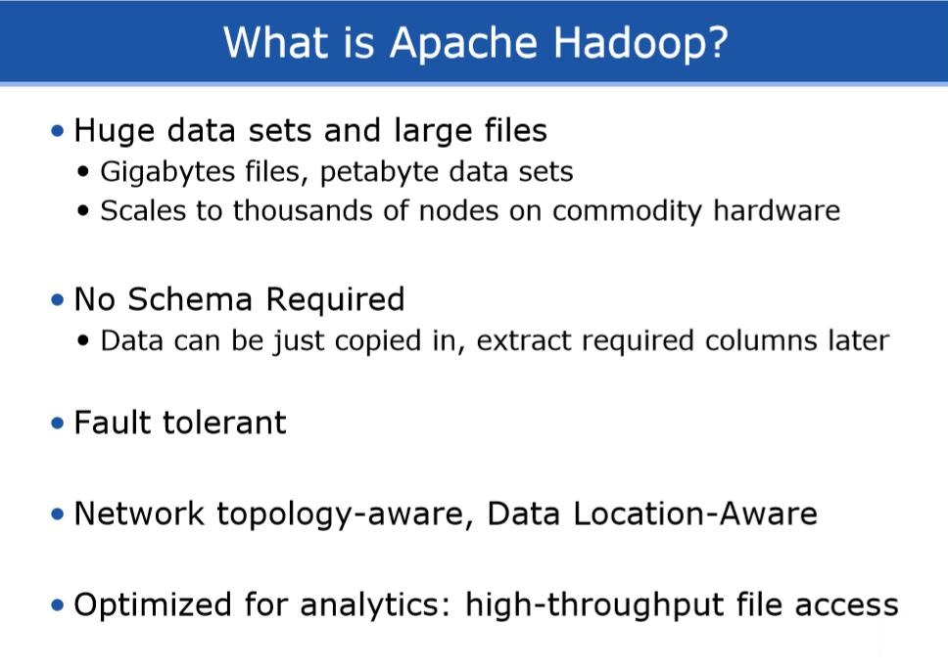

Slide 4
Installing Hadoop 2.6.5
This method of install Hadoop is to install any version of Hadoop 2.x.x As we know that Hadoop requires JVM to run. So we need to install Java before installing Hadoop. So before installing java let us update our package list doing this will automatically give latest version of Java form the Linux vender.
Basic Steps >
$ Update Operating System
$ Install New Version Of Java (default_jdk)
$ Install SSH & Bypass Password
$ Download & Extract Hadoop 2.6.5 (Specified Path)
$ Configuring System Environment
$ Configuring Hadoop Into Single Mode by Editing XML Files $ Format Namenode
$ Start All Hadoop Services $ Check The Running Services
$ Check The Final Status Of Hadoop UI

Slide 5
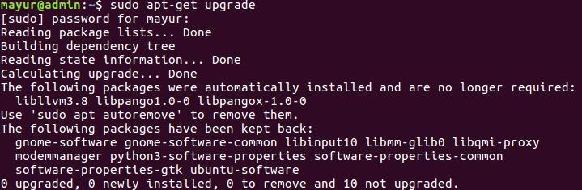
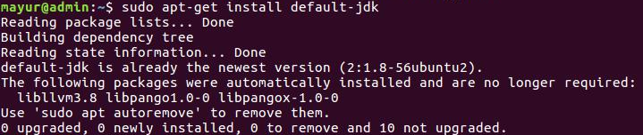

To update Package list type this command in your terminal.
$ sudo apt-get update
doing this will require internet connection.
Once you complete the above step you can install java by typing below command in terminal.
$ sudo apt-get install default-jdk
when you are done to check which java version to do that type
$ java -version
above result describes that our installed version in 1.7.65.

Slide 6
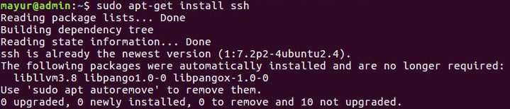
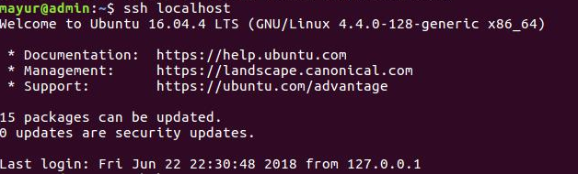
Now we require to install ssh.
ssh is Secure shell. This application allows us to get remote access of any machine(or Local host) by different password other then root and also allows us to bypass the password by setting it to empty. To install ssh use following command
$ sudo apt-get install ssh
if we try to connect local host or local machine though ssh it will ask user password. To check this you can type this command in terminal.
$ ssh localhost
you will get output as

Slide 7
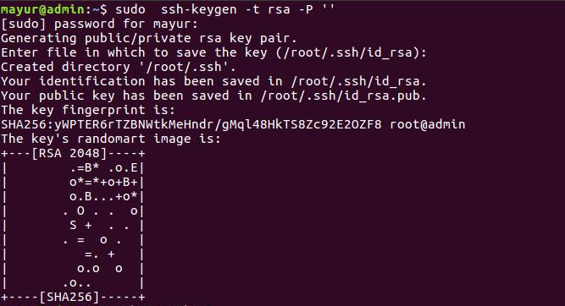
so we need to set our ssh for password less communication. To do that execute following command in terminal.
$ ssh-keygen -t rsa -P ‘’
Once we have completed this we will need to download Hadoop 2.6 or any version from its official site http://hadoop.apache.org/
then extract this Hadoop tar.gz manually or through terminal. Now we need to move Hadoop folder to root this step is optional but its recommend that you may move file to root. To move Hadoop folder to its appropriate location use following command (note this command is only use to move folder to root if you are placing to other location you can do it manually).
$ sudo mv Desktop/hadoop-2.6.5 /usr/local/hadoop

Slide 8
Now we need to set system environment variable so that our system identifies Hadoop. To do this open bashrc file as a root in any text editor.
$ sudo gedit ~/.bashrc
#Hadoop variables export JAVA_HOME=/usr/lib/jvm/java-7-openjdk-amd64
export HADOOP_INSTALL=/usr/local/hadoop export PATH=$PATH:$HADOOP_INSTALL/bin
export PATH=$PATH:$HADOOP_INSTALL/sbin export HADOOP_MAPRED_HOME=$HADOOP_INSTALL
export HADOOP_COMMON_HOME=$HADOOP_INSTALL export HADOOP_HDFS_HOME=$HADOOP_INSTALL
export YARN_HOME=$HADOOP_INSTALL #end of Hadoop variable declaration
Save and close this ~/.bashrc.
As we have add successfully added the environment variable we need to reflect these to our system for this you can do two things
1.Close all terminals and reopen them as needed.
2.use following command
$source ~/.bashrc
once you have done this type this command to check we have installed our Hadoop properly or not you can use this command. $hadoop version
if you get something like this it means you have successful set up Hadoop in your system. Now the last thing we need to update JAVA_HOME in Hadoop so open “/hadoop/etc/hadoop/hadoop-env.sh” from you installed Hadoop path and find these line in it.
replace this line with your installed java path save it and exit. In this way we have installed Hadoop 2.6.0 in our Linux.

Slide 9
Now Hadoop can be use in three different ways
1) Stand Alone Mode This mode generally does not requires any configuration to be done. This mode is usually used for Debugging purpose. All default configuration of Hadoop are done in this mode.
2) Pseudo Distributed Mode (will be Explained in depth Later) This mode is also called single node mode. This mode needs little configuration. This mode is used for Development purpose
3)Distributed Mode (will be Explained in depth Later) This mode is also called as Multinode node. This mode needs some changes to be done in Psedudistrbuted mode along with ssh This mode is generally use for commercial purpose.
10.1.2 Configuring Hadoop 2.6.0 Single Mode/Pseudo Distributed Mode in Linux
Hadoop is by default is configured in Standalone mode. This stand alone mode is used only for debugging purpose but to develops any application we need to configure hadoop in Pseudo Distributed mode.
To configure hadoop in Pseudo Distributed mode we need to edit following files
1)core-site.xml
2)hdfs-site.xml
3)mapred-site.xml
4)yarn-site.xml
All mentioned files are present in hadoop installation directory under “/etc/hadoop” in my case as per previous document its address is “/usr/local/hadoop/etc/hadoop”

Slide 10
so let us configure some of our requirement. Open this file in any of the text editor and add these contents in it between <configurations></configurations>
1) configuring core-site.xml
<property>
<name>fs.defaultFS</name>
<value>hdfs://localhost:9000</value>
</property>
<property>
<name>hadoop.tmp.dir</name>
<value>/home/admin/tmp</value>
</property>
2) Configuring hdfs-site.xml
<property>
<name>dfs.replication</name>
<value>1</value>
</property>
<property> <name>dfs.namenode.name.dir</name>
<value>/home/admin/tmp/namenode</value>
</property>
<property>
<name>dfs.datanode.data.dir</name>
<value>/home/admin/tmp/datanode</value>
</property>

Slide 11
3) Configuring mapred-site.xml
<property>
<name>mapreduce.framework.name</name>
<value>yarn</value>
</property>
4) Configuring yarn-site.xml
<property>
<name>yarn.nodemanager.aux-services</name>
<value>mapreduce_shuffle</value>
</property>
Now we have successfully configured hadoop 2.6.5 in Pseudo distributed mode.
Before starting hadoop we need to format our namenode. Execute this command to format namenode.
$hdfs namenode -format
Now to start hadoop you can use two command
$ start-dfs.sh
$ start-yarn.sh
or you can also use deprecated command as
$ start-all.sh

Slide 12
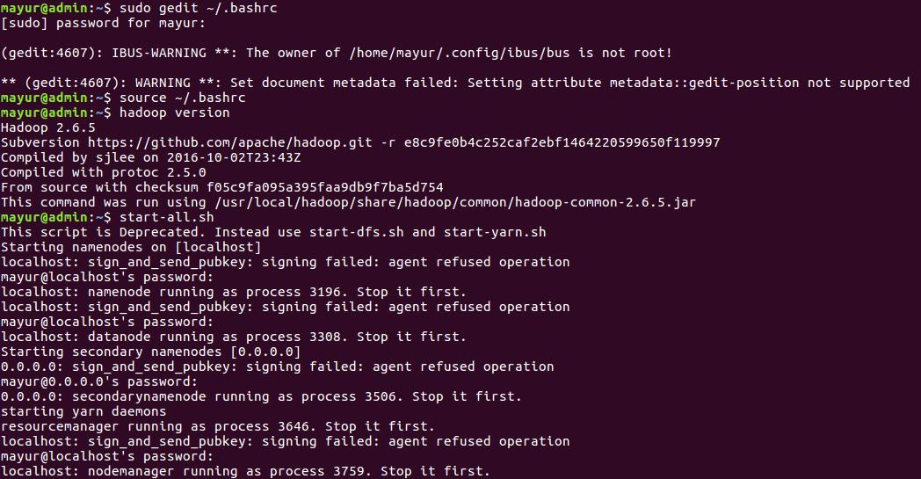

Slide 13
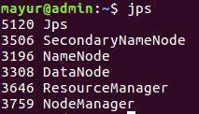
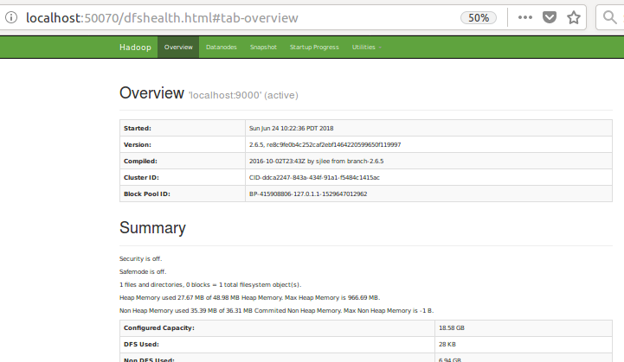
To check the which components are working you can use bellow command
$ jps
you will get output as
Please make note that number preceding are port number they many vary with machine to machine every time you start. If any one component is missing that means you have
incorrectly configured above xml files.
Now to check status of Hadoop through
web UI you can visit
https://namenode:50070/

Slide 14
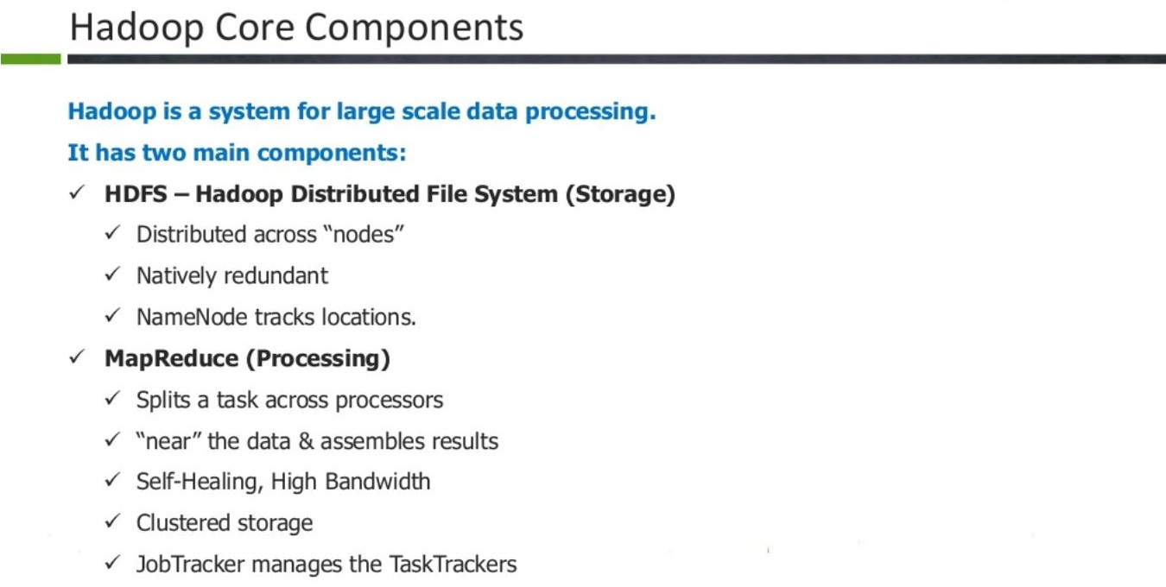

Slide 15
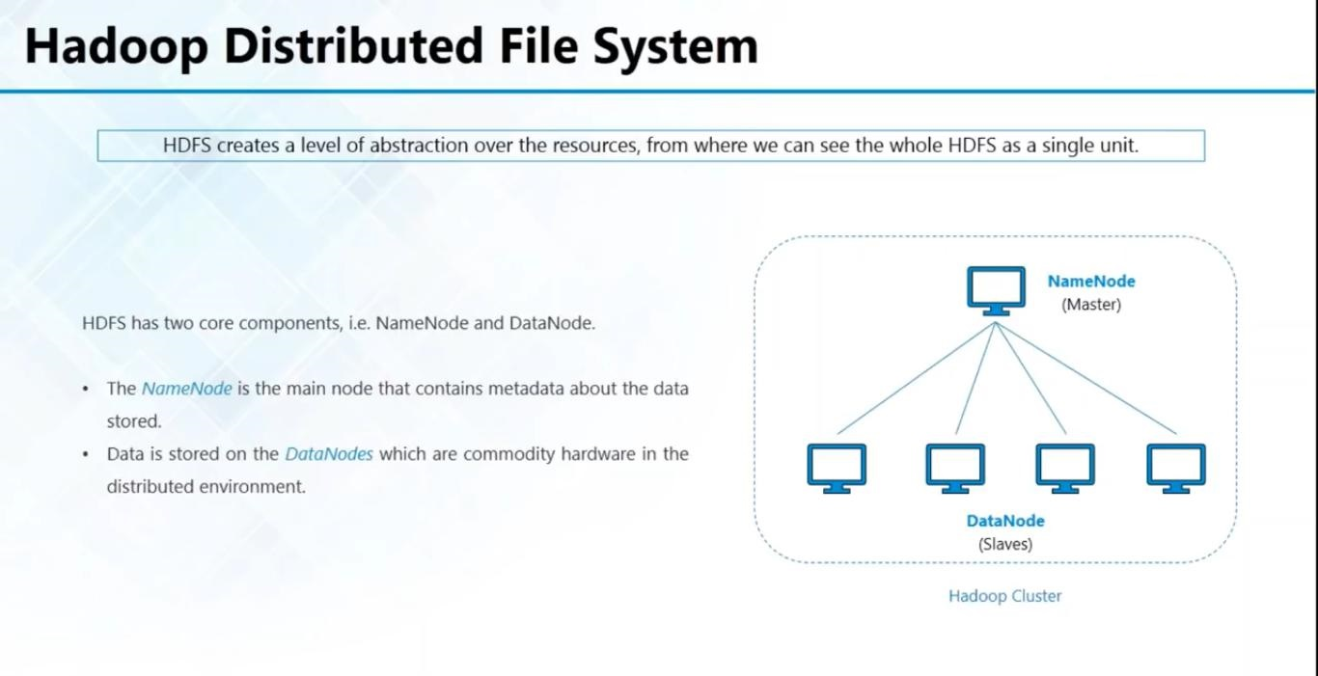

Slide 16
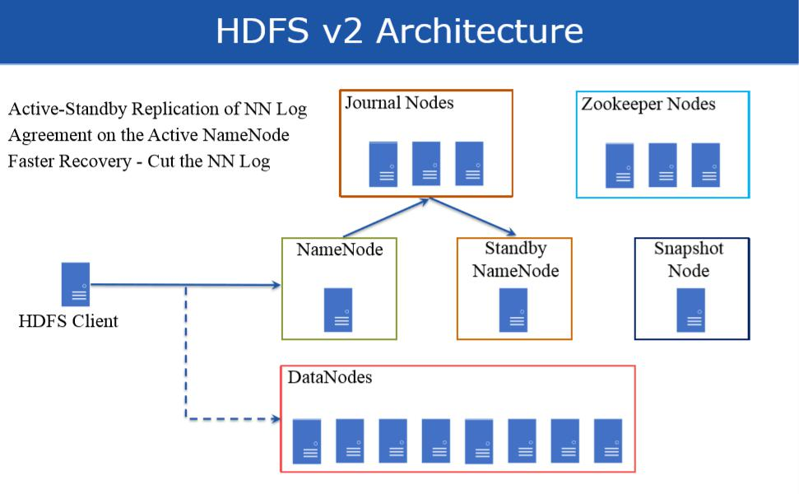

Slide 17


