Slide 1
MAP REDUCE

Slide 2
WHAT IS MAP REDUCE?
MapReduce is a programming model and an associated implementation for processing and generating big data sets with a parallel, distributed algorithm on a cluster.
A MapReduce program is composed of a map procedure, which performs filtering and sorting, and a reduce method, which performs a summary operation.
The major advantage of MapReduce is that it is easy to scale data processing over multiple computing nodes.

Slide 3
THE ALGORITHM (working of MapReduce)
Generally MapReduce paradigm is based on sending the computer to where the data resides!
MapReduce program executes in three stages, namely map stage, shuffle stage, and reduce stage.
Map stage : The map or mapper’s job is to process the input data. Generally the input data is in the form of file or directory and is stored in the Hadoop file system (HDFS). The input file is passed to the mapper function line by line. The mapper processes the data and creates several small chunks of data.
Reduce stage : This stage is the combination of the Shuffle stage and the Reduce stage. The Reducer’s job is to process the data that comes from the mapper. After processing, it produces a new set of output, which will be stored in the HDFS.
During a MapReduce job, Hadoop sends the Map and Reduce tasks to the appropriate servers in the cluster.
The framework manages all the details of data-passing such as issuing tasks, verifying task completion, and copying data around the cluster between the nodes.
Most of the computing takes place on nodes with data on local disks that reduces the network traffic.
After completion of the given tasks, the cluster collects and reduces the data to form an appropriate result, and sends it back to the Hadoop server.

Slide 4
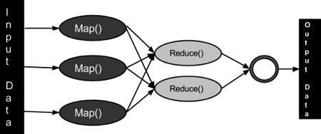
HOW BIG DATA IS MAPPED AND REDUCED

Slide 5
SOME MAPREDUCE ALGORITHMS PROVIDED BY APACHE HADOOP:
WORD COUNT
WORD MEAN
WORD MEDIAN
QUASI MONTE CARLO
WORD STANDARD DEVIATION
MULTIFILE WORD COUNT

Slide 6
IMPLEMENTATION OF MAPREDUCE FUNCTIONS IN HADOOP

Slide 7
Algorithm Of Word_Count Example :
To reach wordcount.java file follow the path :- computer/usr/local/Hadoop/share/Hadoop/mapreduce/sources.
Extract the wordcount.java file to desktop.
Open Hadoop-mapreduce-examples-2.6.5-sources.jar in archive manager to display its contents
In the contents you will find several examples to implement mapreduce in Hadoop
Select WordCount.java and extract it to the Desktop
Open WordCount.java in gedit and delete package org.apache.Hadoop.examples;

Slide 8
IN THE TERMINAL :-
Write source ~/.bashrc to refresh the terminal.
Write start-all.sh to start all Hadoop services
Write cd Desktop/ to change directory to desktop
Write command Hadoop com.sum.tools.javac.Main WordCount.java to extract the class files of the java file to the desktop
Write command jar cf wc.jar WordCount*.class :- this command creates a jar file with all the file with name starting with WordCount and ending with .class
Create a text file with some text in it with touch command.
Use command Hadoop fs –mkdir name to create a directory in Hadoop file system.
Write command Hadoop fs –put text_file directory_name/ to put the text file in Hadoop file system directory.
Finally write command Hadoop jar wc.jar WordCount /directory_name/text file/folder_name :- this command will implement the Word Count algorithm on the text file and save the result in the Hadoop server in the folder with name given in the command
Go to the Hadoop server by writing localhost:50070 on the browser and check the result in the
“Utilities->Browse your file system” category

Slide 9
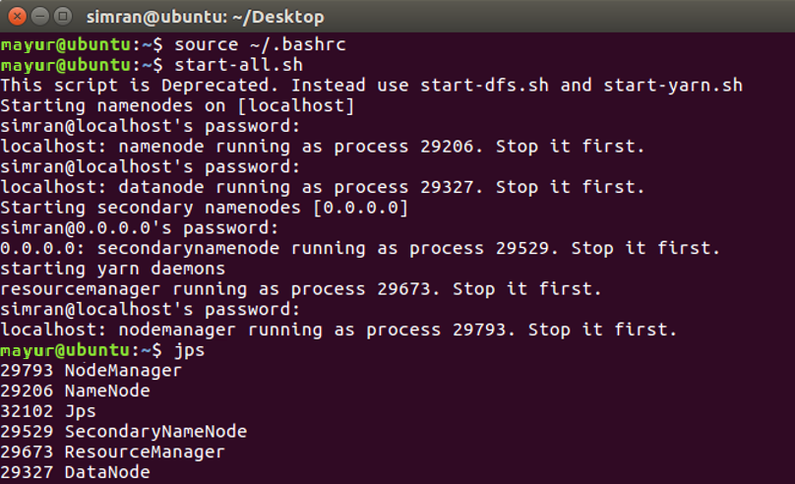
OUTPUT >

Slide 10
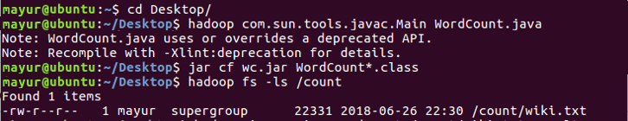
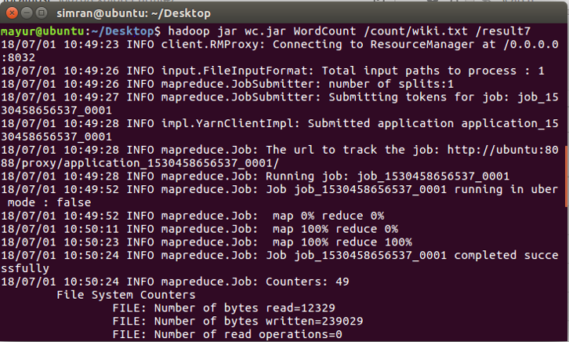

Slide 11
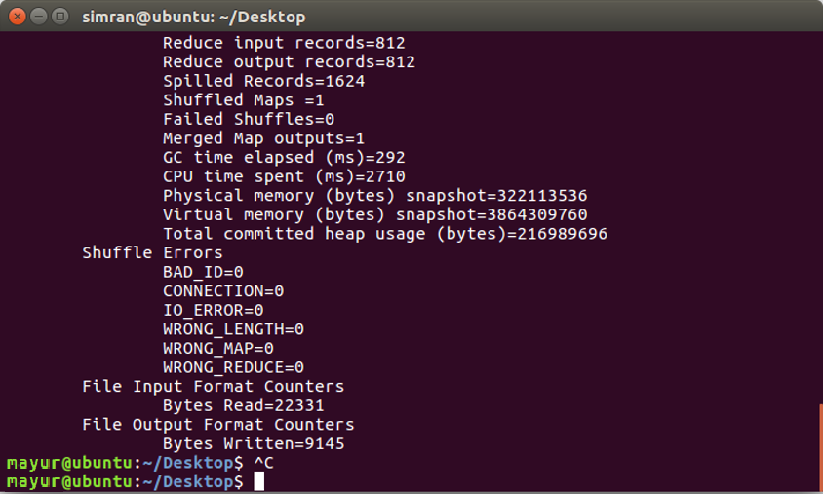

Slide 12
Points to keep in mind while implementing this algorithms to remaining Map Reduce Functions :
Whenever you extract x.java file on the desktop, open it in gedit and delete the package org.apache.Hadoop.examples; line.
The name of the jar file which compresses the .class files should be different every time.
The name of the folder in which the result is stored should be different.
Same text file can be used for implementing algorithms which have text as their input.

