Slide 1
Pig Introduction & Installation
By - Mayur Jain

Slide 2

What is Pig..
Apache Pig is a platform for analyzing large data sets that consists of a high-level language for expressing data analysis programs
Started at Yahoo! Research
Now runs about 30% of Yahoo!’s jobs

Slide 3

How does it work
◦Three ways to use it
-Grunt-pig’s interact to shell
-Write pig latten in a script file
-Embed Pig commands in another language
◦Run modes
-local mode –single machine
-Hadoop – run on name Hadoop/Map reduce cluster
◦Create map reduce code automatically

Slide 4
Why use it ?
It is quicker
It is data omnivorous
It is easy to learn
It is widely used
Minor performance loss
It can be extended via user defined functions(UDF)

Slide 5
Infrastructure & features..
Pig's infrastructure layer consists of
a compiler that produces sequences of Map-Reduce programs,
Pig's language layer currently consists of a textual language called Pig Latin, which has the following key properties:
Ease of programming. It is trivial to achieve parallel execution of simple, "embarrassingly parallel" data analysis tasks. Complex tasks comprised of multiple interrelated data transformations are explicitly encoded as data flow sequences, making them easy to write, understand, and maintain.

Slide 6
Optimization opportunities. The way in which tasks are encoded permits the system to optimize their execution automatically, allowing the user to focus on semantics rather than efficiency.
Extensibility. Users can create their own functions to do special-purpose processing.

Slide 7
Pig Latin data types
Int
Long
Float
Double
Char array
Byte array
Tuple
map

Slide 8
Pig Latin Math's
ABS
EIL
EXP
FLOOR
LOG
ROUND
SIN
TAN

Slide 9
Running pig
You can execute Pig Latin statements:
Using grunt shell or command line
$ pig ... - Connecting to ...
grunt> A = load 'data';
grunt> B = ... ;
In local mode or hadoop mapreduce mode
$ pig myscript.pig
Command Line - batch, local mode mode
$ pig -x local myscript.pig
Either interactively or in batch

Slide 10
Program flow/Organization
A series of "transformation" statements process the data.
LOAD and STORE statements reads data from the file system
A STORE statement writes output to the file system; or, a DUMP statement displays output to the screen.

Slide 11
Interpretation
In general, Pig processes Pig Latin statements as follows:
First, Pig validates the syntax and semantics of all statements.
Next, if Pig encounters a DUMP or STORE, Pig will execute the statements.

Slide 12
A = LOAD 'student' USING PigStorage() AS (name:chararray, age:int, gpa:float);
B = FOREACH A GENERATE name;
DUMP B;
(John)
(Mary)
(Bill)
(Joe)
Store operator will store it in a file

Slide 13
Simple Examples
A = LOAD 'input' AS (x, y, z);
B = FILTER A BY x > 5;
DUMP B;
C = FOREACH B GENERATE y, z;
STORE C INTO 'output';
-----------------------------------------------------------------------------
A = LOAD 'input' AS (x, y, z);
B = FILTER A BY x > 5;
STORE B INTO 'output1';
C = FOREACH B GENERATE y, z;
STORE C INTO 'output2'

Slide 14
Pig and Hive Installation
Open command terminal and type – gedit ~/.bashrc
Now type the following two commands in the bashrc file and click save
export PIG_HOME= /usr /local/pig
export $ PATH= $PATH:$ PIG_HOME/bin
Now type – source ~/.bashrc to permanently save

Slide 15
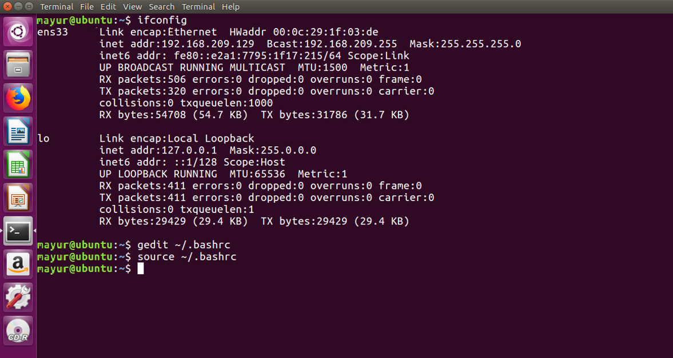

Slide 16
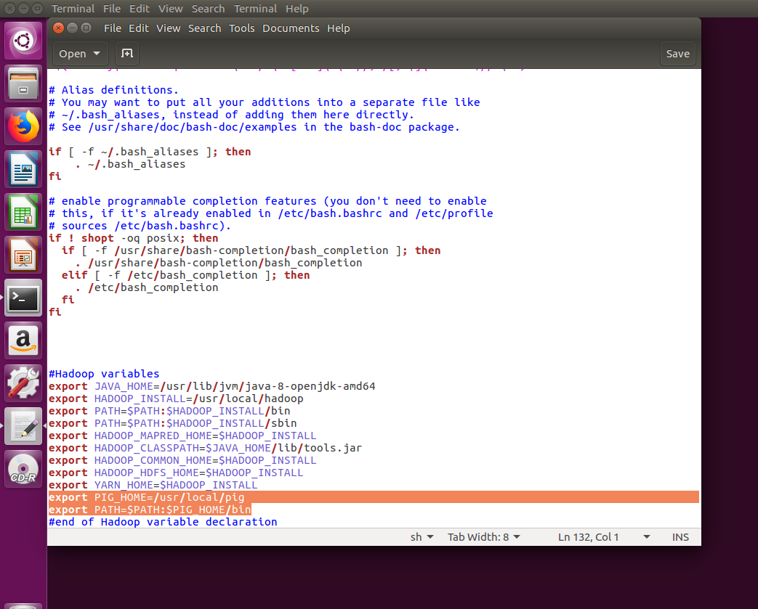

Slide 17
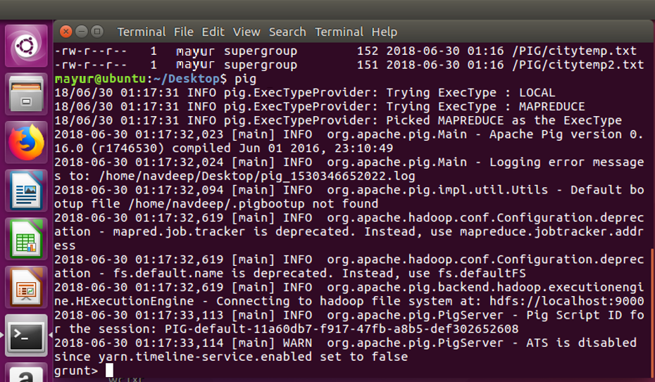
Now move the pig folder using command :-
sudo mv pig-0.15.0 /usr/local/pig
Now type pig
Pig is successfully installed

