Slide 1

SQOOP INSTALLATION
MAYUR JAIN

Slide 2
SQOOP
Sqoop − “SQL to Hadoop and Hadoop to SQL”
Sqoop is a tool designed to transfer data between Hadoop and relational database servers. It is used to import data from relational databases such as MySQL, Oracle to Hadoop HDFS, and export from Hadoop file system to relational databases. It is provided by the Apache Software Foundation.

Slide 3
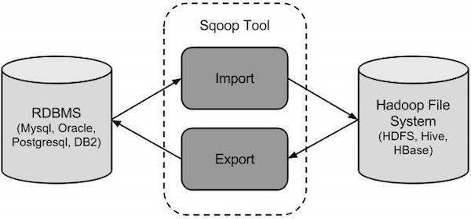
How SQOOP Works?
Sqoop calls the JDBC driver written in the –connect statement from the location where Sqoop is installed. The –username and –password options are used to authenticate the user and Sqoop, internally generates the same command against the MySQL instance.The –table argument defines the MySQL table name, that will receive the data from HDFS. This table must be created prior to running the export command. Sqoop uses the number of columns, their types, and the metadata of the table to validate the data inserted from the HDFS directory. When the export statement is executed, it initiates and creates INSERT statements in MySQl.
For example, the export-job will read each line of the input.txt file from HDFS and produces the intermediate statements.By default, Sqoop export creates INSERT statements. If the –update-key argument is stated, UPDATE statements will be created instead.The -m argument sets the number of map jobs for reading the file splits from HDFS. Each mapper will have its own connection to the MySQL Server.Now, on querying inside MySQL, we see that all the data is mapped inside the table.

Slide 4

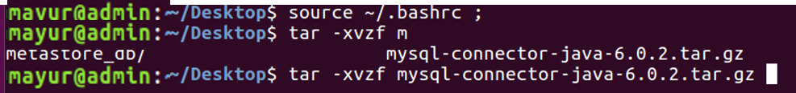
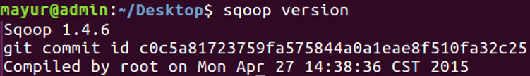
SQOOP INSTALLATION STEPS

Slide 5
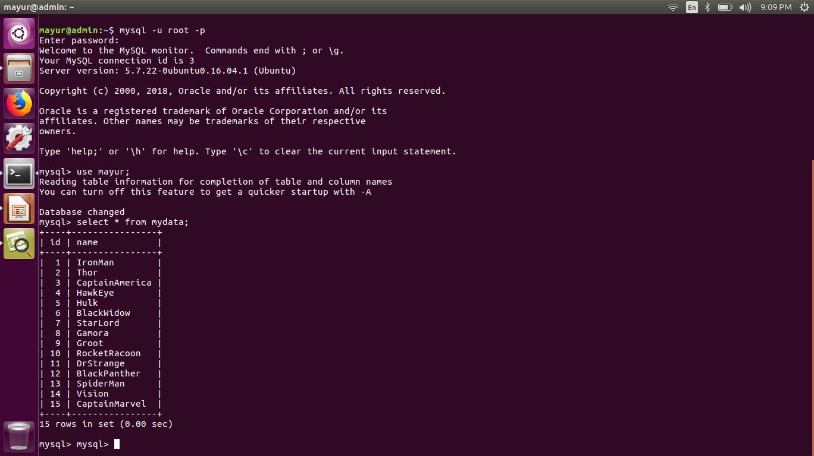
OPEN MYSQL TO GRANT THE PERMISSION

Slide 6
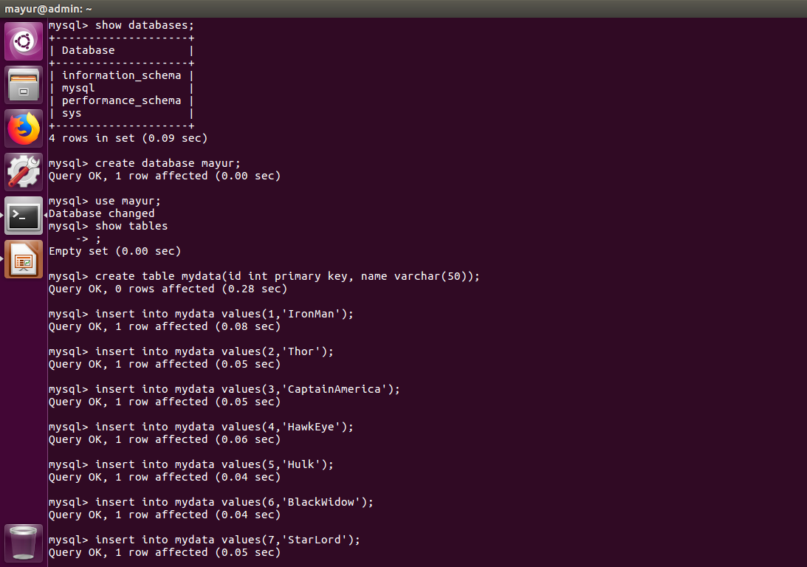

Slide 7
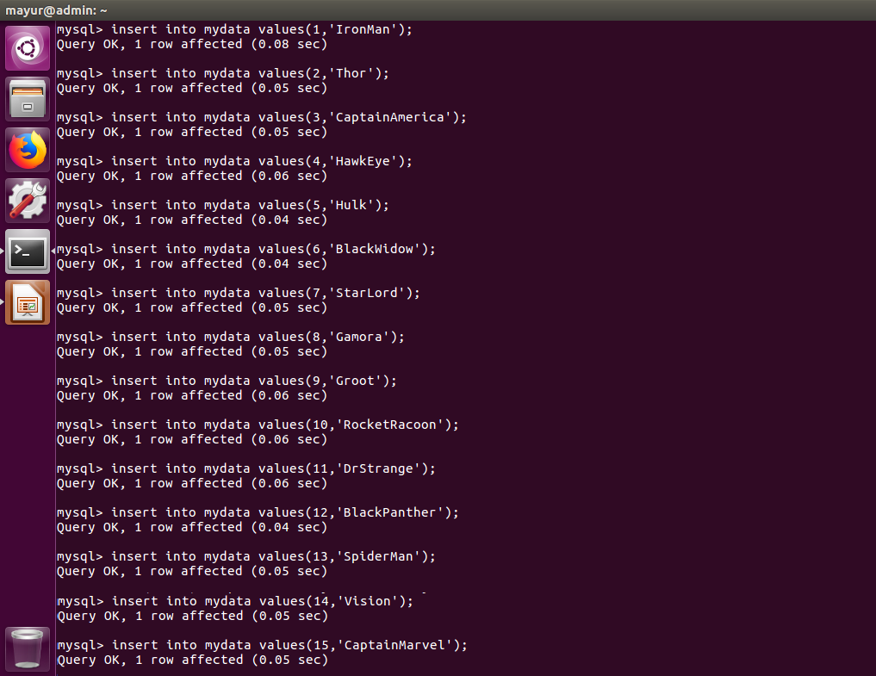

Slide 8
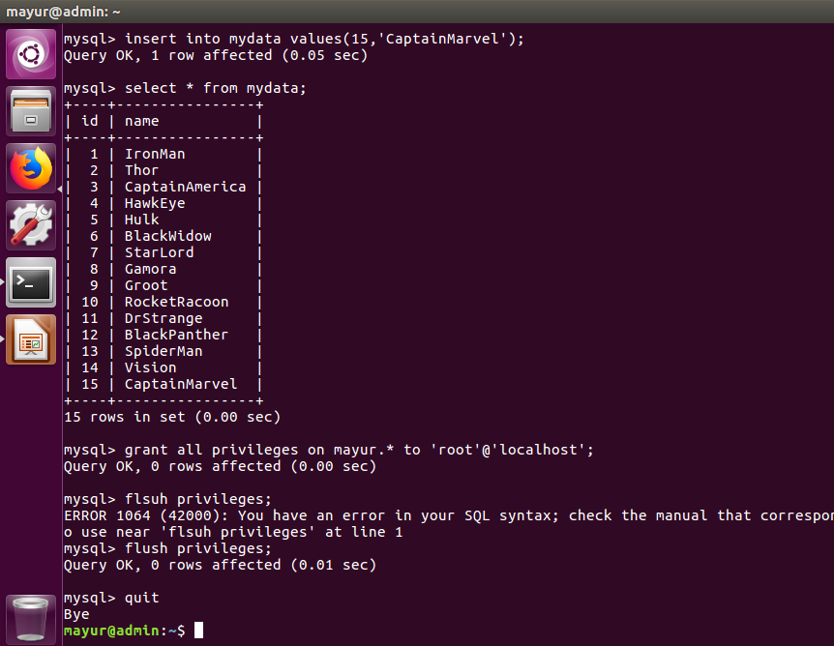

Slide 9
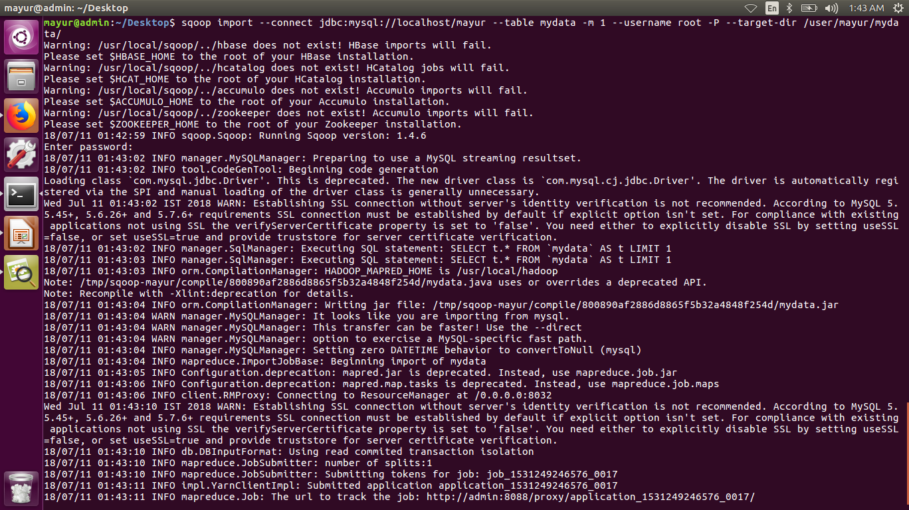
IMPORT THE TABLE TO HDFS DIRECTORY

Slide 10
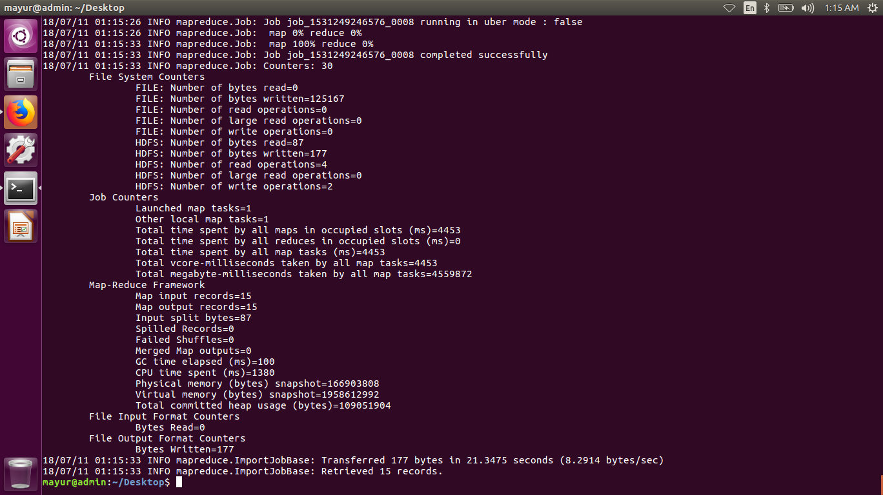
IMPORT THE TABLE TO HDFS DIRECTORY

Slide 11
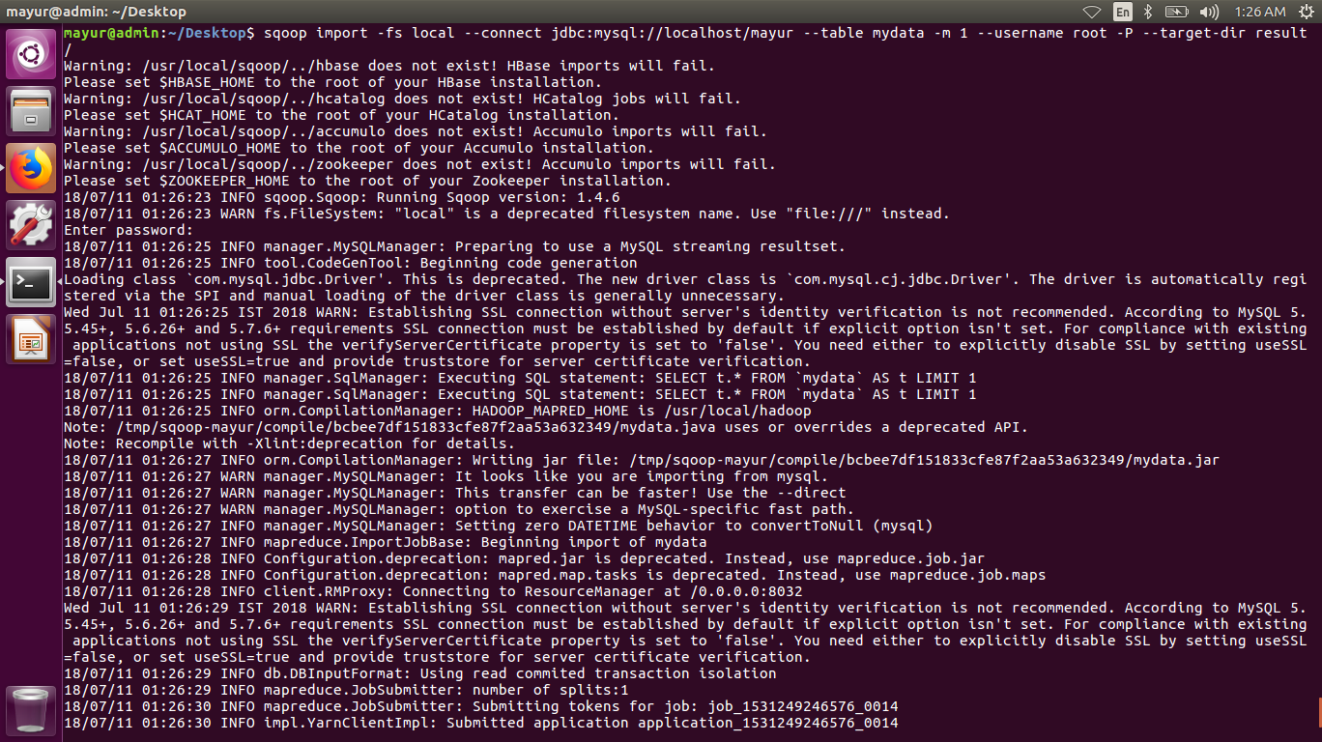
IMPORT THE TABLE TO LOCAL DIRECTORY

Slide 12
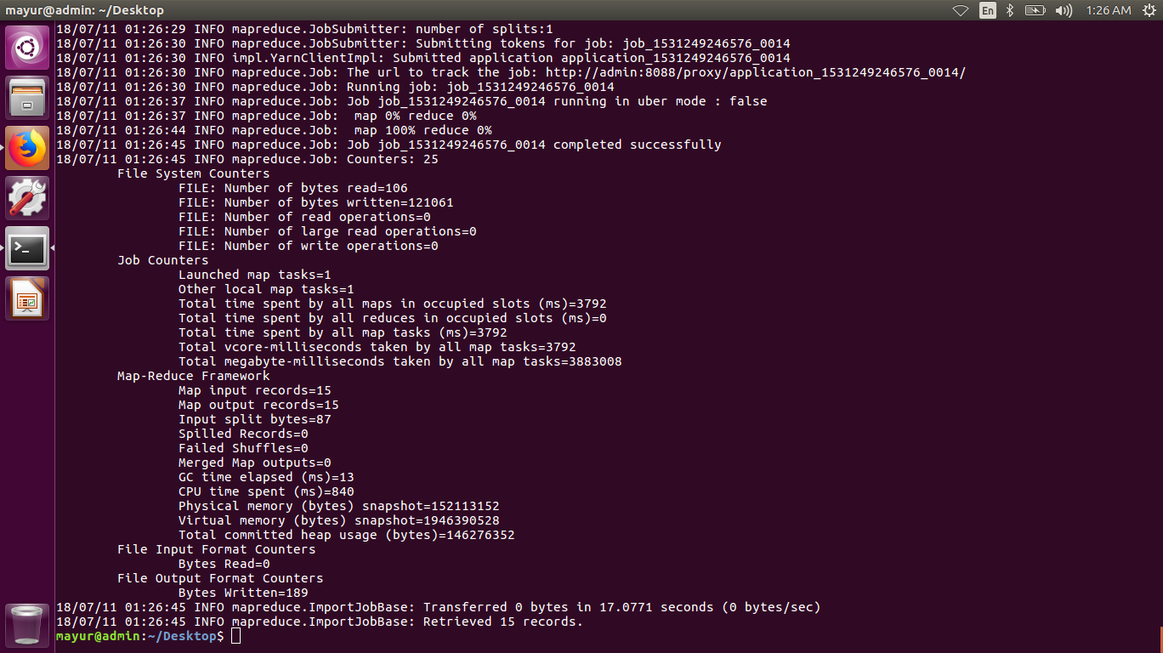
IMPORT THE TABLE TO LOCAL DIRECTORY

Slide 13
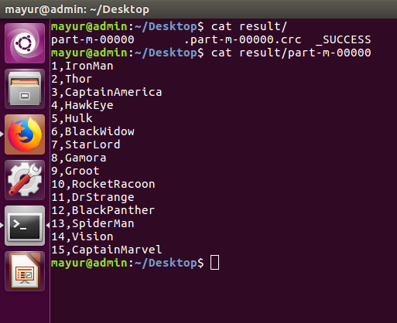
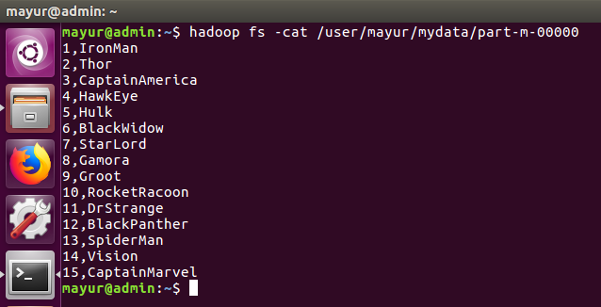
TO OPEN THE IMPORTED TABLE

Slide 14
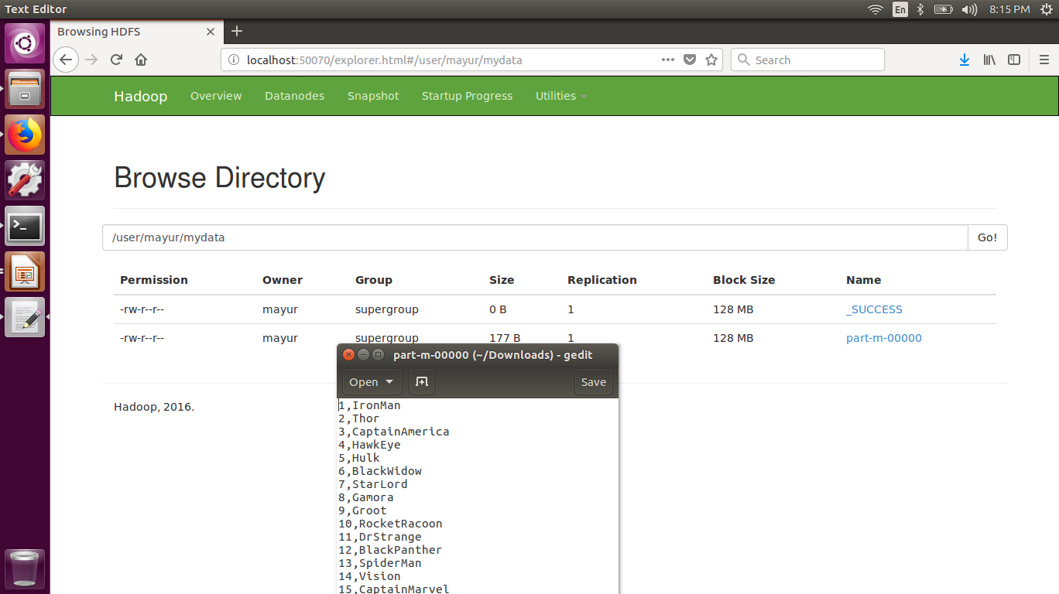
TO OPEN THE IMPORTED TABLE

Slide 15
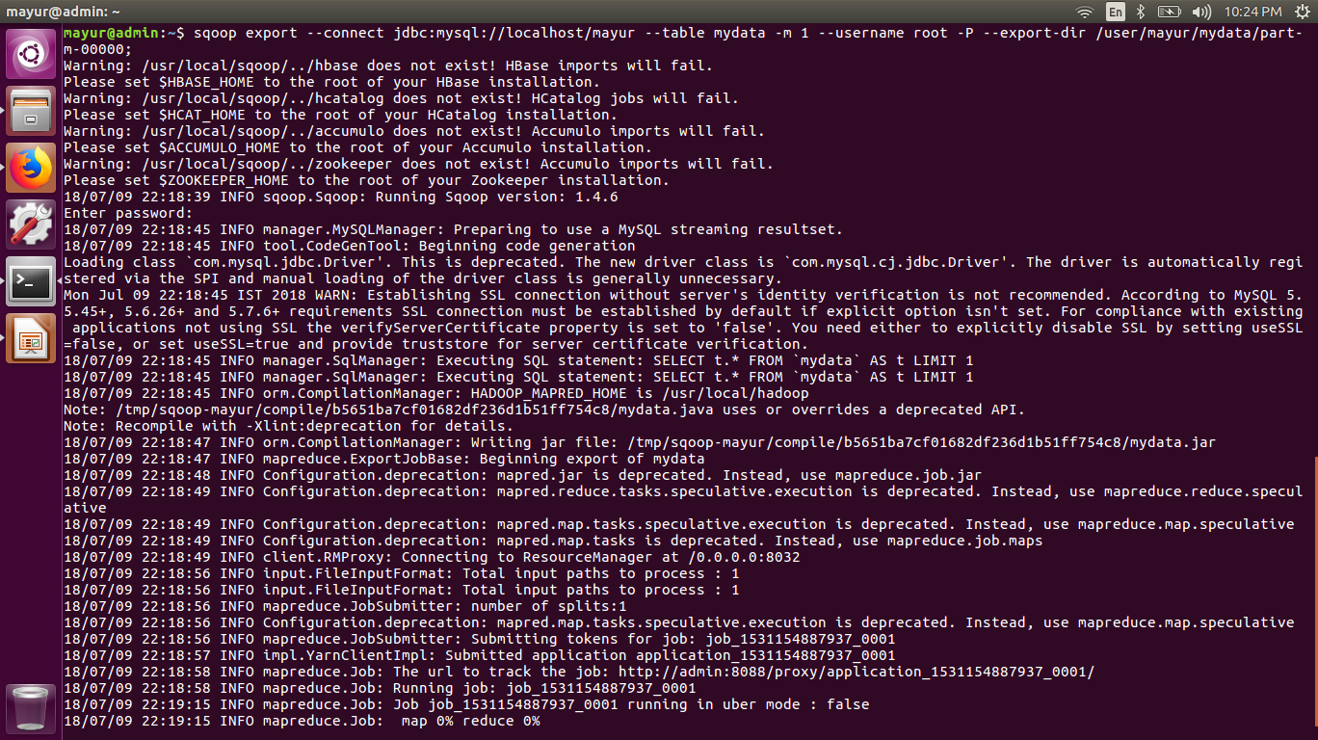
EXPORT THE TABLE

Slide 16

EXPORT THE TABLE

Slide 17


Slide 18
TO BE CONTINUED DAY 9 & 10
HIVE INSTALLATION & BASICS COMMANDS
FLUMES BASICSC

