Slide 1
Flume
By – Mayur Jain

Slide 2
What is Flume?
Apache Flume is a distributed, reliable, and available system for efficiently collecting, aggregating and moving large amounts of log data from many different sources to a centralized data store.
The use of Apache Flume is not only restricted to log data aggregation. Since data sources are customizable, Flume can be used to transport massive quantities of event data including but not limited to network traffic data, social-media-generated data, email messages and pretty much any data source possible.

Slide 3
Requirements
Java Runtime Environment - Java 1.8 or later
Memory - Sufficient memory for configurations used by sources, channels or sinks
Disk Space - Sufficient disk space for configurations used by channels or sinks
Directory Permissions - Read/Write permissions for directories used by agent

Slide 4

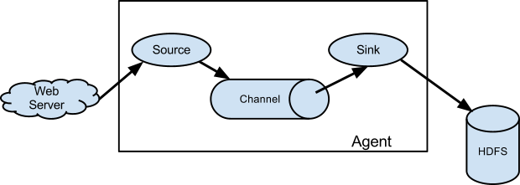
Architecture
A Flume event is defined as a unit of data flow having a byte payload and an optional set of string attributes. A Flume agent is a (JVM) process that hosts the components through which events flow from an external source to the next destination (hop).
A Flume source consumes events delivered to it by an external source like a web server. The external source sends events to Flume in a format that is recognized by the target Flume source. For example, an Avro Flume source can be used to receive Avro events from Avro clients or other Flume agents in the flow that send events from an Avro sink. A similar flow can be defined using a Thrift Flume Source to receive events from a Thrift Sink or a Flume Thrift Rpc Client or Thrift clients written in any language generated from the Flume thrift protocol.When a Flume source receives an event, it stores it into one or more channels. The channel is a passive store that keeps the event until it’s consumed by a Flume sink. The file channel is one example – it is backed by the local filesystem. The sink removes the event from the channel and puts it into an external repository like HDFS (via Flume HDFS sink) or forwards it to the Flume source of the next Flume agent (next hop) in the flow. The source and sink within the given agent run asynchronously with the events staged in the channel.

Slide 5
Complex flows Flume allows a user to build multi-hop flows where events travel through multiple agents before reaching the final destination. It also allows fan-in and fan-out flows, contextual routing and backup routes (fail-over) for failed hops. Reliability The events are staged in a channel on each agent. The events are then delivered to the next agent or terminal repository (like HDFS) in the flow. The events are removed from a channel only after they are stored in the channel of next agent or in the terminal repository. This is a how the single-hop message delivery semantics in Flume provide end-to-end reliability of the flow. Flume uses a transactional approach to guarantee the reliable delivery of the events. The sources and sinks encapsulate in a transaction the storage/retrieval, respectively, of the events placed in or provided by a transaction provided by the channel. This ensures that the set of events are reliably passed from point to point in the flow. In the case of a multi-hop flow, the sink from the previous hop and the source from the next hop both have their transactions running to ensure that the data is safely stored in the channel of the next hop. Recoverability The events are staged in the channel, which manages recovery from failure. Flume supports a durable file channel which is backed by the local file system. There’s also a memory channel which simply stores the events in an in-memory queue, which is faster but any events still left in the memory channel when an agent process dies can’t be recovered.
Features of Flumes

Slide 6
HOW FLUME WORKS
Flume’s high-level architecture is built on a streamlined codebase that is easy to use and extend. The project is highly reliable, without the risk of data loss. Flume also supports dynamic reconfiguration without the need for a restart, which reduces downtime for its agents.
The following components make up Apache Flume:
Flume components interact in the following way:
A flow in Flume starts from the Client.
The Client transmits the Event to a Source operating within the Agent.
The Source receiving this Event then delivers it to one or more Channels.
One or more Sinks operating within the same Agent drains these Channels.
Channels decouple the ingestion rate from drain rate using the familiar producer-consumer model of data exchange.
When spikes in client side activity cause data to be generated faster than can be handled by the provisioned destination capacity can handle, the Channel size increases. This allows sources to continue normal operation for the duration of the spike.
The Sink of one Agent can be chained to the Source of another Agent. This chaining enables the creation of complex data flow topologies.
Because Flume’s distributed architecture requires no central coordination point. Each agent runs independently of others with no inherent single point of failure, and Flume can easily scale horizontally.

Slide 7
Component | Definition
Event | A singular unit of data that is transported by Flume (typically a single log entry)
Source | The entity through which data enters into Flume. Sources either actively poll for data or passively wait for data to be delivered to them. A variety of sources allow data to be collected, such as log4j logs and syslogs.
Sink | The entity that delivers the data to the destination. A variety of sinks allow data to be streamed to a range of destinations. One example is the HDFS sink that writes events to HDFS.
Channel | The conduit between the Source and the Sink. Sources ingest events into the channel and the sinks drain the channel.
Agent | Any physical Java virtual machine running Flume. It is a collection of sources, sinks and channels.
Client | The entity that produces and transmits the Event to the Source operating within the Agent.

Slide 8
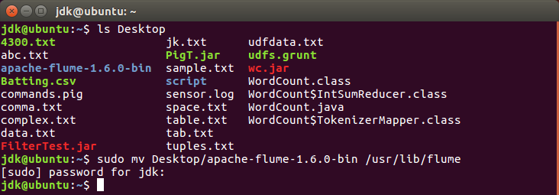
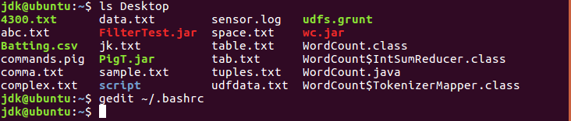
We start with the Live streaming of data as follows:
First we will install flume in the system. Copy the tar file of the apache flume and then extract it on the desktop. Now we move this extracted file from the desktop to the destination /usr/lib/flume using the sudo mv command.
To check if the file has been moved, we use the command ls. Now open the bashrc file as shown.

Slide 9
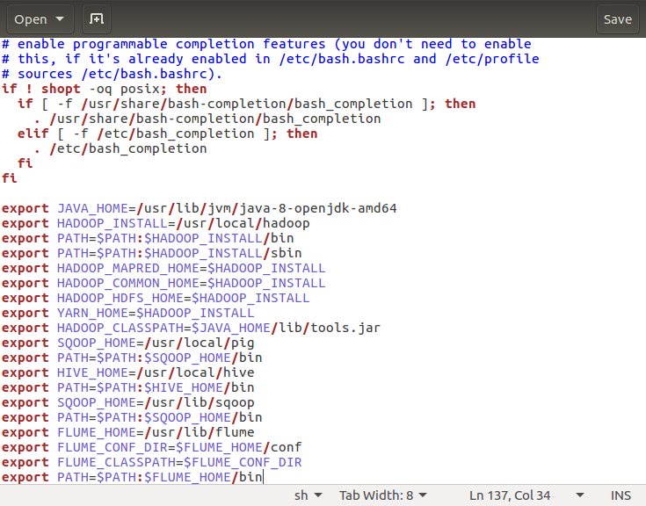
We add the following lines in this file for configuration purposes:
export FLUME_HOME=/usr/lib/flume
export FLUME_CONF_DIR=$FLUME_HOME/conf
export FLUME_CLASSPATH=$FLUME_CONF_DIR
export PATH=$PATH:$FLUME_HOME/bin

Slide 10
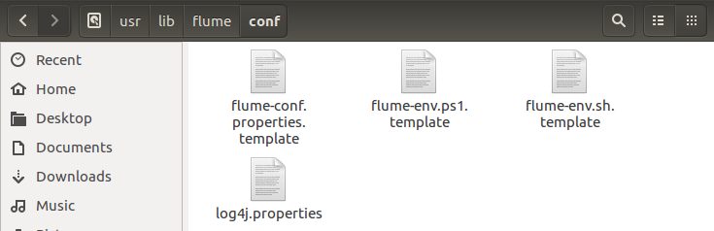
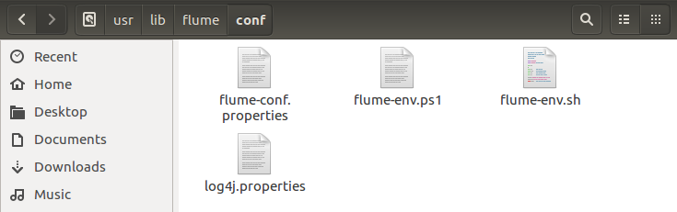
Now, we change the names of 3 files flume-conf.properties.template, flume-env.ps1.template and flume-env.sh.template renaming them and removing the word template from their name.
This is the output of the same.

Slide 11
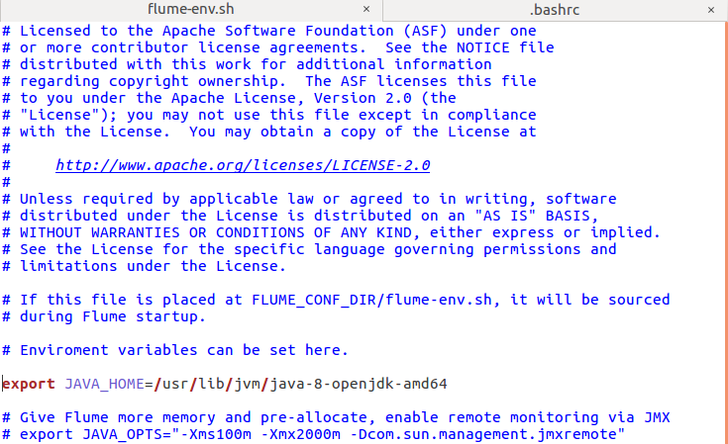
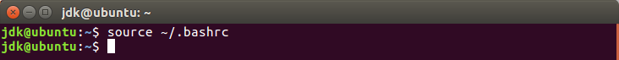
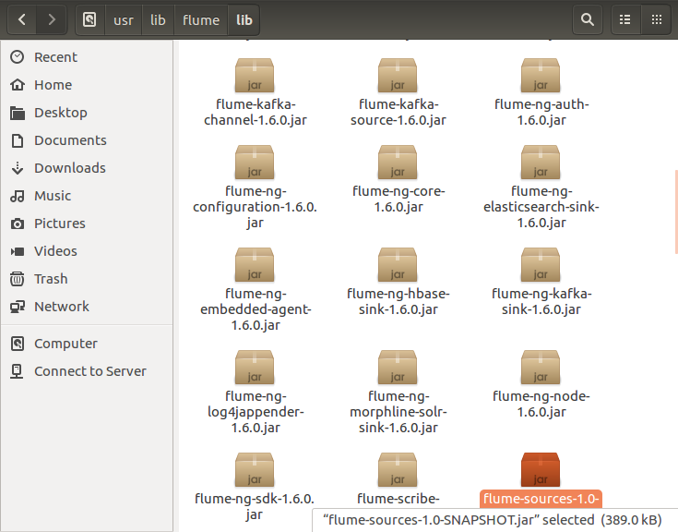
Now, we open the flume-env.sh file and add the JAVA_HOME PATH in it.
Now we permanently save the bashrc file.
Now we move to /usr/libflume/lib and copy a jar file named flume-sources-1.0-SNAPSHOT.jar into this directory.

Slide 12
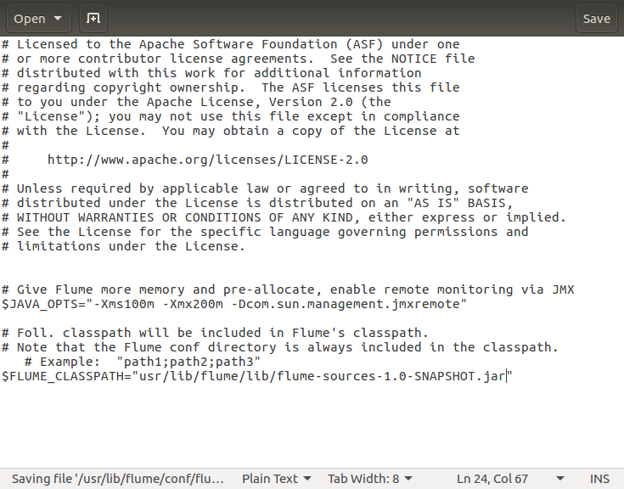
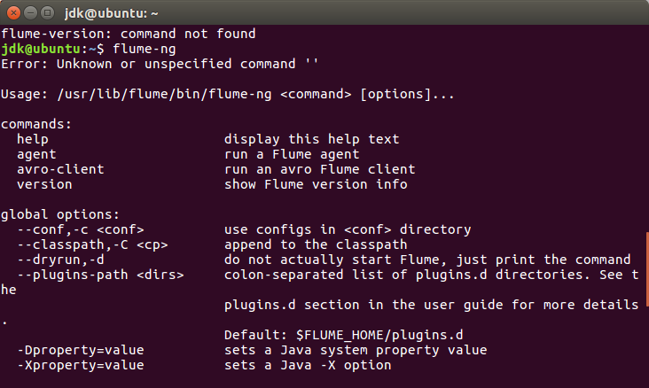
After that we open the flume-env.ps1 file and add the FLUME_CLASSPATH in it.
We use the flume-ng command. If the help desk opens then flume has been successfully installed.

Slide 13
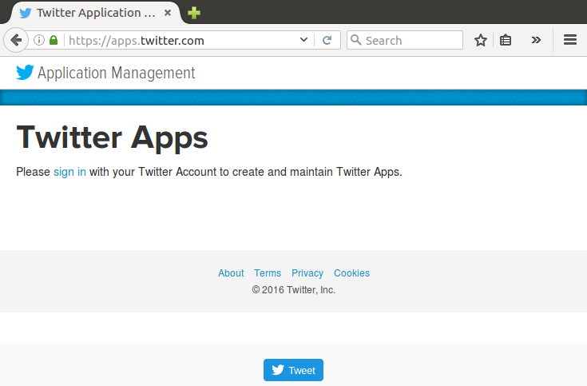
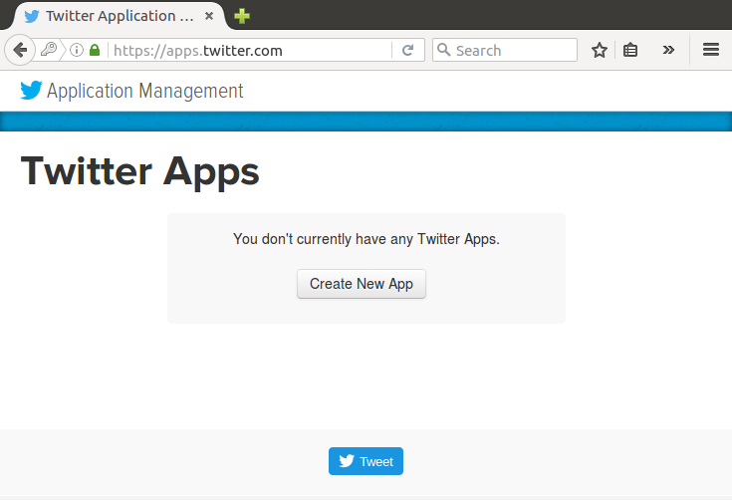
Now we open the website dev.twitter.com/apps in the Mozilla Firefox Browser.
We will now see the website suggesting us to sign in. So, we sign into our twitter account.
Click on Create New App.

Slide 14
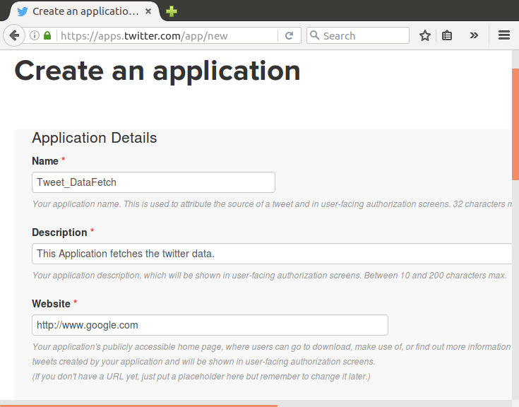
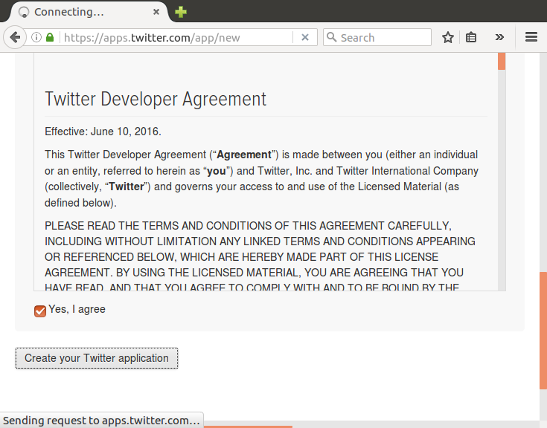
Fill in all the required fields to make the application and use the website as google.com.
Now, scroll down and tick the option Yes, I agree and then click Create your Twitter application.

Slide 15
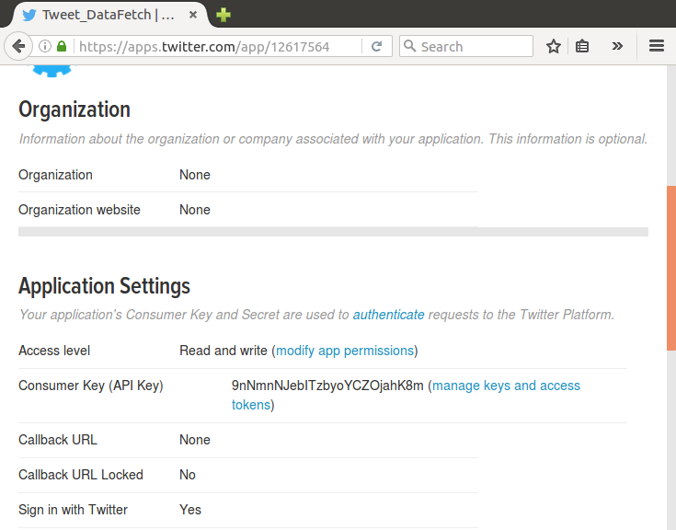
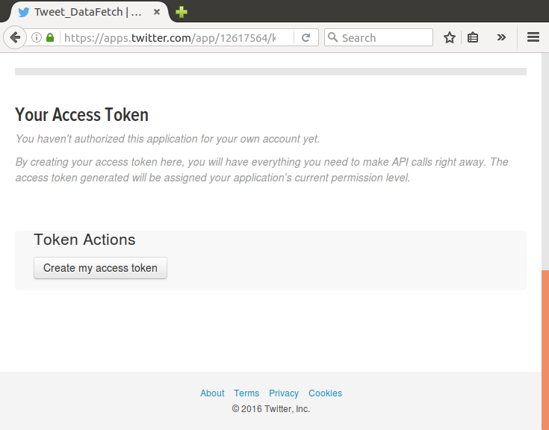
Click on manage keys and access tokens.
Now click on Create my access token.

Slide 16
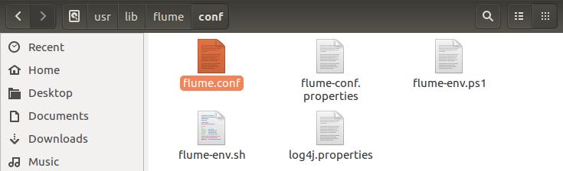
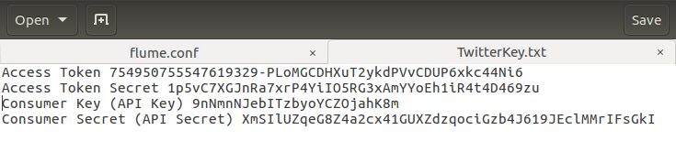
Now, we open flume.conf file in the directory /usr/lib/flume/conf and then change the following keys in the file. These keys will be obtained from the page above.
These are the keys which we will change in the flume.conf file:
Access Token, Access Token Secret, Consumer Key (API Key), Consumer Secret (API Secret)

Slide 17
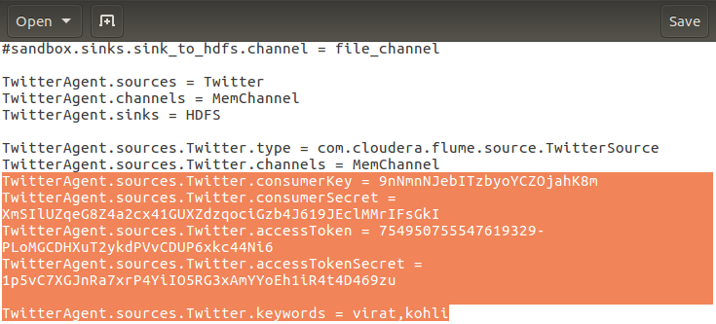
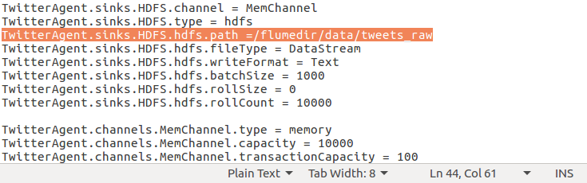
The keys are changed in this. Also add the keywords that we want to extract from twitter.

Slide 18
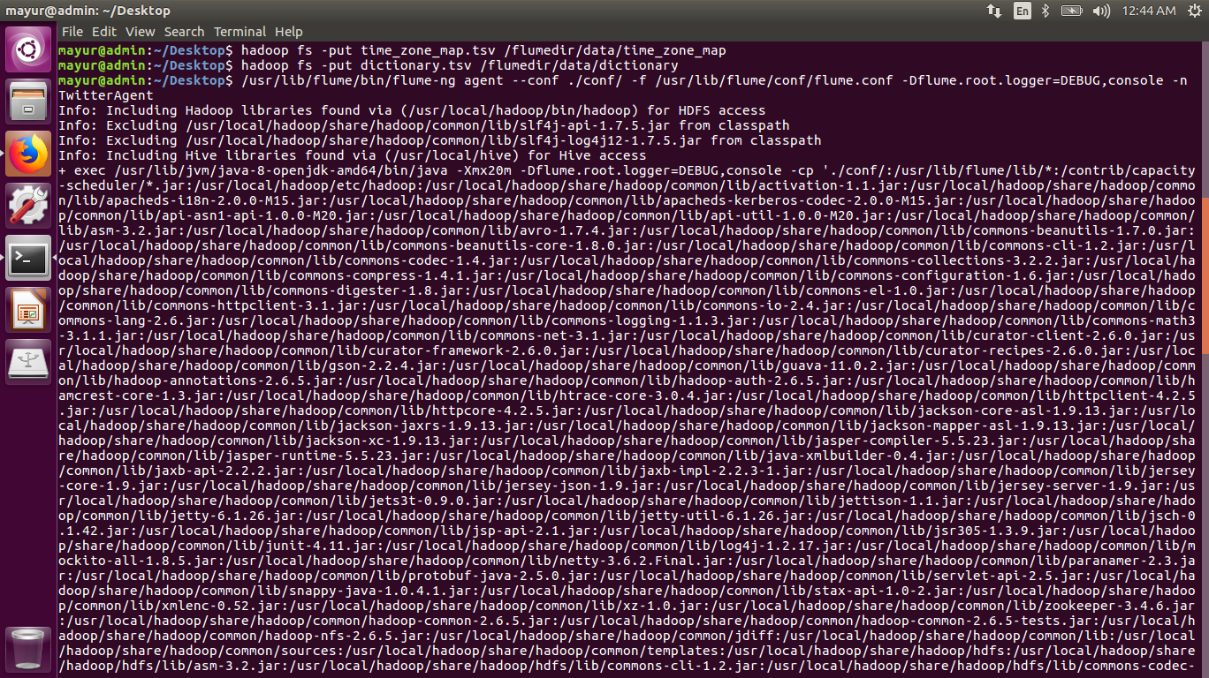

Slide 19
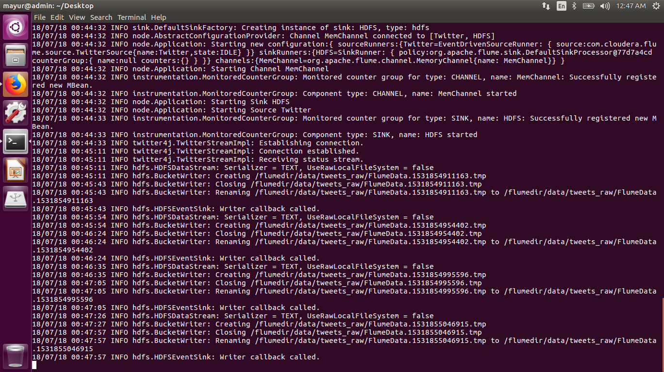

Slide 20
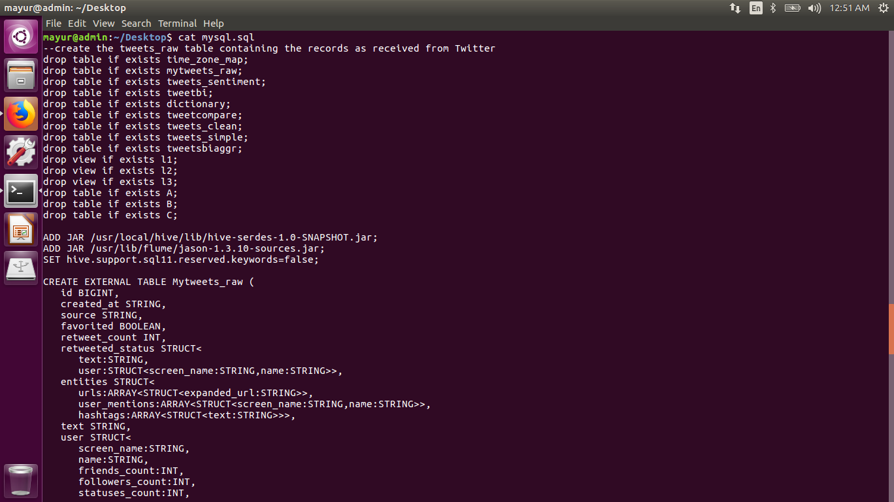

Slide 21
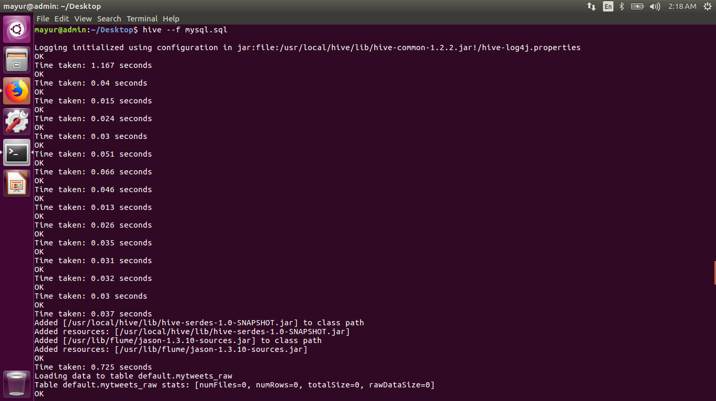

Slide 22
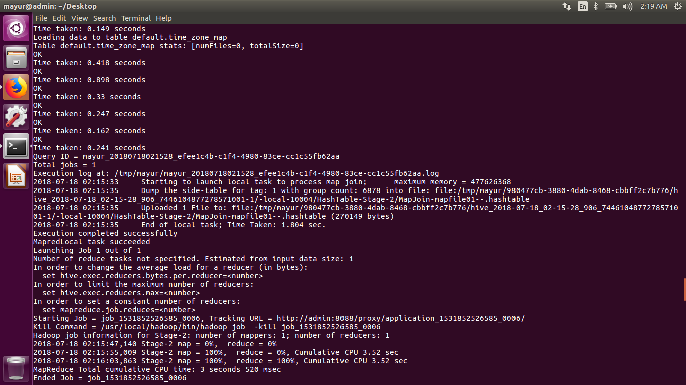

Slide 23
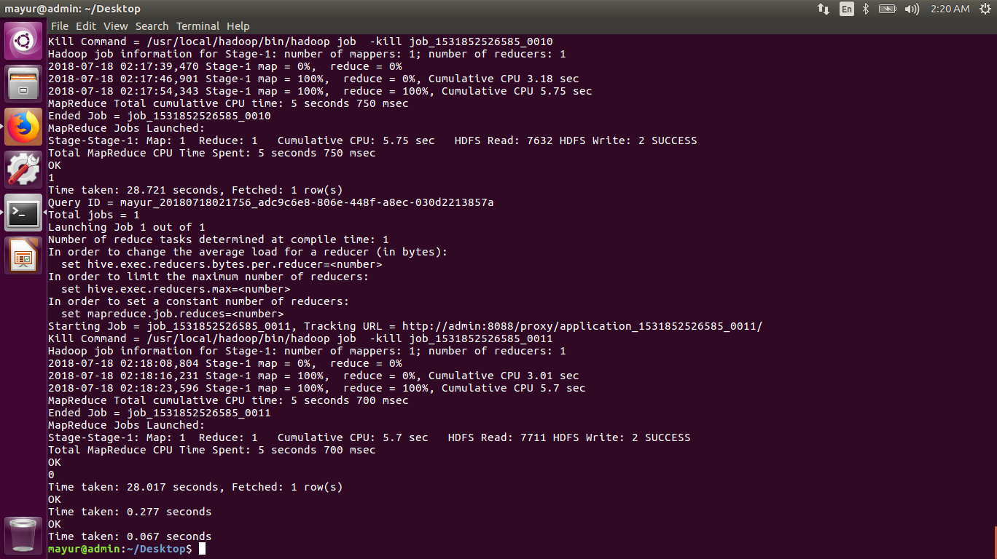

Slide 24
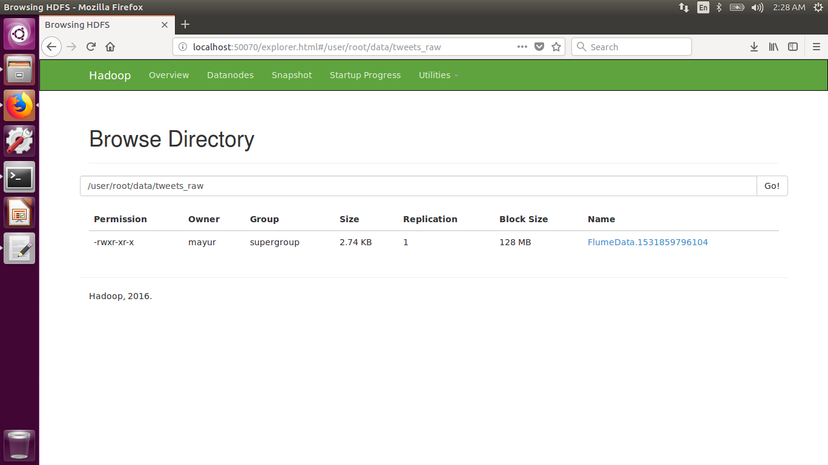

Slide 25
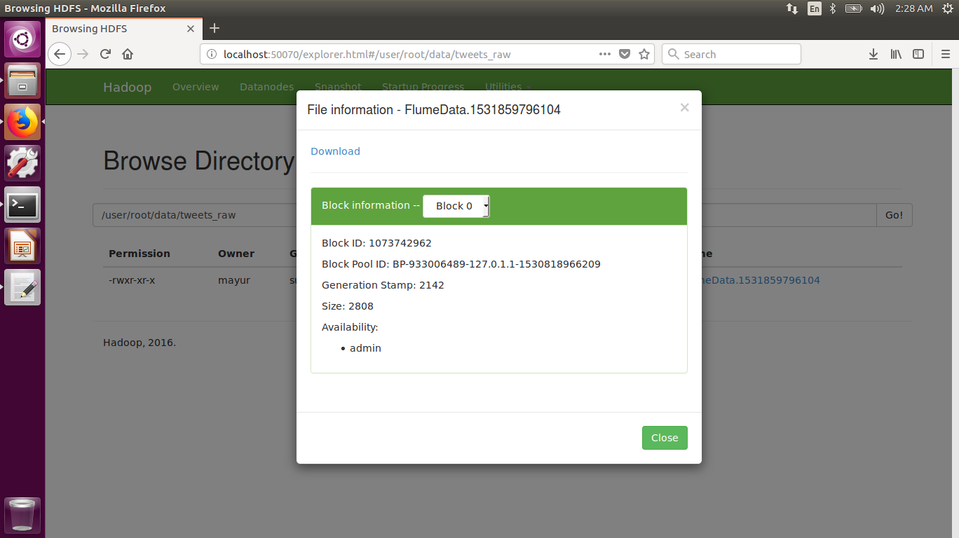

Slide 26
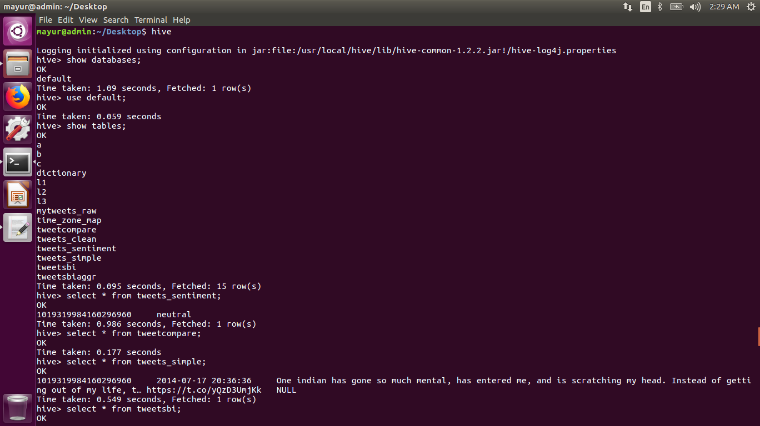

Slide 27
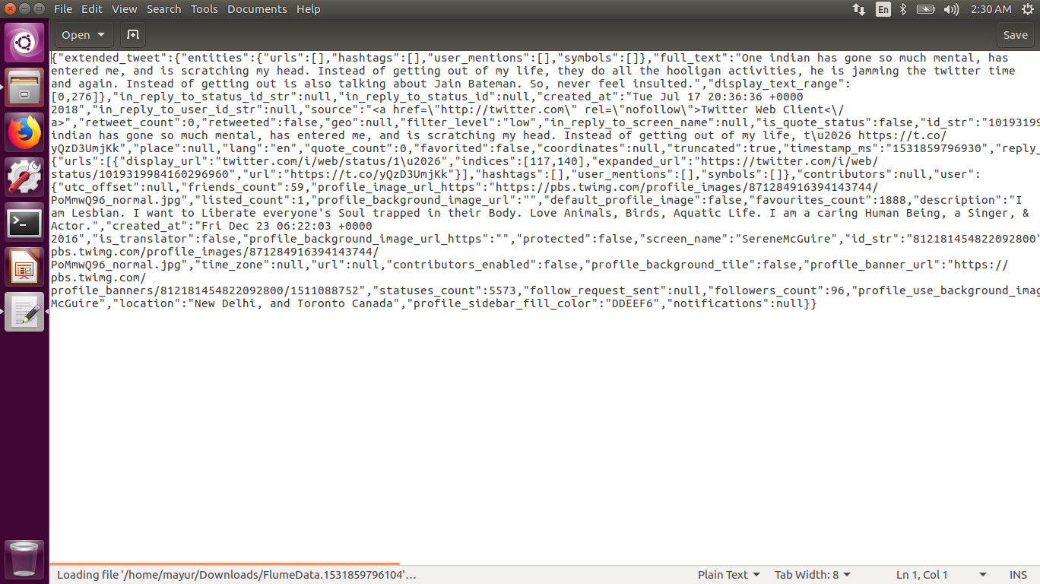

Slide 28


