Slide 1
AmazeKart -a shopping website
IT254 Project
Presented By:
Sanket Hanagandi – 201IT154
Mayur Jinde - 201IT135

Slide 2
Outline
Introduction and Objective
Methodology
Results
Future Work
Individual Contribution

Slide 3
Introduction and Objective
There is a lot of demand of shopping websites in todays generation as the world is becoming more and more online. So, to make the customer access the products and services we have designed a shopping website.
Objectives of our Project: Creating the product catalog models, adding them to the administration site, and building the basic views to display the catalog. Then, designing the registration form to collect and store the user data in the database.

Slide 4
Methodology
The whole project was divided into set of modules and the modules were built independently and then clubbed to form a complete webapp. The modules were:
• Frontend HTML/CSS pages: Basic HTML pages of the complete project were created. The basic HTML pages which were created in the first module were given styling’s and work on aesthetics of the pages was done.
• Dynamic URL linking of the pages: All the pages created for the frontend were dynamically linked to each other, using links we passed the required data for the next page to render.
• Creating views and models: Views contain the functions which will fetch the data from database and will pass this data to the HTML pages to render the data, models are used to create tables for the database.
• Server side handling: Storing the customers data in the XAMPP(open source web server) MySQL database.

Slide 5
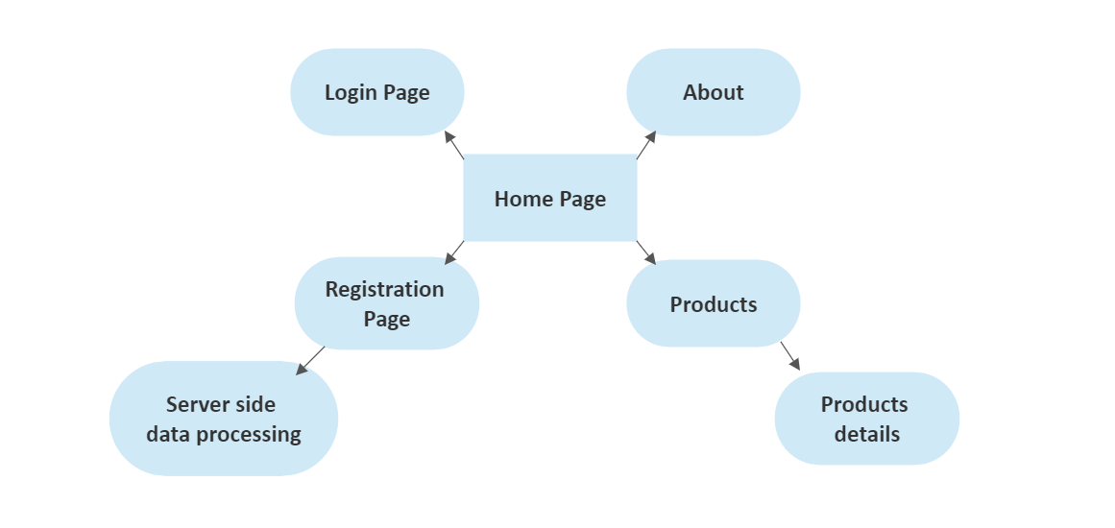
Flow Chart

Slide 6
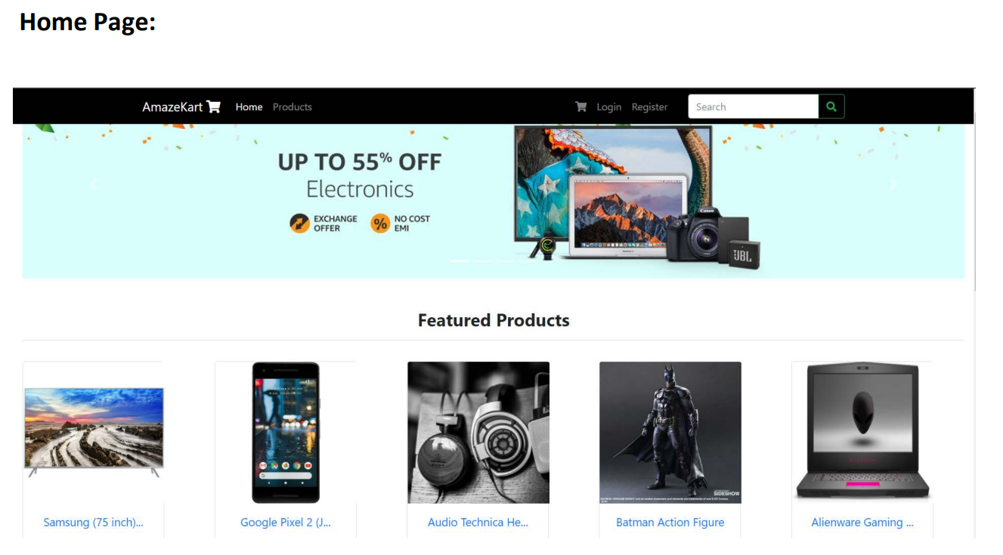
Results

Slide 7
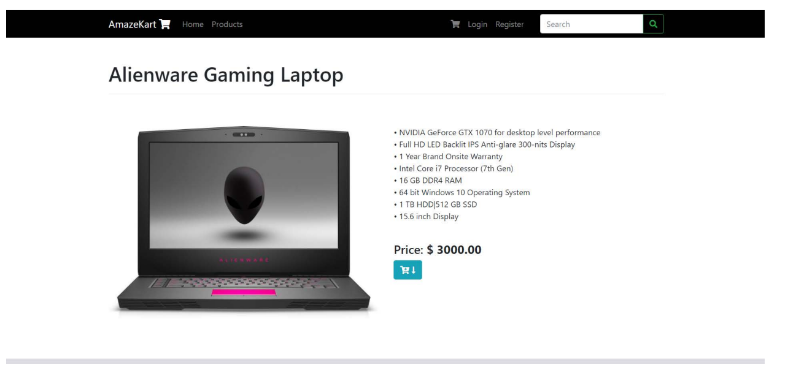
Product Detail Page:

Slide 8
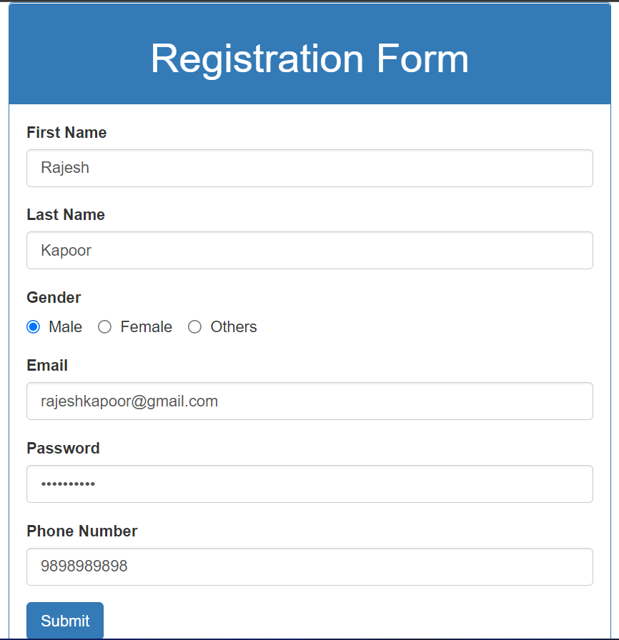
Registration Page:

Slide 9
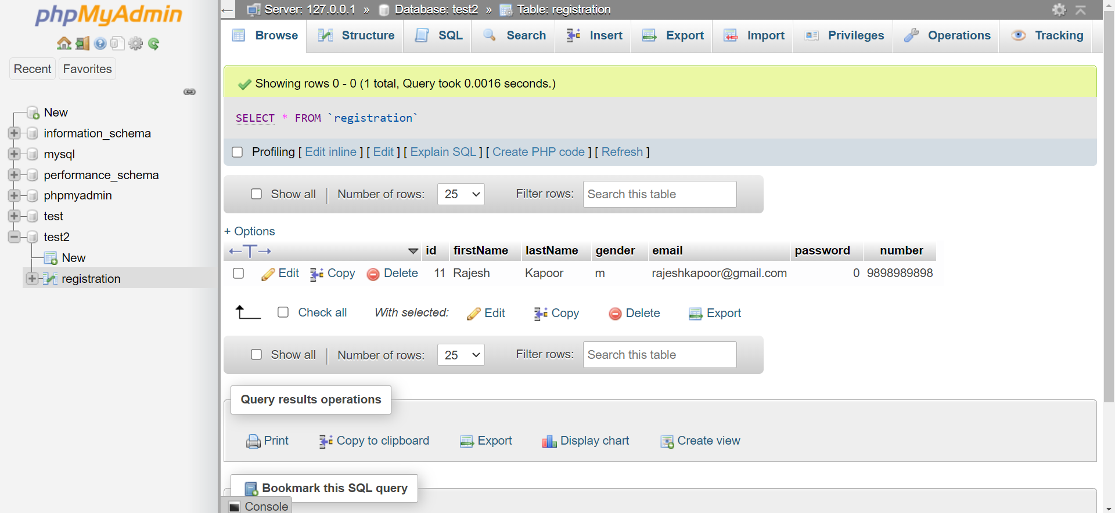
Server Side Database:

Slide 10
Future Work
The future work would be to work on placing the order and including the payment opotion to our website.

Slide 11
Individual Contribution
Sanket : Worked on the server side part and designed the registration page.
Mayur Jinde: Worked on the frontend part and collected the various details of the products.

