Slide 1
Coding Platform and Tool for Plagiarism Detection
Major Project-II (IT499) End-Semester Evaluation
Presented by
Shaulendra Kumar (201IT159)
Mayur Jinde (201IT135)
Ritik Kumar (201IT250)
Under the guidance of
Dr. Rammohana Reddy Guddeti
Professor (HAG Scale)
Department of Information Technology
National Institute of Technology Karnataka, Surathkal-575025

Slide 2
CONTENTS
Introduction
Literature Survey
Outcomes of Literature Survey
Problem statement and Objectives
Methodology
Experimental Results and Discussion
Conclusions and Future Work
References

Slide 3
Introduction
The Coding population is increasing vastly every day since everyone knows that computers are our future. There are only two major Competitive coding websites for more than a million-user base, so obviously, this particular market is yet to be utilized entirely. This project is built with the exact same intention of exploiting this user base. The system consist of various features like problem space, individual space, contest space as well as personal development space.
The platform will contain plagiarism checker that will help in assigning the score to the each individual on the basis of the copy percentage. Hence it will help in eradicating the cheating which is happening among the user.

Slide 4
Literature Survey
Research Paper [1]: “Interactive coding platform for students.”
Summary
This Paper introduces a user-friendly web application to promote coding culture in colleges. Teachers can assign tasks and provide feedback, while students benefit from features like performance comparison and customizable test environments. The initiative addresses the industry demand for essential coding skills in graduating students.
Limitations
Do not talk about plagiarism checking , students might be copying from other sources or from students.
4

Slide 5
Literature Survey (Contd.)
Research Paper [2]: "AST-Based Code Plagiarism Detection Algorithm"
Summary
The paper introduces an advanced plagiarism detection algorithm based on abstract syntax trees (AST), leveraging hash values for efficient comparison. Special measures are taken to minimize errors in hash calculations, particularly in arithmetic operations. Test results demonstrate the algorithm's reliability and effectiveness, showcasing its potential to safeguard source code copyrights and enhance code comparison capabilities.
5

Slide 6
Literature Survey (Contd.)
Research Paper [3]: "A Low-Level Structure-based Approach for Detecting Source Code Plagiarism“
Summary
This research adds to the study of plagiarism detection by introducing a unique low-level structure-based approach for identifying source code plagiarism. It builds on existing methods, focusing on detailed code structure. The presented evaluation results offer insights into its effectiveness compared to established methods.
6

Slide 7
Literature Survey (Contd.)
Research Paper [4]: “A State of Art on Source Code Plagiarism Detection”
Summary
This paper delves into the challenges of detecting plagiarism in code, considering variations in programming languages. The authors present techniques and algorithms to help organizations and academic institutions identify source code plagiarism. The paper also compares these methods to highlight their differences and conflicts.
7

Slide 8
Outcomes of Literature Survey
New and improved methods for detecting code plagiarism are emerging.
Effective code plagiarism detection methods utilize ASTs or token sequences to represent code structure.
Similarity measures such as Jaccard index and Levenshtein distance are effective for comparing code structures.
Effective code plagiarism detection methods are robust to subtle code changes, large datasets, and different programming languages.
Challenges in the field include defining plagiarism and creating diverse datasets.
8

Slide 9
Problem Statement and Objectives
Problem Statement
To develop a coding Platform where students can practice coding problems that can be added by course instructors or the problems will be listed along with the topic tag from different coding platforms like codechef, codeforces, hackerrank, leetcode etc and evaluating the code with plagiarism checker which will check whether the code is taken from other coding platform and AI generated tools such ChatGPT etc.
9

Slide 10
Objective(contd.)
Objectives
Develop a coding platform with many problems in different categories, each with a problem statement, test cases, tags, and rating.
Provide a coding space where users can write or upload code, which will be compiled, evaluated, and results shown.
Develop a plagiarism checker to check if code is taken from other coding platforms.
Make the platform easy to use and accessible to all.
Make the platform scalable and extensible.
10

Slide 11
Requirements
Functional Requirements:
Scraping problems from different websites like Codeforces, HackerEarth, etc.
Codeforces API for fetching problem lists, details, tags, and user details.
Also, code compilation APIs for compiling the code.
Integration of IDE for writing code.
Non-Functional Requirements:
User authentication and authorization.
The React frontend code can be used anywhere on the website which provides reusability.
MongoDB is the database used. Data is protected with pre-configured security features forauthentication, authorization, encryption, and more.

Slide 12
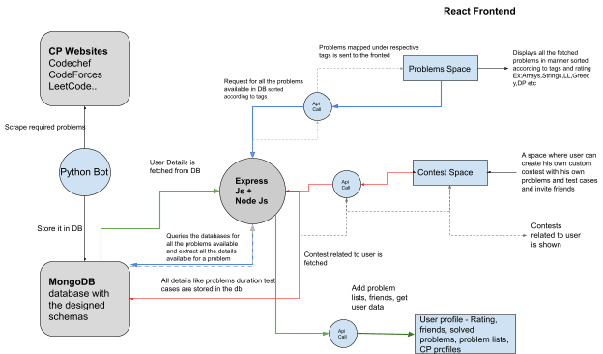
Methodology
12

Slide 13
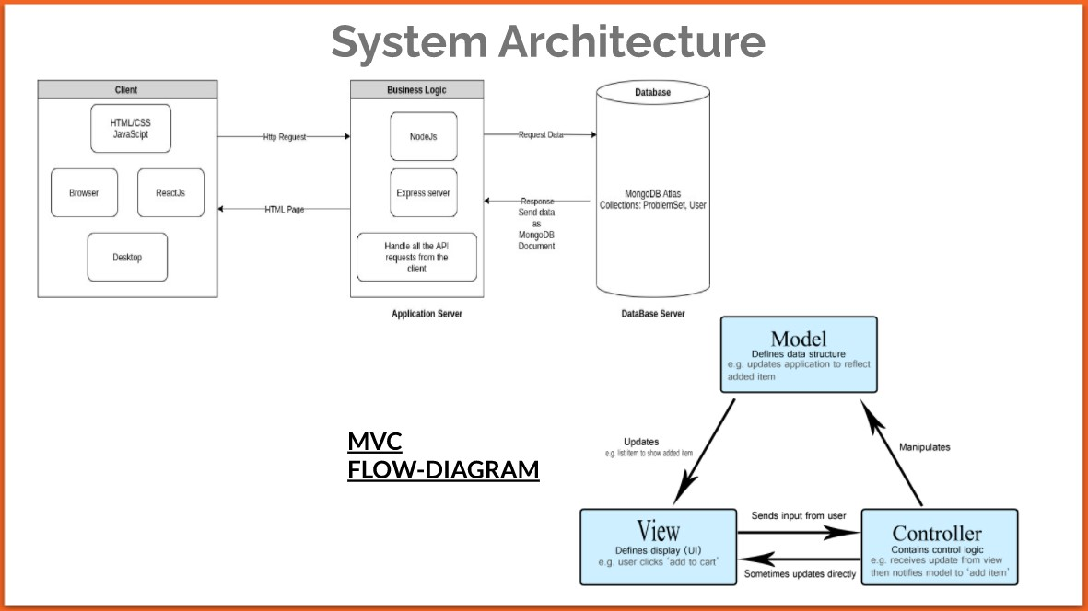
Methodology (Contd.)
13

Slide 14
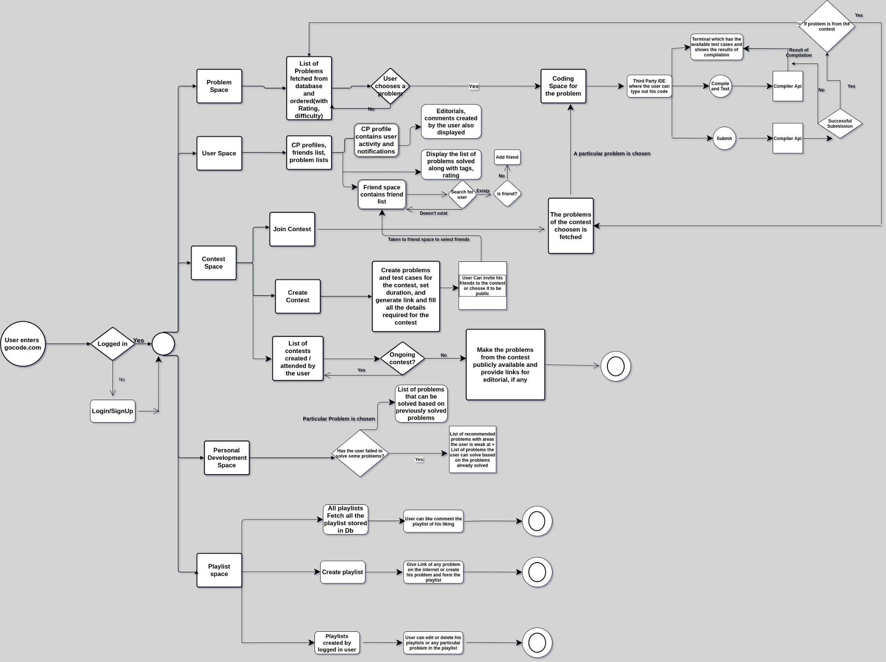
Methodology (Contd.)
14

Slide 15
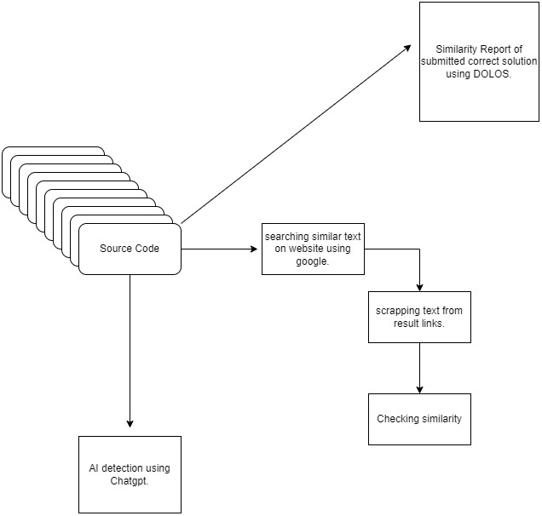
Plagiarism Checker Module
15

Slide 16
Modules of our Project
Problems Space
Coding Space
Personal Development Space
Contest Space
Playlist Space
User Space
16

Slide 17
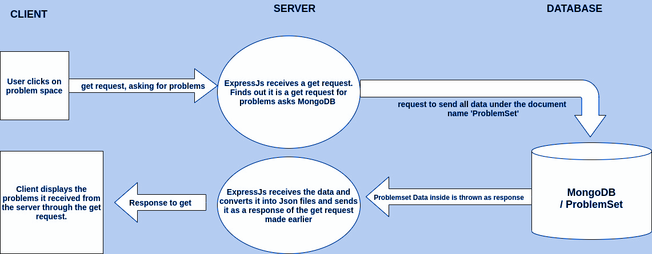
Problems Space
Problem Space: A plethora of problems, in different categories. Each problem would be having a problem statement (that includes constraints), test cases, tags, and rating.

Slide 18
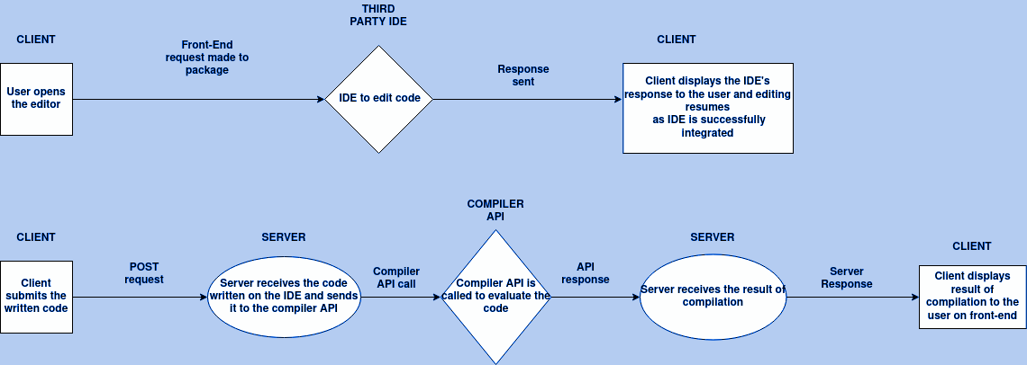
Coding Space
Coding Space: Users can either use the website’s basic IDE to write code and submit or upload their solution file (C, C++, Python, Java). This will be compiled, evaluated and corresponding results will be shown to him/her.

Slide 19
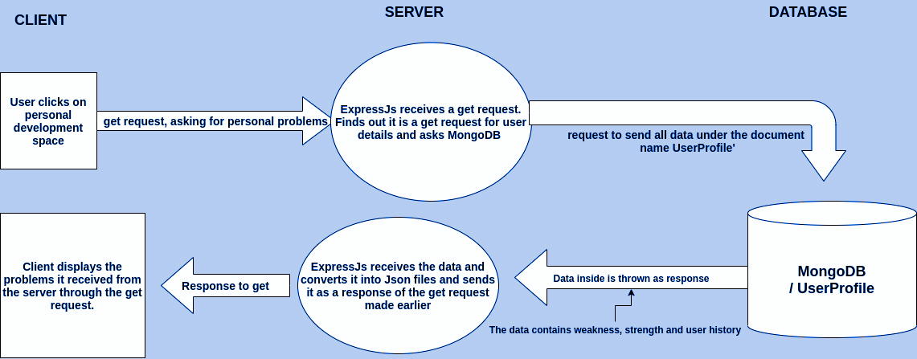
Personal Development Space
Personal Development Space: Users can work out list of problems based on their activity/history and practice. Providing feedback based on the history of the user, in the form of weaknesses and strengths.

Slide 20
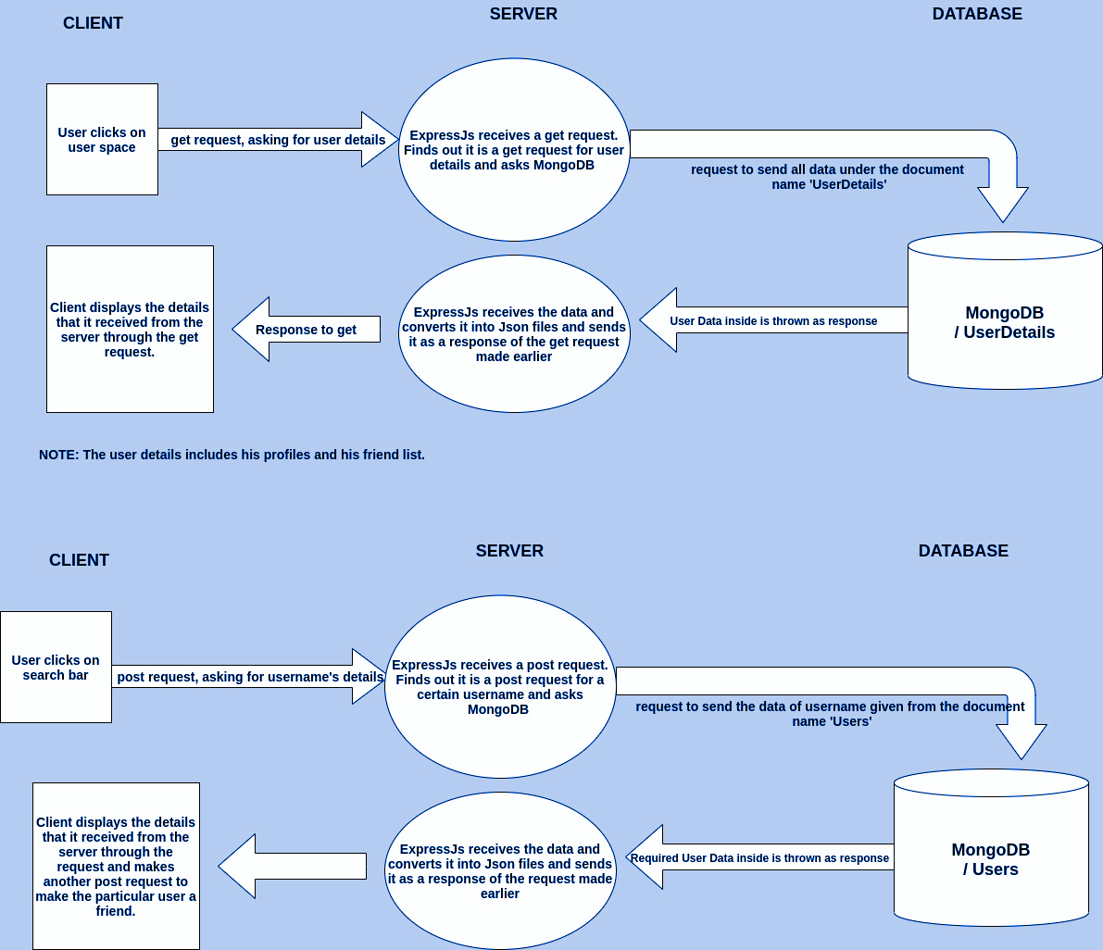
User Space

Slide 21
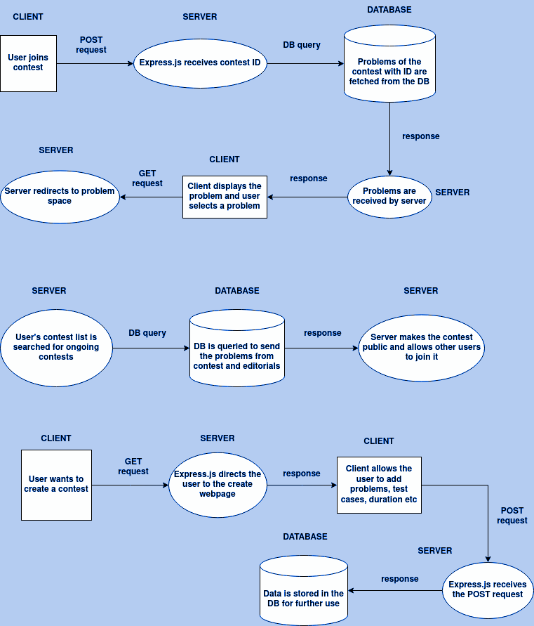
Contest Space

Slide 22
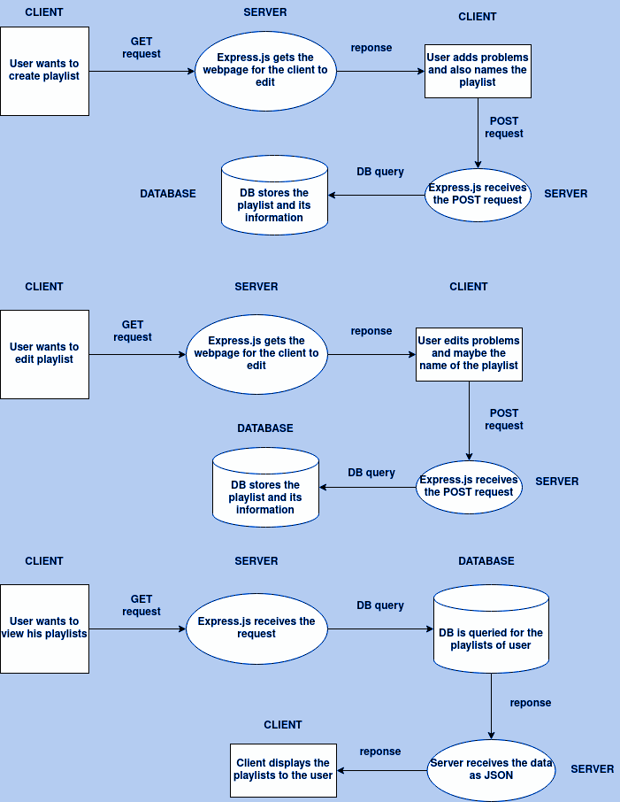
Playlist Space

Slide 23
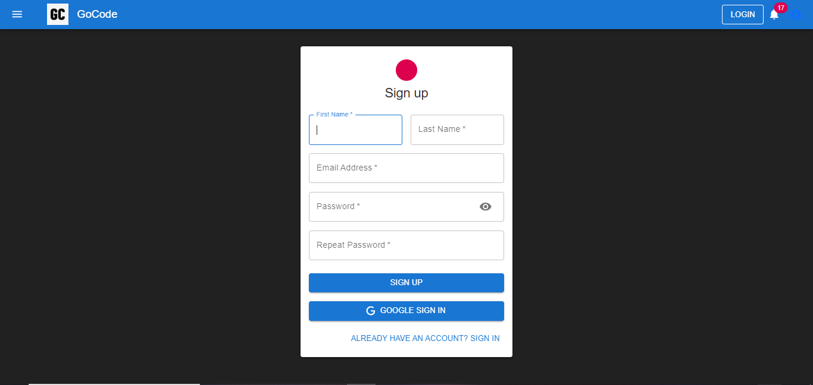
Experimental Result and Discussion
Sign Up
The sign-up page for our platform. It asks for the first name, last name, email, and password. We can also sign up with the Google account if you prefer. If you already have an account, there's a sign-in link at the bottom.
23

Slide 24
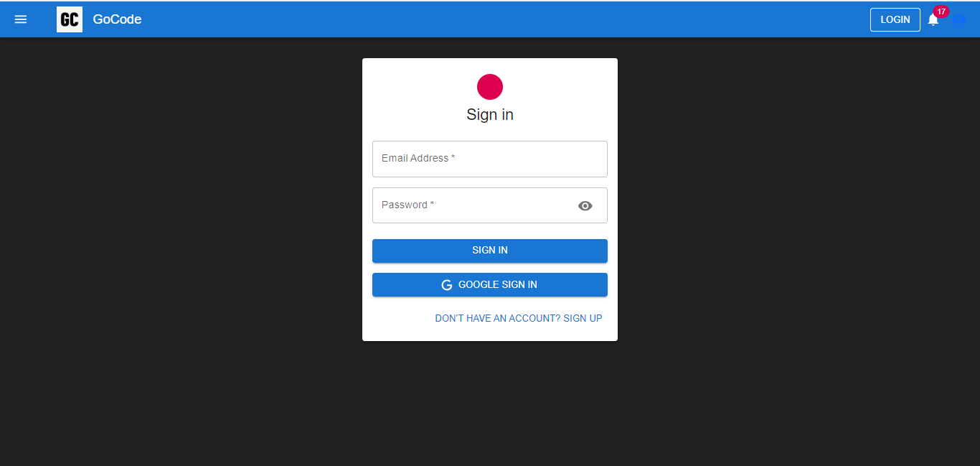
Experimental Result and Discussion(Cntd.)
Sign in
The login screen for our platform. Users can also sign in using a Google account, which eliminates the need to enter a separate username and password.
24

Slide 25
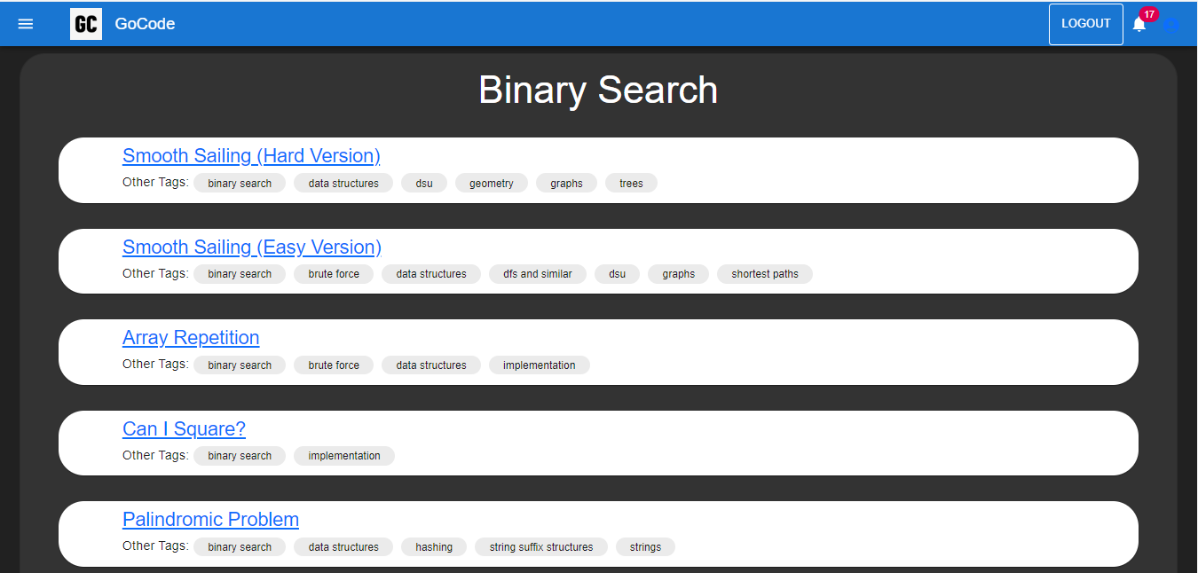
Experimental Result and Discussion(Cntd.)
Problem Space
The picture shows the screenshot of different problems categorized in a particular section called Graphs. Also having their problem tags.
25

Slide 26
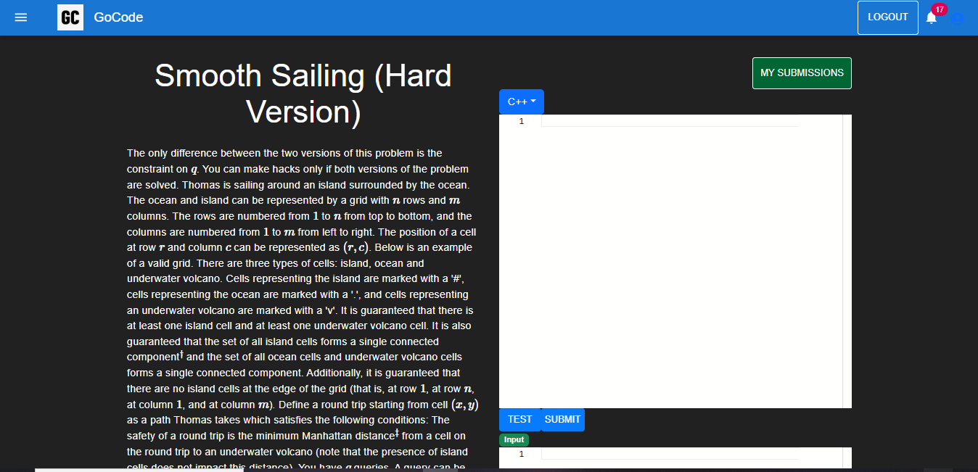
Experimental Result and Discussion(Cntd.)
Problem Statement
The pictures shows the problem statement along with the editor to compile the code. The user is provided with 4 different languages to edit the code.
26

Slide 27
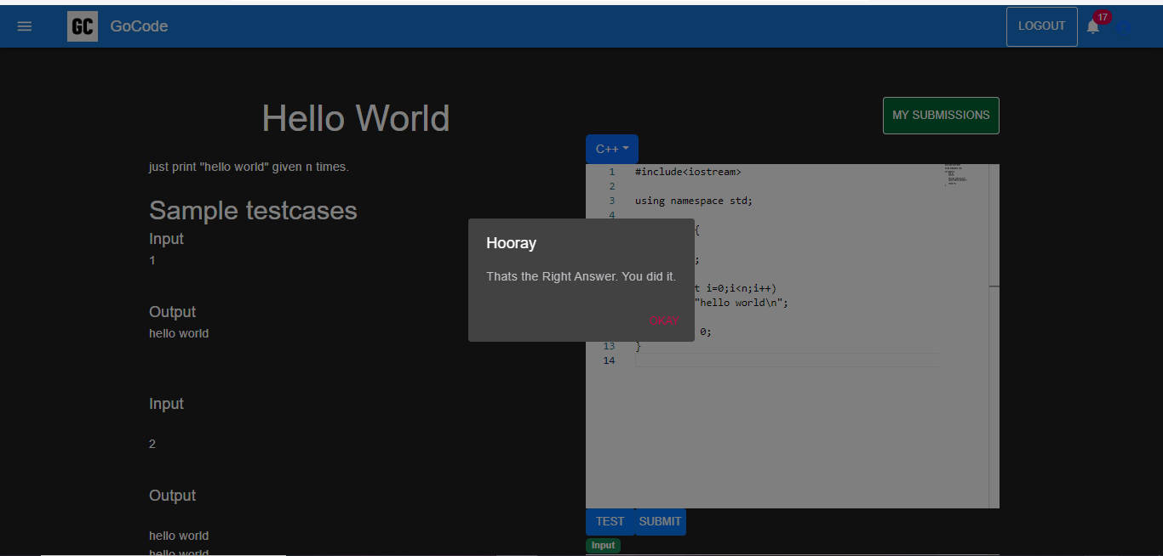
Experimental Result and Discussion(Cntd.)
Successful Submission
The picture shows the popup window for the successful submission of the problem.
27

Slide 28
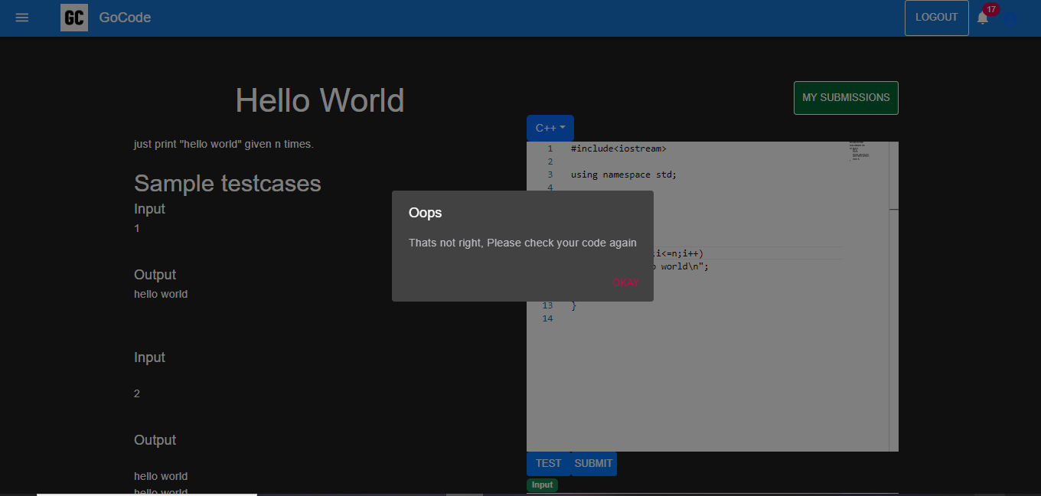
Experimental Result and Discussion(Cntd.)
Wrong Submission
The picture shows the popup window for the wrong submission of the problem. The problem submitted will be recorded in all submissions module.
28

Slide 29
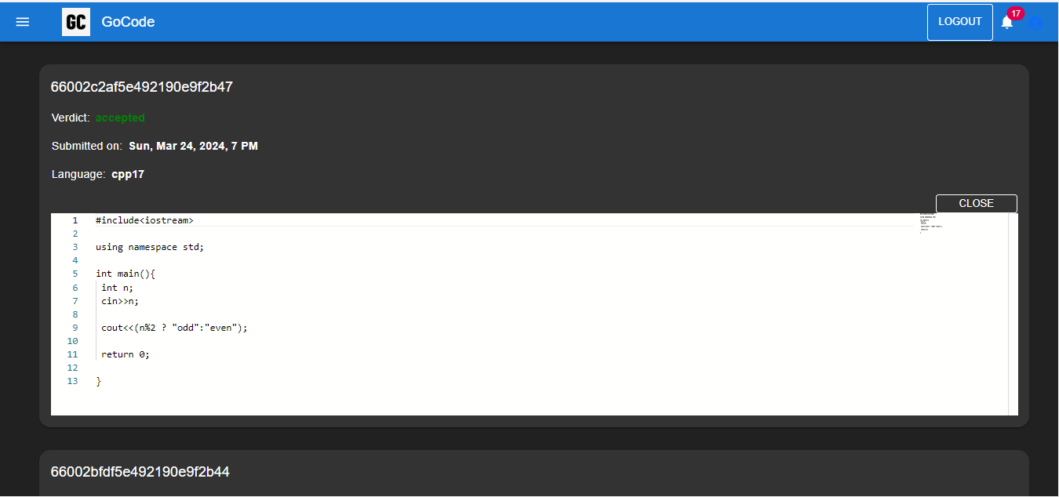
Experimental Result and Discussion(Cntd.)
All Submissions
The picture shows all the submissions made for a particular problem. Contains various details like time of submission etc.
29

Slide 30
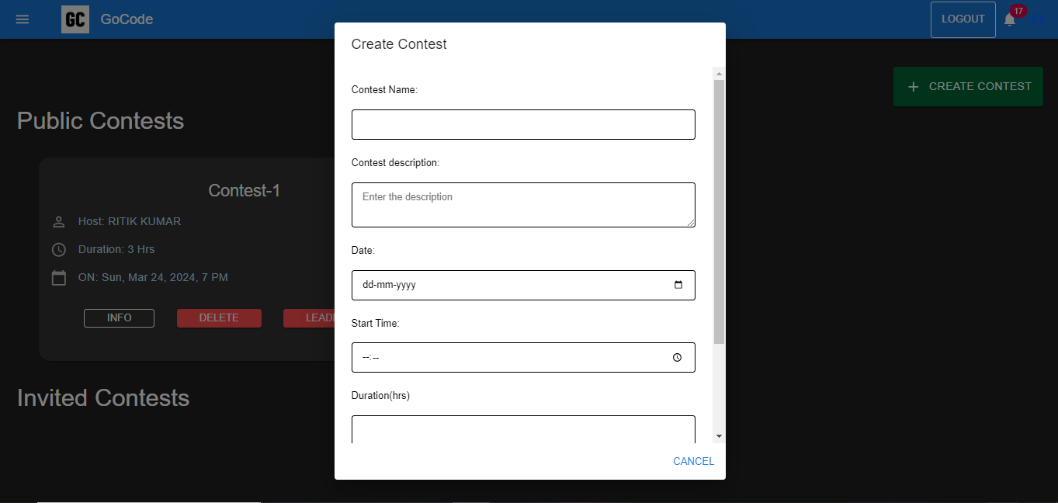
Experimental Result and Discussion(Cntd.)
Create Contest
The picture shows the popup window to create a contest consisting of various parameters.
30

Slide 31
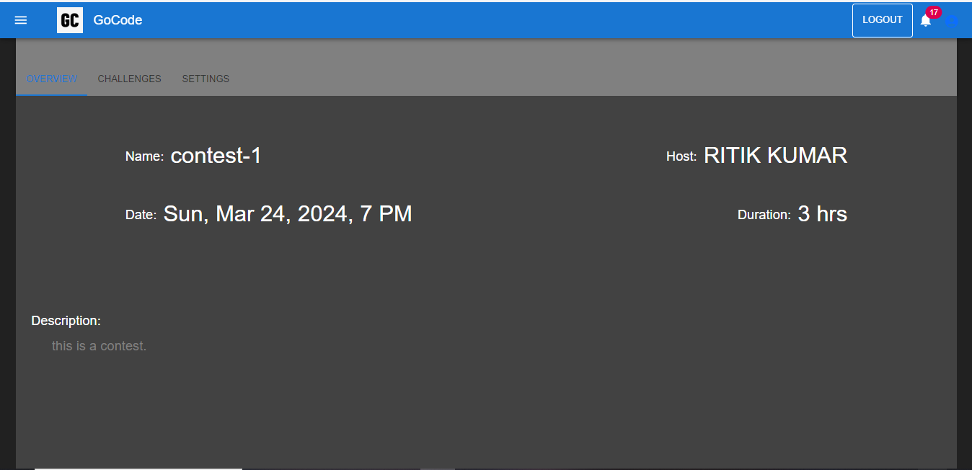
Experimental Result and Discussion(Cntd.)
Contest Overview
The picture shows the overview for the contest created by the user, consisting of various fields such as name of the contest, owner of the contest, duration etc.
31

Slide 32
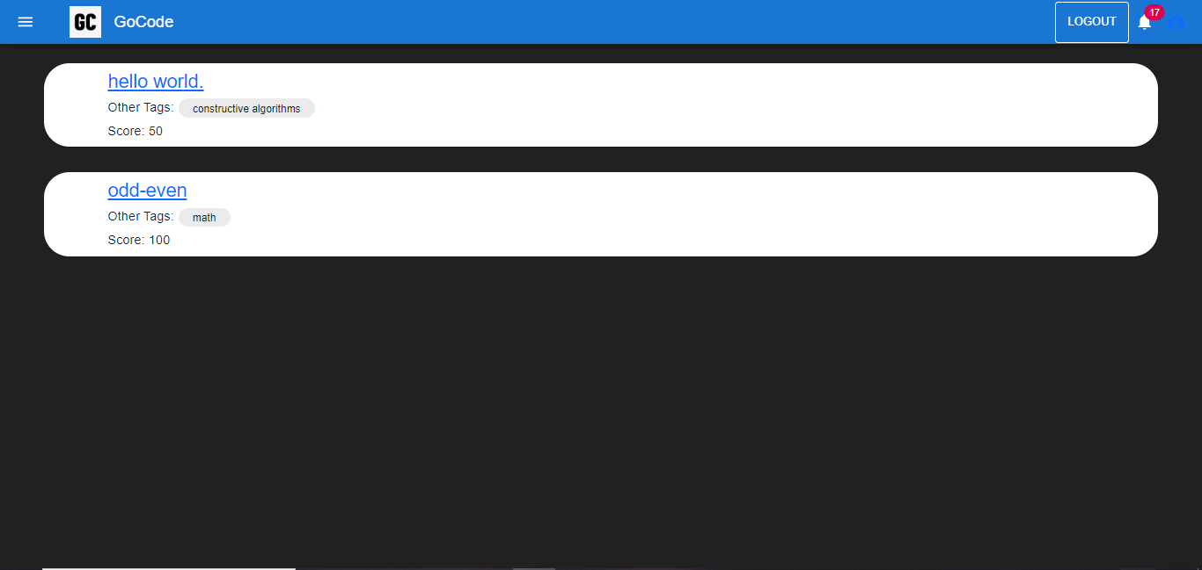
Experimental Result and Discussion(Cntd.)
Created Problems
The picture shows all the problems under the create contest module with various problem tags along with it.
32

Slide 33
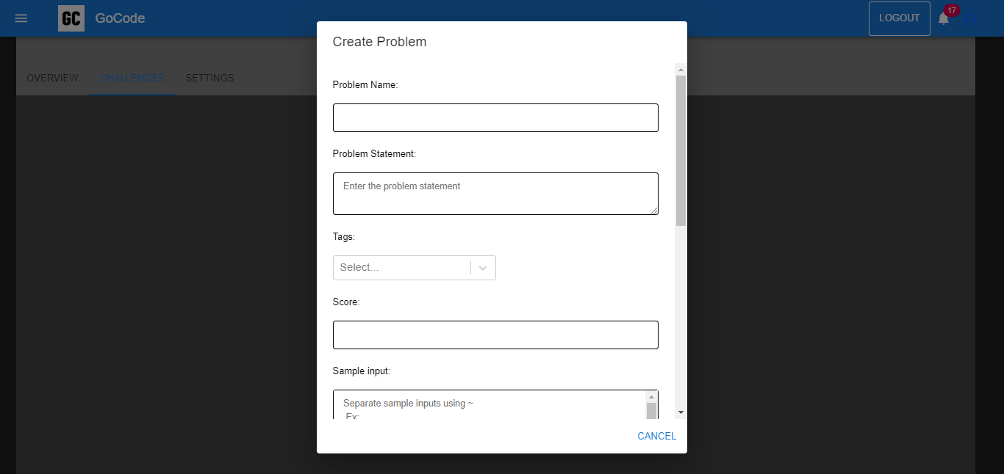
Experimental Result and Discussion(Cntd.)
Create Problems
The above picture shows the popup for the creation of the playlist by the user of different variety of problems..
33

Slide 34
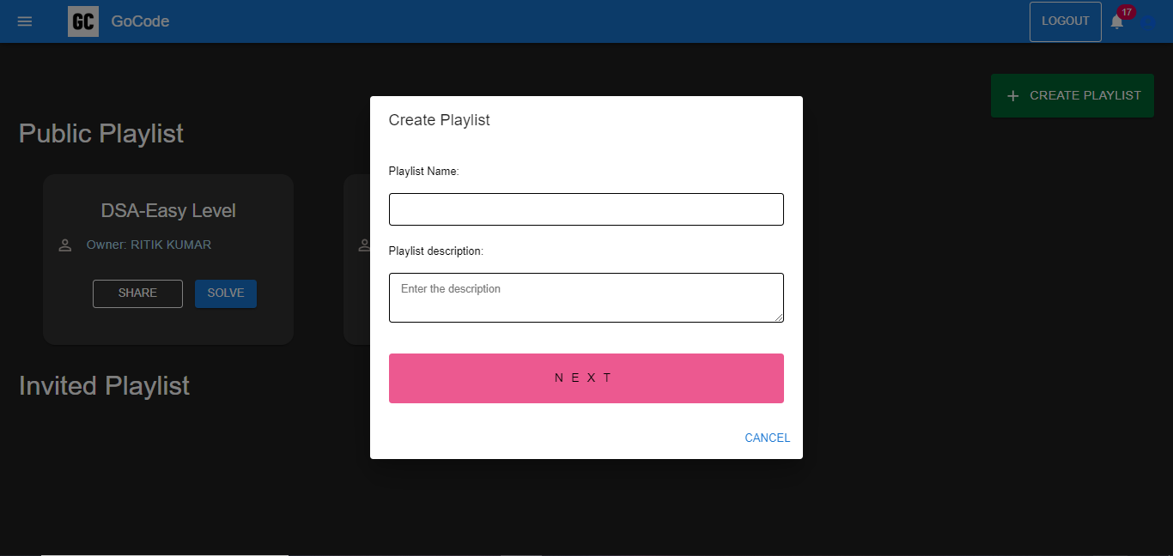
Experimental Result and Discussion(Cntd.)
Create Playlist
The picture shows the popup for the creation of the playlist by the user of different variety of problems.
34

Slide 35
Experimental Result and Discussion(Cntd.)
Playlist Problems
The picture shows all the problems under the Playlists module with various problem tags along with it.
35

Slide 36
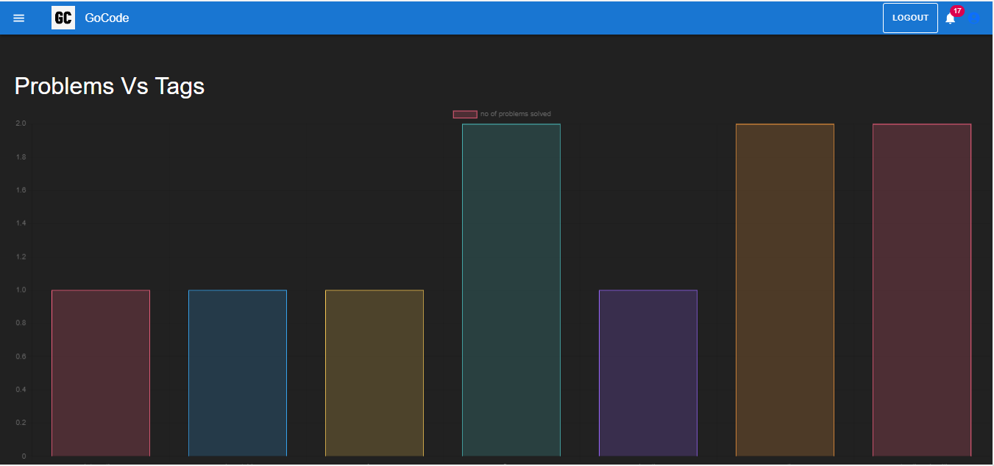
Experimental Result and Discussion(Cntd.)
Problems v/s Tags
The picture shows the number of problems solved under various different categories or tags.
36

Slide 37
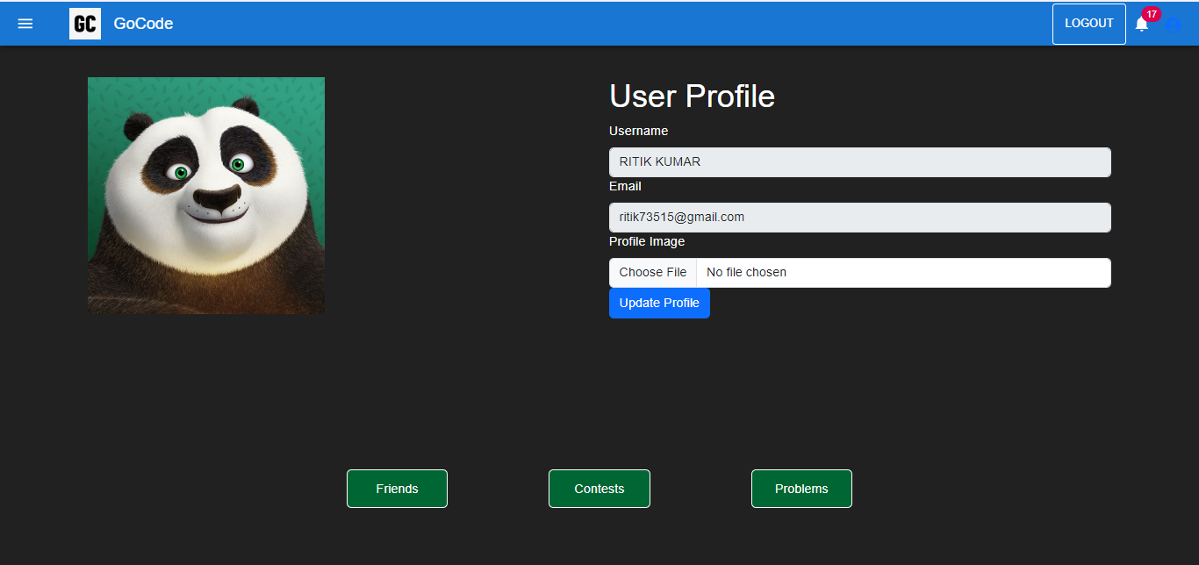
Experimental Result and Discussion(Cntd.)
User Profile
The figure shows the user profile page consisting of username, email, password field. The password of the user may be updated if required.
37

Slide 38
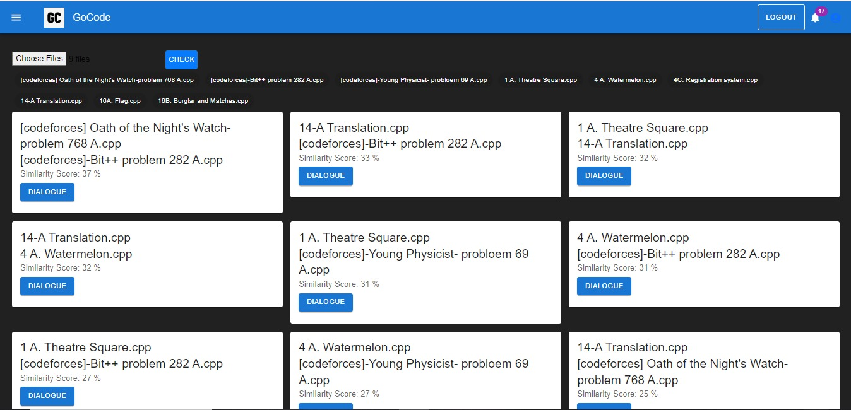
Experimental Result and Discussion(Cntd.)
Similarity Score
The picture shows the similarity score among the chosen source code files (a page to demonstrate to DOLOS framework).
38

Slide 39
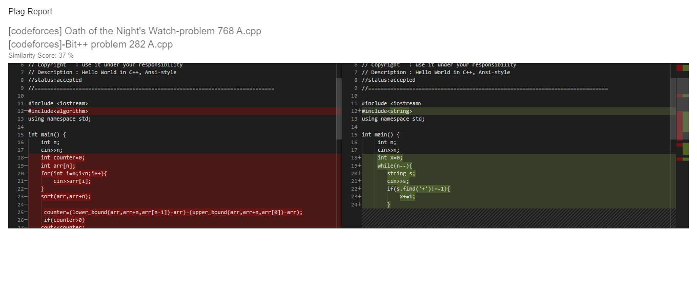
Experimental Result and Discussion(Cntd.)
Plagiarism Report
The picture shows the visual representation of the changes made in second code.
39

Slide 40
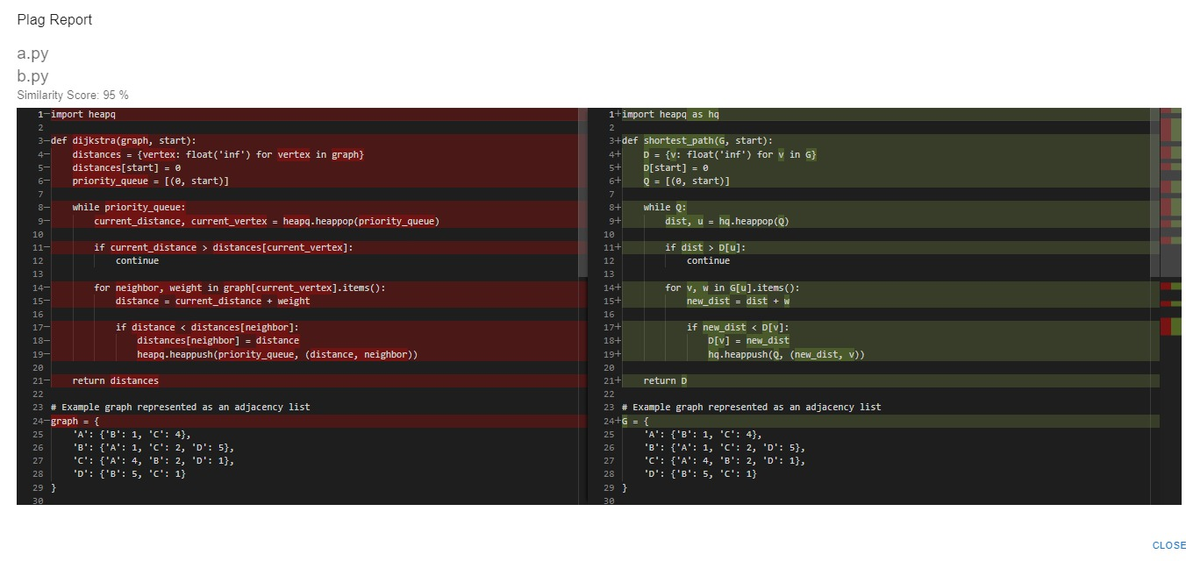
Experimental Result and Discussion(Cntd.)
Plagiarism Report
The shows the plagiarism report for the changed variable names and spotting the similarities.
40

Slide 41
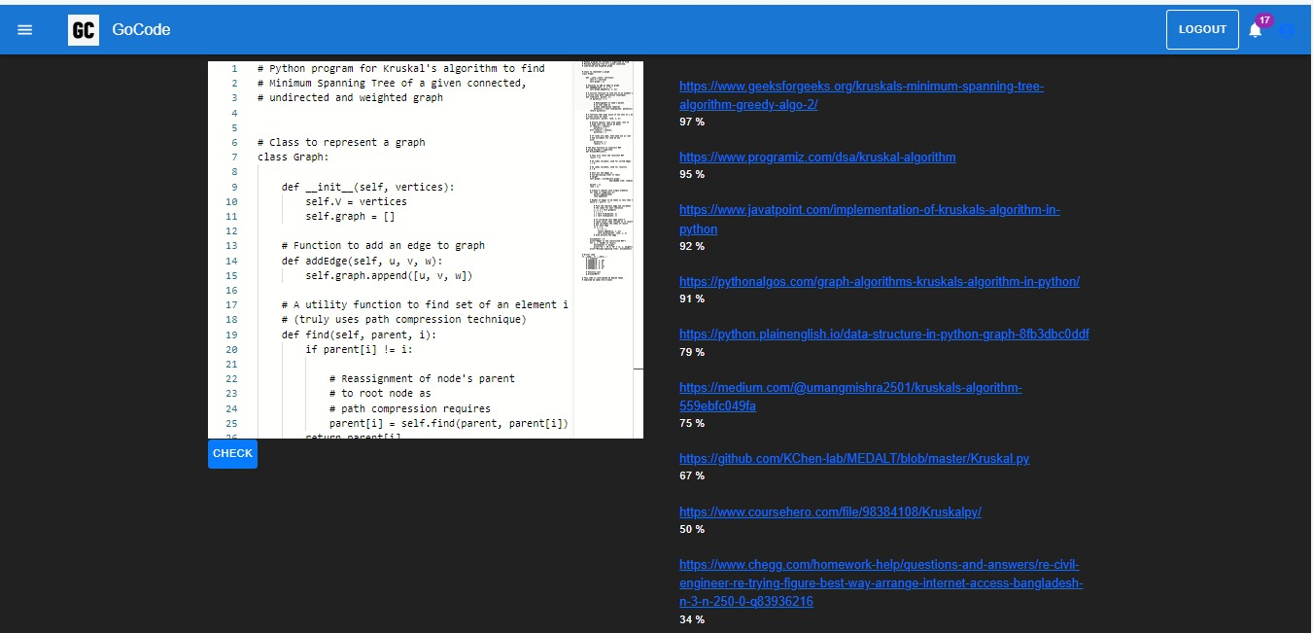
Experimental Result and Discussion(Cntd.)
Source Code similarity across webpages
The picture shows the similarity score of the source code with different website solution code such as codeforces, geekforgeeks, github etc.
41

Slide 42
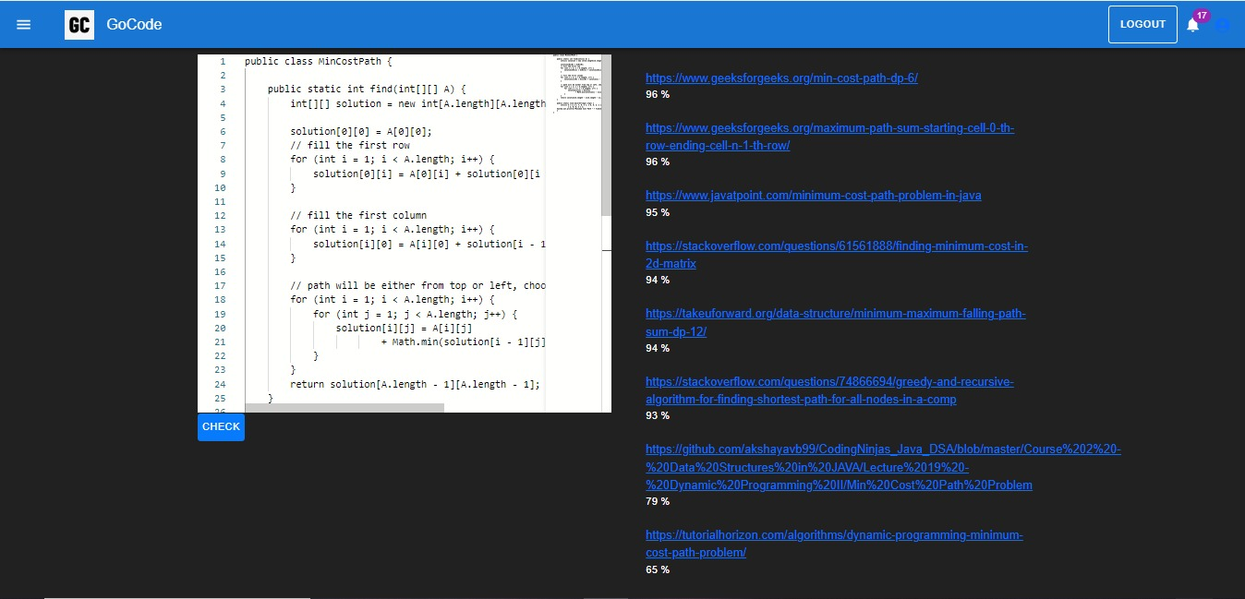
Experimental Result and Discussion(Cntd.)
Source Code similarity across webpages
The picture shows the similarity score of the source code with different website solution code such as codeforces, geekforgeeks, github etc.
42

Slide 43
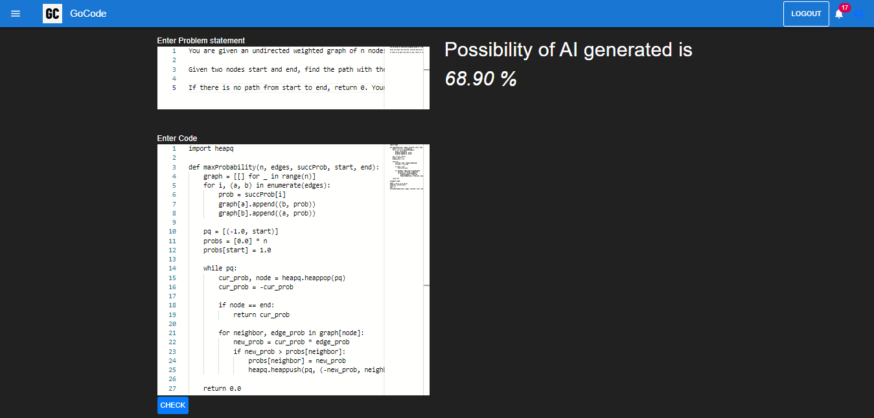
Experimental Result and Discussion(Cntd.)
Possibility of similarity from AI
The picture shows the possibility of similarity of the source code copied from any AI generated tools.
43

Slide 44
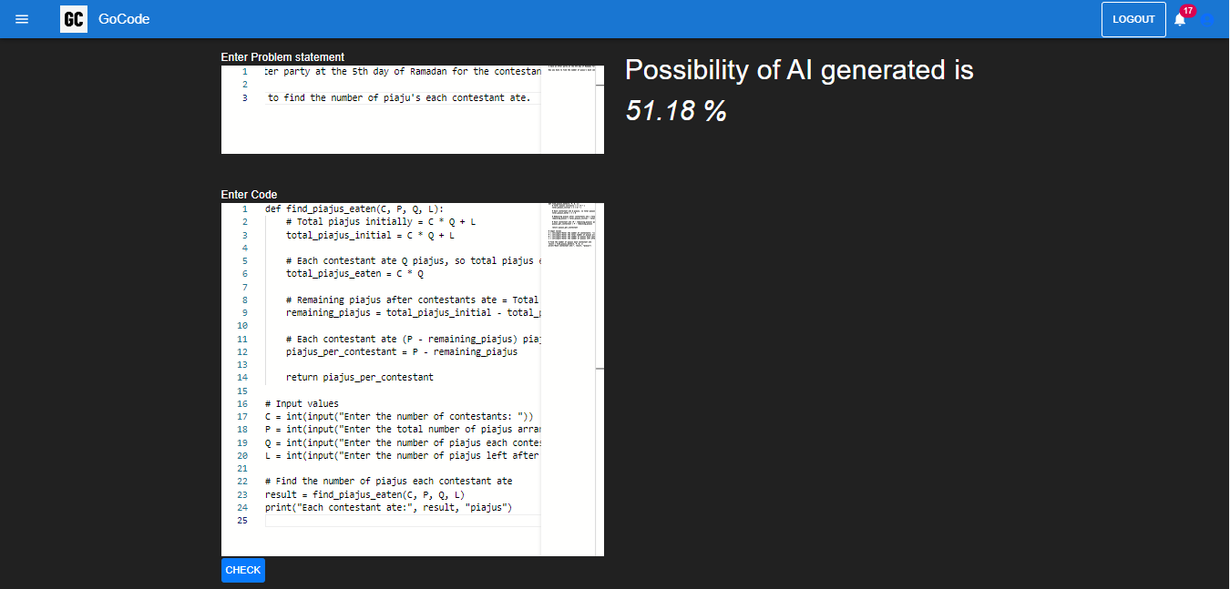
Experimental Result and Discussion(Cntd.)
Possibility of similarity from AI
The picture shows the possibility of similarity of the source code copied from any AI generated tools.
44

Slide 45
Conclusion and Future Work
Our project aims to enhance the GUI by offering more problem options, implementing timers for each problem, expanding language choices, and introducing diverse code editor themes. Additionally, we plan to integrate plagiarism detection from emerging Advanced AI platforms like ChatGPT-4, AI Devin, and Gemini (Ultra). This coding platform not only fosters a coding culture at the college level but also facilitates fair evaluation of assignments, aiding students in honing their skills and preparing for internships and placements by providing a comprehensive range of coding challenges sourced from various platforms.
45

Slide 46
References
[1] S. Karthikeyan K. Saranya T. K. Chandru, M. Dinesh Kumar. Interactive coding platform for students. International Journal of Recent Technology and Engineering (IJRTE), 2018.
[2] Yilun Fu Baojiang Cui Jingling Zhao, Kunfeng Xia. An ast-based code plagiarism detection algorithm. 10th International Conference on Broadband and Wireless Computing, Communication and Applications, 2015.
[3] Oscar Karnalim. A low-level structure-based approach for detecting source code plagiarism. IAENG International Journal of Computer Science, 44(4), 2017.
[4] Mayank Agrawal and Dilip Kumar Sharma. A state of art on source code plagiarism detection. In 2016 2nd International Conference on Next Generation Computing Technologies (NGCT), pages 236–241. IEEE, 2016.
46

Slide 47
Thank You

