Slide 1
Parallelizing Strassen's matrix multiplication
IT301 Project
Group 34
Group Members:
Sanket Hanagandi – 201IT154
Mayur Jinde – 201IT135
Shaulendra Kumar – 201IT159

Slide 2
Introduction
Matrix Multiplication is possibly one of the most important matrix operations and is actively employed in multiple scientific and engineering applications.
But the main problem faced during computing the product of matrices is that matrix multiplication is a computationally intensive algorithm.
The worst time complexity of the traditional or naive Matrix Multiplication algorithm is O(n^3) due to which this algorithm is not suitable for larger sizes of matrices.
Strassen's Matrix Multiplication Algorithm is a newer and interesting approach to compute the product of matrices and manages to reduce the worst time complexity.

Slide 3
Research Paper
Click here for the Research Paper link
Implementation of Strassen's Algorithm for Matrix Multiplication
Steven Huss-Lederman
Elaine M. Jacobson
Jeremy R. Johnson
Anna Tsao
Thomas Turnbull

Slide 4
LITERATURE SURVEY
There has been some, although not much work related to implementing Strassen’s algorithm on the GPU. Li, Ranka and Sahni have implemented Strassen’s algorithm on GPU, but they have not talked about the recursion limit. Arafat, Elango and Sadayappan have implemented Strassen-Winograd’s algorithm for matrix multiplication on the GPU.
They’ve also discussed about a cutoff point, where the algorithm switches from Strassen’s algorithm to the classic method. Yugopuspito, Sutrisno, and Hudi have talked about managing the memory required for implementing Strassen’s algorithm.
Since it is a recursive algorithm, multiple matrices are declared at each step, and hence the memory required is quite large. Khan, Al- Mouhamed and Fatayer have further developed a method to optimize Strassen’s algorithm on GPU.

Slide 5
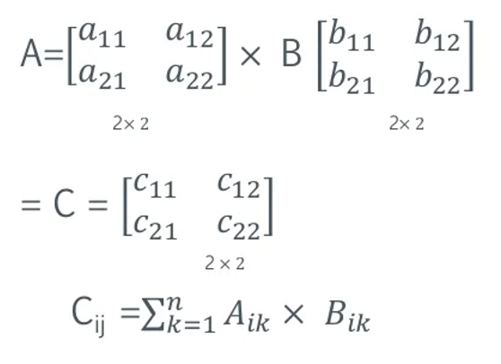
Naïve Matrix multiplication
Matrix multiplication, also known as matrix product and the multiplication of two matrices, produces a single matrix.
If A and B are the two matrices, then the product of the two matrices A and B are denoted by: X = AB
Hence, the product of two matrices is the dot product of the two matrices.

Slide 6
Strassen’s METHODOLOGY
Strassen's Matrix Multiplication Algorithm uses a Divide and Conquer approach to bring down the time complexity to approximately O(n^2.81). But this approach has its own shortcomings as this algorithm is potentially more memory intensive and has a larger constant factor which makes this algorithm unsuitable for multiplication of smaller matrices.
This project focuses on improving the execution time of matrix multiplication by using standard parallel computing practices to perform parallel matrix multiplication.
OpenMP, MPI are used to develop algorithms by combining the naive matrix multiplication algorithm and Strassen's matrix multiplication algorithm to create hybrid algorithms which allow parallel computation of matrix multiplication to give better results in the form of smaller execution time.
The algorithms are written in C++ programming language and results produced by each of the parallel hybrid algorithms are analyzed to decide which algorithm works the best.

Slide 7
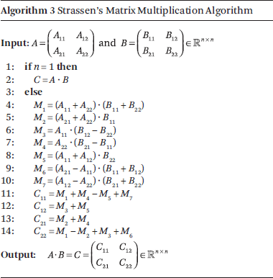
algorithm

Slide 8
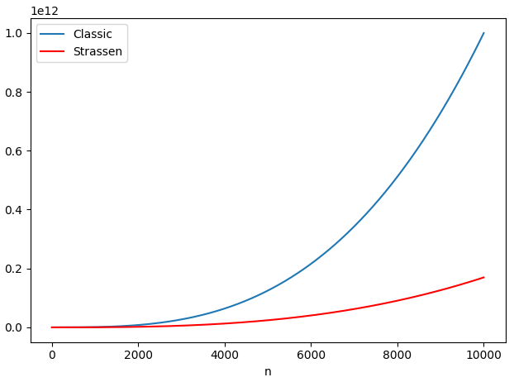
Comparison plot

Slide 9
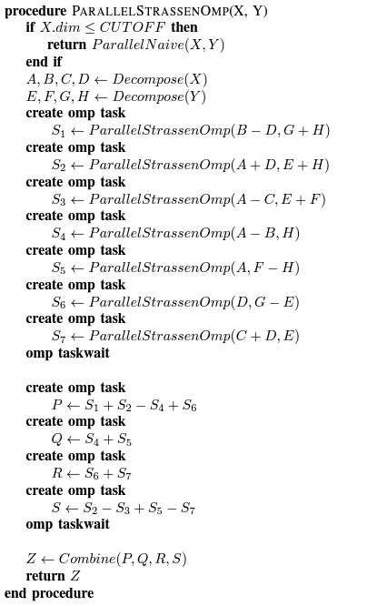
Openmp
Pseudo code
OpenMP(Open Multi-Processing) is an application programming interface that is explicitly used to perform multi-threaded, shared memory parallelism. The proposed algorithm uses the concept of OpenMP tasks and collapsing of for loops to enable parallel execution of matrix multiplication using OpenMP.
An OpenMP task is created for each of the 7 recursive calls in Strassen’s algorithm as shown in Algorithm 3, which enables the computation of matrices S1, S2,..., S7 parallelly leading to better performance.

Slide 10
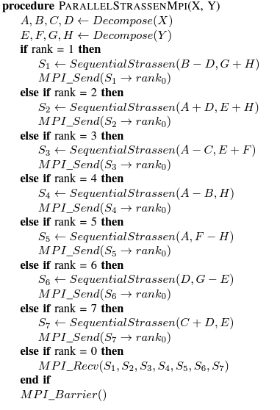
MPI
Pseudo code
It is a standardized system that allows exchange of messages between multiple computers running a program across distributed memory. The same program is executed by multiple processes leading to parallelism.
To perform parallel execution of matrix multiplication, the MPI environment is initialized with 8 processes. Each process has a rank assigned to it, starting from rank 0 to rank 7. The initial 7 sub-problems or recursive calls are assigned to processes with rank 1 to rank 7. So, the process with rank 1 executes the 1st recursive call, the process with rank 2 executes the 2nd recursive call, and so on.

Slide 11
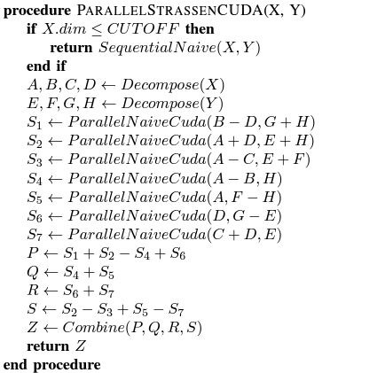
cuda
Pseudo code
CUDA is an Application Programming Interface (API) that harnesses the power of Graphical Processing Units (GPUs) to perform parallelism. It is a parallel computing platform developed by NVIDIA for performing parallel computation on GPUs.
As CUDA specializes in performing computationally intensive, highly parallel tasks thus, it can be used to perform parallel computation of Matrix multiplication.

Slide 12
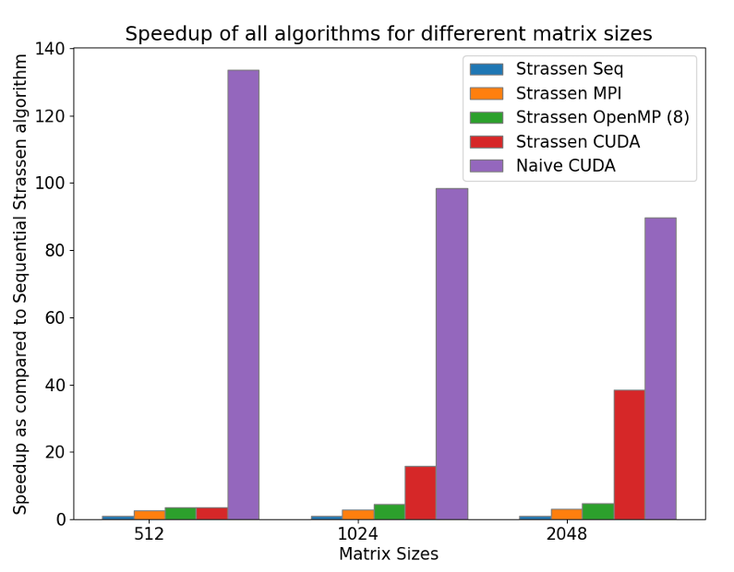
Comparision graph

Slide 13
Thank you

