Slide 1
Plagiarism Detection & Grading of documents
IT350
Data Analytics
Aakash Bhalla
Sanket Hanagandi
Mayur Jinde
Shaulendra Kumar

Slide 2
Abstract
In current times professors are busy with projects and different academic works checking the answer sheet of the individuals and detection the plagiarism among answer sheets would be a more tedious task to complete which takes too much time. This brings the call for us to come up with a project to grade the answer sheets and find plagiarism among the students using semantic similarity.

Slide 3
Dataset
1. The "brown.sents" corpus is a dataset that is part of the larger Brown Corpus, which is a collection of text samples from a wide variety of sources. The Brown Corpus was compiled in the 1960s and contains over one million words of American English text.
2. The "brown.sents" dataset specifically consists of 5,000 sentence samples taken from the Brown Corpus. Each sentence is labeled with metadata including its source text, genre, and author.
3. The Brown Corpus, including the "brown.sents" dataset, has been widely used in linguistic research and natural language processing tasks such as text classification, language modeling, and machine translation.

Slide 4
Introduction
Semantic analysis, also known as natural language processing (NLP), is the process of analyzing text and understanding the meaning behind the words. In the context of grading documents, semantic analysis can be used to evaluate the quality of the content based on various factors such as relevance, coherence, and complexity
In this project, semantic analysis involves the use of word embedding technique to compute the text similarity for the grading of documents and checking the plagiarism among the given documents.
By using semantic analysis to grade documents, educators and professionals can gain a more objective and consistent way to evaluate written content. This approach can also help identify areas for improvement and provide feedback to help writers develop their skills. Overall, semantic analysis is a powerful tool for enhancing the quality and effectiveness of written communication.

Slide 5
Problem Statement
Compute the text similarity for the grading of documents and checking the plagiarism among the given documents using word embedding technique.

Slide 6
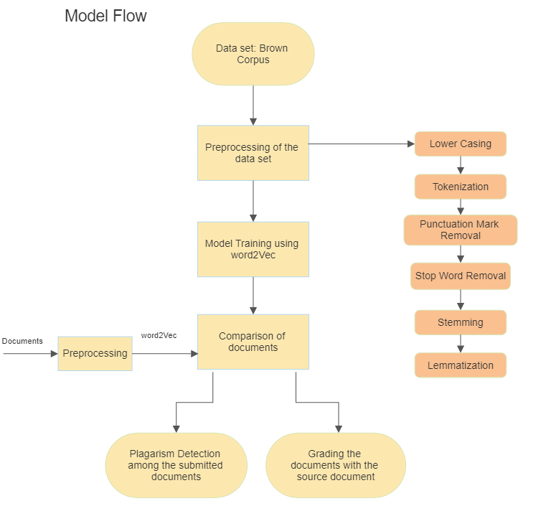
Methodology

Slide 7
Novelty
If the document contain synonyms, our model will easily detect and the grading will be done accordingly and will be accurate too. Similar goes with the plagiarism too.

Slide 8
Thank You

