Slide 1

EDA Project - Analysis of AMCAT Data
by-Mayur Kumar Sourav

Slide 2
About me
Background: Bachelors of Data Science and Artificial Intelligence Honours
Why you want to learn Data Science: I want to learn Data Science to become a Data Scientist and secure a better job.
Work Experience: MedTourEasy-
Machine Learning Intern (May 2023 - June 2023)
linkedin: https://www.linkedin.com/in/mayur-kumar-sourav/
github: https://github.com/mayurks23

Slide 3
Agenda
Objective of the Project
Summary of the Data
Exploratory Data Analysis:
Univariate Analysis Steps
Bivariate Analysis Steps
Key Business Question
Conclusion (Key finding overall)
Your Experience/Challenges working on Web Scraping – Data Analysis Project.

Slide 4
Objective of the Project
Perform Exploratory Data Analysis (EDA) on the ameo_data data-set. Consider Salary as a target variable.
Summary of the Data
The dataset was released by Aspiring Minds from the Aspiring Mind Employment Outcome 2015 (AMEO). The study is primarily limited only to students with engineering disciplines. The dataset contains the employment outcomes of engineering graduates as dependent variables (Salary, Job Titles, and Job Locations) along with the standardized scores from three different areas – cognitive skills, technical skills and personality skills. The dataset also contains demographic features. The dataset contains around 40 independent variables and 4000 data points. The independent variables are both continuous and categorical in nature. The dataset contains a unique identifier for each candidate.

Slide 5
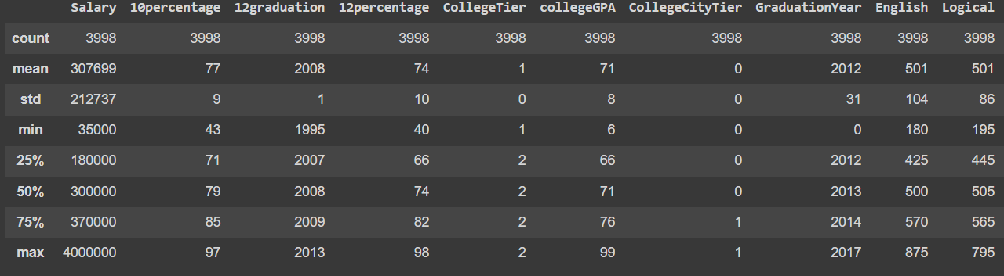
Exploratory Data Analysis:
Univariate Analysis Steps

Slide 6
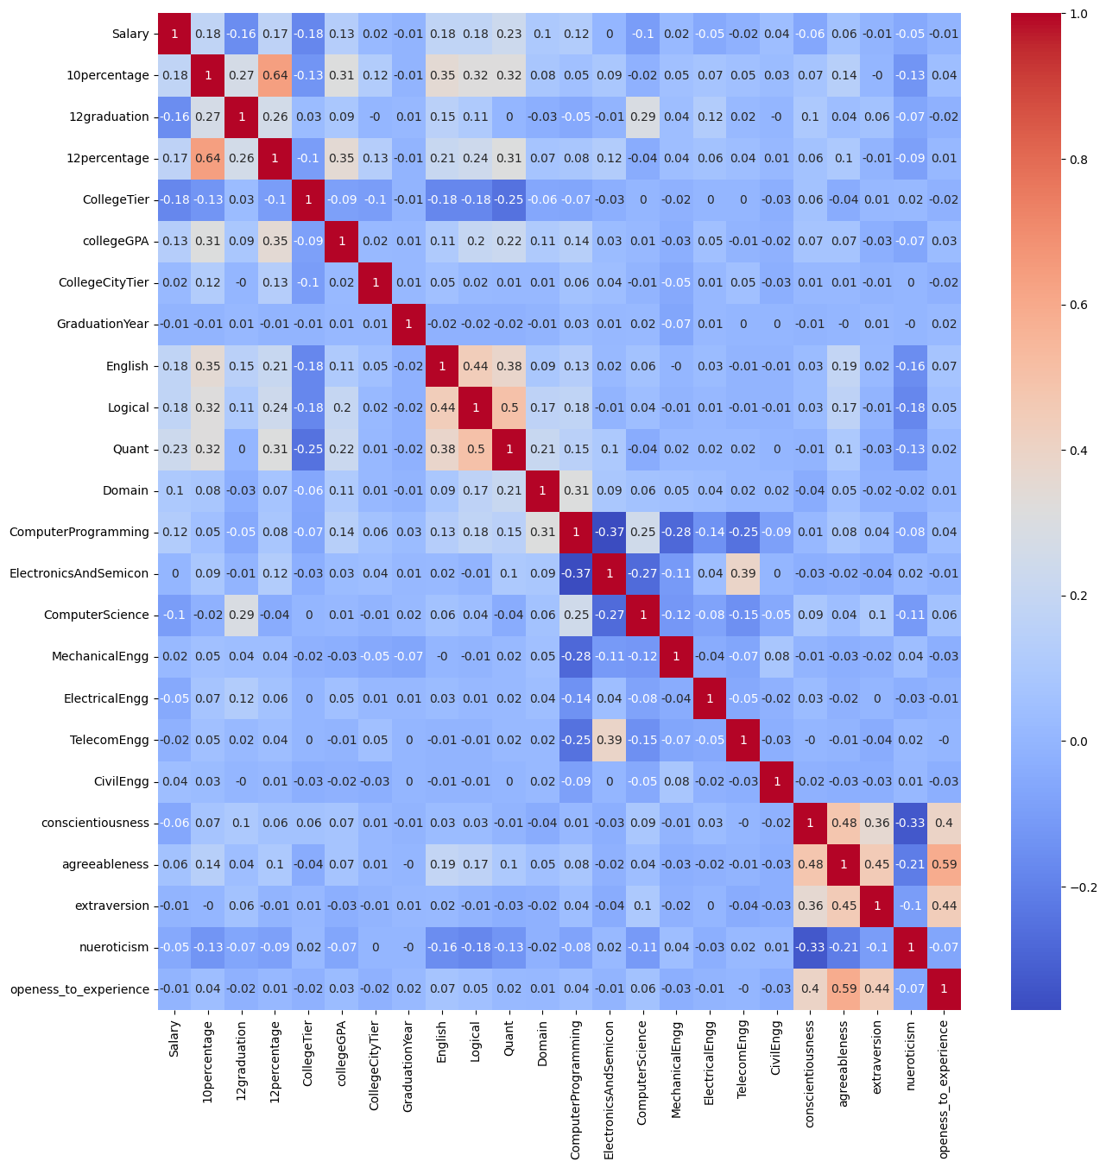
Exploratory Data Analysis:
Bivariate Analysis Steps
There doesn't seem to be any relevant relationship between numerical variables instead of that subjects marks and 10th and 12 percentage has positive correlation.

Slide 7
Key Business Question
Times of India article dated Jan 18, 2019 states that “After doing your Computer Science Engineering if you take up jobs as a Programming Analyst, Software Engineer, Hardware Engineer and Associate Engineer you can earn up to 2.5-3 lakhs as a fresh graduate.” Test this claim with the data given to you.

Slide 8
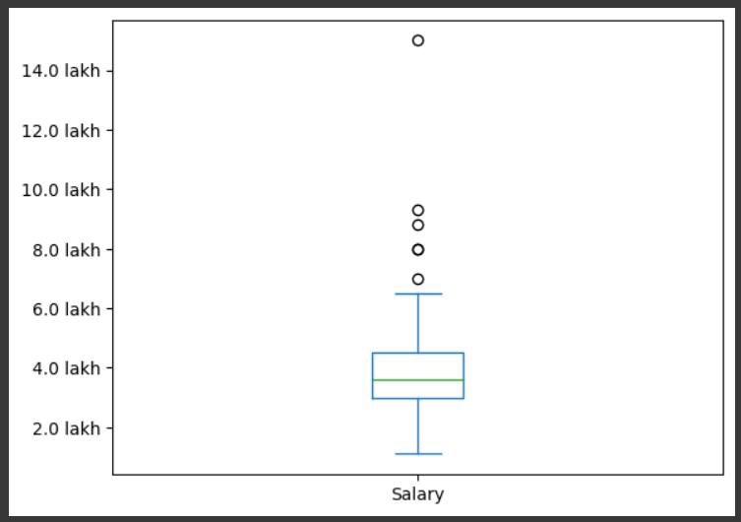
Key Business Question
As we can see in box plot itself that indeed the students after doing Computer Science Engineering has jobs with salaries between 2.5 - 3 lakhs but it seems the salaries can be much more.
Our finding is that the salary can be from 2.5 lakhs - 5 lakhs
there are some outliers which shows that with Computer Science Engineering one can get a job of salary upto 15 lakhs

Slide 9
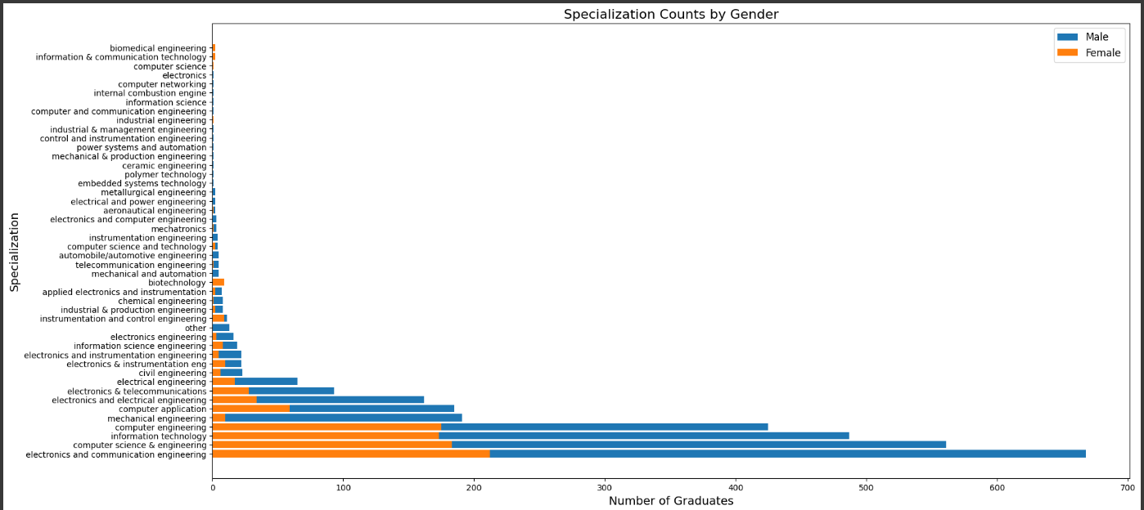
Key Business Question
Is there a relationship between gender and specialization? (i.e. Does the preference of Specialisation depend on the Gender?)

Slide 10
Key Business Question
Is there a relationship between gender and specialization? (i.e. Does the preference of Specialisation depend on the Gender?)
There is not any relationship between gender and specialization.

Slide 11
Your Experience/Challenges – Data Analysis Project.
Experience is great couldn't have gotten any better internship than this for beginners.
Challenges:
I am not confident applying methods, I have to cross check what i'm doing every time.
It feels like I am just applying methods for the sake of completing the task, I don’t feel like I am applying concept behind.

Slide 12

THANK YOU

