Slide 1
DEPOSITIQ
Which clients to call today
A ranking model for a bank telemarketing campaign, and the price at which
calling stops paying for itself.
45,211 clients | 9,043 held out | XGBoost, 12 features | cut 0.0750
mayurkusmade/depositiq-term-deposit-prediction | 2026-10-30

Slide 2
THE ANSWER
Spend the same calls better, not fewer
At 1.50 EUR a call and a 20.00 EUR deposit, break-even is 7.50% - below the 11.6982% rate of the modelling half.
So this model converts a fixed call budget. It is not a case for cutting campaign spend.
Calling 41.10% of the list reaches 77.90% of subscribers: 43,621.00 EUR against 30,368.00 EUR for calling everyone.
+13,253.00 EUR, on 21,302 fewer calls.
Per campaign | Call everyone | Ranked, cut at 0.0750
Calls made | 36,168 | 14,866
Subscribers reached | 4,231 | 3,296
Net value | 30,368.00 EUR | 43,621.00 EUR
Held out: 10,988.50 EUR against 7,595.50, on 3,621 calls.
Source: models/playbook.json, models/threshold_choice.json
2 / 15

Slide 3
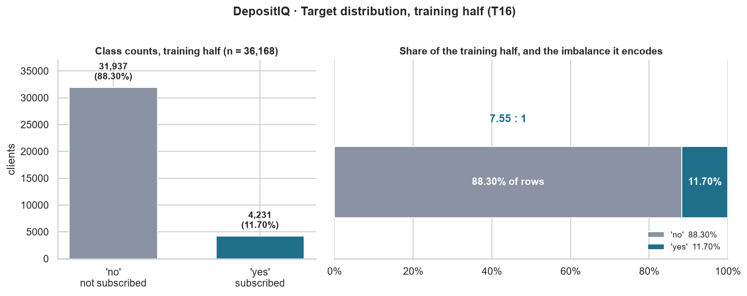
1 - THE DECISION
Seven calls in eight are wasted
45,211 clients in the file; 5,289 subscribed - 11.70%, a 7.55 : 1 split.
Each day the bank has more clients than agents, so its decision is which clients to call.
The constraint is agent capacity, not budget: the unit of cost is one call.
So the question is not 'will this client buy', but 'is this client worth a call today'.
One deposit per 8.55 calls, so an unordered list wastes seven calls in eight.
Source: docs/01_problem_definition.md, models/threshold_choice.json
3 / 15

Slide 4
2 - THE COST MODEL
The cut is a price, not a parameter
A call costs C = 1.50 EUR; a captured deposit is worth V = 20.00 EUR. Both are assumptions, and both are declared as such.
Call when V x p > C, so the break-even probability is p* = C / V = 7.50%.
Every euro here is linear in V: at 40.00 EUR the cut halves and the totals double.
The ranking does not move, which is why the decisions rest on order and the euros stay labelled.
Quantity | Value | Where it comes from
C, cost of a call | 1.50 EUR | assumption
V, value of a deposit | 20.00 EUR | assumption
p*, break-even | 7.50% | C / V
Base rate | 11.6982% | measured: 4,231 in 45,211
Source: src/cost.py, models/threshold_choice.json, docs/01_problem_definition.md
4 / 15

Slide 5
3 - THE DATA
No missing values, and that is the problem
Zero NaN in 45,211 rows: missingness arrives as a literal string. poutcome = unknown covers 81.7%; contact = unknown covers 28.8%.
pdays = -1 means 'never contacted', not 'minus one day'. Read as a number it returns a mean of 40.2 days that no client has.
pdays and days_since_contact carry the same number on all 6,584 rows where both exist: a duplicate, not a correlation.
The two unknowns are different objects. poutcome = unknown is a fact about the bank; contact = unknown is a failure to record.
So one becomes a level and the other becomes recommendation R1.
Source: docs/02_data_dictionary.md, docs/05_leakage_audit.md
5 / 15

Slide 6
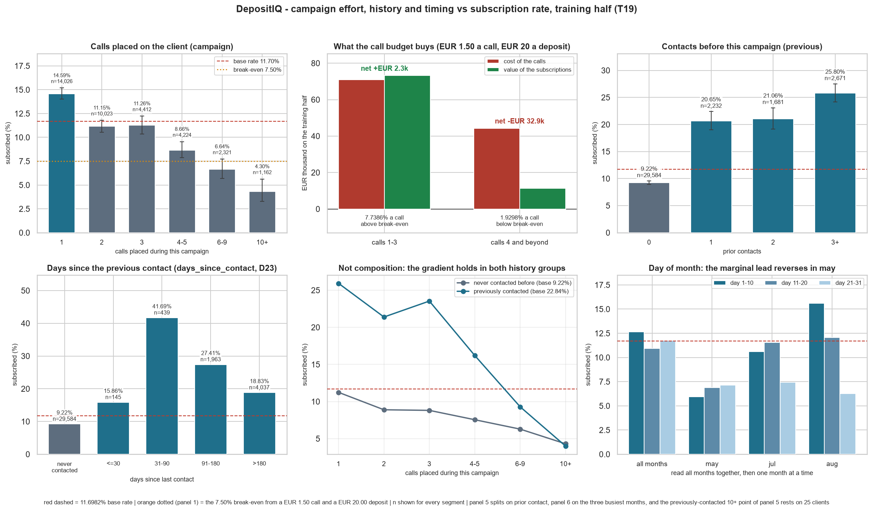
4 - WHAT THE CAMPAIGN ALREADY GETS WRONG
The fourth call costs more than it earns
poutcome = success converts at 64.65% - 779 of 1,205 clients - and is known before the call.
Clients needing 4 or more calls hold 52.68% of the calls for 13.47% of the successes.
The first three calls convert at 7.7386%, just above the price; the extra calls at 1.9298%.
That tail is 32,906 EUR of agent time against a 20.00 EUR deposit.
The cap must be targeted: 93.28% of the tail has no known outcome, while poutcome = success still returns 22.55% a call.
Call count, contact type and prior outcome, against the price line.
Source: docs/04_eda_insights.md, reports/figures/04_campaign_vs_target.png
6 / 15

Slide 7
5 - LEAKAGE: PROHIBITION ONE
The column that doubles the money and must not be used
duration is the length of the call. It is recorded after the call ends, so it does not exist when today's list is built.
Alone it reaches ROC-AUC 0.8078, more than the shipped model. Its bands climb from 0.16% under a minute to 48.56% at ten minutes or more.
Given to the model it adds 0.1788 PR-AUC and 20,340.00 EUR.
The verdict came from a rule written before the numbers existed, and it says leakage.
Arm | PR-AUC | ROC-AUC | Net at 7.50%
A - without duration (ships) | 0.4460 | 0.7990 | 43,621.00 EUR
B - with duration (diagnostic) | 0.6254 | 0.9360 | 63,961.00 EUR
Arm A ships regardless: the column does not exist at the moment a decision is made.
Source: models/duration_comparison.json, docs/05_leakage_audit.md
7 / 15

Slide 8
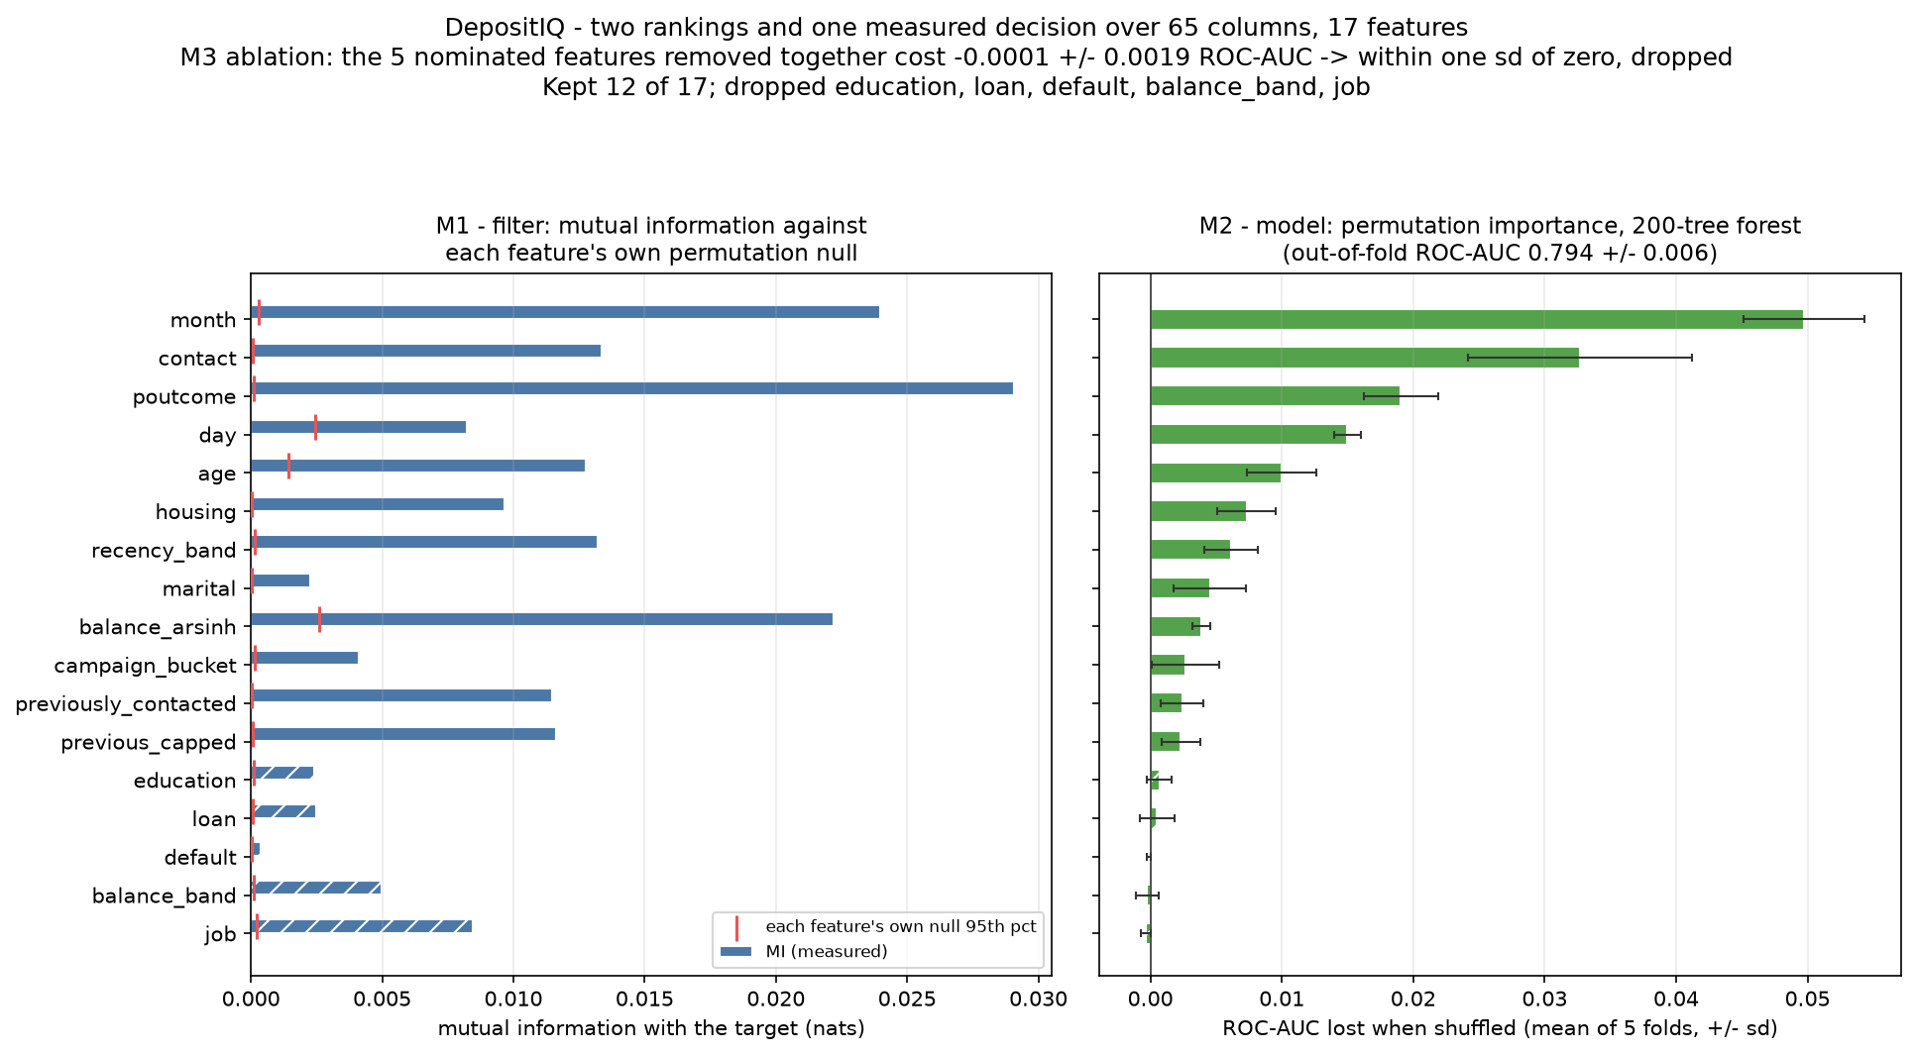
6 - FEATURES
Seventeen features became twelve, and the loss was measured
Five engineered columns replace their raw ones rather than sit beside them; balance through arsinh takes absolute skew from 8.34 to 1.68.
Two rankings over the same 17 features - mutual information and permutation importance - correlate at +0.647.
Removing the five nominated features costs 0.00014 +/- 0.00195 ROC-AUC, with 3 of 5 folds improving, so the one-standard-error rule drops them.
Re-measured per model: the forest loses 0.0014 +/- 0.0024 and the booster 0.0001 +/- 0.0008. The matrix goes from 65 columns to 40.
Two rankings, each feature's own permutation null, and the five dropped features hatched.
Source: docs/05_leakage_audit.md, reports/figures/06_feature_importance.png
8 / 15

Slide 9
7 - MODELS
One harness, seven builds, and a fix that made it worse
Build | PR-AUC | ROC-AUC | Brier | Role
dummy_prior | 0.1170 | 0.5000 | 0.1033 | floor
logreg_balanced | 0.4008 | 0.7640 | 0.1852 | baseline
random_forest | 0.4346 | 0.7906 | 0.1403 | candidate
XGBoost, weighted | 0.4420 | 0.7993 | 0.1637 | candidate
XGBoost, untreated | 0.4444 | 0.7993 | 0.0821 | candidate
XGBoost, SMOTE | 0.4152 | 0.7799 | 0.1221 | rejected
XGBoost, tuned | 0.4460 | 0.7990 | 0.0818 | shipped
Same folds, same rows, same scorer for every build - 36,168 training rows and 4,231 positives.
Ranking and calibration are separate problems: the logistic baseline ranks at 0.7640 ROC-AUC while predicting 0.4161 on average against a 0.1170 base rate.
SMOTE lost in 0 of 5 folds and ran three times slower; the class weight bought no ranking and halved the Brier score.
Tuning added 0.00165 +/- 0.00286 - 0.58 SE - so the tuned point is kept for not being worse, not for being better.
Source: models/cv_results.json, models/imbalance_results.json, models/final_model.json
9 / 15

Slide 10
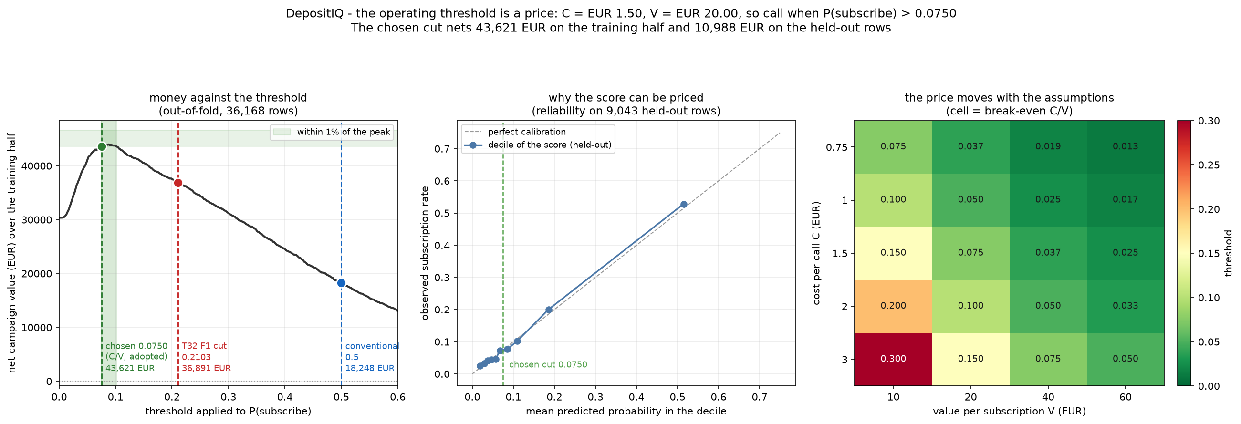
8 - THE OPERATING POINT
The cut is the price the bank already pays
Cut | Calls | Reached | Net value
Call everyone | 36,168 | 4,231 | 30,368.00 EUR
0.5 | - | - | 18,248.00 EUR
F1 cut 0.2103 | - | - | 36,891.00 EUR
Price 0.0750 | 14,866 | 3,296 | 43,621.00 EUR
Empirical peak 0.0821 | 13,247 | 3,194 | 44,009.50 EUR
The peak is worth 388.50 EUR more, and is chosen by looking at the data it then scores.
0.0750 sits 0.0004 above the bottom of the 1%-of-peak plateau: the most aggressive cut still within 1% of the best.
ROI is a trap of its own: 0.5 posts 765% and loses money in absolute terms.
Net value against the cut, with the price, the 1%-of-peak plateau and both empirical argmaxes marked.
Source: models/threshold_choice.json, reports/figures/07_threshold_curve.png
10 / 15

Slide 11
9 - HELD OUT, SPENT ONCE
On clients it never saw, the ranking holds
Metric | Held out | Cross-validated
PR-AUC | 0.4616 | 0.4460
ROC-AUC | 0.8052 | 0.7990
Brier | 0.0804 | 0.0818
Mean prediction | 0.1151 | 0.1166
The artifact was loaded, not refitted, and scored once on 9,043 rows holding 1,058 subscribers.
Net value 10,988.50 EUR against 7,595.50 for calling everyone, at a recall of 77.60%.
The gap of 0.0155 is not a gain: the bootstrap over these same rows spans 0.4304 to 0.4969, which is 0.92 standard deviations.
What this does not say: the prices are assumptions, the split is random rather than temporal, and the held-out rows are the same campaign.
Source: models/holdout_eval.json, models/metrics_cv.json
11 / 15

Slide 12
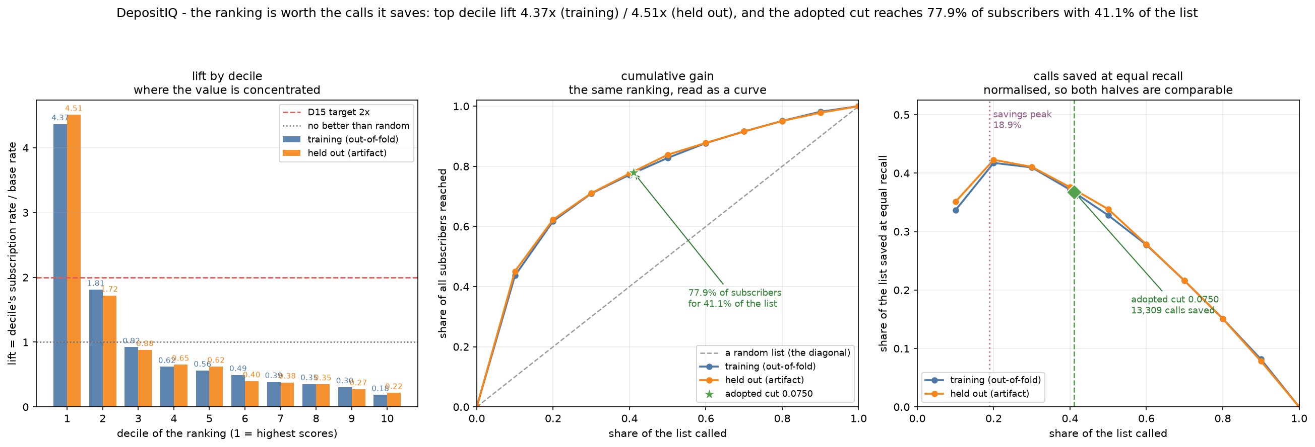
10 - LIFT
The top tenth of the list converts 4.5 times the base rate
Top decile lift 4.5100 held out and 4.3652 out of fold; that decile holds 45.09% of all subscribers.
Decile 3 is already below random at 0.88 - past the best fifth, the model's message is 'do not call'.
The adopted cut saves 13,309 calls, 19,964 EUR, against a fixed order needing 28,175.
Calls saved peaks at 18.89% coverage, before the cut; the 8,033 calls between them still convert at 8.96%.
A shuffled-score self-test reruns the table on noise and finds lifts of 0.950 to 1.108.
Lift and cumulative gain per decile on both halves, each against its own base rate.
Source: models/lift_results.json, reports/lift_table.csv, reports/figures/08_lift_gain.png
12 / 15

Slide 13
11 - THE METRIC WE REFUSE: PROHIBITION TWO
The best model by accuracy finds nobody
Cut | Accuracy | Balanced accuracy
Always 'no' | 88.3003% | 50%
0.5 | 89.6052% | 61.28%
Price 0.0750 | 66.42% | 71.27%
Every figure in that table is held out, from the same 9,043 rows.
A model that answers 'no' to everyone is 88.3003% accurate and calls nobody.
At its cut this model scores 66.42% - 22 points worse - while finding 77.60% of subscribers.
The most accurate cut is 0.5 at 89.6052%, and it still misses 801 of the 1,058.
A metric that ranks 'call nobody' above 'call the right 40%' is not a headline.
Source: models/holdout_eval.json, models/metrics_cv.json
13 / 15

Slide 14
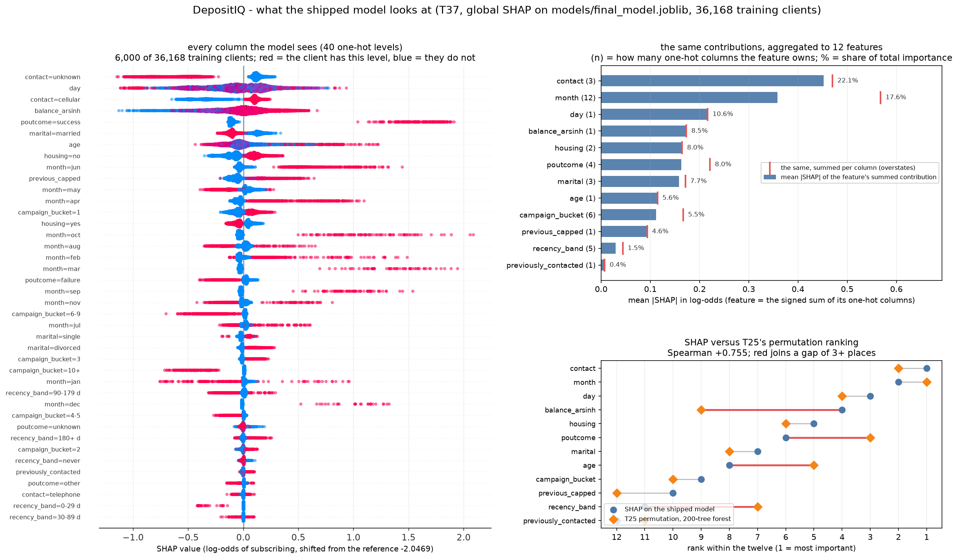
12 - WHAT DRIVES THE SCORE
The top driver is a blank field
contact carries 22.14% of importance, month 17.55% and day 10.60%: campaign-side features take 55.75% against 44.25% for the client's own.
contact = unknown contributes -1.0150 log-odds on 28.72% of clients, who subscribe at 4.11% against 14.83% for cellular.
The model is not saying those clients are bad prospects. It is saying it cannot tell.
Prohibition three: month is a calendar from a 2008-2010 recession. Schedule with it; never predict a person's answer from it.
The twelve features by share of importance, each contribution's sign, and the shared one-hot blocks that keep the values additive.
Source: models/shap_global.json, reports/shap_importance.csv, reports/figures/09_shap_summary.png
14 / 15

Slide 15
13 - WHAT TO DO
Eight actions, each with the number that would prove it wrong
 | Action | Headline | Falsified if
R1 | Make contact a required field | 28.72% of clients at -1.0150 | filled and the segment does not re-score
R2 | Call in model order, stop at 0.0750 | +13,253.00 EUR, 21,302 fewer calls | a later campaign reaches under 60%
R3 | Do not stop where calls saved peaks | 8,033 calls at 8.96%, +2,350.50 EUR | the held-out block replicates at scale
R4 | Never feed call duration to the model | +0.1788 PR-AUC, dead at dial time | a dialler can supply it before the call
R5 | Establish the value of a subscription | every euro is linear in V = 20.00 EUR | the bank publishes a true V
R6 | Track precision and net value, not accuracy | 88.3003% from a model that finds nobody | a stakeholder accepts a cost-based cut
R7 | Keep the twelve-feature XGBoost | 0.4460 against 0.4346 and 0.4008 | a re-tune beats 0.4008 by over one SE
R8 | Use month to schedule, never to predict | 17.55% of importance, 2008-2010 confound | a campaign outside the recession persists
Source: models/playbook.json, reports/playbook.csv, docs/08_recommendations.md
15 / 15

