Slide 1
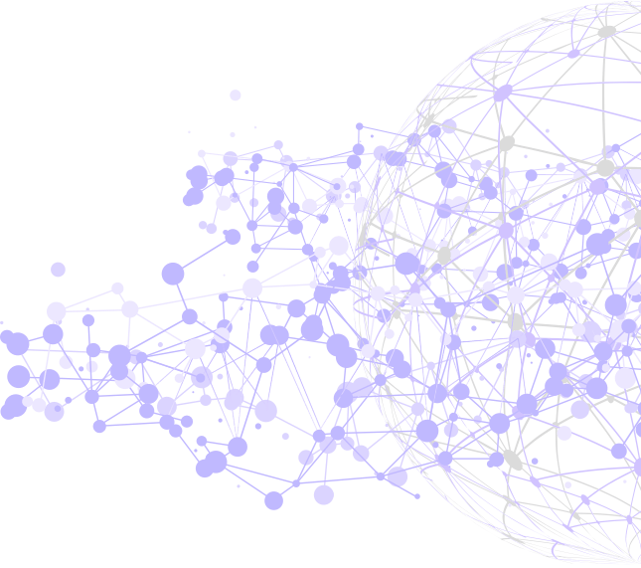
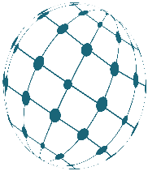


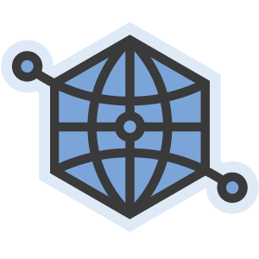

SOLID

Slide 2
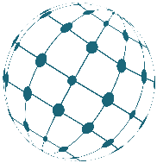

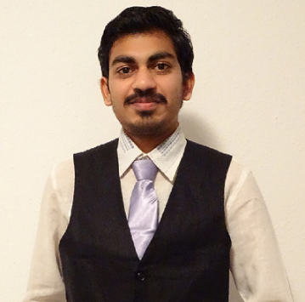
Aditya Shukla
Mayur Lakhani
Web Developer
Web Developer
PHEVOS

Slide 3
01
Current Trends
& Issues
02
Centralization
Agenda
03
Solid Intro with
Decentralization
04
Security in Apps
05
Demo

Slide 4
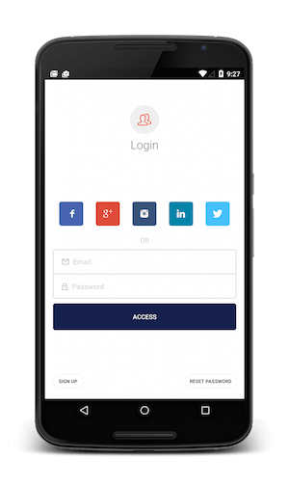





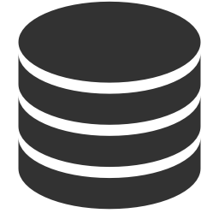



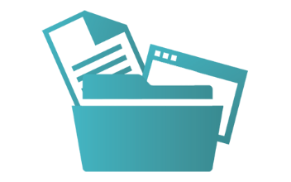
Current Trends in APPs

Slide 5
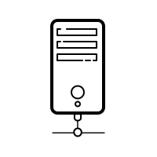




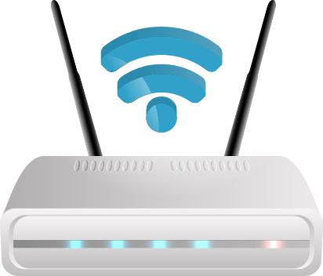
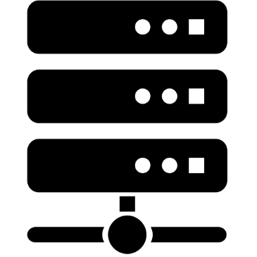

Centralized App Architecture
Cenetral Serve
System
Centralized Apps
Documents
Internet
Server System
Devices

Slide 6
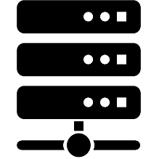
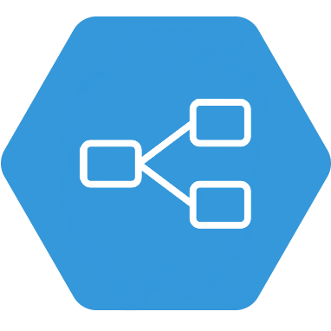

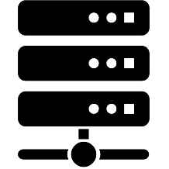
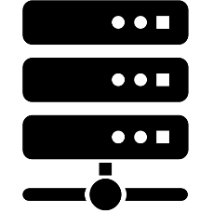
Traditional way of apps not suitable
App related Logic
Client of Centralized Web App
Server
Incompatible server
Hard coded sequence of interface

Slide 7
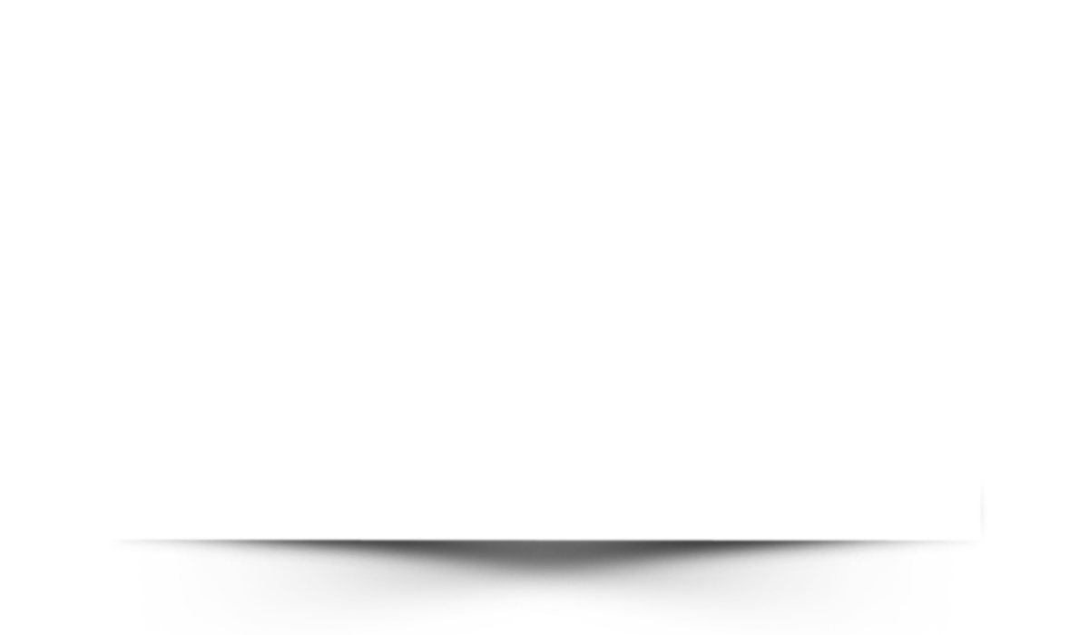
CENTRALIZED
DECENTRALIZED
NO VENDOR LOCK-IN
VENDOR-LOCK IN
Multiple Copies of Data
REUSING EXISTING DATA
Central Server System
PEER 2 PEER CONNECTION

Slide 8

SoLiD
What is Solid?
What is Solid?
Solid (derived from "social linked data"),
set of conventions and tools for building decentralized social application.
The project led by Prof. Tim Berners-Lee,
inventor of the World Wide Web, taking place at MIT
In order to provide true data ownership as well as improved data privacy.

Slide 9





03
SoLiD Features
Reusing existing data
02
04
Modular Design
Data Reliability
01
SOCIAL LINKED DATA
05
True Data Ownership
FasteTransferr Data

Slide 10
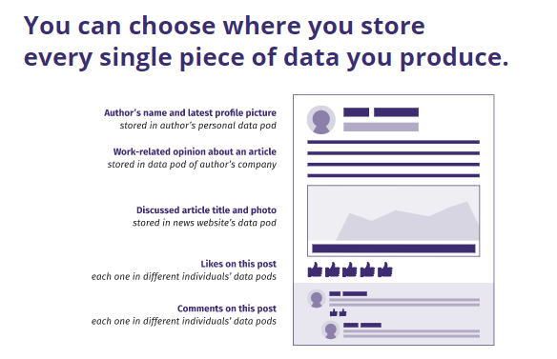
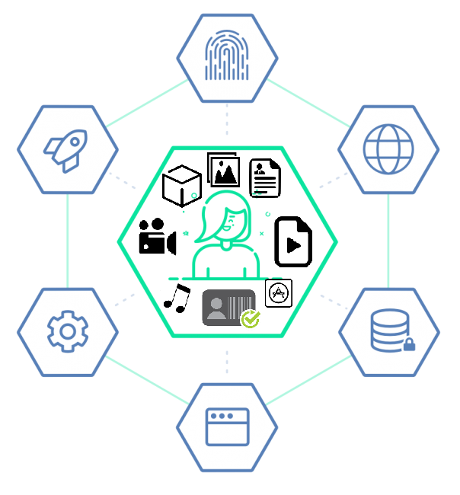
SoLiD POD
Source: https://inrupt.com/solid
https://rubenverborgh.github.io/Solid-DeSemWeb-2018

Slide 11
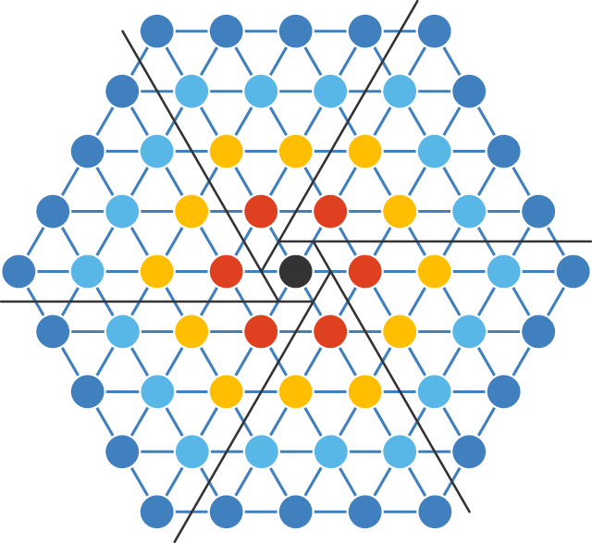
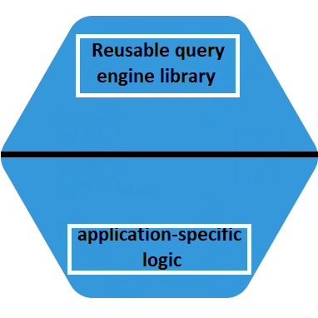
Decentralize Architecture with
different App Technique
Interface
Interface
Interface
Interface
Interface
Result Stream
Query
Interface
Interface
Interface
Decentralized Web App
Interface
Dynamic sequence of interface

Slide 12
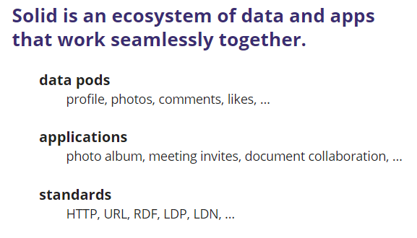
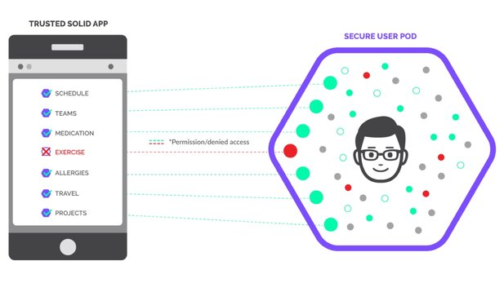
Source: https://inrupt.com/solid
https://rubenverborgh.github.io/Solid-DeSemWeb-2018

Slide 13
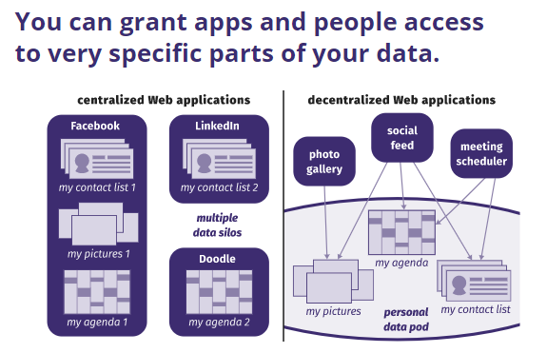
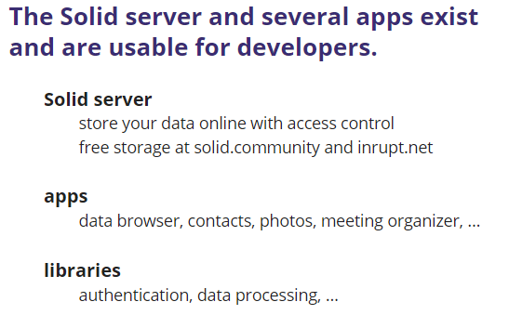
Source: https://rubenverborgh.github.io/Solid-DeSemWeb-2018

Slide 14
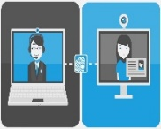

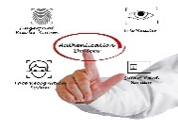

Primary Authentication
WebID - OIDC
Alternative Authentication
WebID - TLS
OAuth2/OpenID
Connect protocols
UserID - Pwd
WebID - TLS protocol
WebID-TLS
Delegation

Slide 15
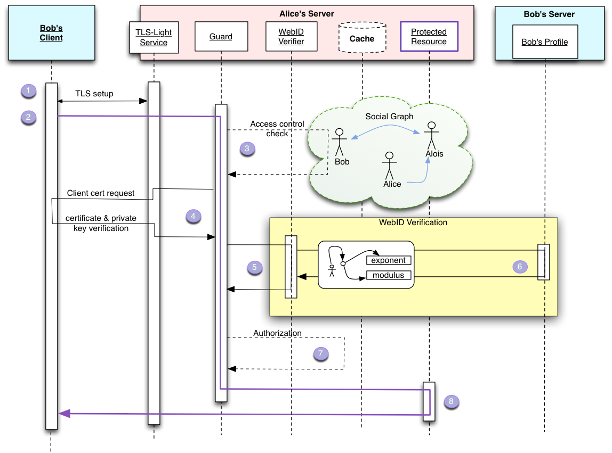
WebID TLS
Authentication
Resource: https://www.w3.org/2005/Incubator/webid/spec/tls

Slide 16
WebID OIDC – Two servers are involved for data Exchange
Alice
Bob
Requested for Bob.com (unauthorized)
401 unauthorized
Sign In
Popup.html - By selected WebID service provider (WebID URI)
https://alice.solidtest.space/signIn => Authentication via WebID TLS
Also User Concent Screen to also signIn in Bob.com
Authentication response redirected to https://bob.com/res1
Server of Bob received signed Id token from alice.solidtest.space
Bob server controls resource – validates ID token, extraction Alice WebID URI
And now Alice is signed In in Bob server
Data extchange
Bob.com confirms now Alice authorized OIDC provider

Slide 17
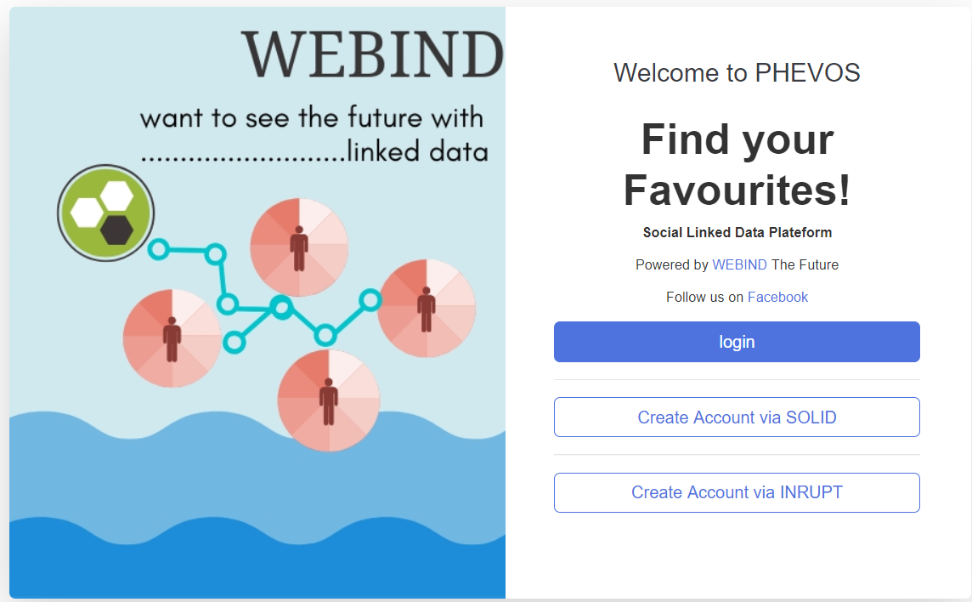
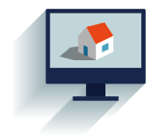
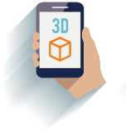

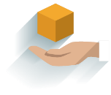
PHEVOS
FIND YOUR FAVOURITE!
PHOTO
EVENTS
ORGANIZE
SHARE

Slide 18
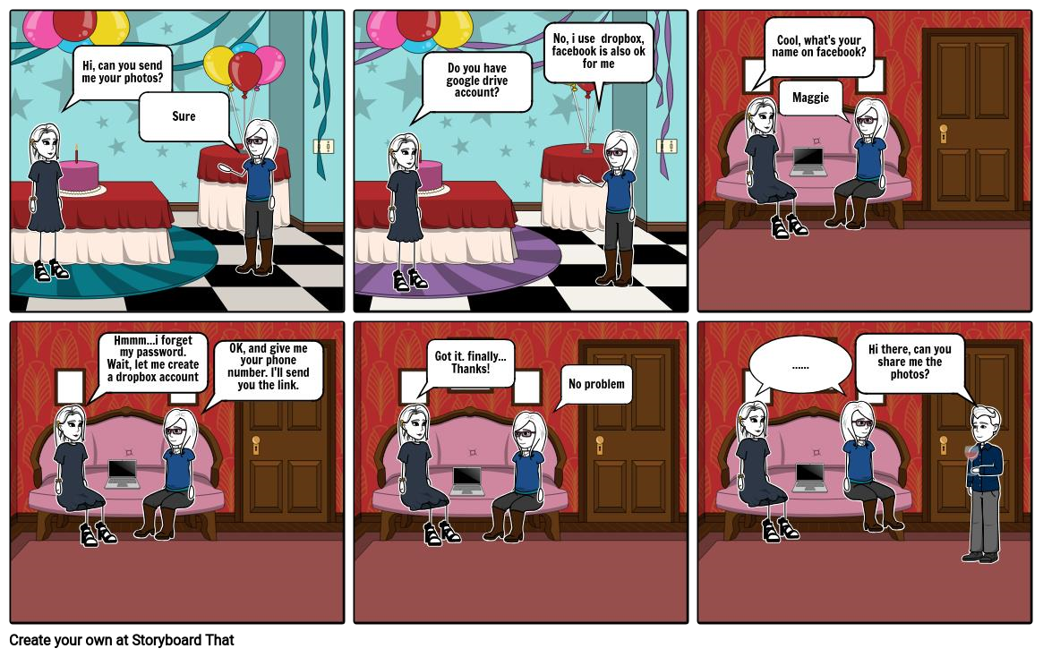
1.User persona :: Sharing Photo with friends is difficult

Slide 19
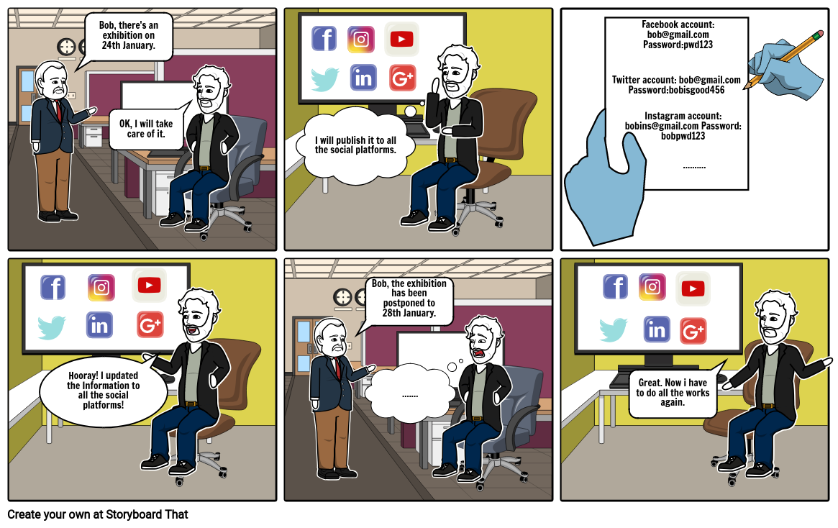
2.User persona :: event organization is tough on different Platform

Slide 20
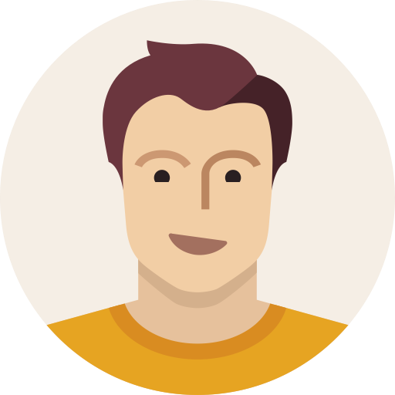



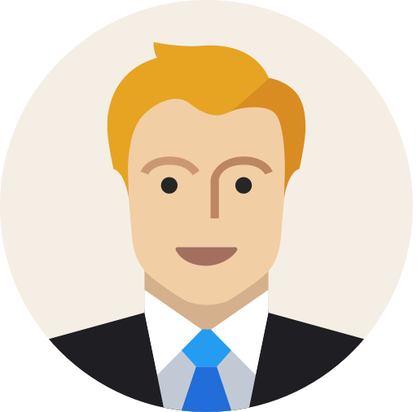

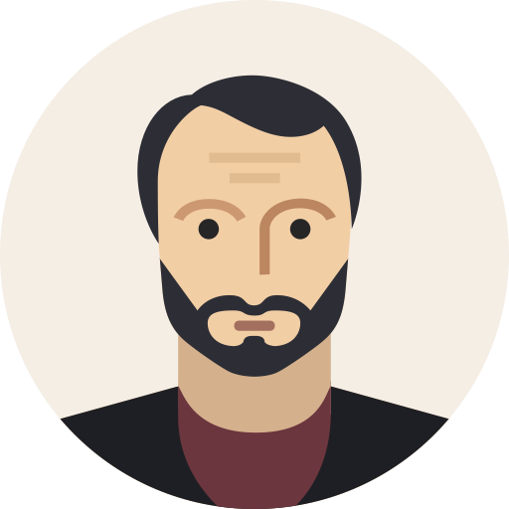

CHARLIE
EVENT ORGANIZE
OPTION 01
PHOTO UPLOAD
ALICE
OPTION
OPTION 02
DAVE
INVITE ATTENDEE
OPTION 03
BOB
SEARCH FOR AN EVENT
OPTION 04

Slide 21
ADVANTAGES
PERMISSION GRANTING
NO USER DATA COLLECTION
FETCHING FRIENDS
PERSONAL ONLINE STORAGE

Slide 22
FUNCTIONALITY
1
PHOTO/FILE CRUD
SEARCHING DATA
5
2
PERMISSION GRANTING
EVENT SCHEDULLING
4
3
GALLERY VIEW

Slide 23
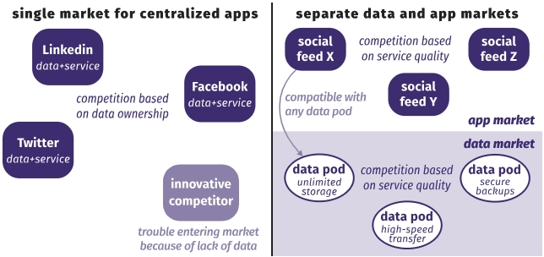
COMPETITION MODEL
PHOTO:
INSTAGRAM, FLICKER
EVENTS:
FACEBOOK, MEETUP
Source: https://rubenverborgh.github.io/Solid-DeSemWeb-2018

Slide 24
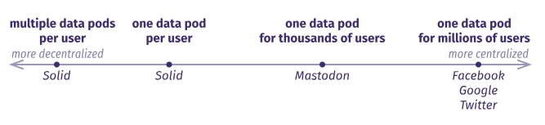
STRATEGY
LIGHT USERS
PHOTO+
EVENT: NICE MARKET
Source: https://rubenverborgh.github.io/Solid-DeSemWeb-2018

Slide 25

FUTURE ASPECTS
01
Artificial Intelligence
True Data Ownership in Social App
02
COOL User Interface View
03
Voice Recognition
04

Slide 26
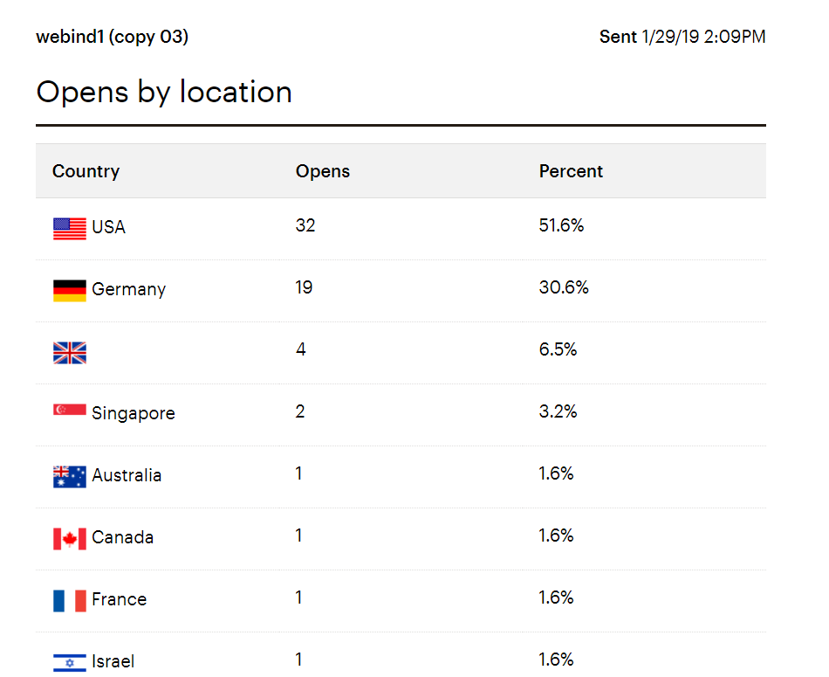
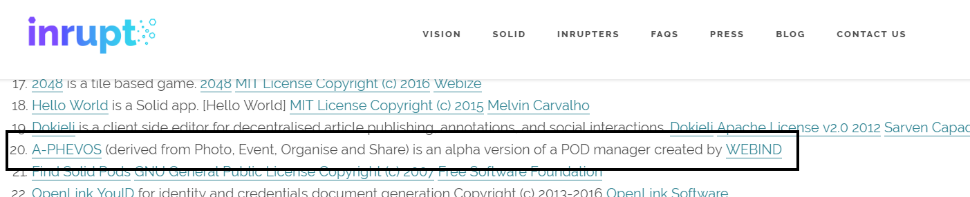

Slide 27
DEMO

Slide 28
References
Https://github.com/solid/solid-spec [Online – GitHub 21.05.2019]
https://solid.mit.edu/ [Online 10.05.2019]
https://solid.inrupt.com/how-it-works [Online 17.05.2019]
https://rubenverborgh.github.io/Solid-DeSemWeb-2018
[Online 17.05.2019]

