Slide 1
Effective Static Race Detection for Java
Mayur Naik
Alex Aiken
John Whaley
Stanford University

Slide 2
The Problem
A multi-threaded program contains a race if:
  Two threads can access a memory location
  At least one access is a write
  No ordering between the accesses
As a rule, races are bad
  And common …
  And hard to find …

Slide 3
Previous Work
A lot of previous work
  Dozens of papers in on-line citation indices
  Spanning decades
Two broad classes
  Dynamic
  Static

Slide 4
Dynamic Race Detectors
Three kinds
  happens-before (Lamport, 1978)
  lockset (Savage et al., 1997)
  hybrid (e.g., O’Callahan and Choi, 2003)
Drawbacks
  Unsound
  Cannot analyze open programs (e.g., libraries)
  Need sufficient input data for closed programs

Slide 5
Static Race Detectors
Three kinds
  Type systems (e.g., rccjava, LOCKSMITH)
  Dataflow analyses (e.g., RacerX)
  Model checkers (e.g., BLAST, KISS)
Drawback: all find relatively few bugs
  Precise techniques not applied to large programs
  Coarse techniques find a few bugs in > 1 MLOC

Slide 6
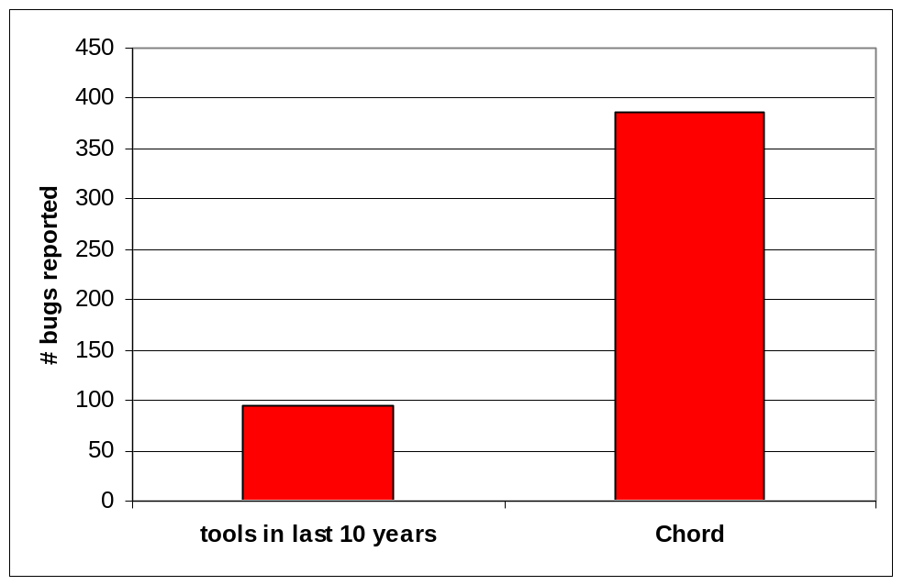
# Bugs Found Using Our Approach
387 bugs in mature Java programs comprising 1.5 MLOC
  Many fixed within a week by developers

Slide 7
Our Static Race Detection Algorithm
original pairs
reachable pairs
aliasing pairs
escaping pairs
unlocked pairs

Slide 8
Architecture of Chord
Reachable
pairs
Aliasing
pairs
Alias
analysis
Call graph
analysis
Escaping
pairs
Thread-escape
analysis
Lock
analysis
Unlocked
pairs

Slide 9
Flow Insensitivity
Helps scalability
Hurts precision
Affects kinds of synchronization idioms we can handle
  Lexically-scoped, lock-based synchronization
  fork/join synchronization (42 annotations in 1.5 MLOC)
  wait/notify synchronization
Simplifies handling of open programs
Simplifies counterexample generation

Slide 10
Context Sensitivity
Precise alias analysis is crucial
  Central to call graph, thread-escape, and lock analyses
  Most alias analyses are too imprecise
    CHA, context-insensitive analysis, k-CFA
What works: k-object-sensitive analysis
  Proposed by Milanova et al., 2003
  Our implementation leverages BDD-based context-sensitive program analysis
  k = 3 necessary in our experiments

Slide 11
Running Example
static public void main() {
A a;
a = new A();
a.get();
a.inc(); }
Harness
(Note: Single-threaded)
public A() {
f = 0; }
public int get() {
return rd(); }
public sync int inc() {
int t = rd() + (new A()).wr(1);
return wr(t); }
private int rd() {
return f; }
private int wr(int x) {
f = x;
return x; }
Notes:
Add newlines b/w methods

Slide 12
Computing Original Pairs
All pairs of accesses such that:
  Both access the same instance field or the same static field or array elements
  At least one is a write

Slide 13
Example: Original Pairs
static public void main() {
A a;
a = new A();
a.get();
a.inc(); }
private int rd() {
return f; }
private int wr(int x) {
f = x;
return x; }
public A() {
f = 0; }
public int get() {
return rd(); }
public sync int inc() {
int t = rd() + (new A()).wr(1);
return wr(t); }
private int rd() {
return f; }
private int wr(int x) {
f = x;
return x; }

Slide 14
Computing Reachable Pairs
Step 1
  Access pairs with at least one write to same field
Step 2
  Consider access pair (e1, e2)
  To have a race, e1 must be reachable from a thread-spawning call site s1 without “switching” threads
  And s1 must be reachable from main
  And similarly for e2
Notes:
Invert colors

Slide 15
Example: Reachable Pairs
static public void main() {
A a;
a = new A();
a.get();
a.inc(); }
private int rd() {
return f; }
private int wr(int x) {
f = x;
return x; }
public A() {
f = 0; }
public int get() {
return rd(); }
public sync int inc() {
int t = rd() + (new A()).wr(1);
return wr(t); }
private int rd() {
return f; }
private int wr(int x) {
f = x;
return x; }

Slide 16
Example: Two Object-Sensitive Contexts
static public void main() {
A a;
a = new A();
a.get();
a.inc(); }
private int rd() {
return f; }
private int wr(int x) {
f = x;
return x; }
public A() {
f = 0; }
public int get() {
return rd(); }
public sync int inc() {
int t = rd() + (new A()).wr(1);
return wr(t); }
private int rd() {
return f; }
private int wr(int x) {
f = x;
return x; }

Slide 17
Example: 1st Context
static public void main() {
A a;
a = new A();
a.get();
a.inc(); }
private int rd() {
return f; }
private int wr(int x) {
f = x;
return x; }
public A() {
f = 0; }
public int get() {
return rd(); }
public sync int inc() {
int t = rd() + (new A()).wr(1);
return wr(t); }
private int rd() {
return f; }
private int wr(int x) {
f = x;
return x; }

Slide 18
Example: 2nd Context
static public void main() {
A a;
a = new A();
a.get();
a.inc(); }
private int rd() {
return f; }
private int wr(int x) {
f = x;
return x; }
public A() {
f = 0; }
public int get() {
return rd(); }
public sync int inc() {
int t = rd() + (new A()).wr(1);
return wr(t); }
private int rd() {
return f; }
private int wr(int x) {
f = x;
return x; }

Slide 19
Example: Reachable Pairs
static public void main() {
A a;
a = new A();
a.get();
a.inc(); }
private int rd() {
return f; }
private int wr(int x) {
f = x;
return x; }
public A() {
f = 0; }
public int get() {
return rd(); }
public sync int inc() {
int t = rd() + (new A()).wr(1);
return wr(t); }
private int rd() {
return f; }
private int wr(int x) {
f = x;
return x; }

Slide 20
Computing Aliasing Pairs
Steps 1-2
  Access pairs with at least one write to same field
  And both are reachable from some thread
Step 3
  To have a race, both must access the same memory location
  Use alias analysis

Slide 21
Example: Aliasing Pairs
static public void main() {
A a;
a = new A();
a.get();
a.inc(); }
private int rd() {
return f; }
private int wr(int x) {
f = x;
return x; }
public A() {
f = 0; }
public int get() {
return rd(); }
public sync int inc() {
int t = rd() + (new A()).wr(1);
return wr(t); }
private int rd() {
return f; }
private int wr(int x) {
f = x;
return x; }

Slide 22
Computing Escaping Pairs
Steps 1-3
  Access pairs with at least one write to same field
  And both are reachable from some thread
  And both can access the same memory location
Step 4
  To have a race, the memory location must also
  be thread-shared
  Use thread-escape analysis

Slide 23
Example: Escaping Pairs
static public void main() {
A a;
a = new A();
a.get();
a.inc(); }
private int rd() {
return f; }
private int wr(int x) {
f = x;
return x; }
public A() {
f = 0; }
public int get() {
return rd(); }
public sync int inc() {
int t = rd() + (new A()).wr(1);
return wr(t); }
private int rd() {
return f; }
private int wr(int x) {
f = x;
return x; }

Slide 24
Computing Unlocked Pairs
Steps 1-4
  Access pairs with at least one write to same field
  And both are reachable from some thread
  And both can access the same memory location
  And the memory location is thread-shared
Step 5
  Discard pairs where the memory location is guarded by a common lock in both accesses
  Needs must-alias analysis
  We use approximation of may-alias analysis, which is unsound

Slide 25
Example: Unlocked Pairs
static public void main() {
A a;
a = new A();
a.get();
a.inc(); }
private int rd() {
return f; }
private int wr(int x) {
f = x;
return x; }
public A() {
f = 0; }
public int get() {
return rd(); }
public sync int inc() {
int t = rd() + (new A()).wr(1);
return wr(t); }
private int rd() {
return f; }
private int wr(int x) {
f = x;
return x; }

Slide 26
Example: Counterexample
static public void main() {
A a;
a = new A();
4: a.get();
5: a.inc(); }
field reference A.f (A.java:10) [Rd]
A.get(A.java:4)
Harness.main(Harness.java:4)
field reference A.f (A.java:12) [Wr]
A.inc(A.java:7)
Harness.main(Harness.java:5)
public A() {
f = 0; }
public int get() {
4: return rd(); }
public sync int inc() {
int t = rd() + (new A()).wr(1);
7: return wr(t); }
private int rd() {
10: return f; }
private int wr(int x) {
12: f = x;
return x; }

Slide 27
Benchmarks
classes
19
21
366
370
370
422
493
388
461
465
553
1746
KLOC
3
3
75
76
76
83
103
124
115
122
165
646
description
JDK 1.1 java.util.Vector
JDK 1.1 java.util.Hashtable
JDK 1.4 java.util.Hashtable
JDK 1.4 java.util.Vector
Traveling Salesman Problem
Web crawler
Apache FTP server
Apache object pooling library
Transaction manager
O/R mapping system
JDBC driver
Apache RDBMS
vect1.1
htbl1.1
htbl1.4
vect1.4
tsp
hedc
ftp
pool
jdbm
jdbf
jtds
derby

Slide 28
Running Time and Annotation Counts
time
0m08s
0m07s
1m04s
1m02s
1m03s
1m10s
1m17s
5m29s
1m33s
1m42s
3m23s
26m03s
root annot.
1
1
1
1
1
0
7
5
1
1
2
7
local annot.
0
0
0
0
1
9
4
0
0
0
0
0
vect1.1
htbl1.1
htbl1.4
vect1.4
tsp
hedc
ftp
pool
jdbm
jdbf
jtds
derby

Slide 29
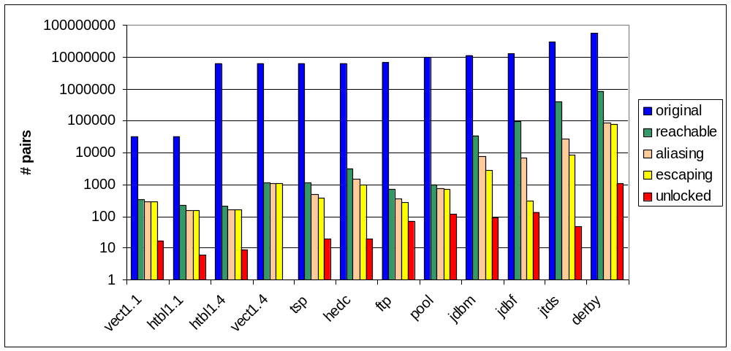
Pairs Retained After Each Stage (Log scale)

Slide 30
Classification of Unlocked Pairs
harmful
5
0
0
0
7
4
45
105
91
130
34
1018
benign
12
6
9
0
0
2
3
10
0
0
14
0
false
0
0
0
0
12
13
23
0
0
0
0
0
# bugs
1
0
0
0
1
1
12
17
2
18
16
319
vect1.1
htbl1.1
htbl1.4
vect1.4
tsp
hedc
ftp
pool
jdbm
jdbf
jtds
derby

Slide 31
Conclusions
A scalable and precise approach to static race detection
  Largest program analyzed: ~ 650 KLOC (derby)
  48 false positives and 42 annotations in total in 1.5 MLOC
Handles common synchronization idioms, analyzes open programs, and generates counterexamples
An example where precise alias analysis is key
  Not just any alias analysis (k-object sensitivity)
  Good stress test for alias analysis

Slide 32
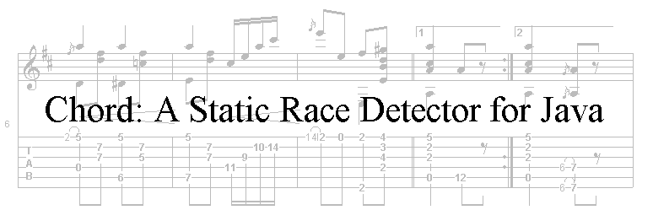
The End
http://www.cs.stanford.edu/~mhn/chord.html

