Slide 1

Chord: An Extensible Program Analysis Framework Using CnC
Mayur Naik
Intel Labs Berkeley

Slide 2
About Chord …
An extensible static/dynamic analysis framework for Java
Started in 2006 as static “Checker of Races and Deadlocks”
Portable: mostly written in Java, works on Java bytecode
  independent of OS, JVM, Java version
    works at least on Linux, MacOS, Windows/Cygwin
  few dependencies (e.g. not Eclipse-based)
Open-source, available at http://jchord.googlecode.com
Primarily used in Intel Labs and academia
  by researchers in program analysis, systems, and machine learning
  for applying program analyses to parallel/cloud computing problems
  for advancing program analyses driven by these applications

Slide 3
Research Using Chord
Application to Parallel Computing
Application to Cloud Computing
static deadlock checker (ICSE’09)
M. Naik, C. Park, D. Gay, K. Sen
Mantis: estimating performance and
resource usage of software (NIPS’10)
B. Chun, L. Huang, P. Maniatis, M. Naik
static race checker (PLDI’06, POPL’07)
M. Naik, A. Aiken, J. Whaley
CloneCloud: partitioning and migration
of apps between phone and cloud
B. Chun, S. Ihm, P. Maniatis, M. Naik
static atomic set serializability checker
Z. Lai, S. Cheung, M. Naik
generalized dynamic deadlock
checker (FSE’10)
P. Joshi, M. Naik, K. Sen, D. Gay
debugging configuration options in
systems software (e.g. Hadoop)
A. Rabkin, R. Katz
Advanced Program Analyses
Evaluating precision of static heap
abstractions (OOPSLA’10, POPL’11)
P. Liang, O. Tripp, M. Naik, M. Sagiv
Precise and scalable static analyses
(e.g. points-to, thread-escape, etc.)
M. Naik, P. Liang, M. Sagiv

Slide 4

Intended Audience of Chord
Researchers prototyping program analysis algorithms
analysis
specialists
Initial focus
Current focus
Researchers with limited program analysis background prototyping systems having program analysis parts
Ultimate
goal
system
builders
Users with no background in program analysis using it as
a black box
programmers

Slide 5
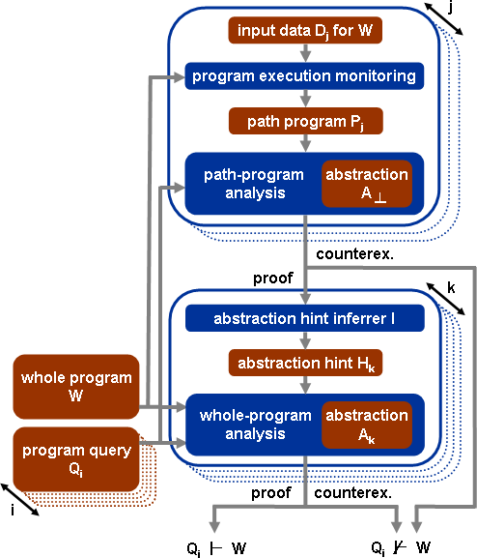
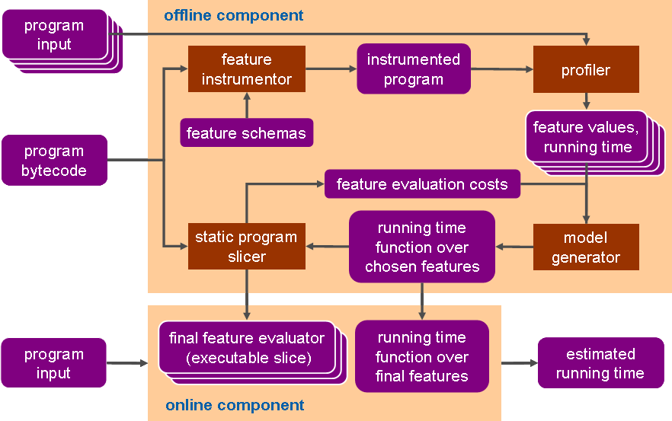
Why CnC?
Productivity:
rapidly prototype systems by interconnecting reusable program analysis components in complex ways
Performance:
expose and exploit sharing and parallelism ubiquitous in program analysis

Slide 6
Example: Estimating Program Running Time*
Problem: quickly and accurately estimate running time of given program on given input
Applications: scheduling, resource allocation, etc.
in cloud computing
Assumption: program running time is independent
of environment factors (OS, cache, etc.)
program P
Our solution: Mantis
A novel combination of
techniques from
program analysis and
machine learning
estimated
running time of P(I)
input I
*Joint work with B. Chun, L. Huang, P. Maniatis (Intel)

Slide 7
Architecture of Mantis
inputs
I₁, …, I_{N}
offline component
feature
instrumentor
instrumented program
profiler
feature schemas
feature values,
running time
program P
feature evaluation costs
running time function over
chosen features
static program
slicer
model
generator
final feature evaluator
(executable slice)
running time function over
final features
estimated
running time
of P(I)
input I
online component

Slide 8
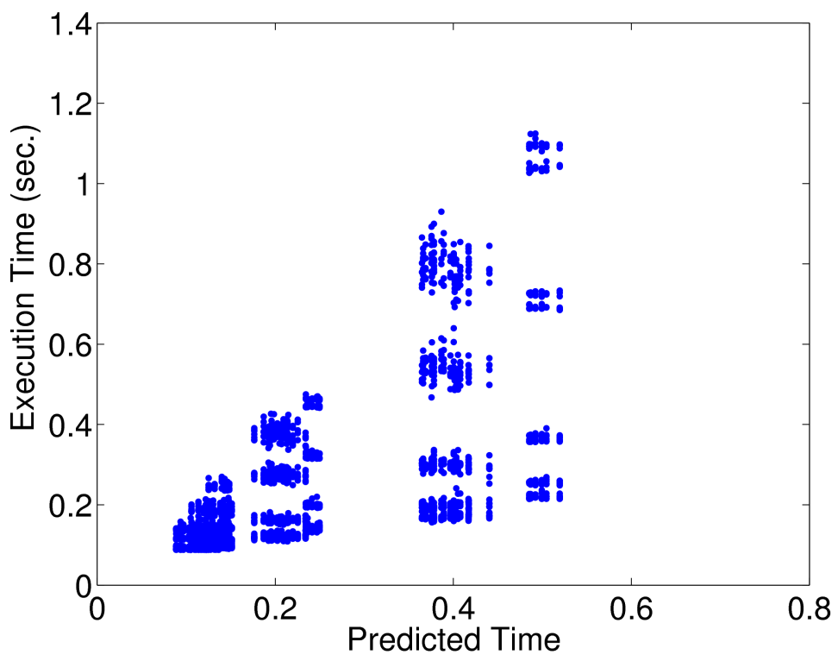
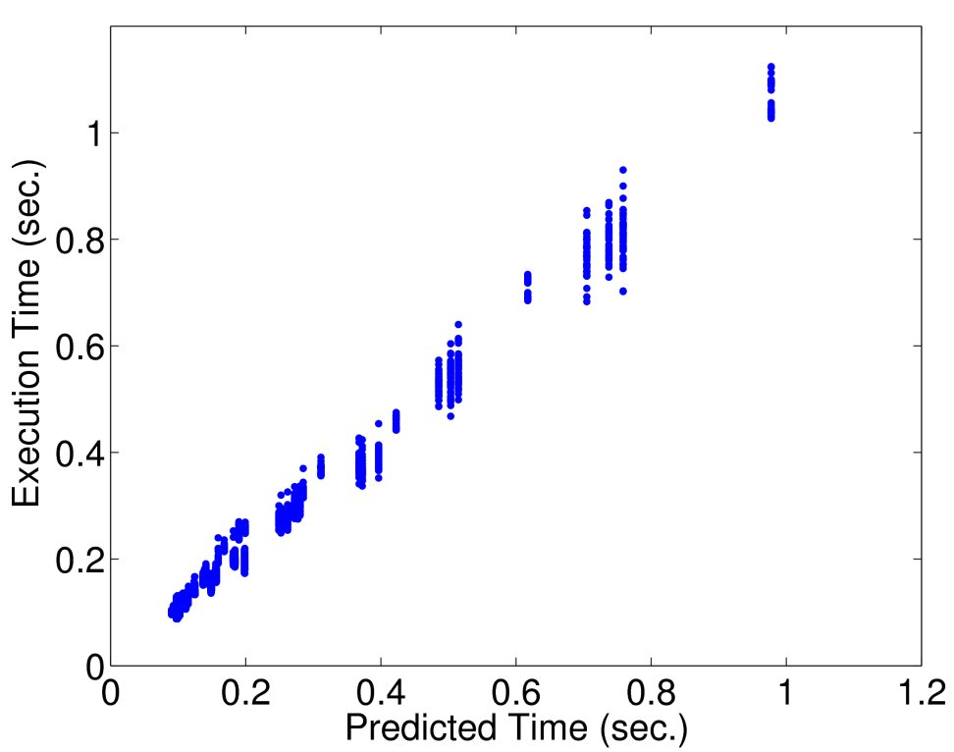
Results for Lucene (search library)
keyword search on the Shakespeare and King James Bible dataset
3000 input samples, 10% for training
128 features (9 loop, 29 branch, 90 variable values)
prediction error > 38% for strawman approach, < 7% for Mantis
f(command line arguments)
f = 0.1 + 0.09 p + 0.52 q – 0.07 p² –
0.69 q² + 1.16 q³ + 0.13 q p²
p = #processors/thread, q = #queries

Slide 9
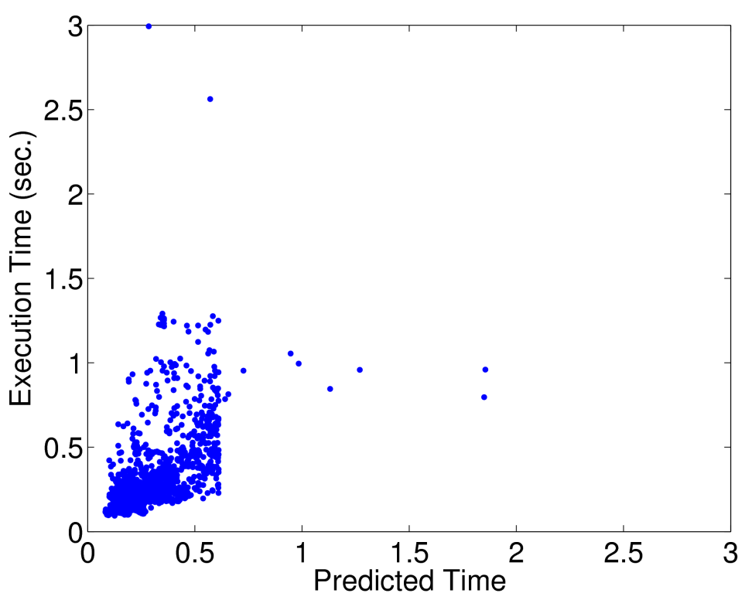
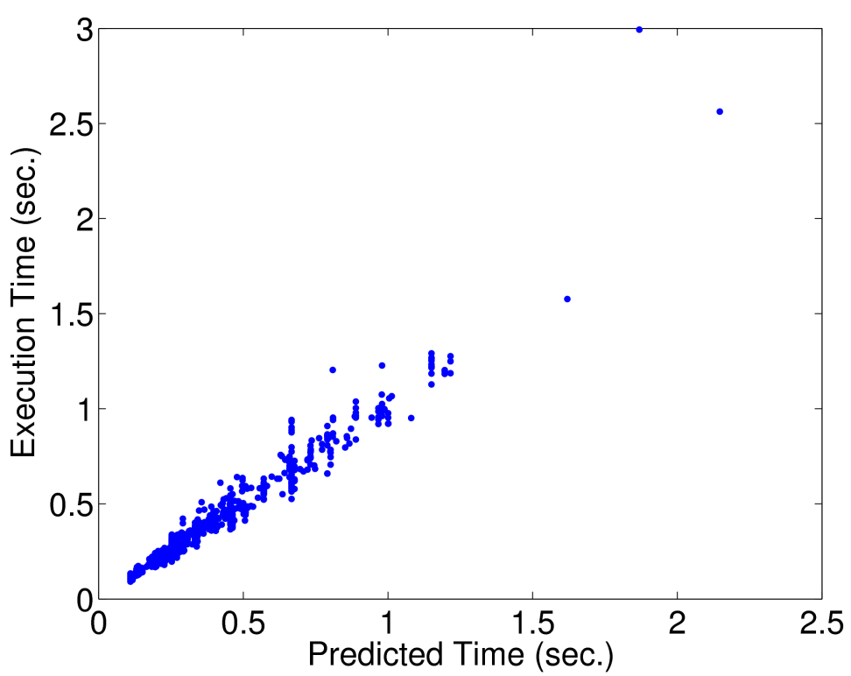
Results for ImageJ (image processing)
find local maxima of images from popular computer vision datasets
3000 images, 10% for training
5516 features (291 loop, 2935 branch, 2290 variable values)
prediction error > 35% for strawman approach, < 6% for Mantis
f(image size)
f = .1 + .08w + .07h + .33wh + .02h²
w = width of region of interest, h = height of image

Slide 10
Example: Reasoning About Program Heaps*
Applications
Who needs to reason about the heap?
Tools:
  race/deadlock/atomicity checking
  type-state verification
  program slicing
Programmers:
  memory bloat removal
  program parallelization
Heap Abstractions
What heap abstraction frameworks
are suitable for a given application?
Classic: object allocation sites
Newer: call stack (k-CFA), object recency, heap connectivity
Future: regular expressions, …
Analysis Techniques
How to efficiently find a concise heap abstraction in a
given framework for a given program and client?
Dynamic analysis: learn across executions (within program)
Machine learning: learn across programs
*Joint work with P. Liang, O. Tripp, M. Sagiv

Slide 11
Static Race Detection for Java [PLDI’06,POPL’07]
// thread t1 // thread t2
sync (l1) { sync (l2) {
… e1 … … e2 …
} }
candidate race:
(t1,e1,t2,e2)
Is e1 (resp. e2) reachable from t1 (resp. t2)?
  Call graph analysis
Can e1 and e2 access the same location?
  May-alias analysis
Can e1 and e2 access thread-shared locations?
  Thread-escape analysis
Can t1 and t2 execute e1 and e2 in parallel?
  May-happen-in-parallel analysis
May t1 and t2 not hold a common lock while executing e1 and e2?
  Conditional must-not alias analysis
reachable(t1,e1)?
reachable(t2,e2)?
may-alias(e1,e2)?
shared(e1)?
shared(e2)?
parallel(t1,e2,t2,e2)?
unguarded(t1,e1,t2,e2)?

Slide 12
Static Deadlock Detection for Java [ICSE’09]
// thread t1 // thread t2
sync (l1) { sync (l3) {
sync (l2) { … } sync (l4) { … }
} }
candidate deadlock:
(t1,l1,l2,t2,l3,l4)
reachable(t1,l1,l2)?
reachable(t2,l3,l4)?
Can t1 get lock at l1 then l2 (~ for t2, l3, l4)?
  Call graph analysis
Can l1 and l4 be same lock (~ for l2 and l3)?
  May-alias analysis
Are locks at l1, l2, l3, l4 thread-shared?
  Thread-escape analysis
Can t1 and t2 execute l2 and l4 in parallel?
  May-happen-in-parallel analysis
Can t1 get non-reentrant locks at l1 and l2
(~ for t2, l3, l4)?
  Must-alias analysis
Can t1, t2 reach l1, l3 w/o common lock held?
  Conditional must-not alias analysis
may-alias(l1,l4)?
may-alias(l2,l3)?
shared(l1)? shared(l2)?
shared(l3)? shared(l4)?
parallel(t1,l2,t2,l4)?
non-reent(t1,l1,l2)?
non-reent(t2,l3,l4)?
unguarded(t1,l1,t2,l3)?

Slide 13
Example: Reasoning About Program Heaps*
Applications
Who needs to reason about the heap?
Tools:
  race/deadlock/atomicity checking
  type-state verification
  program slicing
Programmers:
  memory bloat removal
  program parallelization
Heap Abstractions
What heap abstraction frameworks
are suitable for a given application?
Classic: object allocation sites
Newer: call stack (k-CFA), object recency, heap connectivity
Future: regular expressions, …
Analysis Techniques
How to efficiently find a concise heap abstraction in a
given framework for a given program and client?
Dynamic analysis: learn across executions (within program)
Machine learning: learn across programs
*Joint work with P. Liang, O. Tripp, M. Sagiv

Slide 14
Dynamically Evaluating Precision of Static Heap Abstraction Frameworks (OOPSLA’10)
Goal: Methodology for evaluating precision of given static heap abstraction framework for given program and client
Frameworks: object allocation sites augmented with more context
  call stack (k-CFA), object recency, heap connectivity
Clients: motivated by concurrency
  THREADESCAPE, SHAREDACCESS, SHAREDLOCK, NONSTATIONARYFIELD
Programs: 9 real-world programs from DaCapo benchmark suite
Result: investigate all combinations

Slide 15
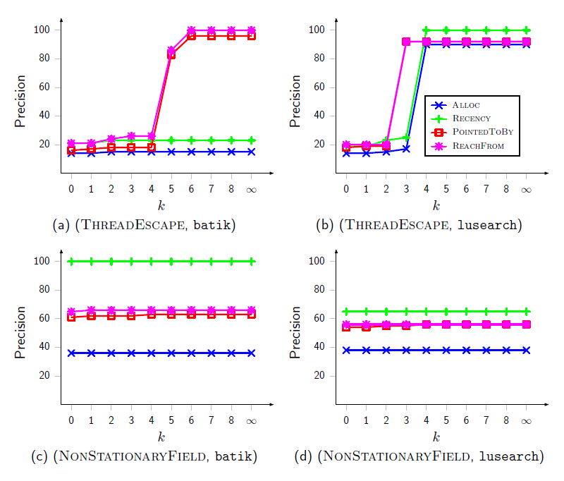
Empirical Result: Effect of call stack depth k
Phase transition: sharp increase in precision beyond k ~ 5
Utility varied across clients but consistent across programs

Slide 16
Learning Minimal Abstractions (POPL’11)
Goal: Methodology for finding minimal abstraction in given parametric abstraction framework for given program and client
Abstraction framework: k-CFA with heap cloning
  what k value to use for each call site and for each allocation site?
Client: static race detection; uses points-to information pervasively
Goal: find smallest k values that yield as precise results as uniform
k-CFA for static race detection on a given program
DATALOGREFINE: Deterministic iterative refinement; computes dependencies from effects (races) to causes (k values)
HYBRIDLEARN: Randomized refinement/coarsening; combination of:
  STATREFINE (a Monte-Carlo algorithm: running time is fixed but may
  not find minimal abstraction)
  ACTIVECOARSEN (a Las Vegas algorithm: running time is random but guaranteed to find minimal abstraction)

Slide 17
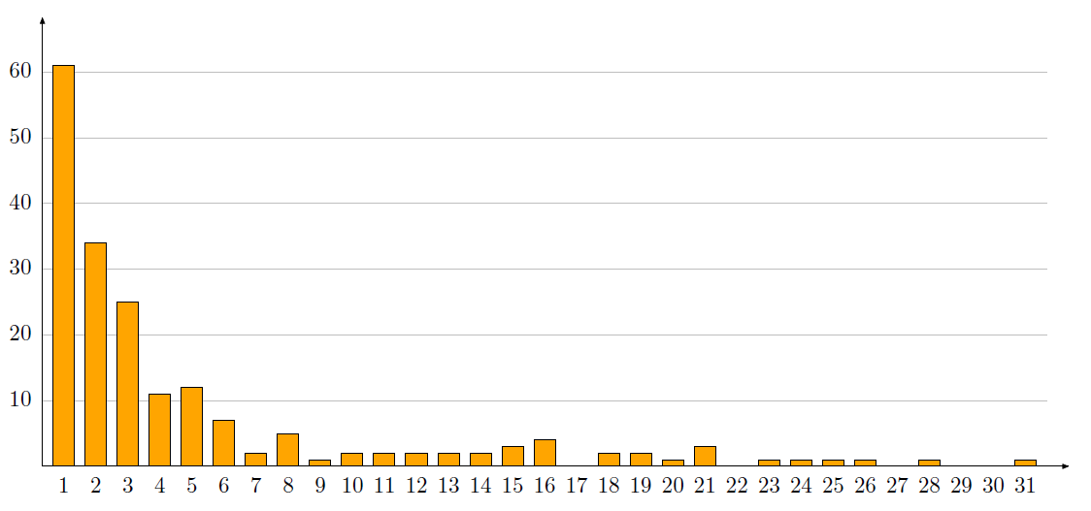
Empirical Result: HEDC (web crawler from ETH)
algorithm | sum of k values of all sites | average k value of site
uniform 2-CFA | 24,902 | 2
DATALOGREFINE | 19,300 | 1.55
HYBRIDLEARN | 361 | 0.028
#races reported by uniform k-CFA:
(k=0):16,306 (k=2): 10,292; (diff): 6,014
#call and allocation sites: 12,451
HYBRIDLEARN partitions 6,014 races into
189 groups, each with a different minimal
abstraction
#queries in largest, smallest groups: 1190, 1
tiny abstraction enough for many groups
(k value of 1 for only 1 site for 61 groups)
  Number of groups
Sum of k values of all sites in minimal abstraction computed by HYBRIDLEARN that proves all queries in group

Slide 18
Example: Reasoning About Program Heaps*
Applications
Who needs to reason about the heap?
Tools:
  race/deadlock/atomicity checking
  type-state verification
  program slicing
Programmers:
  memory bloat removal
  program parallelization
Heap Abstractions
What heap abstraction frameworks
are suitable for a given application?
Classic: object allocation sites
Newer: call stack (k-CFA), object recency, heap connectivity
Future: regular expressions, …
Analysis Techniques
How to efficiently find a concise heap abstraction in a
given framework for a given program and client?
Dynamic analysis: learn across executions (within program)
Machine learning: learn across programs
*Joint work with P. Liang, O. Tripp, M. Sagiv

Slide 19
Leveraging Dynamic Analysis for Static Analysis
j
Parameterize static analysis
with abstraction parameter dictating its precision/scalability tradeoff
Obtain parameter value for each query by running program on a given input
Group queries having same parameter value
Run program on multiple
inputs for better precision
and scalability
input data D_{j} for W
program execution monitoring
program trace P_{j}
dynamic
analysis
abstraction
A
┴
counterex.
proof
k
parameter value inferrer I
whole program
W
parameter value H_{k}
static
analysis
abstraction
A_{k}
program query
Q_{i}
i
proof
counterex.
Q_{i} ⊢ W
Q_{i} ⊬ W

Slide 20
Our Thread-Escape Analysis
fully flow- and context-sensitive
heap abstraction framework: sub-0-CFA with 2 partitions
  local partition: sites reachable from at most one thread
  shared partition: sites reachable from possibly multiple threads
  2^|sites| choices: which partition for each site?
    must avoid edge from shared to local partition
A_{k} =
v1 = new h1
v2 = new h2
v1.f1 = v2
p1: … v2.f2 …
g = v1
p2: … v2.f2 …
if (*)
v3 = new h3
v4 = new h4
v3.f3 = v4
else
v4 = new h5
p3: … v4.f4 …
v1 = new h
v2 = new h
v1.f1 = v2
p1: … v2.f2 …
g = v1
p2: … v2.f2 …
if (*)
v3 = new h’
v4 = new h’
v3.f3 = v4
else
v4 = new h
p3: … v4.f4 …
v1
v2
at p3:
f1
g
h1
h2
v3
v4
H_{k} =
f3
{ h3,h4 }
h3
h4
h5
W =
v1
at p3:
g
f1
v2
v4
f3
v3

Slide 21
Empirical Result: Precision of Our
Thread-Escape Analysis
benchmark | # heap-accessing statements in appplication code
 | reachable by dynamic R | possibly local by dynamic U (% of R) | proven local by our static (% of U)
hedc | 278 | 203 (74%) | 141 (69%)
weblech | 423 | 263 (62%) | 247 (94%)
lusearch | 2,142 | 1,785 (83%) | 1,428 (80%)
hsqldb | 4,387 | 2,616 (60%) | 2,571 (98%)

Slide 22
Kinds of Program Analyses in Chord
static analysis written imperatively in Java
dynamic analysis written imperatively in Java
seamlessly
integrated!
static or dynamic analysis written declaratively in Datalog and solved using BDDs

Slide 23
Typical Chord Usage
Java program to analyze
[chord.properties file: entry point, classpath, etc.]
chord
–Dchord.work.dir=…
–Dchord.java.analysis.path=…
–Dchord.dlog.analysis.path=…
–Dchord.run.analyses=…
run
Path specifying analyses written in Java
[classes annotated @Chord]
Path specifying analyses written in Datalog
[*.dlog and *.datalog files]
List of names of analyses defined in above paths
to run on above program

Slide 24
Generic Program Analysis Template
public class JavaAnalysis {
protected Object[] consumes, produces, controls;
public void run() { }
public void run(Object ctrl, StepCollection sc) {
for (each DataCollection dc consumed by sc)
let sc2 be unique StepCollection producing dc
let cc2 be CtrlCollection prescribing sc2
cc2.Put(ctrl);
consumes[i] = dc.Get(ctrl);
run();
for (each DataCollection dc produced by sc)
dc.Put(ctrl, produces[i])
for (each CtrlCollection cc produced by sc)
cc.Put(controls[i])
}
}

Slide 25
User-Defined Program Analysis
@Chord(name=…, // name of StepCollection induced by this analysis
prescriber=…, // name of CtrlCollection prescribing this analysis
consumes=…, // names of DataCollection’s consumed by this analysis
produces=…, // names of DataCollection’s produced by this analysis
controls = … // names of CtrlCollection’s produced by this analysis
)
public class MyAnalysis extends JavaAnalysis {
public void run() {
// analysis-specific code reading consumes[*] and
// writing produces[*] and controls[*]
}
public void run(Object ctrl, StepCollection sc) {
// override default template behavior if necessary
}
}

Slide 26
Specialized Program Analysis Templates
JavaAnalysis
program domain: a finite set of items of similar kind
ProgramDom
program relation: a finite set of tuples over domains
ProgramRel
DlogAnalysis
Datalog analysis: computing output relations from input relations
RHSAnalysis
DynamicAnalysis
Reps-Horwitz-Sagiv interprocedural dataflow analysis engine
…

Slide 27
Example Program Domain Analysis
// Domain of all lock acquisition points, including monitorenter
// statements and entry basic blocks of synchronized methods
@Chord(name=“L”, prescriber=“L”, consumes={}, produces={“L”}, controls={})
public class DomL extends ProgramDom<Inst> implements IAcqLockInstVisitor {
public void visit(jq_Class c) { }
public void visit(jq_Method m) {
if (!m.isAbstract() && m.isSynchronized()) {
EntryOrExitBasicBlock head = m.getCFG().entry();
add(head);
}
}
public void visitAcqLockInst(Quad q) {
add(q);
}
…
}

Slide 28
Example Program Relation Analysis
// Relation containing each tuple (e,f) such that statement
// e accesses instance field, static field, or array element f
@Chord(name=“EF”,sign=“E0,F0:F0_E0”,
prescriber=“EF”,consumes={“E”,“F”},produces={“EF”},controls={})
public class RelEF extends ProgramRel {
public void fill() {
DomE domE = (DomE) doms[0];
DomF domF = (DomF) doms[1];
for (int e = 0; e < domE.size(); e++) {
Quad stmt = domE.get(e);
jq_Field field = stmt.getField();
int f = domF.indexOf(field);
add(e, f);
}
}
}

Slide 29
Example Datalog Analysis
.include “E.dom”
.include “F.dom”
.include “T.dom”
.bddvarorder E0xE1_T0_T1_F0
EF(e:E0, f:F0) input
write(e:E0) input
reach(t:T0, e:E0) input
alias(e1:E0, e2:E1) input
escape(e:E0) input
unguarded(t1:T0, e1:E0, t2:T1, e2:E1) input
hasWrite(e1:E0, e2:E1)
candidate(e1:E0, e2:E1)
datarace(t1:T0, e1:E0, t2:T1, e2:E1) output
hasWrite(e1, e2) :- write(e1).
hasWrite(e1, e2) :- write(e2).
candidate(e1, e2) :- EF(e1,f), EF(e2, f),
hasWrite(e1, e2), e1 <= e2.
datarace(t1, e1, t2, e2) :- candidate(e1, e2),
reach(t1, e1), reach(t2, e2), alias(e1, e2),
escape(e1), escape(e2), unguarded(t1, e1, t2, e2).
program domains
BDD variable ordering
input, intermediate, output
program relations
represented as BDDs
analysis constraints
(Horn Clauses)
solved via BDD operations

Slide 30
Seamless Integration of Analyses in Chord
program
quadcode
example program analysis
domain D₁
analysis
relation R₁₂
analysis
domain D₂
analysis
bytecode to
quadcode
(joeq)
domain D₁
relation R₁₂
domain D₂
relation
R₁
relation
R₂
program
bytecode
dynamic
analysis
Datalog
analysis
static
analysis
bytecode
instrumentor
(javassist)
bddbddb
BuDDy
program
inputs
Java program
CnC/Habanero Java Runtime
program
source
analysis result
in HTML
analysis result
in XML
Java2HTML
saxon XSLT

Slide 31
Executing an Analysis in Chord
starts, blocks on D₁
resumes, runs to finish
starts, runs to finish
program
quadcode
example program analysis
domain D₁
analysis
relation R₁₂
analysis
domain D₂
analysis
starts, runs to finish
bytecode to
quadcode
(joeq)
✓
✓
✓
domain D₁
relation R₁₂
domain D₂
relation
R₁
✓
✓
relation
R₂
program
bytecode
dynamic
analysis
Datalog
analysis
static
analysis
bytecode
instrumentor
(javassist)
bddbddb
BuDDy
program
inputs
Java program
user demands this to run
starts, blocks on D₁
starts, blocks on D₁, D₂, R₁, R₁₂
starts, blocks on R₂, D₂
resumes, runs to finish
resumes,
runs to finish
resumes, runs to finish
CnC/Habanero Java Runtime
program
source
analysis result
in HTML
analysis result
in XML
Java2HTML
saxon XSLT

Slide 32
Benefits of Using CnC in Chord
Modularity
  analyses (steps) are written independently
Flexibility
  analyses can be made to interact in powerful ways with other analyses (by specifying data/control dependencies)
Efficiency
  analyses are executed in demand-driven fashion
  results computed by each analysis are automatically cached for reuse by other analyses without re-computation
  independent analyses are automatically executed in parallel
Reliability
  CnC’s “dynamic single assignment” property ensures result is same regardless of order in which analyses are executed

Slide 33
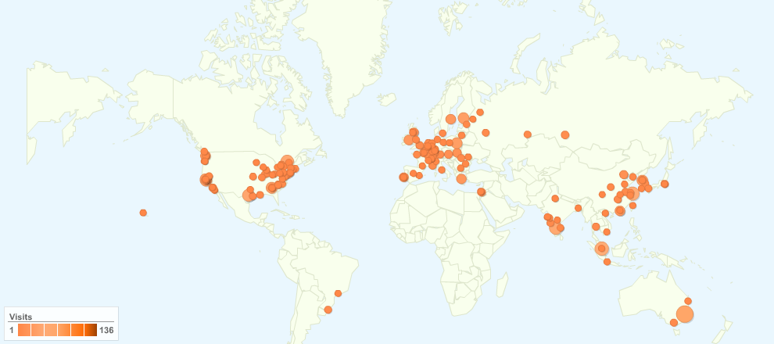
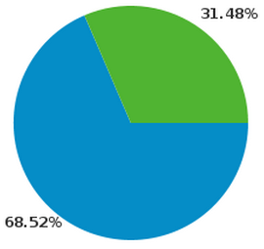
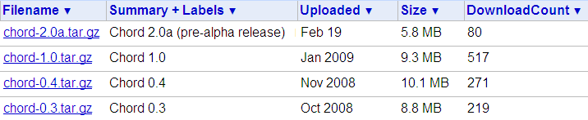

Chord Usage Statistics
3,881 visits came from 961 cities (Oct 1, 2008 – May 18, 2010)

Slide 34
Download Chord from:
jchord.googlecode.com
Chord project website:
berkeley.intel-research.net/chord

