Slide 1

Mechanizing
Program Analysis
With Chord
Mayur Naik
Intel Labs Berkeley

Slide 2
About Chord …
An extensible static/dynamic analysis framework for Java
Started in 2006 as static “Checker of Races and Deadlocks”
Portable: mostly written in Java, works on Java bytecode
  independent of OS, JVM, Java version
    works at least on Linux, MacOS, Windows/Cygwin
  few dependencies (e.g. not Eclipse-based)
Open-source, available at http://code.google.com/p/jchord
Primarily used in Intel Labs and academia
  by researchers in program analysis, systems, and machine learning
  for applying program analyses to parallel/cloud computing problems
  for advancing program analyses driven by these applications

Slide 3
Research Using Chord
Application to Parallel Computing
Application to Cloud Computing
static deadlock checker (ICSE’09)
M. Naik, C. Park, D. Gay, K. Sen
Mantis: estimating performance and
resource usage of systems software
B. Chun, L. Huang, P. Maniatis, M. Naik
static race checker (PLDI’06, POPL’07)
M. Naik, A. Aiken, J. Whaley
CloneCloud: partitioning and migration
of apps between phone and cloud
B. Chun, S. Ihm, P. Maniatis, M. Naik
static atomic set serializability checker
Z. Lai, S. Cheung, M. Naik
CheckMate: generalized dynamic
deadlock checker (FSE’10)
P. Joshi, K. Sen, M. Naik, D. Gay
debugging configuration options in
systems software (e.g. Hadoop)
A. Rabkin, R. Katz
Advanced Program Analyses
dynamically evaluating precision of
static heap abstractions (OOPSLA’10)
P. Liang, O. Tripp, M. Naik, M. Sagiv
Scalable client-driven static heap
analyses (e.g. points-to, thread-escape)
M. Naik, M. Sagiv, Z. Anderson, D. Gay

Slide 4
Mantis: Estimating Program Running Time*
program
input
offline component
feature
instrumentor
instrumented program
profiler
feature schemas
feature values,
running time
program
bytecode
feature evaluation costs
dynamic analysis
component
running time function over
chosen features
static program
slicer
model
generator
static analysis
component
final feature evaluator
(executable slice)
running time function over
final features
program
input
estimated
running time
online component
*Joint work with B. Chun, L. Huang, P. Maniatis (Intel)

Slide 5
Primary Goal of Chord
Enable users to productively prototype a broad class of program analyses
⇒ mechanize program analysis

Slide 6
Kinds of Program Analyses in Chord
static analysis written imperatively in Java
dynamic analysis written imperatively in Java
seamlessly
integrated!
static or dynamic analysis written declaratively in Datalog and solved using BDDs

Slide 7
Static vs. Dynamic Uses of Chord
= only static
= only dynamic
= static + dynamic
Application to Parallel Computing
Application to Cloud Computing
static deadlock checker (ICSE’09)
M. Naik, C. Park, D. Gay, K. Sen
Mantis: estimating performance and
resource usage of systems software
B. Chun, L. Huang, P. Maniatis, M. Naik
static race checker (PLDI’06, POPL’07)
M. Naik, A. Aiken, J. Whaley
CloneCloud: partitioning and migration
of apps between phone and cloud
B. Chun, S. Ihm, P. Maniatis, M. Naik
static atomic set serializability checker
Z. Lai, S. C. Cheung, M. Naik
CheckMate: generalized dynamic
deadlock checker (FSE’10)
P. Joshi, K. Sen, M. Naik, D. Gay
debugging configuration options in
systems software (e.g. Hadoop)
A. Rabkin, R. Katz
Advanced Program Analyses
dynamically evaluating precision of
static heap abstractions (OOPSLA’10)
P. Liang, O. Tripp, M. Naik, M. Sagiv
Scalable client-driven static heap
analyses (e.g. points-to, thread-escape)
M. Naik, M. Sagiv, Z. Anderson, D. Gay

Slide 8
Unusual Uses of Dynamic Analysis
Guide choice of approximation aspects of static analysis
  obtain lower bounds on precision of different approximation aspects by simulating each of them dynamically
Optimize static analysis
  property fails on run ⇒ do not attempt to prove it holds on all runs
Guess abstraction to be used by static analysis
  property holds on run ⇒ generalize reason why it holds to all runs
dynamically evaluating precision of
static heap abstractions (OOPSLA’10)
P. Liang, O. Tripp, M. Naik, M. Sagiv
Scalable client-driven static heap
analyses (e.g. points-to, thread-escape)
M. Naik, M. Sagiv, Z. Anderson, D. Gay

Slide 9
Leveraging Dynamic Analysis for Static Analysis*
j
Parameterize given sound, precise,
but non-scalable whole-program
analysis with an abstraction hint
Obtain abstraction hint by path-program analysis
  Obtain path program by running
  program on some input
  Simulate analysis instantiated
  using most precise abstraction
  hint on path program
Group queries having
same abstraction hint
Use multiple path
programs for improved
precision and scalability
input data D_{j} for W
program execution monitoring
path program P_{j}
path-program
analysis
abstraction
A
┴
┴
counterex.
proof
k
abstraction hint inferrer I
whole program
W
abstraction hint H_{k}
whole-program
analysis
abstraction
A_{k}
program query
Q_{i}
i
proof
counterex.
Q_{i} ⊢ W
Q_{i} ⊬ W
*Joint work with M. Sagiv, Z. Anderson, D. Gay

Slide 10
Our Thread-Escape Analysis
j
input data D_{j} for W
Flow-sensitive, top-down summary-
based context-sensitive analysis
  sound and precise
  not scalable:
  O(2^(|H|².|F|)) contexts/method
  O(|P|.2^(|H|².|F|)) abstract heaps
Abstraction hint H_{k} = set of object
allocation sites in program W that
are relevant to query Q_{i}
program execution monitoring
path program P_{j}
path-program
analysis
abstraction
A
┴
┴
counterex.
proof
k
abstraction hint inferrer I
whole program
W
abstraction hint H_{k}
whole-program
analysis
abstraction
A_{k}
program query
Q_{i}
i
proof
counterex.
Q_{i} ⊢ W
Q_{i} ⊬ W

Slide 11
Abstraction Hint for Our Thread-Escape Analysis
H_{k} = { h3, h4 }
A_{k} =
at p3:
v1
v2
v1 = new h1
v2 = new h2
v1.f1 = v2
p1: … v2.f2 …
g = v1
p2: … v2.f2 …
if (*)
v3 = new h3
v4 = new h4
v3.f3 = v4
else
v4 = new h5
p3: … v4.f4 …
v1 = new h
v2 = new h
v1.f1 = v2
p1: … v2.f2 …
g = v1
p2: … v2.f2 …
if (*)
v3 = new h3
v4 = new h4
v3.f3 = v4
else
v4 = new h
p3: … v4.f4 …
f1
g
h1
h2
v3
v4
f3
h3
h4
h5
W =
at p3:
v1
g
f1
v2
v3
v4
f3
h3
h4

Slide 12
Our Thread-Escape Analysis
j
input data D_{j} for W
Flow-sensitive, top-down summary-
based context-sensitive analysis
  sound and precise
  not scalable:
  O(2^(|H|².|F|)) contexts/method
  O(|P|.2^(|H|².|F|)) abstract heaps
Abstraction hint H_{k} = set of object
allocation sites in program W that
are relevant to query Q_{i}
For our benchmarks:
average |H| = 2600
average |H_{k}| = 3.2
  our approach is scalable!
program execution monitoring
path program P_{j}
path-program
analysis
abstraction
A
┴
┴
counterex.
proof
k
abstraction hint inferrer I
whole program
W
abstraction hint H_{k}
whole-program
analysis
abstraction
A_{k}
program query
Q_{i}
i
proof
counterex.
Q_{i} ⊢ W
Q_{i} ⊬ W

Slide 13
Dynamic Analysis Implementation Space for Java
 | Implement inside a JVM | Use JVMTI | Instrument bytecode at load-time | Instrument bytecode offline (used in Chord)
Portability | ☹ dependency on specific version of specific JVM | 😐 not supported by some JVMs (e.g. Android) | 😐 not supported by some JVMs (e.g. Android) | ☺
Efficiency | ☺ | 😐 | ☹ | ☹
Flexibility | ☺ | ☹ no support for what is doable by bytecode instru. | 😐 can only change method bytecode after class loaded | ☺
Other issues | not trivial to modify production JVM | event handing code must be written in C/C++ |  | must run program twice to find which classes to instru.
 |  |  | bytecode verifier may fail at runtime even using -Xverify:none (except IBM J9 VM)

Slide 14
Architecture of Dynamic Analysis in Chord
Analysis writer specifies kinds of events and code to handle them:
Analysis writer chooses kind of event handling:
enter/leave method m t | before/after method call i t o | getfield/putfield e t b f o
enter quad p t | enter/leave/iteration loop w t | thread start/join/wait/notify i t o
enter basic block b t | new/newarray h t o | acquire/release lock l t o
online, in JVM running instru. program Pro: can inspect state Con: either exclude JDK from instru. or do not use it in event handling code, to avoid correctness and performance issues | offline, in separate JVM after JVM running instru. program finishes Con: infeasible for long-running programs generating lots of events since all events stored in a file on disk | online, in separate JVM in parallel with JVM running instru. program Best option: uses buffered POSIX pipe to communicate events between event-generating JVM and event-handling JVM

Slide 15
Example Datalog Analysis
.include “E.dom”
.include “F.dom”
.include “T.dom”
.bddvarorder E0xE1_T0_T1_F0
field(e:E0, f:F0) input
write(e:E0) input
reach(t:T0, e:E0) input
alias(e1:E0, e2:E1) input
escape(e:E0) input
unguarded(t1:T0, e1:E0, t2:T1, e2:E1) input
hasWrite(e1:E0, e2:E1)
candidate(e1:E0, e2:E1)
datarace(t1:T0, e1:E0, t2:T1, e2:E1) output
hasWrite(e1, e2) :- write(e1).
hasWrite(e1, e2) :- write(e2).
candidate(e1, e2) :- field(e1,f), field(e2, f),
hasWrite(e1, e2), e1 <= e2.
datarace(t1, e1, t2, e2) :- candidate(e1, e2),
reach(t1, e1), reach(t2, e2), alias(e1, e2),
escape(e1), escape(e2), unguarded(t1, e1, t2, e2).
program domains
BDD variable ordering
input, intermediate, output
program relations
represented as BDDs
analysis constraints
(Horn Clauses)
solved via BDD operations

Slide 16
Pros and Cons of Datalog/BDDs
Good for rapidly crafting initial versions of an analysis with focus on false positive/negative rate instead of scalability
  initial versions tend to have intolerable false positive/negative rate
Good for analyses …
  whose constraint solving strategy is not obvious (e.g. best known alternative is chaotic iteration)
  involving data with lots of redundancy and large as to be impossible to compute/store/read using Java if represented explicitly (e.g. cloning-based analyses)
  involving few simple rules (e.g. transitive closure)
Bad for analyses …
  with more complicated formulations (e.g. summary-based analyses)
  over domains not known exactly in advance (i.e. on-the-fly analyses)
  involving many interdependent rules (e.g. points-to analyses)
Unintuitive effects of BDDs on performance (e.g. smaller non-uniform k values in k-CFA worse than larger uniform k values)

Slide 17
Expressing Analysis Dependencies Using CnC*
C₁
…
C_{n}
step instance t_{i} is “enabled” when tag t_{i} arrives in T
get’s block until an item with tag t_{i} arrives in each of C₁, …, C_{n}
analysis is performed
an item with tag t_{i} is put in each of P₁, …, P_{m}
data collections
c_{1i} = C₁.get(t_{i});
…
c_{ni} = C_{n}.get(t_{i});
p_{1i}…p_{mi} = analysis(c_{1i}…c_{ni});
P₁.put(t_{i}, p_{1i});
…
P_{m}.put(t_{i}, p_{mi});
P₁
…
P_{m}
T
step
collection
control collection
*Joint work with V. Sarkar and Habanero team (Rice U.)

Slide 18
Example Datalog Analysis Using CnC
C₁
…
C_{n}
.include “D₁.dom”
.include “D₂.dom”
R₁(d₁:D₁) input
R₁₂(d₁:D₁, d₂:D₂) input
R₂(d₂:D₂) output
R₂(d₂) :- R₁(d₁), R₁₂(d₁,d₂).
c_{1i} = C₁.get(t_{i});
…
c_{ni} = C_{n}.get(t_{i});
p_{1i}…p_{mi} = analysis(c_{1i}…c_{ni});
P₁.put(t_{i}, p_{1i});
…
P_{m}.put(t_{i}, p_{mi});
P₁
…
P_{m}
T

Slide 19
Example Datalog Analysis Using CnC
domain D₁
relation R₁₂
domain D₂
.include “D₁.dom”
.include “D₂.dom”
R₁(d₁:D₁) input
R₁₂(d₁:D₁, d₂:D₂) input
R₂(d₂:D₂) output
R₂(d₂) :- R₁(d₁), R₁₂(d₁,d₂).
D_{1i} = D₁.get(program_{i});
D_{2i} = D₂.get(program_{i});
R_{1i} = R₁.get(program_{i});
R_{12i} = R₁₂.get(program_{i});
R_{2i}(d₂) :- R_{1i}(d₁), R_{12i}(d₁, d₂).
R₂.put(program_{i}, R_{2i});
relation
R₁
relation
R₂
program

Slide 20
Seamless Integration of Analyses in Chord
program
quadcode
example program analysis
domain D₁
analysis
relation R₁₂
analysis
domain D₂
analysis
bytecode to
quadcode
(joeq)
domain D₁
relation R₁₂
domain D₂
relation
R₁
relation
R₂
program
bytecode
dynamic
analysis
Datalog
analysis
static
analysis
bytecode
instrumentor
(javassist)
bddbddb
BuDDy
program
inputs
Java program
CnC/Habanero-Java Runtime
program
source
analysis result
in HTML
analysis result
in XML
Java2HTML
saxon XSLT

Slide 21
Executing an Analysis in Chord
starts, blocks on D₁
resumes, runs to finish
starts, runs to finish
program
quadcode
example program analysis
domain D₁
analysis
relation R₁₂
analysis
domain D₂
analysis
starts, runs to finish
bytecode to
quadcode
(joeq)
✓
✓
✓
domain D₁
relation R₁₂
domain D₂
relation
R₁
✓
✓
relation
R₂
program
bytecode
dynamic
analysis
Datalog
analysis
static
analysis
bytecode
instrumentor
(javassist)
bddbddb
BuDDy
program
inputs
Java program
user demands this to run
starts, blocks on D₁
starts, blocks on D₁, D₂, R₁, R₁₂
starts, blocks on R₂, D₂
resumes, runs to finish
resumes,
runs to finish
resumes, runs to finish
CnC/Habanero Java Runtime
program
source
analysis result
in HTML
analysis result
in XML
Java2HTML
saxon XSLT

Slide 22
Benefits of Using CnC in Chord
Modularity
  analyses (steps) are written independently
Flexibility
  analyses can be made to interact in powerful ways with other analyses (by specifying data/control dependencies)
Efficiency
  analyses are executed in demand-driven fashion
  results computed by each analysis are automatically cached for reuse by other analyses without re-computation
  independent analyses are automatically executed in parallel
Reliability
  CnC’s “dynamic single assignment” property ensures result is same regardless of order in which analyses are executed

Slide 23

Intended Audience of Chord
Researchers prototyping program analysis algorithms
analysis
specialists
Initial focus
Current focus
Researchers with limited program analysis background prototyping systems having program analysis parts
Ultimate
goal
system
builders
Users with no background in program analysis using it as
a black box
programmers

Slide 24
Classification of Chord Uses
= only program analysis
= program analysis + systems
= program analysis + ML
Application to Parallel Computing
Application to Cloud Computing
static deadlock checker (ICSE’09)
M. Naik, C. Park, D. Gay, K. Sen
Mantis: estimating performance and
resource usage of systems software
B. Chun, L. Huang, P. Maniatis, M. Naik
static race checker (PLDI’06, POPL’07)
M. Naik, A. Aiken, J. Whaley
CloneCloud: partitioning and migration
of apps between phone and cloud
B. Chun, S. Ihm, P. Maniatis, M. Naik
static atomic set serializability checker
Z. Lai, S. Cheung, M. Naik
CheckMate: generalized dynamic
deadlock checker (FSE’10)
P. Joshi, K. Sen, M. Naik, D. Gay
debugging configuration options in
systems software (e.g. Hadoop)
A. Rabkin, R. Katz
Advanced Program Analyses
dynamically evaluating precision of
static heap abstractions (OOPSLA’10)
P. Liang, O. Tripp, M. Naik, M. Sagiv
Scalable client-driven static heap
analyses (e.g. points-to, thread-escape)
M. Naik, M. Sagiv, Z. Anderson, D. Gay

Slide 25
Why Cater to Non-Specialists?
Gain fresh perspectives for program analysis
  New program analysis problems
    e.g. Mantis project: estimating program execution time on given input (in contrast to WCET and asymptotic worst case bounds)
  New variants of known program analysis problems
    e.g. Mantis project: new definitions of program slice: executable and approximate (in contrast to debuggable and exact)
Others (esp. systems) need program analysis solutions
Program analysis needs solutions from others (esp. ML)
Experiment for each area: see if its “systematic” solutions are necessary to solve problems in other areas
  e.g. ML solutions used in program analysis are heuristics

Slide 26
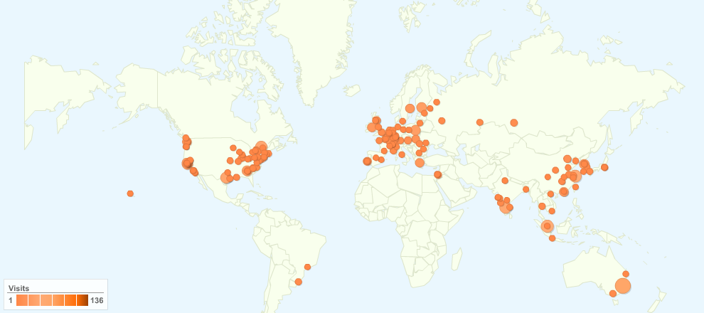
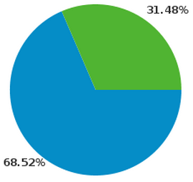
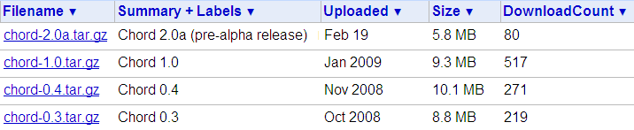

Chord Usage Statistics
3,881 visits came from 961 cities (Oct 1, 2008 – May 18, 2010)

Slide 27
Acknowledgments
Intel Labs Berkeley
  Byung-Gon Chun
  David Gay
  Ling Huang
  Petros Maniatis
UC Berkeley
  Koushik Sen
  Pallavi Joshi
  Chang-Seo Park
  Zachary Anderson
  Percy Liang
  Ariel Rabkin
Tel-Aviv U.
  Mooly Sagiv
  Omer Tripp
CnC/Habanero team at Rice U.
  Vivek Sarkar
  Kath Knobe (Intel)
  Zoran Budimlic
  Michael Burke
  Dragos Sbirlea
  Alina Simion
  Sagnak Tasirlar
Open-source software in Chord
  joeq and bddbddb, by John Whaley
  javassist, by Shigeru Chiba

