Slide 1
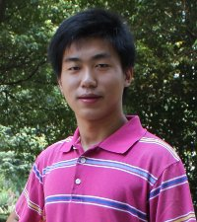
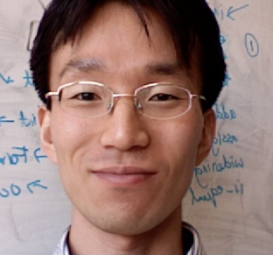


Finding Optimal Program Abstractions
Mayur Naik Georgia Tech
Joint work with:
Xin Zhang (Georgia Tech)
Hongseok Yang (Oxford)
Percy Liang (Stanford)
Mooly Sagiv (Tel-Aviv U)

Slide 2
Static Analysis: 70’s to 90’s
client-oblivious
“Because clients have different precision and scalability needs, future work should identify the client they are addressing …” M. Hind, Pointer Analysis: Haven’t We Solved This Problem Yet?, 2001
program p
abstraction a
query q₁
query q₂
p ² q₁?
p ² q₂?

Slide 3
Static Analysis: 00’s to Present
client-driven
demand-driven points-to analysis Heintze & Tardieu ’01, Guyer & Lin ’03, Sridharan & Bodik ’06, …
CEGAR model checkers: SLAM, BLAST, …
program p
abstraction a
query q₁
query q₂
p ² q₁?
p ² q₂?

Slide 4
Static Analysis: 00’s to Present
client-driven
demand-driven points-to analysis Heintze & Tardieu ’01, Guyer & Lin ’03, Sridharan & Bodik ’06, …
CEGAR model checkers: SLAM, BLAST, …
abstraction a₁
abstraction a₂
q₁
p
q₂
p ² q₁?
p ² q₂?

Slide 5
Our Static Analysis Setting
client-driven + parametric
new search algorithms: testing, machine learning, …
new analysis questions: optimality, impossibility, …
0 1 0 0 0
1 0 0 0 1
abstraction a₁
abstraction a₂
q₁
p
q₂
p ² q₁?
p ² q₂?

Slide 6
Example 1: Predicate Abstraction (CEGAR)
Predicates to use in predicate abstraction
0 1 0 0 0
1 0 0 0 1
abstraction a₁
abstraction a₂
q₁
p
q₂
p ² q₁?
p ² q₂?

Slide 7
Example 2: Shape Analysis (TVLA)
Predicates to use as abstraction predicates
0 1 0 0 0
1 0 0 0 1
abstraction a₁
abstraction a₂
q₁
p
q₂
p ² q₁?
p ² q₂?

Slide 8
Example 3: Cloning-based Pointer Analysis
K value to use for each call and each allocation site
0 1 0 0 0
1 0 0 0 1
abstraction a₁
abstraction a₂
q₁
p
q₂
p ² q₁?
p ² q₂?

Slide 9
Problem Statement
An efficient algorithm with:
INPUTS:
program p and query q
abstractions A = { a₁, …, a_{n} }
boolean function S(p, q, a)
OUTPUT:
Impossibility: @ a 2 A: S(p, q, a) = true
Proof: a 2 A: S(p, q, a) = true
8 a’ 2 A: (a’ · a Æ S(p, q, a’) = true) ) a’ = a
a
p
_{S}
q
p ` q
p 0 q
AND
Optimal Abstraction

Slide 10
Problem Statement
An efficient algorithm with:
INPUTS:
program p and query q
abstractions A = { a₁, …, a_{n} }
boolean function S(p, q, a)
OUTPUT:
Impossibility: @ a 2 A: S(p, q, a) = true
Proof: a 2 A: S(p, q, a) = true
8 a’ 2 A: (a’ · a Æ S(p, q, a’) = true) ) a’ = a
1111 finest
S(p, q, a)
: S(p, q, a)
0100 optimal
0000 coarsest
AND
Optimal Abstraction

Slide 11
Orderings on A
Efficiency Partial Ordering
a₁ ·_{cost} a₂ , sum of a₁’s bits · sum of a₂’s bits
S(p, q, a₁) runs faster than S(p, q, a₂)
Precision Partial Ordering
a₁ ·_{prec} a₂ , a₁ is pointwise · a₂
S(p, q, a₁) = true ) S(p, q, a₂) = true

Slide 12
Why Optimality?
Empirical lower bounds for static analysis
Efficient to compute
Better for user consumption
analysis imprecision facts
assumptions about missing program parts
Better for machine learning

Slide 13
Why is this Hard in Practice?
|A| exponential in size of p, or even infinite
S(p, q, a) = false for most p, q, a
Different a is optimal for different p, q

Slide 14
Talk Outline
Abstraction Coarsening [POPL’11]
Abstractions from Tests [POPL’12]
Abstraction Refinement [PLDI’13]

Slide 15
Talk Outline
Abstraction Coarsening [POPL’11]
Abstractions from Tests [POPL’12]
Abstraction Refinement [PLDI’13]

Slide 16
Abstraction Coarsening [POPL’11]
For given p, q: start with finest a, incrementally replace 1’s with 0’s
Two algorithms:
deterministic vs. randomized
In practice, use combination of the algorithms
1111 finest
S(p, q, a)
: S(p, q, a)
0100 optimal
0000 coarsest

Slide 17
Randomized Coarsening Algorithm
a Ã (1, …, 1)
Loop:
Remove each component from a with probability (1 - ®)
Run S(p, q, a)
If :S(p, q, a) then add components back
Else remove components permanently

Slide 18
Performance of Randomized Coarsening
Let: n = total # components
s = # components in largest optimal abstraction
If set probability ® = e^{(-1/s)} then outputs optimal abstraction in O(s log n) expected time
Significance: s is small, only log dependence on total # components

Slide 19
Application: Pointer Analysis Abstractions
Client: static datarace detector [PLDI’06]
Pointer analysis using k-CFA with heap cloning
Uses call graph, may-alias, thread-escape, and may-happen-in-parallel analyses
 | # components (x 1000) |  | # unproven queries (dataraces) (x 1000)
 | alloc sites | call sites | 0-CFA | 1-CFA | diff | 1-obj | 2-obj | diff
hedc | 1.6 | 7.2 | 21.3 | 17.8 | 3.5 | 17.1 | 16.1 | 1.0
weblech | 2.6 | 12.4 | 27.9 | 8.2 | 19.7 | 8.1 | 5.5 | 2.5
lusearch | 2.9 | 13.9 | 37.6 | 31.9 | 5.7 | 31.4 | 20.9 | 10.5

Slide 20
Experimental Results: All Queries
K-CFA | # components (x 1000) | BasicRefine (x 1000) | ActiveCoarsen
hedc | 8.8 | 7.2 (83%) | 90 (1.0%)
weblech | 15.0 | 12.7 (85%) | 157 (1.0%)
lusearch | 16.8 | 14.9 (88%) | 250 (1.5%)
K-obj | # components (x 1000) | BasicRefine (x 1000) | ActiveCoarsen
hedc | 1.6 | 0.9 (57%) | 37 (2.3%)
weblech | 2.6 | 1.8 (68%) | 48 (1.9%)
lusearch | 2.9 | 2.1 (73%) | 56 (1.9%)

Slide 21
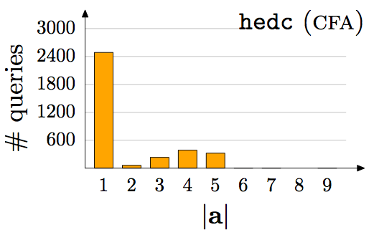
Empirical Results: Per Query

Slide 22
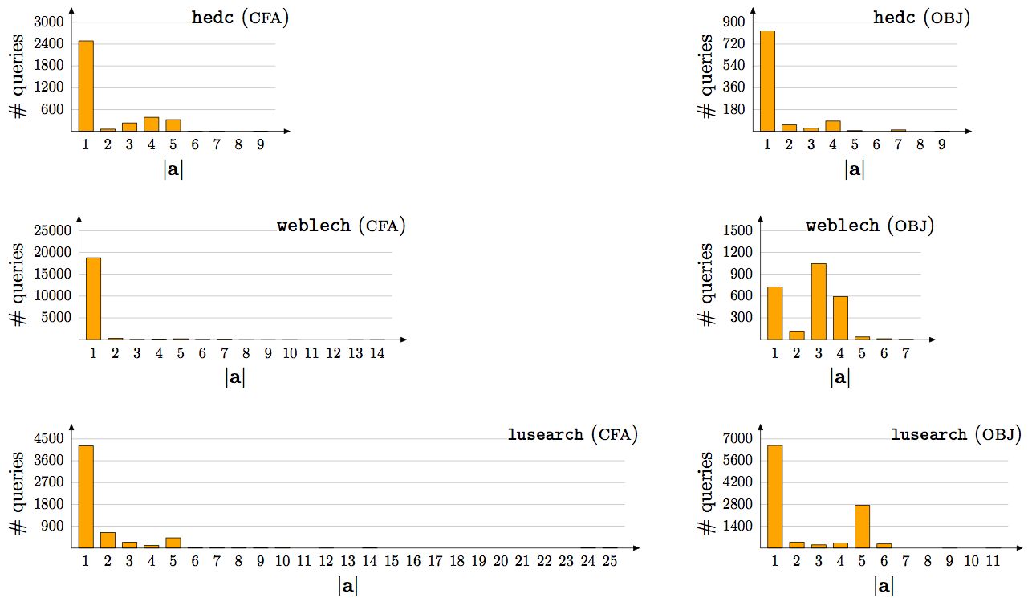
Empirical Results: Per Query, contd.

Slide 23
Talk Outline
Abstraction Coarsening [POPL’11]
Abstractions from Tests [POPL’12]
Abstraction Refinement [PLDI’13]

Slide 24
Talk Outline
Abstraction Coarsening [POPL’11]
Abstractions from Tests [POPL’12]
Abstraction Refinement [PLDI’13]

Slide 25



Abstractions From Tests [POPL’12]
dynamic analysis
p, q
0 1 0 0 0
and optimal!
static analysis
p ² q?

Slide 26
Combining Dynamic and Static Analysis
Previous work:
Counterexamples: query is false on some input
suffices if most queries are expected to be false
Likely invariants: a query true on some inputs is likely true on all inputs [Ernst 2001]
Our approach:
Proofs: a query true on some inputs is likely true on all inputs and for likely the same reason!

Slide 27
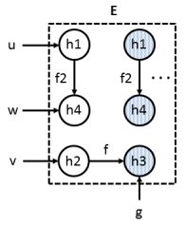

Example: Thread-Escape Analysis
// u, v, w are local variables
// g is a global variable
// start() spawns new thread
for (i = 0; i < N; i++) {
u = new h1;
v = new h2;
g = new h3;
v.f = g;
w = new h4;
u.f2 = w;
pc: w.id = i;
u.start();
}
h1 h2 h3 h4
L L L L
local(pc, w)?

Slide 28
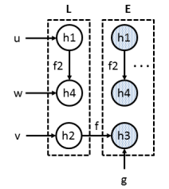
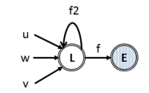
Example: Thread-Escape Analysis
// u, v, w are local variables
// g is a global variable
// start() spawns new thread
for (i = 0; i < N; i++) {
u = new h1;
v = new h2;
g = new h3;
v.f = g;
w = new h4;
u.f2 = w;
pc: w.id = i;
u.start();
}
h1 h2 h3 h4
L L E L
local(pc, w)?
but not optimal

Slide 29
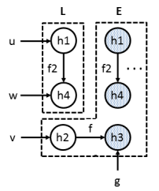
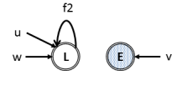
Example: Thread-Escape Analysis
// u, v, w are local variables
// g is a global variable
// start() spawns new thread
for (i = 0; i < N; i++) {
u = new h1;
v = new h2;
g = new h3;
v.f = g;
w = new h4;
u.f2 = w;
pc: w.id = i;
u.start();
}
h1 h2 h3 h4
L E E L
local(pc, w)?
and optimal!

Slide 30
Benchmarks
 | classes |  | bytecodes (x 1000) |  | alloc. sites (x 1000)
 | app | total | app | total
hedc | 44 | 355 | 16 | 161 | 1.6
weblech | 57 | 579 | 20 | 237 | 2.6
lusearch | 229 | 648 | 100 | 273 | 2.9
sunflow | 164 | 1,018 | 117 | 480 | 5.2
avrora | 1,159 | 1,525 | 223 | 316 | 4.9
hsqldb | 199 | 837 | 221 | 491 | 4.6

Slide 31
Precision: Thread-Escape Analysis

Slide 32
Running Time (seconds) CDFs

Slide 33
Running Time (seconds) CDFs

Slide 34
Talk Outline
Abstraction Coarsening [POPL’11]
Abstractions from Tests [POPL’12]
Abstraction Refinement [PLDI’13]

Slide 35
Talk Outline
Abstraction Coarsening [POPL’11]
Abstractions from Tests [POPL’12]
Abstraction Refinement [PLDI’13]

Slide 36
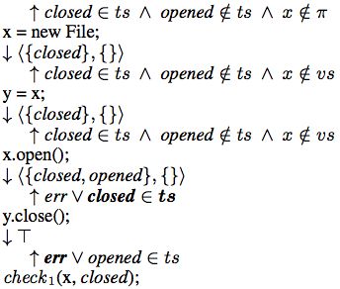
Example: Type-State Analysis
`21.548`
x = new File;
y = x;
if (*) z = x;
x.open();
y.close();
if (*)
check1(x, closed);
else
check2(x, opened);
`21.548`
`21.548`
`21.548`
`21.548`
Query | Abstraction
check1 | Any >= { x, y }
check2 | None
Query | Abstraction
check1 | { }
check2

Slide 37
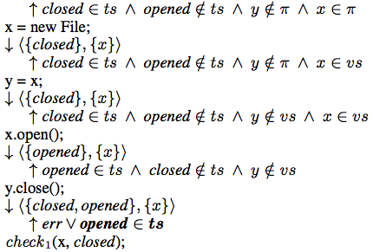
Example: Type-State Analysis
`21.548`
x = new File;
y = x;
if (*) z = x;
x.open();
y.close();
if (*)
check1(x, closed);
else
check2(x, opened);
`21.548`
`21.548`
`21.548`
`21.548`
Query | Abstraction
check1 | Any >= { x, y }
check2 | None
Query | Abstraction
check1 | { }
check2
{ x }
{ x, y }

Slide 38
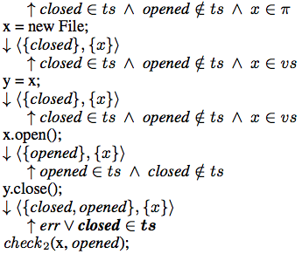
Example: Type-State Analysis
`21.548`
x = new File;
y = x;
if (*) z = x;
x.open();
y.close();
if (*)
check1(x, closed);
else
check2(x, opened);
`21.548`
`21.548`
`21.548`
`21.548`
Query | Abstraction
check1 | Any >= { x, y }
check2 | None
Query | Abstraction
check1 | { }
check2 | { }
{ x }
{ x, y }
{ x }

Slide 39
Precision: Thread-Escape Analysis

Slide 40
Comparison with Abstractions from Tests

Slide 41
Number of Iterations
 | proven queries |  |  | impossible queries
 | min | max | avg | min | max | avg
hsqldb | 2 | 27 | 3 | 1 | 13 | 2
antlr | 2 | 18 | 9 | 1 | 47 | 8
avrora | 2 | 82 | 48 | 1 | 30 | 4
lusearch | 2 | 32 | 2 | 1 | 23 | 2

Slide 42
Running Time
 | proven queries |  |  | impossible queries
 | min | max | avg | min | max | avg
hsqldb | 20s | 25m | 94s | 4s | 50m | 55s
antlr | 18s | 77m | 98s | 6s | 21m | 64s
avrora | 16s | 28m | 67s | 5s | 3h | 41s
lusearch | 14s | 13m | 112s | 6s | 45m | 131s

Slide 43
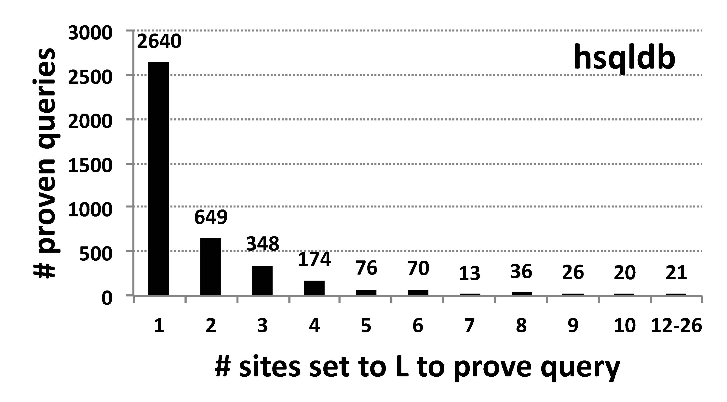
Size of Optimal Abstraction

Slide 44
Size of Optimal Abstraction

Slide 45
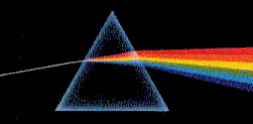
Key Takeaways
New questions: optimality, impossibility, …
New applications: lower bounds, lib assumptions, …
New techniques: search algorithms, abstractions, …
New tools: meta-analysis, parallelism, …
pag.gatech.edu/prism

