Slide 1
Combining Logical and Probabilistic Reasoning in Program Analysis
Mayur Naik, University of Pennsylvania
Joint work with:
Mukund Raghothaman
Xin Zhang
Sulekha Kulkarni
Xujie Si
Notes:
Thank you.

Slide 2
Conventional Logical Approach
Program
Analysis
Notes:
Designing program analyses that work in practice remains as much as art as its science
Current approach: Knowledgeable writer designs analyses
Also, needs experience. Uses experience to decide what approximations to incorporate.
Why approximations?
Undecidable problems
Properties ill-defined, For example, consider an analysis trying to find races in the program. Many data races are benign and programmers do want them to be reported. Notion of benign is subjective and not well-defined.
Most large programs call native code i.e code for which we don’t have source code but only the binaries. These are invisible to analysis tools that operate on source/assembly code.
No well defined recipe for choosing approximations. And the guiding principle employed is to choose approximations such that analysis still produces useful results inspite of the inherent imprecision due to the approximations.

Slide 3
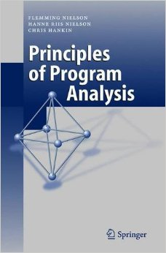

Conventional Logical Approach
Program
Analysis
Approximations
Exact solutions impossible to compute
Properties impossible to state precisely
Missing or opaque program fragments
…
path(a, a).
path(a, c) :- path(a, b), edge(b, c).
Notes:
Designing program analyses that work in practice remains as much as art as its science
Current approach: Knowledgeable writer designs analyses
Also, needs experience. Uses experience to decide what approximations to incorporate.
Why approximations?
Undecidable problems
Properties ill-defined, For example, consider an analysis trying to find races in the program. Many data races are benign and programmers do want them to be reported. Notion of benign is subjective and not well-defined.
Most large programs call native code i.e code for which we don’t have source code but only the binaries. These are invisible to analysis tools that operate on source/assembly code.
No well defined recipe for choosing approximations. And the guiding principle employed is to choose approximations such that analysis still produces useful results inspite of the inherent imprecision due to the approximations.

Slide 4

Conventional Logical Approach
false alarm!
path(1,1)
edge(1,7)
Program
Analysis
edge(7,2)
path(1,7)
edge(7,5)
edge(2,8)
path(1,2)
path(1,5)
edge(5,8)
path(1,8)
edge(8,6)
path(1,6)
x may be null …
int f(A z) {
...
x.f = y;
...
}
1
4
path(a, a).
path(a, c) :- path(a, b), edge(b, c).
7
2
5
8
3
6
Notes:
- On the other side of current picture,
User runs analysis on programs.
For large programs, analysis might produce many reports.
User needs to analyze the reports and fix the bugs.
Problem! Many reports are false alarms.
False alarms because approximations.
Approximations are necessary but guide the approximations.
Much effort wasted leading to user frustration.
Stop using tool.
Key issue: the writer’s notion of usefulness when choosing approximations did not match the user’s notion

Slide 5

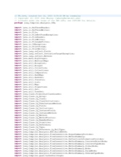
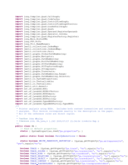

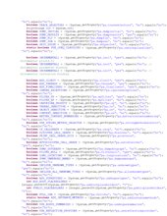
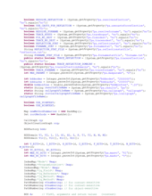
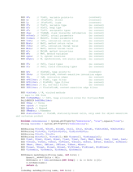
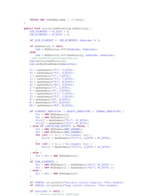
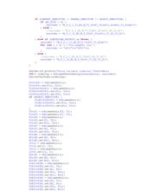
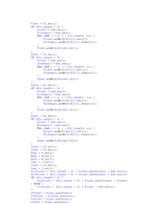
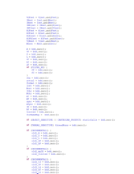
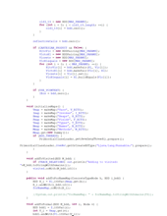
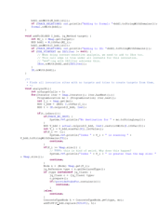
Conventional Logical Approach
Program
Analysis
“People ignore the tool if more than
30% false positives are reported …”
[Coverity, CACM’10]
Notes:
- On the other side of current picture,
User runs analysis on programs.
For large programs, analysis might produce many reports.
User needs to analyze the reports and fix the bugs.
Problem! Many reports are false alarms.
False alarms because approximations.
Approximations are necessary but guide the approximations.
Much effort wasted leading to user frustration.
Stop using tool.
Key issue: the writer’s notion of usefulness when choosing approximations did not match the user’s notion

Slide 6
Our Key Idea
Shift decisions about usefulness of results
from analysis writers to analysis users
Approximations
Program
Analysis
Feedback
Analysis Writer
Analysis User
Notes:
- Writer still makes decisions about approximations.
User can also give feedback to the analysis tool and guide it towards more acceptable results.
Key technical challenges:
Allow both writer and user to systematically interact with the system
Approach should be smart enough to learn from limited user feedback

Slide 7
Combined Logical and Probabilistic Approach
Program
Analysis
path(a, c) :- path(a, b), edge(b, c). 2.0
Logic
Probability

Slide 8
Combined Logical and Probabilistic Approach
Stochastic Logic Programs (SLP)
[Muggleton, 1996]
Probabilistic Relational Models (PRM)
[Koller, 1999]
path(a, c) :- path(a, b), edge(b, c). 2.0
Bayesian Logic (BLOG)
[Milch et al., 2005]
Markov Logic Network (MLN)
[Richardson & Domingos, 2006]
Logic
Probability
Probabilistic Prolog (ProbLog)
[De Raedt et al., 2007]
…

Slide 9
Our Results: Applications, Inference, Learning
Analysis
Objective
Petablox
Analysis
Instance
Weighted Constraints
Nichrome
or
Notes:
To enable effective learning and inference on the weighted constraints, we have developed multiple solving techniques inside Nichrome.

Slide 10
Our Results: Applications, Inference, Learning
Analysis
Objective
Petablox
Analysis
Instance
Objective | Addressed Challenge | Publication
Accuracy in bug-finding | User feedback | FSE 2015
Accuracy in verification | Assertions of interest | PLDI 2013 PLDI 2014
Scalability on single program | Procedure reuse within a program | PLDI 2014
Automated
Verification
Abstraction Selection
PLDI 2014
Static Bug
Detection
Alarm Classification
FSE 2015
Interactive
Verification
Alarm Resolution
OOPSLA 2017
Notes:
To enable effective learning and inference on the weighted constraints, we have developed multiple solving techniques inside Nichrome.

Slide 11
Our Results: Applications, Inference, Learning
Insight | Solving Technique | Publications
Sparsity | Iterative-lazy | SAT 2015
Horn Clauses | Proof-guided | AAAI 2016
Locality | Query-guided | POPL 2016
Similarity across instances | Incremental | CP 2016
Sparsity
Iterative-lazy
SAT 2015
Horn Clauses
Proof-guided
AAAI 2016
Locality
Query-guided
POPL 2016
Similarity across
instances
Incremental
CP 2016
Nichrome
Notes:
With all these techniques, nichrome can scale learning and inference to large instances containing up to 10^30 clauses that are from domains like …

Slide 12
Our Results: Applications, Inference, Learning
Frontend
Petablox
Adapativity Task
Analysis Task
Scale to problems containing upto 10³⁰ clauses from domains like software verification, statistical AI, mathematical optimization, and information retrieval
Weighted Analysis
Backend
Nichrome
or
Notes:
With all these techniques, nichrome can scale learning and inference to large instances containing up to 10^30 clauses that are from domains like …

Slide 13
Our Results: Applications, Inference, Learning
path(1,1)
edge(1,7)
edge(7,2)
path(1,7)
edge(7,5)
edge(2,8)
path(1,2)
path(1,5)
edge(5,8)
path(1,8)
edge(8,6)
Is path(1, 6) true in most likely world?
What is probability of path(1, 6) being true?
path(1,6)
Maximum A Posteriori (MAP) Inference
Marginal Probability Inference

Slide 14
Our Results: Applications, Inference, Learning
points(a, b) :- addr(a, b).
points(a, b) :- copy(a, c), points(c, b).
copy(a, b) :- assign(a, b).
copy(a, b) :- load(c, a), points(c, b).
copy(a, b) :- store(c, b), points(c, a).
path(a, c) :- path(a, b), edge(b, c). 2.0
Structure Learning
Weight Learning
Constraint-Based Synthesis of Datalog Programs, CP ’17.
Synthesizing Datalog Programs via Active Learning, 2018.

Slide 15
Empirical Results: Alarm Ranking
 | Graph size |  | Alarms |  | FP fraction at full rank
 | Tuples | Clauses | Reported | Oracle | Random | MLN classifier | Bayesian ranker
Datarace Detection Analysis (28 rules)
avrora | 25,187 | 27,135 | 1,226 | 641 | 0.48 | 0.19 | 0.05
FTP server | 44,182 | 49,925 | 549 | 225 | 0.59 | 0.32 | 0.12
web crawler | 7,211 | 7,856 | 188 | 55 | 0.71 | 0.33 | 0.18
Information Flow Analysis (38 rules)
App 1 | 4,421 | 6,759 | 352 | 150 | 0.57 | 0.33 | 0.23
App 2 | 2,661 | 3,830 | 212 | 52 | 0.75 | 0.69 | 0.46
App 3 | 5,648 | 9,456 | 288 | 32 | 0.89 | 0.83 | 0.58

Slide 16
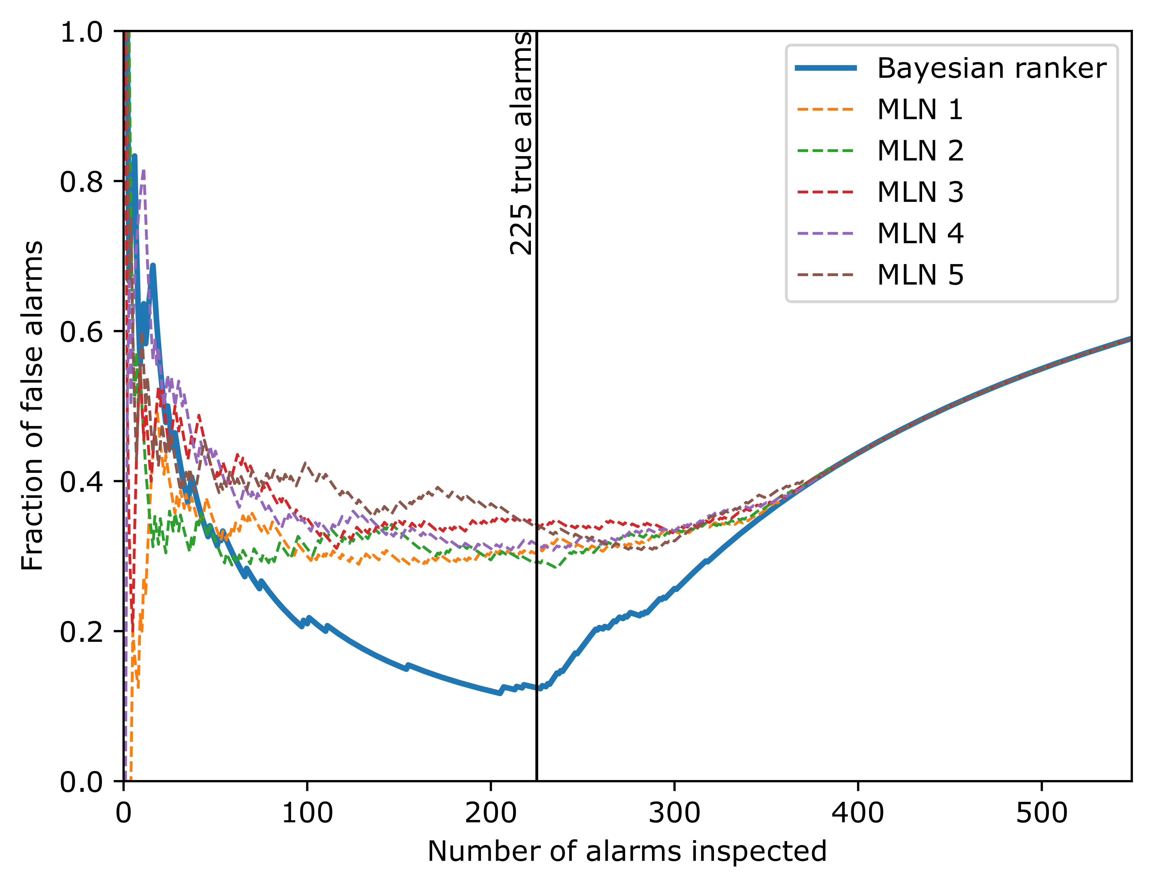
Empirical Results: Dataraces, FTP server

Slide 17
Conclusions
Combining logical and probabilistic reasoning in program analysis provides best of both worlds
Our approach: extend conventional program analyses by augmenting logical rules with weights
=> Adopt semantics of models from AI community
New solver for accurate and scalable inference and learning by leveraging domain insights

