Slide 1
Datalog for Program Analysis: Beyond the Free Lunch
Mayur Naik Georgia Tech Joint work with:
Xin Zhang and Ravi Mangal Georgia Tech
Radu Grigore and Hongseok Yang Oxford Univ

Slide 2
Program Analysis
Discovering useful facts about programs
For optimization, bug-finding, etc.
Broadly two kinds:
Dynamic analysis
program analysis using program runs
Static analysis
program analysis using program text

Slide 3
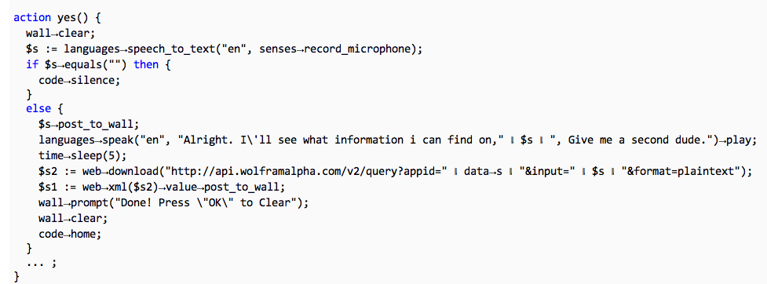





Example: Information-Flow Analysis
program p
information-flow analysis
query q₁
query q₂
X
X
p ² q₁?
p ² q₂?

Slide 4
Application: Malware Analysis of Android Apps
Demo

Slide 5
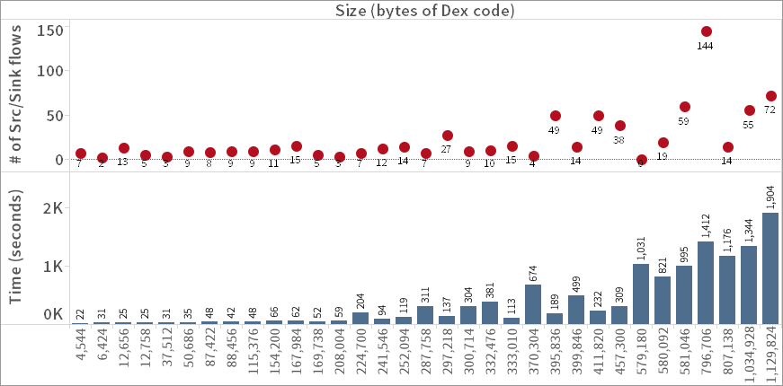
Results of Malware Analysis on Android Apps

Slide 6
Information-flow Analysis
Information flow analysis
Pointer analysis
Type-state analysis
Call-graph analysis
program p
information-flow analysis
query q₁
query q₂
p ² q₁?
p ² q₂?

Slide 7
Program Analysis as Building Blocks
Information flow analysis
Pointer analysis
Type-state analysis
Call-graph analysis
Program slicing analysis
Pointer analysis
Dependence analysis
Call-graph analysis
Datarace detection analysis
Pointer analysis
Lockset analysis
Call-graph analysis
Thread-escape analysis
May-happen-in-parallel analysis

Slide 8
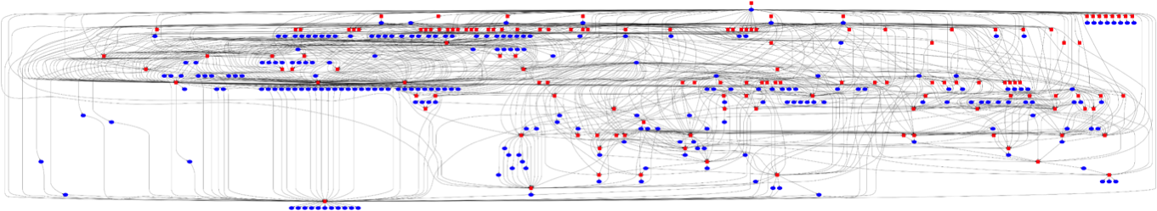
All Analyses in Chord
147 tasks (square nodes)
246 targets (oval nodes)
1050 dependencies (edges)

Slide 9
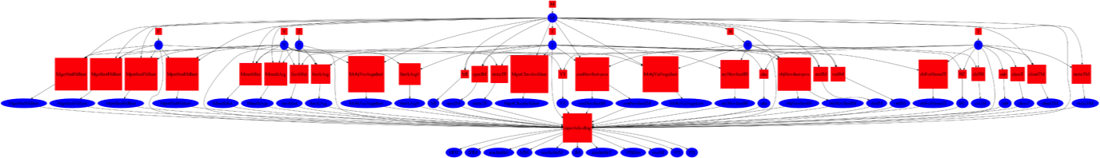
A Pointer Analysis (0-CFA) in Chord
37 tasks (square nodes)
49 targets (oval nodes)
154 dependencies (edges)

Slide 10
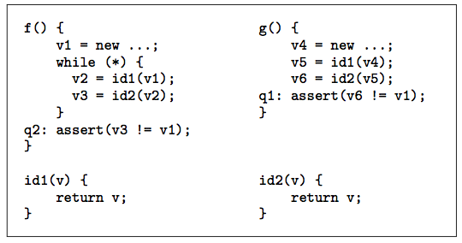
Pointer Analysis Example

Slide 11

Balancing Precision and Scalability
Precision
Scalability

Slide 12
Static Analysis: 70’s to 90’s
client-oblivious
“Because clients have different precision and scalability needs, future work should identify the client they are addressing …” M. Hind, Pointer Analysis: Haven’t We Solved This Problem Yet?, 2001
program p
abstraction a
query q₁
query q₂
p ² q₁?
p ² q₂?

Slide 13
Static Analysis as Building Blocks
Information flow analysis
Pointer analysis
Type-state analysis
Call-graph analysis
Program slicing analysis
Pointer analysis
Dependence analysis
Call-graph analysis
Datarace detection analysis
Pointer analysis
Lockset analysis
Call-graph analysis
Thread-escape analysis
May-happen-in-parallel analysis

Slide 14
Static Analysis: 00’s to Present
client-driven
program p
abstraction a
query q₁
query q₂
p ² q₁?
p ² q₂?

Slide 15
Static Analysis: 00’s to Present
client-driven
modern pointer analyses
software model checkers
abstraction a₁
abstraction a₂
q₁
p
q₂
p ² q₁?
p ² q₂?

Slide 16
Our Static Analysis Setting
client-driven + parametric
new search algorithms: testing, machine learning, …
new analysis questions: optimality, impossibility, …
0 1 0 0 0
1 0 0 0 1
abstraction a₁
abstraction a₂
q₁
p
q₂
p ² q₁?
p ² q₂?

Slide 17
Example 1: Predicate Abstraction (CEGAR)
Predicates to use in predicate abstraction
0 1 0 0 0
1 0 0 0 1
abstraction a₁
abstraction a₂
q₁
p
q₂
p ² q₁?
p ² q₂?

Slide 18
Example 2: Shape Analysis (TVLA)
Predicates to use as abstraction predicates
0 1 0 0 0
1 0 0 0 1
abstraction a₁
abstraction a₂
q₁
p
q₂
p ² q₁?
p ² q₂?

Slide 19
Example 3: Cloning-based Pointer Analysis
K value to use for each call site and each allocation site
0 1 0 0 0
1 0 0 0 1
abstraction a₁
abstraction a₂
q₁
p
q₂
p ² q₁?
p ² q₂?

Slide 20
Problem Statement
An efficient algorithm with:
INPUTS:
program p and query q
abstractions A = { a₁, …, a_{n} }
boolean function S(p, q, a)
OUTPUT:
Impossibility: @ a 2 A: S(p, q, a) = true
Proof: a 2 A: S(p, q, a) = true
8 a’ 2 A: (a’ · a Æ S(p, q, a’) = true) ) a’ = a
a
p
_{S}
q
p ` q
p 0 q
AND
Optimal Abstraction

Slide 21
Problem Statement
An efficient algorithm with:
INPUTS:
program p and query q
abstractions A = { a₁, …, a_{n} }
boolean function S(p, q, a)
OUTPUT:
Impossibility: @ a 2 A: S(p, q, a) = true
Proof: a 2 A: S(p, q, a) = true
8 a’ 2 A: (a’ · a Æ S(p, q, a’) = true) ) a’ = a
1111 finest
S(p, q, a)
: S(p, q, a)
0100 optimal
0000 coarsest
AND
Optimal Abstraction

Slide 22
Why Optimality?
Empirical lower bounds for static analysis
Efficient to compute
Better for user consumption
analysis imprecision facts
assumptions about missing program parts
Better for machine learning

Slide 23
Why is this Hard in Practice?
|A| exponential in size of p, or even infinite
S(p, q, a) = false for most p, q, a
Different a is optimal for different p, q
A
S(p, q, a)
: S(p, q, a)

Slide 24
Pointer Analysis Example

Slide 25
Pointer Analysis as Graph Reachability
a’
0
a
b
3
b’
6’
6
6’’
c’
1
c
d
4
d’
7’
7
7’’
2
5

Slide 26
Graph Reachability in Datalog
Input Relations:
hardEdge(i, j) softEdge(i, j, n) abs(n)
Derived Relations:
path(i, j) Rules: path(i, i). path(i, j) :- path(i, k), hardEdge(k, j). path(i, j) :- path(i, k), softEdge(k, j, n), abs(n).
a’
0
a
b
3
b’
6’
6
6’’
c’
1
c
d
4
d’
7’
7
7’’
2
5

Slide 27
Problem Statement
a’
0
a
b
3
b’
An efficient algorithm with:
INPUTS:
program p and query q
abstractions A = { a₁, …, a_{n} }
boolean function S(p, q, a)
OUTPUT:
Impossibility: @ a 2 A: S(p, q, a) = true
Proof: a 2 A: S(p, q, a) = true AND
8 a’ 2 A: (a’ · a Æ S(p, q, a’) = true) ) a’ = a
6’
6
6’’
c’
1
c
d
4
d’
7’
7
7’’
2
5
Query | Answer
path(0,5) | { a’, b, c’, d }
path(0,2) | Impossible

Slide 28
Our Approach
Based on Counterexample-Guided Abstraction Refinement (CEGAR)
Enjoys great success in software model checking
e.g., Microsoft’s Static Driver Verifier
But many new challenges in our setting
e.g., What is a counterexample in Datalog?

Slide 29
CEGAR for Datalog: Iteration 1
a’
0
a
b
3
b’
6’
6
6’’
c’
1
c
d
4
d’
7’
7
7’’
2
5
 | { a, b, c, d }
path(0,5)
path(0,2)
✗
✗

Slide 30
Derivation Hypergraph of Iteration 1
path(0,0)
softEdge(0,6,a)
abs(a)
hardEdge(6,1)
path(0,6)
hardEdge(6,4)
abs(c)
softEdge(1,7,c)
path(0,1)
path(0,4)
softEdge(4,7,d)
abs(d)
hardEdge(7,2)
path(0,7)
hardEdge(7,5)
hardEdge(2,0)
path(0,2)
path(0,5)

Slide 31
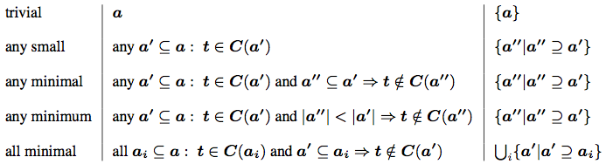
Taxonomy of Counterexamples in Datalog
Datalog analysis C derives query t under abstraction a
Counterexample |  | Abstractions Eliminated

Slide 32
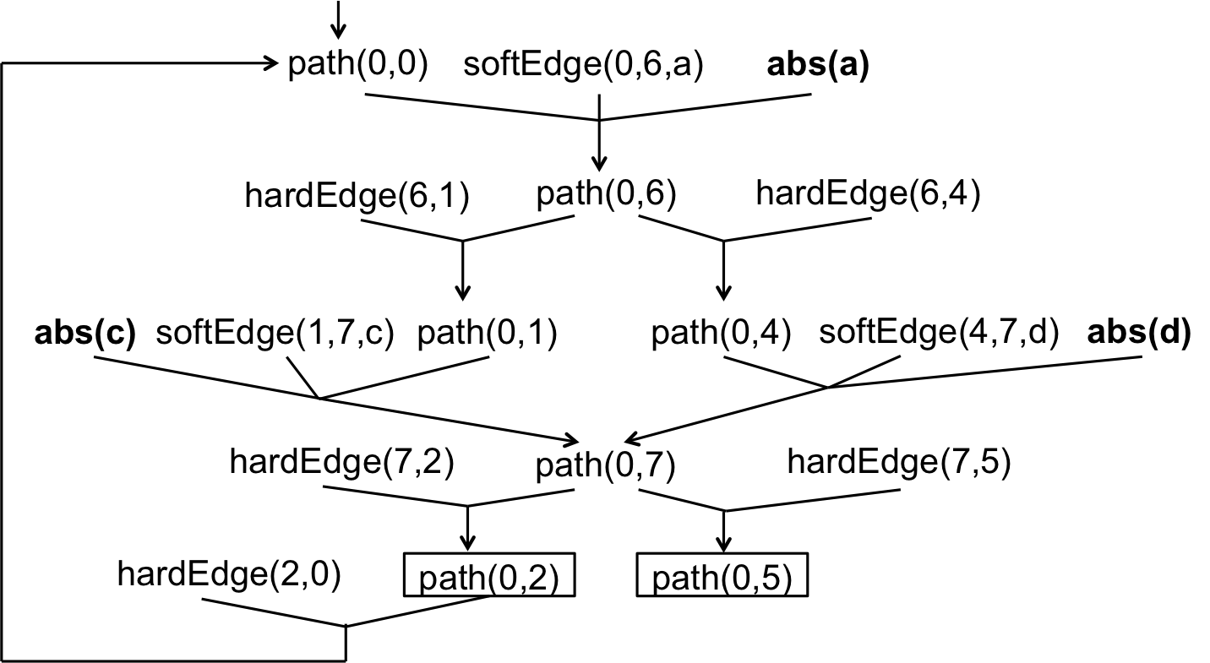
Our Approach: MaxSAT
Hard Constraints:
path(0, 0) ∧ (path(0, 0) ∨ :path(0,2)) ∧
(path(0,6) ∨ :path(0,0) ∨ :abs(a)) ∧ (path(0,1) ∨ :path(0,6)) ∧
(path(0,7) ∨ :path(0,1) ∨ :abs(c)) ∧
(path(0,4) ∨ :path(0,6)) ∧ …
Soft Constraints:
(abs(a) weight 1) ∧ (abs(b) weight 1) ∧
(abs(c) weight 1) ∧ (abs(d) weight 1) ∧
(: path(0,5) weight 5) ∧
(: path(0,2) weight 5) ∧
Solution:
path(0,2) = 0 path(0,6) = 0 abs(b) = 1
path(0,0) = 1 path(0,4) = 0 path(0,7) = 0 abs(c) = 1
path(0,1) = 0 path(0,5) = 0 abs(a) = 0 abs(d) = 1
Key Properties: Generality, Completeness, Optimality

Slide 33
CEGAR for Datalog: Iteration 2
a’
0
a
b
3
b’
6’
6
6’’
c’
1
c
d
4
d’
7’
7
7’’
2
5
 | { a, b, c, d } | {a’, b, c, d }
path(0,5)
path(0,2)
✗
✗
✗
✗

Slide 34
Derivation Hypergraph of Iteration 2
path(0,0)
softEdge(0,6’,a’)
abs(a’)
hardEdge(6’,1)
path(0,6’)
abs(c)
path(0,1)
softEdge(1,7,c)
hardEdge(7,2)
path(0,7)
hardEdge(7,5)
hardEdge(2,0)
path(0,2)
path(0,5)

Slide 35
CEGAR for Datalog: Iteration 3
a’
0
a
b
3
b’
6’
6
6’’
c’
1
c
d
4
d’
7’
7
7’’
2
5
 | { a, b, c, d } | { a’, b, c, d } | { a’, b, c’, d }
path(0,5)
path(0,2)
✗
✗
✓
✗
✗
✗

Slide 36
Empirical Evaluation
Unmodified off-the-shelf solvers
Datalog: bddbddb
MaxSAT: MiFuMaX
Two different analyses written in Datalog
Pointer analysis
flow-insensitive, weak-updates, cloning-based
Typestate analysis
flow-sensitive, strong-updates, summary-based
Six real-world Java benchmark programs
Platform: Linux, 16GB RAM, 3 GHz CPU

Slide 37
Benchmarks
 | # classes |  | bytecodes (KB) |  | KLOC
 | app | total | app | total | app | total
cache4j | 4 | 107 | 1.2 | 16.3 | 1 | 52
elevator | 5 | 998 | 2.3 | 390 | 1 | 269
hedc | 44 | 1,066 | 16 | 442 | 6 | 283
weblech | 57 | 1,263 | 20 | 504 | 13 | 326
lusearch | 229 | 1,236 | 101 | 511 | 42 | 314
antlr | 118 | 1,134 | 131 | 532 | 29 | 303

Slide 38
Statistics of Analyses in Datalog
 | # rules | # relations | # attributes
pointer analysis | 72 | 86 | 10
typestate analysis | 52 | 47 | 9

Slide 39
Results: Pointer Analysis
 | # queries |  |  | abstraction size |  | # iters.
 | total | resolved | timeout | final | max
cache4j | - | - | - | - | - | -
elevator | - | - | - | - | - | -
hedc | 47 | 47 | 0 | 255 (1.5%) | 17,054 | 65
weblech | 5 | 5 | 0 | 36 (0.2%) | 18,384 | 20
antlr | 143 | 143 | 0 | 976 (4.8%) | 20,453 | 58
lusearch | 321 | 316 | 5 | 1,000 (4.8%) | 24,308 | 56

Slide 40
Performance of Datalog: Pointer Analysis
lusearch

Slide 41
Performance of Datalog: Pointer Analysis
lusearch
antlr
hedc
weblech

Slide 42
Performance of MaxSAT: Pointer Analysis
lusearch

Slide 43
Performance of MaxSAT: Pointer Analysis
lusearch
antlr
hedc
weblech

Slide 44
Results: Typestate Analysis
 | # queries |  |  | abstraction size |  | # iters.
 | total | resolved | timeout | final | max
cache4j | 15 | 15 | 0 | 28 (0.3%) | 9,614 | 11
elevator | 55 | 55 | 0 | 34 (0.4%) | 9,583 | 11
hedc | 799 | 799 | 0 | 271 (1.1%) | 23,581 | 13
weblech | 189 | 189 | 0 | 173 (0.7%) | 25,453 | 14
antlr | 491 | 491 | 0 | 457 (1.8%) | 24,815 | 17
lusearch | 456 | 456 | 0 | 598 (1.8%) | 33,506 | 17

Slide 45
Performance of Datalog: Typestate Analysis
lusearch

Slide 46
Performance of Datalog: Typestate Analysis
lusearch
antlr
hedc
weblech

Slide 47
Performance of MaxSAT: Typestate Analysis
lusearch

Slide 48
Performance of MaxSAT: Typestate Analysis
lusearch
antlr
hedc
weblech

Slide 49
Statistics of MaxSAT Formulae
 | pointer analysis |  | typestate analysis
 | # variables | # clauses | # variables | # clauses
cache4j | - | - | 17K | 19K
elevator | - | - | 640K | 795K
hedc | 1.3M | 2.5M | 11.5M | 15M
weblech | 1.6M | 3.1M | 8.7M | 12M
antlr | 85M | 183M | 20M | 26M
lusearch | 98M | 365M | 35M | 49M

Slide 50
Limitations / Future Work
Speeding up convergence
Trading soundness for precision/scalability

Slide 51
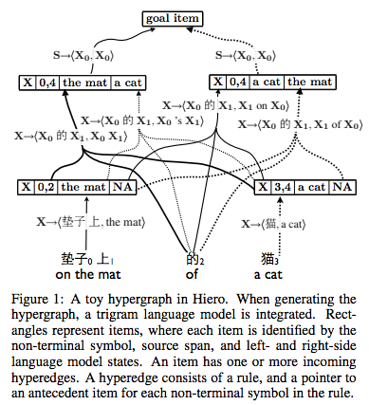
Speeding up convergence
“First- and Second-Order Expectation Semirings with Applications to Minimum-Risk Training on Translation Forests.” EMNLP 2009.

Slide 52
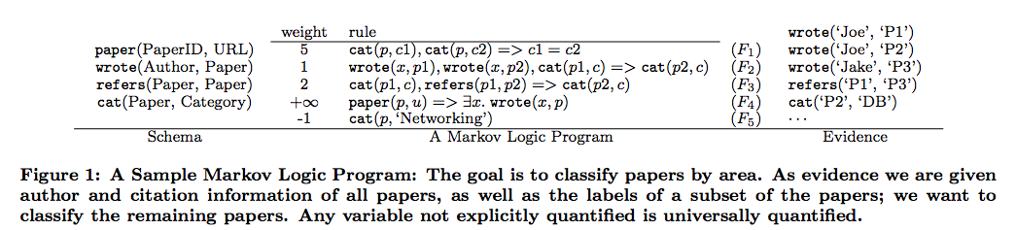
Trading soundness for precision/scalability
“Tuffy: Scaling up Statistical Inference in Markov Logic Networks using an RDBMS.” VLDB 2011.

Slide 53
Conclusion
Time is ripe for Datalog for program analysis!
Advances in implementations of Datalog
bddbddb, LogicBlox, …
Integration of Datalog into program analysis tools
Chord, Soot, Z3, …
Reasoning about analyses written in Datalog
HSF, this work, …

