Slide 1



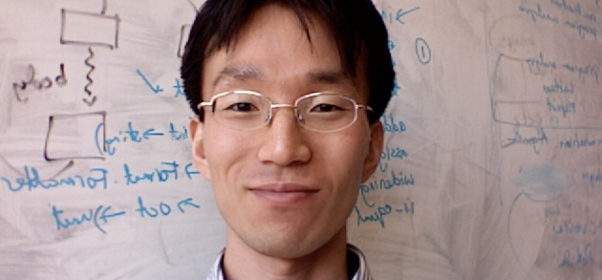
Automated Concolic Testing of Smartphone Apps
Saswat Anand
Stanford Univ.
Mayur Naik
Georgia Tech.
Hongseok Yang
Univ. of Oxford
Mary Jean Harrold
Georgia Tech.
Notes:
This work was done while I was a student at Georgia Tech with professors from Georgia Tech and Univ. of Oxford.
A smartphone has advanced computing capability and connectivity than traditional phones.
The software that runs on smartphones are called Apps.
In this talk, I will present some ideas on testing smartphone apps.
%Those ideas however apply to other types of similar devices like tablets.

Slide 2
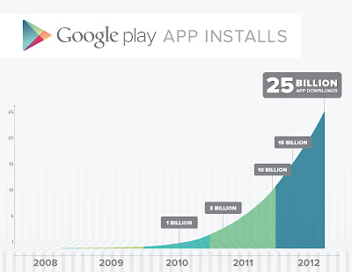
Motivation
Notes:
This plot shows the total numbers of apps installed from Google Play, which is the Google’s official appstore, in last five years.
Until now, more than 25 billion apps have been installed until now.
And as you can see, the curve is increasing exponentially.
In sum, smartphones are getting very popular, and will soon the standard.

Slide 3
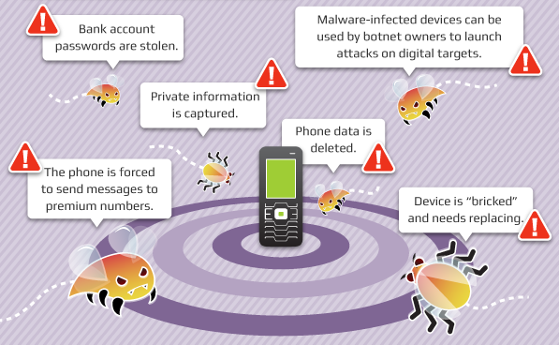
Motivation
Problems with Smartphone Apps
Notes:
Increased use of smartphones bring several security and privacy problems.
Malware can steal bank account passwords.
Private information could be leaked from the device.
Phones can send SMS messages to premium numbers.

Slide 4
Problem
Automatically generate test inputs for bounded exhaustive testing of smartphone apps
Notes:
There are several approaches to reason about program behavior. In this work, we take the software testing approach.
So our goal is to automatically generate …
In next slides, I will explain what I mean by “test inputs” and “bounded exhaustive testing”

Slide 5
Test Inputs for Apps
Whole-program testing
Test input is a sequence of events e₁, e₂…, e_{n}
Types of events: a tap on the screen, change in geo-location, arrival of a SMS message, etc.
Notes:
Definition of test inputs depend on what level of granularity the testing is performed.
We test the entire app.
Smartphone apps are event driven.
A large class of inputs thus consist of sequences of events.
There are many types of inputs: tap on the screen, change in …

Slide 6
Bounded Exhaustive Testing of Apps
S, the set of all event sequences* s.t. each sequence takes a unique path
Set of covered branches
Goal: cover these
*of bounded-length
Notes:
In an earlier slide, I said our goal is bounded exhaustive testing of apps. What does it mean?
Consider the set S of event sequences of bounded length. Each sequence takes a unique program path.
When we execute S, we get a set of branches covered.

Slide 7
Two subproblems
Generate individual events
Generate sequences of events
Notes:
Our problem breaks down into two subproblems.
…

Slide 8
Generating Individual Events
An event is associated with data
X & Y coordinates of a tap event
geo-location of a change-in-geo-location event
content of an incoming SMS event
etc.
Data determine which program path is taken
Challenge: Generate the “right” data for events

Slide 9
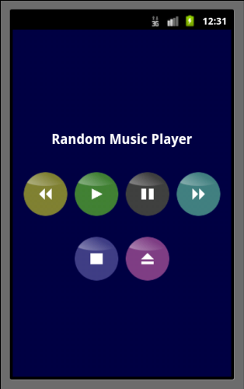
Example: Music Player App
Play
Pause
Rewind
Skip
Stop
Eject

Slide 10
Example: Music Player App
public void onClick(View target) {
if (target == play)
startService(new Intent(ACTION_PLAY)); else if (target == pause)
startService(new Intent(ACTION_PAUSE));
else if (target == skip)
startService(new Intent(ACTION_SKIP));
else if (target == rewind)
startService(new Intent(ACTION_REWIND));
else if (target == stop)
startService(new Intent(ACTION_STOP));
else if (target == eject)
showUrlDialog(); }
tap(136, 351)

Slide 11
Example: Music Player App
public void onClick(View target) {
if (target == play)
startService(new Intent(ACTION_PLAY)); else if (target == pause)
startService(new Intent(ACTION_PAUSE));
else if (target == skip)
startService(new Intent(ACTION_SKIP));
else if (target == rewind)
startService(new Intent(ACTION_REWIND));
else if (target == stop)
startService(new Intent(ACTION_STOP));
else if (target == eject)
showUrlDialog(); }
tap(248, 351)

Slide 12
Example: Music Player App
public void onClick(View target) {
if (target == play)
startService(new Intent(ACTION_PLAY)); else if (target == pause)
startService(new Intent(ACTION_PAUSE));
else if (target == skip)
startService(new Intent(ACTION_SKIP));
else if (target == rewind)
startService(new Intent(ACTION_REWIND));
else if (target == stop)
startService(new Intent(ACTION_STOP));
else if (target == eject)
showUrlDialog(); }
tap(360, 351)

Slide 13
Example: Music Player App
public void onClick(View target) {
if (target == play)
startService(new Intent(ACTION_PLAY)); else if (target == pause)
startService(new Intent(ACTION_PAUSE));
else if (target == skip)
startService(new Intent(ACTION_SKIP));
else if (target == rewind)
startService(new Intent(ACTION_REWIND));
else if (target == stop)
startService(new Intent(ACTION_STOP));
else if (target == eject)
showUrlDialog(); }
tap(24, 351)

Slide 14
Example: Music Player App
public void onClick(View target) {
if (target == play)
startService(new Intent(ACTION_PLAY)); else if (target == pause)
startService(new Intent(ACTION_PAUSE));
else if (target == skip)
startService(new Intent(ACTION_SKIP));
else if (target == rewind)
startService(new Intent(ACTION_REWIND));
else if (target == stop)
startService(new Intent(ACTION_STOP));
else if (target == eject)
showUrlDialog(); }
tap(136, 493)

Slide 15
Example: Music Player App
public void onClick(View target) {
if (target == play)
startService(new Intent(ACTION_PLAY)); else if (target == pause)
startService(new Intent(ACTION_PAUSE));
else if (target == skip)
startService(new Intent(ACTION_SKIP));
else if (target == rewind)
startService(new Intent(ACTION_REWIND));
else if (target == stop)
startService(new Intent(ACTION_STOP));
else if (target == eject)
showUrlDialog(); }
tap(305, 544)

Slide 16
Generating Individual Events
Existing alternatives
Random Testing
Cannot perform systematic/exhaustive testing
Platform-specific tools (e.g., hierarchy viewer in Android)
Limited to GUI Events
Cannot handle third-party GUI widgets

Slide 17
Generating Individual Events
Our solution
Use concolic execution to generate data associated with events
Notes:
Our idea is to use concolic execution to generate data associated with events.

Slide 18
Generating Individual Tap Events
tap(int x, int y){
1 if (x>2 && x<4){ 2 if (y>1 && y<3)
3 W1_clicked(); 4 else 5 W2_clicked(); 6 }else 7 W3_clicked();
}
x>2 && x<4
1
T
F
y>1 && y<3
2
7
T
F
3
5

Slide 19
Generating Individual Tap Events
x>2 && x<4
1
T
F
y>1 && y<3
2
7
T
F
3
5
tap(1, 5)

Slide 20
Generating Individual Tap Events
x>2 && x<4
1
T
F
y>1 && y<3
2
7
T
F
3
5
(x>2 && x<4)
tap(1, 5)
tap(3, 5)
F1 !(x>2 && x<4)
W3_clicked()

Slide 21
Generating Individual Tap Events
x>2 && x<4
1
T
F
y>1 && y<3
2
7
T
F
3
5
(x>2 && x<4) (y>1 && y<3)
(x>2 && x<4)
tap(1, 5)
T1 (x>2 && x<4) F2 !(y>1 && y<3)
W2_clicked()
tap(3, 5)
tap(3, 2)

Slide 22
Generating Individual Tap Events
x>2 && x<4
1
T
F
y>1 && y<3
2
7
T
F
3
5
(x>2 && x<4) (y>1 && y<3)
tap(1, 5)
tap(3, 5)
T1 (x>2 && x<4) T2 (y>1 && y<3)
W1_clicked()
tap(3, 2)

Slide 23
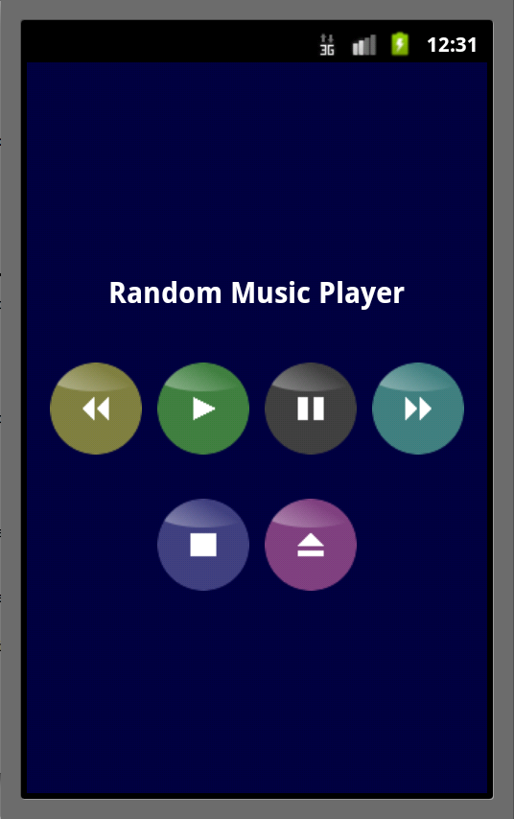
Example: Music Player App
❖
❖
❖
❖
❖
❖
❖
❖
❖
❖
❖

Slide 24
Two subproblems
Generate individual events
Generate sequences of events
Notes:
Our problem breaks down into two subproblems.
…

Slide 25
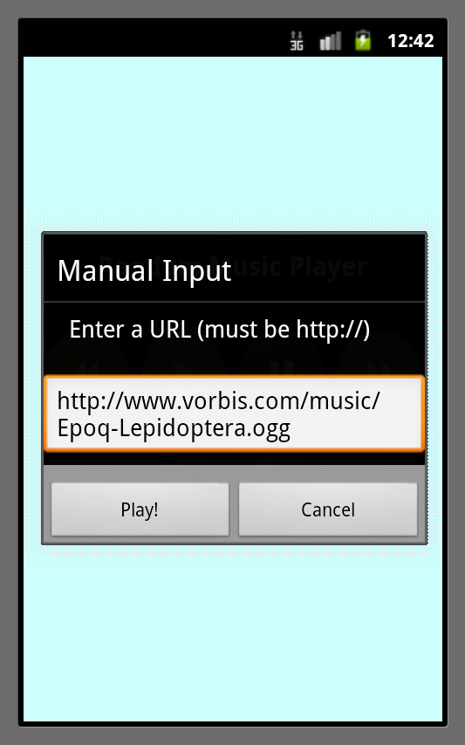
Generating Sequences of Events
Concatenate individual events generated by concolic execution.
Notes:
Our approach of using concolic execution to generate events can naturally handle sequences of events.
For example, our approach can generate sequences of taps that can take from one screen to the other.

Slide 26
Baseline Algorithm
S, Set of all event sequences s.t. each sequence takes a unique path
Baseline algorithm
Set of covered branches
Goal: cover these
Notes:
Recall that our problem specification is as shown here.
Initially, we attempted to generate the set S. However, fortunately or unfortunately based on how you looked at it, it did not scale very well.
The problem is that apps have too many program paths. This problem is known as the path-explosion problem.

Slide 27
Baseline Algorithm Suffers from Path Explosion
Number of sequences generated
for Music Player app by baseline algorithm
Notes:
Horizontal axis represents the lengths of event sequences.
Vertical axis represent the number of event sequences corresponding to different lengths.
We can see that as the length increases, the number of sequences increase exponentially.

Slide 28
ACTEve Algorithm
ACTEve: Automated Concolic Testing of Event-driven programs
Notes:
Suppose this is a path that program takes in response to a sequence of n events.
The upper part p1 corresponds to the first (n-1) events.
The lower part p’ corresponds to the last event.
Now also suppose that the last event is irrelevant to the program, and as a result the no memory location is written to.

Slide 29
ACTEve Algorithm
S, Set of all event sequences s.t. each sequence takes a unique path
ACTEve algorithm
Baseline algorithm
R s.t. R ⊆ S
Set of covered branches
Goal: cover these
ACTEve is relatively sound
Notes:
Recall that our problem specification is as shown here.
Initially, we attempted to generate the set S. However, fortunately or unfortunately based on how you looked at it, it did not scale very well.
The problem is that apps have too many program paths. This problem is known as the path-explosion problem.

Slide 30

Path Subsumption
Program state in concolic execution
Maps memory location to values (symbolic or concrete)
$$<γ,C>$$
Path constraint

Slide 31

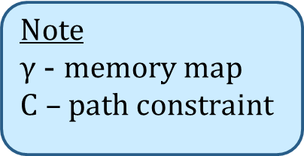

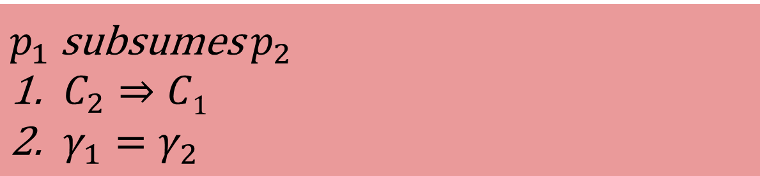


Path Subsumption
Program entry
Note
$γ$ - memory map
$C$ – path constraint
Path $p_{1}$
Path $p_{2}$
$$<γ_{1},C_{1}>$$
$$<γ_{2},C_{2}>$$
$p_{1}$ subsumes $p_{2}$
$C_{2}⇒C1$
$γ_{1}=γ_{2}$

Slide 32
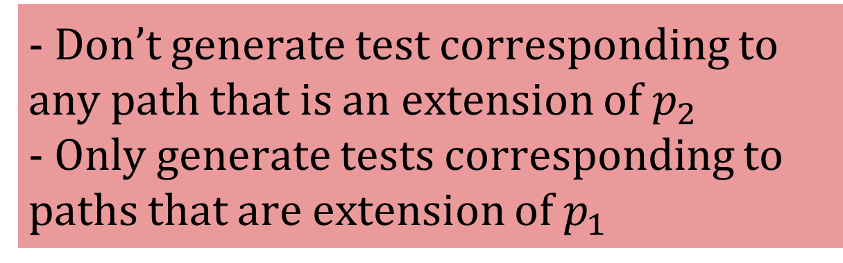
Path Subsumption
Program entry
Note
$γ$ - memory map
$C$ – path constraint
Path $p_{1}$
Path $p_{2}$
$$<γ_{1},C_{1}>$$
$$<γ_{2},C_{2}>$$
$p_{1}$ subsumes $p_{2}$
$C_{2}⇒C1$
$γ_{1}=γ_{2}$
- Don’t generate test corresponding to any path that is an extension of $p_{2}$
- Only generate tests corresponding to paths that are extension of $p_{1}$

Slide 33
Path Subsumption
Checking path subsumption is very expensive in general
Constraint implication check
Matching memory map
But, path subsumption can be checked cheaply in special cases
Read-only events
Events whose mutual ordering does not matter
etc.

Slide 34
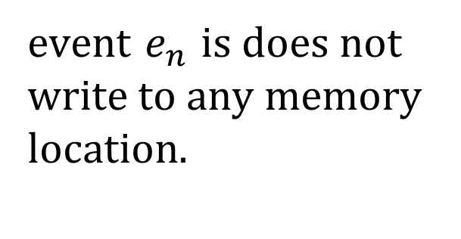
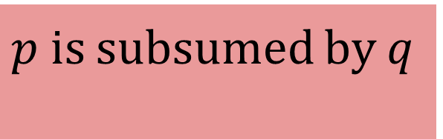
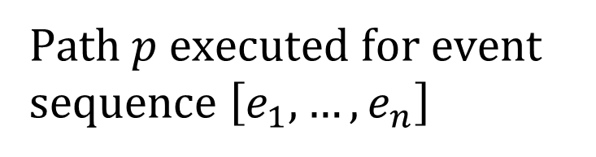
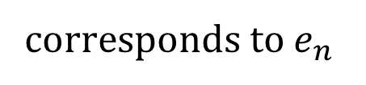
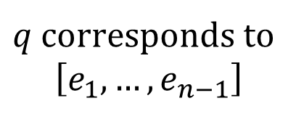
Read-only Events
Program Entry
event $e_{n}$ is does not write to any memory location.
$q$ corresponds to
$$\left[e_{1},…,e_{n−1}\right]$$
$p$ is subsumed by q
corresponds to $e_{n}$
Path $p$executed for event sequence $\left[e_{1},…, e_{n}\right]$
Notes:
Suppose this is a path that program takes in response to a sequence of n events.
The upper part p1 corresponds to the first (n-1) events.
The lower part p’ corresponds to the last event.
Now also suppose that the last event is irrelevant to the program, and as a result the no memory location is written to.

Slide 35
Read-only Events
❖
❖
❖
❖
❖
❖
❖
❖
❖
❖
❖
Read-only events are represented as ❖
Notes:
So in search of a better algorithm, we looked closely at the results. One outstanding observation was that some events are read-only.
As an example, consider the music player app. The marks correspond to the X and Y coordinates of the generated tap events.
Notice that the taps that are shown as red marks do not fall on any widget. Those tap events are examples of one class of read-only events.
Next, I will describe how read-only events

Slide 36
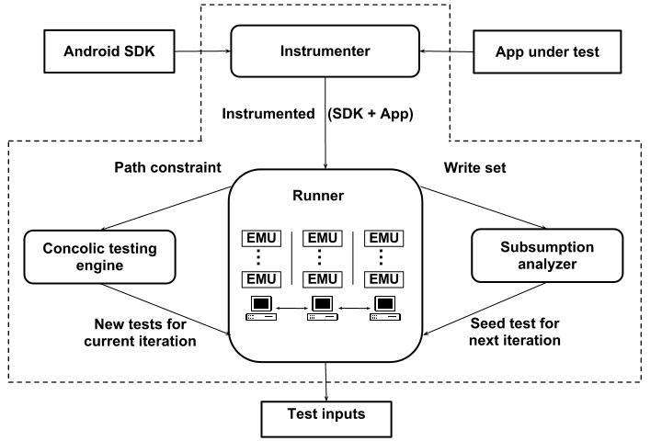
ACTEve System Architecture

Slide 37
Empirical Study
Apply ACTEve and baseline algorithms
event sequences of length up to 4
16 concurrently running emulators
time budget of 12 hours
Measured three metrics
running time
number of feasible paths
number of satisfiability checks

Slide 38
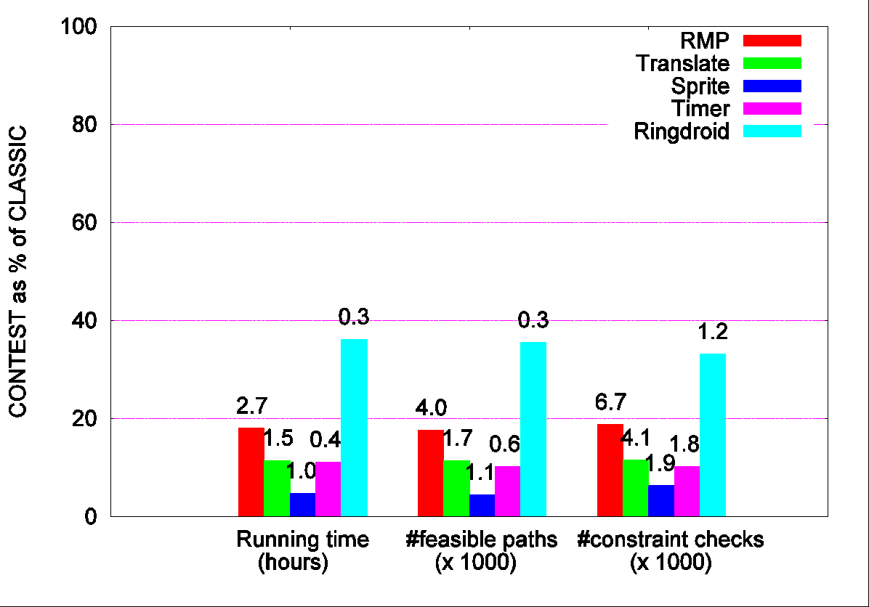
Empirical Results
Notes:
There are three clusters of bars. Each cluster correspond to a different metric. For example, the left-most cluster corresponds to running time.
Inside each cluster, there is a bar for each subject. Each subject is represented by a different color. For example, red represents RMP.
The height of a bar represents the savings that our algorithm provides. Shorter bar represents more savings. The bar that has height equal to 100% means that our algorithm provided
No benefit.
Now lets look a one bar. This bar corresponds to RMP and shows the running times of the algorithm. This bar says our algorithm took only about 18% of the time that the naïve algorithm took. The number on the top of the bar 2.7 is the number of hours our algo took.
We can see that over five subjects, our algorithm takes between 5 to 36 percent of time that the naïve algorithm took.
We get similar benefits for other two metrics.

Slide 39
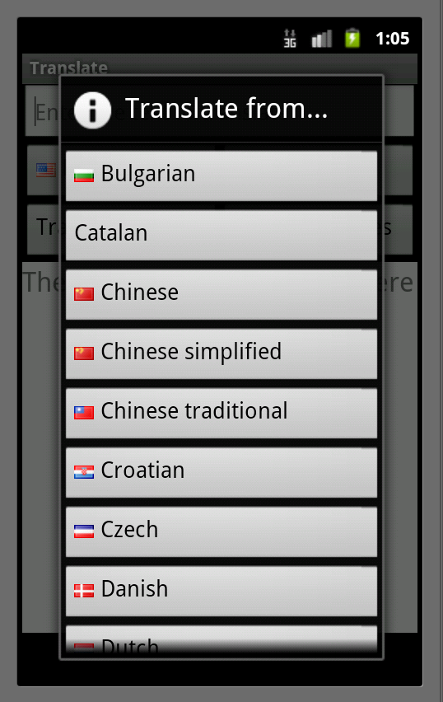
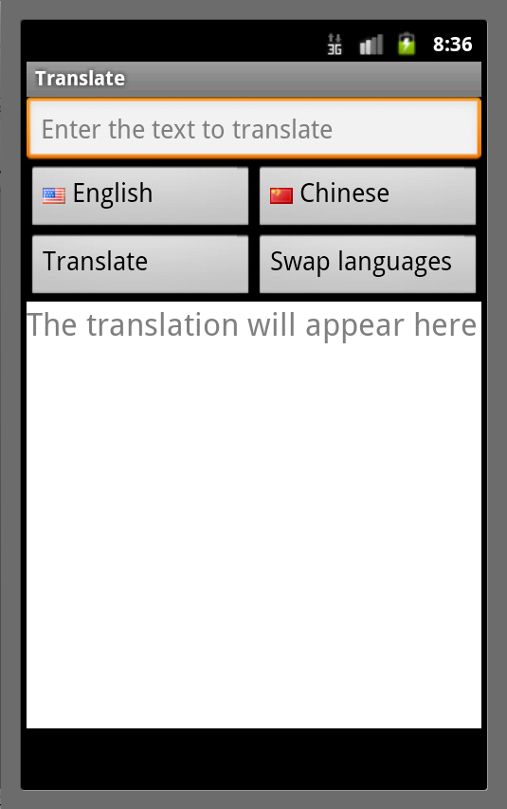
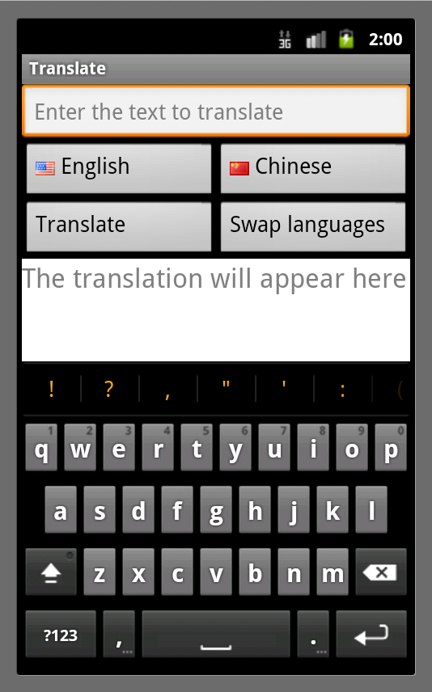
Future Work
Widget Explosion

Slide 40
Main Contributions
Concolic execution to generate individual events
ACTEve: an efficient algorithm for bounded exhaustive testing of event-driven programs
Requires only a small fraction (5-36%) of time compared to baseline algorithm
Implementation for Android

Slide 41
Backup slides

Slide 42
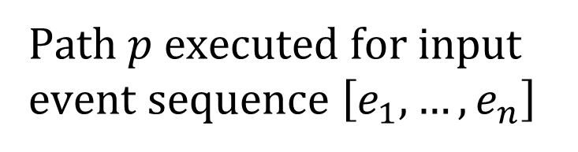

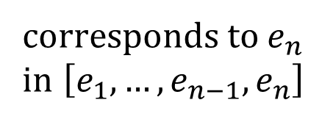
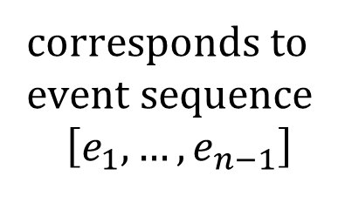
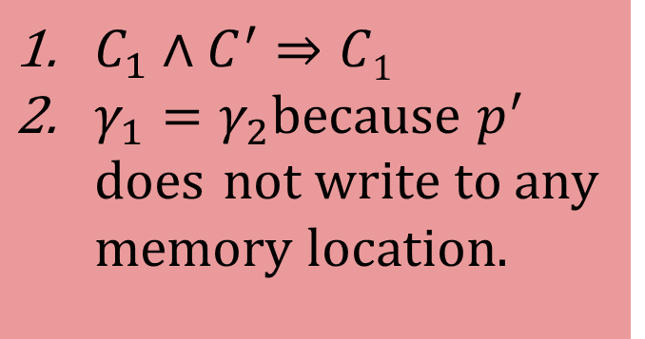

Read-only Events
Program Entry
$C_{1}∧C^{′}⇒C1$
$γ_{1}=γ_{2}$because $p^{′}$ does not write to any memory location.
corresponds to
event sequence
$$\left[e_{1},…,e_{n−1}\right]$$
$$<γ1,C1>$$
corresponds to $e_{n}$
in $\left[e_{1},…,e_{n−1},e_{n}\right]$
$$<γ2,C_{1}∧C^{′}>$$
Path $p$executed for input event sequence $\left[e_{1},…, e_{n}\right]$
Notes:
Now suppose

Slide 43
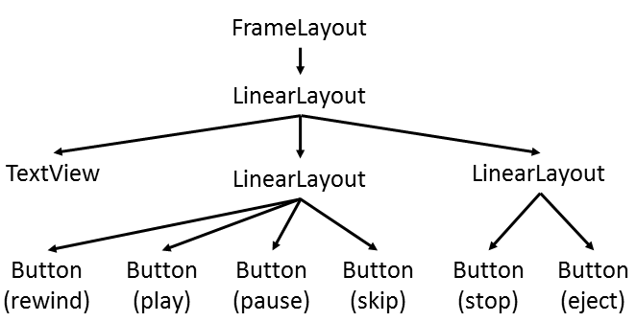
A Solution: Use Platform-specific Knowlege
Output of Android’s “Hierarchy Viewer” tool

Slide 44
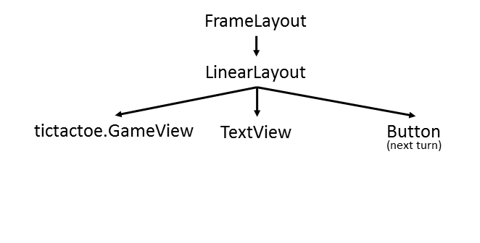
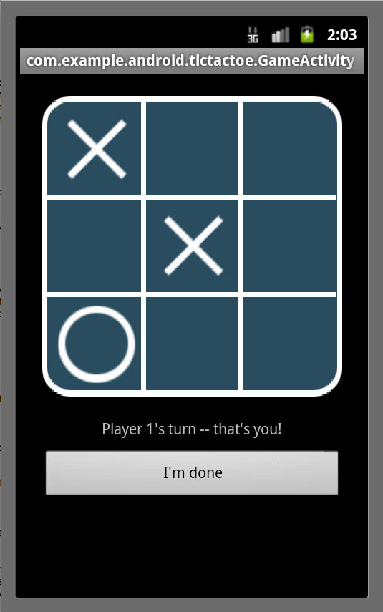
A Solution: Use Platform-specific Knowlege
Output of Android’s “Hierarchy Viewer” tool
void onTouchEvent(MotionEvent e) { int rawX = (int) e.getX(); int rawY = (int) e.getY(); int x = (rawX – MARGIN) / SIZE; int y = (rawY – MARGIN) / SIZE; if (x >= 0 && x < 3 && y >= 0 & y < 3) { int cell = x + 3 * y; … }

Slide 45


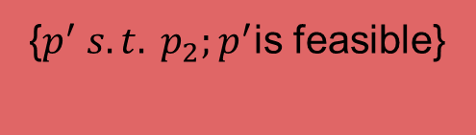

Path Subsumption
Program Entry
Program Entry
same program location
Path $p_{2}$
Path $p_{1}$
{$p^{′} s.t. p_{1};p^{′}$is feasible}
{$p^{′} s.t. p_{2};p^{′}$is feasible}
Covered branches
Covered branches

Slide 46
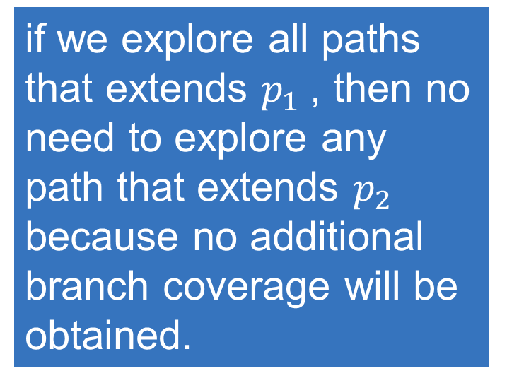
Path Subsumption
Program Entry
Program Entry
same program location
Path $p_{2}$
Path $p_{1}$
if we explore all paths that extends $p_{1}$, then no need to explore any path that extends $p_{2}$ because no additional branch coverage will be obtained.
{$p^{′} s.t. p_{1};p^{′}$is feasible}
{$p^{′} s.t. p_{2};p^{′}$is feasible}
Covered branches
Covered branches

Slide 47
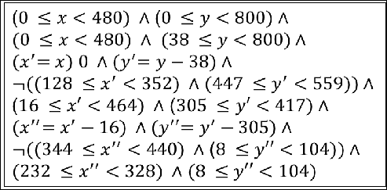
Example: Music Player App
Path constraint when PAUSE
button is tapped on

