Slide 1
HOPPITY: LEARNING GRAPH TRANSFORMATIONS TO DETECT AND FIX BUGS IN PROGRAMS
Elizabeth Dinella*, Hanjun Dai*, Ziyang Li, Mayur Naik, Le Song, and Ke Wang
*equal contribution
Notes:
Hello I’m Elizabeth Dinella and in this talk I will present our work on Hoppity, an end to end approach to detect and fix bugs in Javascript programs using a Graph Neural Network technique.

Slide 2

Problem & Motivation
Notes:
Tools to automatically detect bugs in programs have existed for decades. However, the problem of static analysis is undecidable and traditional analysis techniques have limitations.

Slide 3
Problem & Motivation
Source-Code Analysis is:
Undecidable
Noisy
Rules are hand written
Tailored to specific code bases / bug patterns
Notes:
Tools to automatically detect bugs in programs have existed for decades. However, the problem of static analysis is undecidable and traditional analysis techniques have limitations. When attempting to enforce an undecidable analysis rule, errors will likely arise. These are often in the form of false positives which can be distracting to the user.
Furthermore, traditional analyses often require handwritten rules that target certain error patterns in a particular codebase or specific bug types.

Slide 4
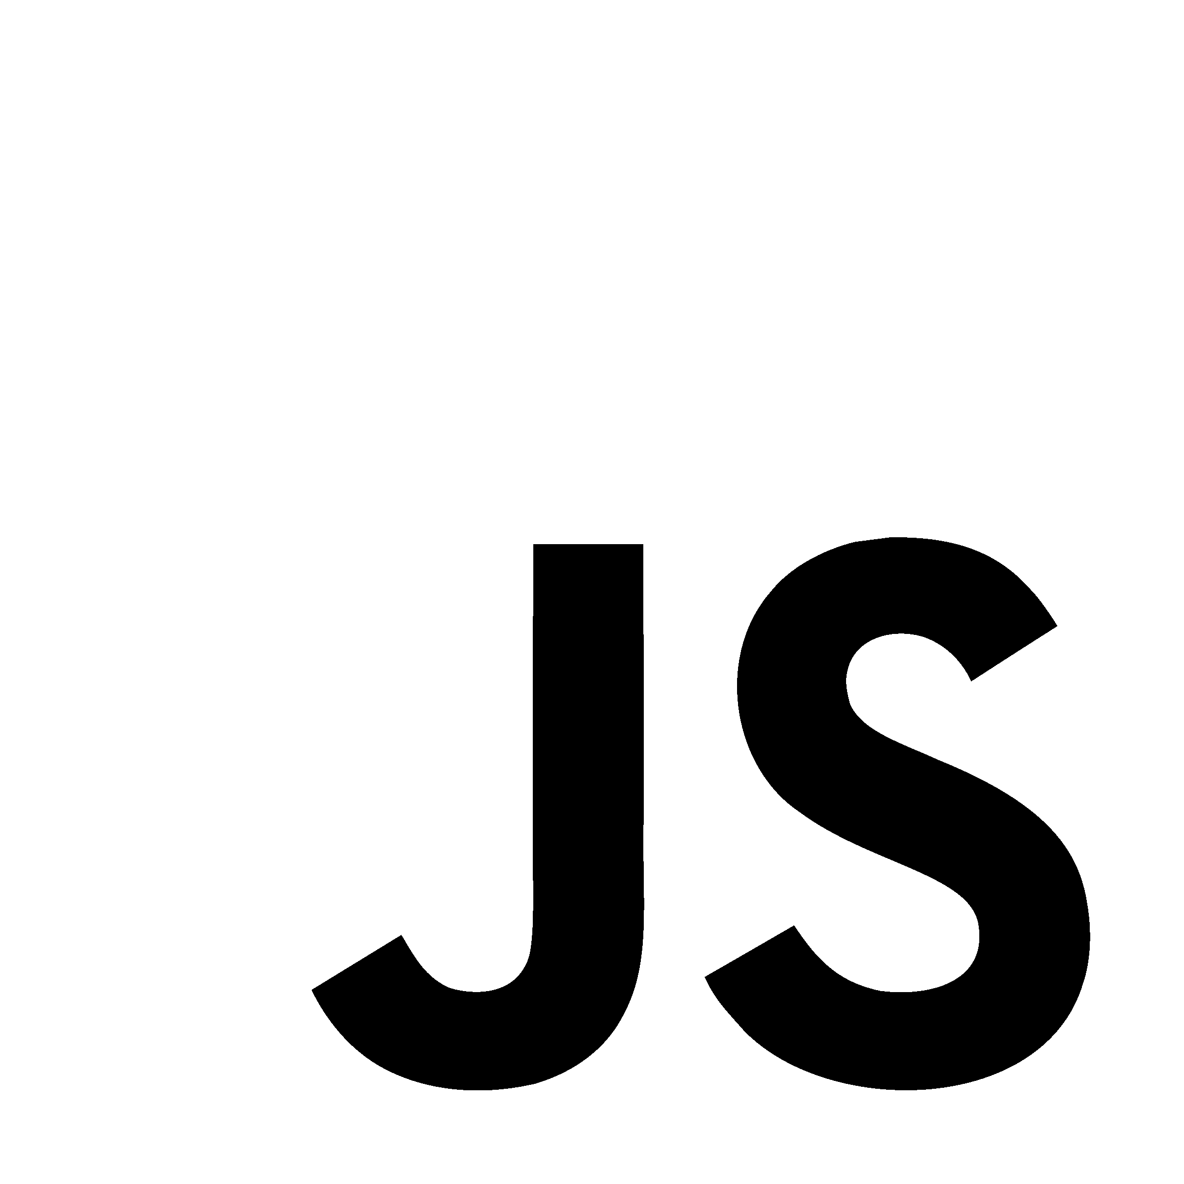
Problem & Motivation
Notes:
To make matters worse, the popularity of dynamic scripting languages such as javascript provide a unique challenge.
Bugs in Javascript manifest in exceedingly diverse ways and cannot be captured in a single rule.
Therefore, the primary goal of our approach is generality. An effective bug finding tool for Javascript must be operative against a broad spectrum of programming errors.

Slide 5
Problem & Motivation
Incorrect operators
Incorrect identifiers
Accessing undefined properties
Mishandling variable scopes
Type incompatibilities
.....
HOPPITY
Notes:
To make matters worse, the popularity of dynamic scripting languages such as javascript provide a unique challenge.
Bugs in Javascript manifest in exceedingly diverse ways and cannot be captured in a single rule.
Therefore, the primary goal of our approach is generality. An effective bug finding tool for Javascript must be operative against a broad spectrum of programming errors.

Slide 6
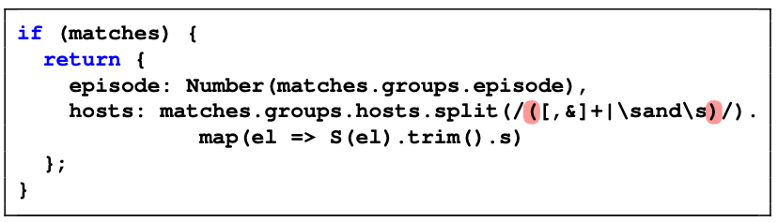
Solution - leverage large amounts of Javascript fixes on Github to locate and repair bugs
‘ and ‘
[ ‘’, ‘ and ‘, ‘’ ]
[ ‘’, ‘’ ]
Notes:
WE PROPOSE an approach that leverages commit data on Github to locate and repair bugs.
You might be asking the question, why deep learning?
Consider this example. The goal is to split a string using regular expressions. However, the program incorrectly splits the input ' and ' into ['', ' and ', ''] instead of ['' , ''], which is what the developer intended. Since the error is simply a mismatch between the developer’s implicit specification and implementation, static analyzers are incapable of catching it.

Slide 7
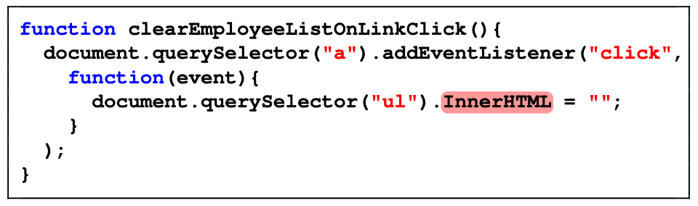
Notes:
Now, let’s take a look at a segment of buggy code that traditional static analyzers have a fighting chance of catching.
Here, the developer mistakenly capitalizes the first letter of innerHTML. innerHTML (lowercase i) is innerHTML is a property of class Element in the DOM.
However, dynamically adding properties to an object is valid in Javscript and will NOT result in a runtimme error. So, here, we are adding a property InnerHtml and setting the value. This has no effect on the value of (lowercase) innerHTML.
Popular analysis tools for Javascript choose to ignore analyzing external libraries for scalability, including the DOM, and fail to catch the error.
The bugs that static analyzers missed in both cases are in hindsight quite obvious to human programmers. The criteria humans use is very simple: any code snippet that seems to deviate from common code patterns is likely to be buggy. This is precisely the observation that our approach seeks to mimic. In particular, if a model observes a property or an unusual way of splitting strings that never appeared in the training data, it is likely to recognize those abnormal code fragments as potential bugs. So, to answer our question why deep learning?, Learning provides a highly flexible and bug type independent approach to analysis.
In general, our approach differs from recent works in Deep Learning for program reasoning as the approaches are not general in that they target specific bug patterns. Furthermore, most of these approaches cannot handle fixes that require adding or removing statements from a program.

Slide 8
Represent source code
Represent fixes
Learning
CHALLENGES
Notes:
This technique presents three major challenges
How do we represent source code?
How do we represent fixes?
How do we learn from these edits to detect and repair faults in unseen code?

Slide 9
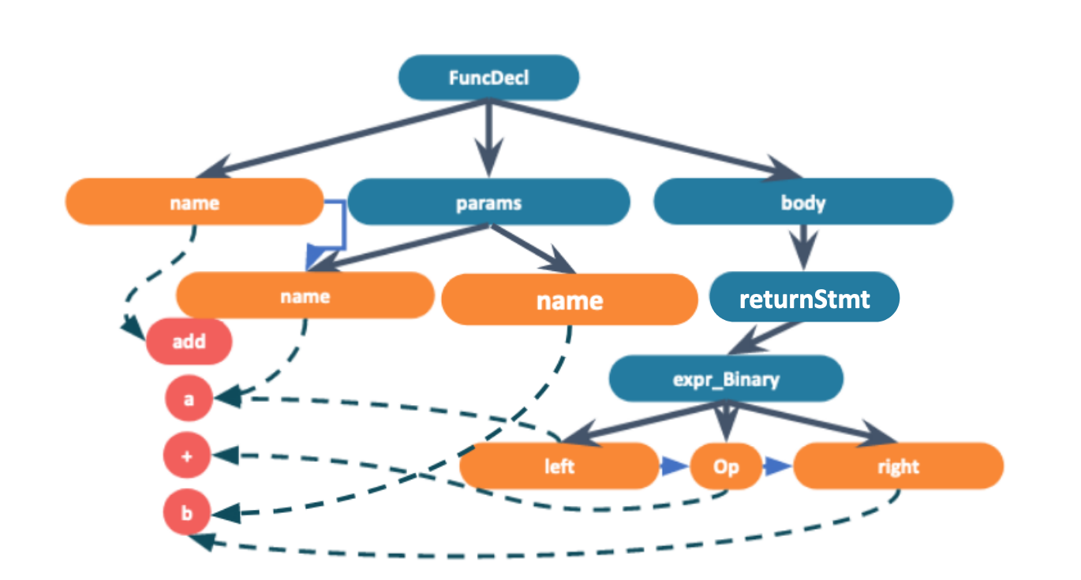
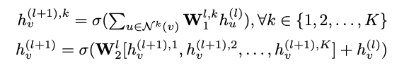
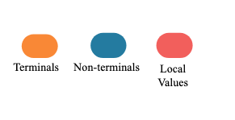
Graph Embedding
function add(a, b) { return a + b; }
Node Embeddings
FuncDecl
...
name
Value Embeddings
Each graph (program) g is the aggregation of each h_{v}
add
...
GNN
Notes:
ASTs provide a nice structure for reasoning about programs via Graph Neural Networks. In order to aid in learning program meaning, we augment the AST with additional edges for adjacent tokens and Value links to local values.
Now that our program is in a graph structure, the remaining challenge is to map the graph to a fixed dimension vector space.
To do so, we need to obtain a d-dimensional representation of the graph as well as representations of the individual nodes.
We do this using a standard message passing technique using L levels.
More concretely, we use the following equations.
***** animation *****
Each nodes representation is denoted by hv. It is calculated by a summation of the neighboring nodes’ representations (denoted by Nv) * a weights matrix.
A node’s initial state is represented as a one hot vector with a 1 representing the node’s type.
We do this for each edge type (k) for L levels.
Now that we have a fixed dimension vector for each node, we are ready to create a representation for the entire graph. Similarly, we aggregate each node’s representation through max pooling.
Note that we don’t include variable names or function names in the representation. Instead, we focus on the structure of the source code. This allows our model to be identifier agnostic.

Slide 10
Represent source code
Represent fixes
Learning
CHALLENGES
Notes:
Now let’s consider how to represent edits

Slide 11
Key Idea: Represent fixes as a sequence of graph edits
Notes:
Our key idea is that any “fix” in source code can be represented by a sequence of graph edits to the AST.

Slide 12
function add(a) { a + b; }
function add(a, b) { a + b; }
function add(a, b) { return a + b; }
Notes:
Consider the following edit in which the developer adds an parameter b and the return keyword How can we represent these changes as a series of graph edits?

Slide 13
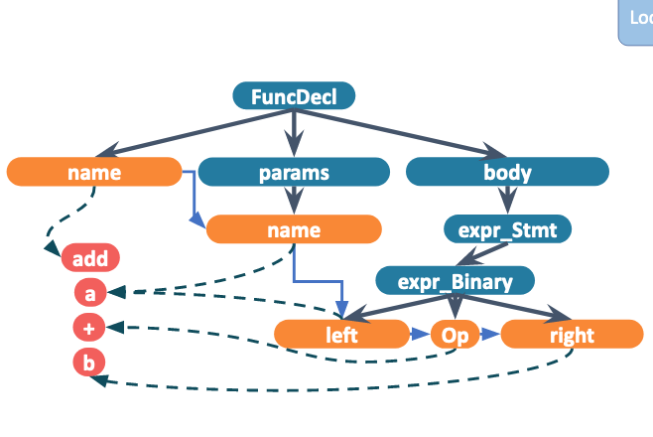
GNN
function add(a) { a + b; }
Notes:
Adding the b parameter is represented by adding a node to the graph.

Slide 14
params
Locate
GNN
GNN
function add(a) { a + b; }
Notes:
First, we must select a parent node to add our new child node to.

Slide 15
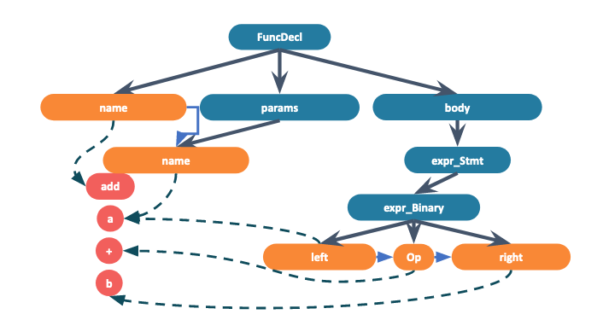
No
Action
replace
value
replace
type
del
node
name
add
node
Locate
GNN
function add(a, b) { a + b; }
Notes:
Now, we must select which graph edit operation to perform. In this case, we select add node to add the parameter b to the graph.
The value b is chosen from a global value dictionary and the type of the node, parameter, is chosen from a global type dictionary.

Slide 16
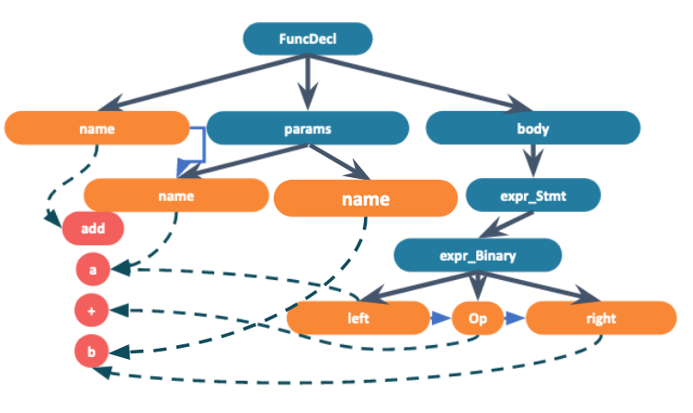
Global type dictionary
No
Action
IfStmt, WithStmt, ArrayExpr, CallExpr, ReturnStmt ......
replace
value
replace
type
del
node
returnStmt
expr_Stmt
add
node
Locate
GNN
function add(a, b) { return a + b; }
Notes:
Now, we continue in the sequence by modifying the type of the binary expression “a+b” to a return expression. We select the replace type operator and the type is chosen from a global type dictionary.

Slide 17
No
Action
replace
value
replace
type
del
node
returnStmt
add
node
Locate
GNN
function add(a, b) { return a + b; }
Notes:
We represent that the sequence is completed by selecting the NO_OP or STOP operator.

Slide 18
More Formally,
Notes:
More formally,
Given a buggy graph, we are trying to predict the fixed graph through a sequence of T edits. Different programs may need a different number of steps which is also determined by the model.

Slide 19
Anatomy of a graph edit -
“replace_val”
“replace_type”
Predict Location
Predict Value
Predict Location
Predict Type
“remove”
“add”
Predict Location
Predict Location
Predict Value
Predict Type
Predict Child Number
Notes:
In general, a fix is a sequence of the following graph edit operators we have defined:
When combined into multi-step edits, these operators suffice to capture a rich variety of code modifications
Notice that these operators share some common low-level primitives,such as finding the location or predicting a value
** maybe add more here ****

Slide 20
Represent source code
Represent fixes
Learning
CHALLENGES
Notes:
Now, let’s consider how to learn to detect and repair faults in unseen code?

Slide 21

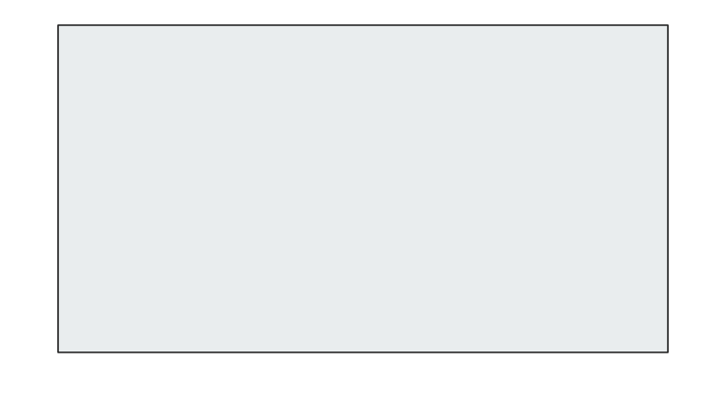






Model: GNN + LSTM
g_{t}
Predict Location
Predict Child Number
Predict Value
Predict Type
Notes:
Our model keeps track of state through two contexts: A macro context that keeps track of the edits in the total sequence predicted, and a micro context keeps track of low-level predictions made within each graph edit.
At each step of predicting a primitive, the micro-context is updated.
In this way, the location chosen is used in predicting the child number, which is in turn used in predicting the value and so on.
After completing the sequence of low level primitive prediction, the model performs the edit to the graph to create graph gt. Lastly, the new graph and micro-context, are used to update the Macro-context.
This process continues until the model predicts a NO-OP or STOP operator.

Slide 22

Learning Objective
Given the dataset:
Maximize the likelihood of the fixes:
Notes:
In summary, given a dataset of pairs of buggy and fixed code mined from Github commits, our model is trained to maximize the likelihood of the fixes.

Slide 23
Evaluation
Notes:
We evaluate our approach on three datasets mined from github commits. Each dataset is named based on the number of edits targeted. We target commits with a low number of AST edits based on our insight is that a commit with a smaller number of AST differences is more likely to be a bug fix

Slide 24
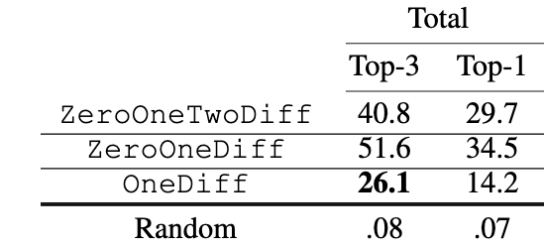
Accuracy
Notes:
Our approach achieves over 25% end to end accuracy on the one diff dataset. Accuracy is defined end to end which could involve predicting the type of edit, the location, value, and type.
A model that randomly selects predictions is shown for comparison to illustrate the size of the prediction space.
The ZeroOneDiff model was trained on buggy code that requires 1 AST modification to fix in addition to “correct” code that requires no fix or 0 AST modifications. The accuracy increases in this setting as accurately classifying a sample as correct only requires one prediction from the model. Although the problem space increased, there are more cases in which the model does not have to predict location, value, type, etc. in order to make an accurate prediction.
Similarly, the ZeroOneTwoDiff was trained on the same dataset as the ZeroOneDiff model plus samples that require two AST modifications to fix.

Slide 25

False Positive Evaluation
7,210 False Positives
27,815 Non-Buggy Samples
25.92%
Notes:
We also conducted a false positive evaluation on the ZeroOneDiff datatset. Of the 27,815 Correct or non-buggy samples we evaluated on, the model raised an alarm on only around 7,200 of them.
This amounts to a near 26% false positive rate which is competitive with traditional static analysis tools.

Slide 26
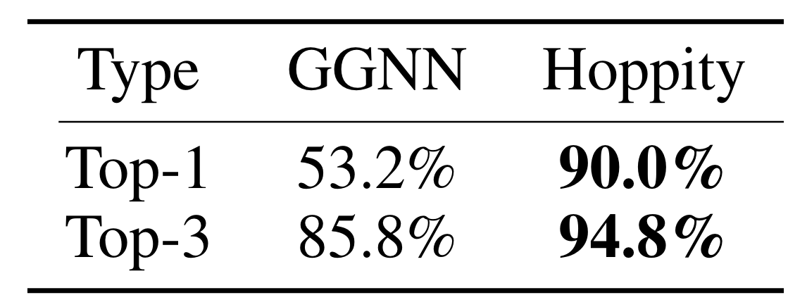
Baselines - GGNN
Learning to Represent Programs with Graphs, Allamanis et al.
VarMisuse
Notes:
Existing approaches cannot add or remove nodes (and other things?), so we compare our work in a restricted setting.
We compare Hoppity to two existing models: a GNN model and a token base sequence to sequence translation model.
Our goal here is to show that even though our model is trained for a much more general task, we produce similar or better accuracy for the specialized tasks that our baselines target.
We start with the Gated Graph Neural Network model. This model was trained on two tasks: Var-misuse and Var-naming
In the varmisuse setting, the model predicts the correct variable that should be used at a given location. We adapt this task to compare with Hoppity by setting the candidate variables to be types. So rather than choosing a variable to be used at a given location, the model predicts a type at a given location.
Hoppity has a higher top-1 and top-3 accuracy by about 35% and about 9% respectively.
Ours is different in that GGNN uses a max margin approach in which
For each type:
Make a modification to the graph with that type
Produce a score
Choose the type with the highest score.
We did better because it’s difficult for REP to notice small changes in the graph?

Slide 27
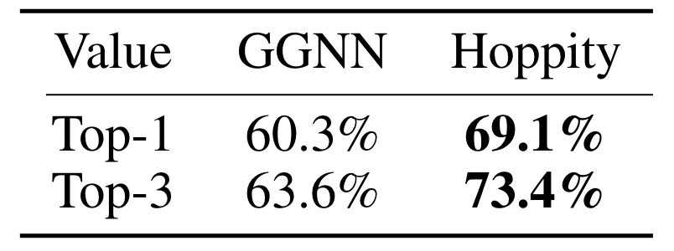
Baselines - GGNN
Learning to Represent Programs with Graphs, Allamanis et al.
VarNaming
Notes:
In the var-naming setting, the model predicts a variable name given its usage. We adapt this task to compare with Hoppity by predicting values ?????
?????? I’m confused about this do we use char level or sub token ?????
Our approach has higher accuracy in this limited setting. We believe this is because we employed a pointer network to predict from a finite vocabulary rather than predicting
“Also for the value prediction, our formulation of pointer on graph is more effective. We found when the space of decisions is large, it is hard to apply structured prediction method like GGNN-Rep in this setting. Since real-world programs are noisy, the sentences used in different programs vary greatly, making it difficult for language models to predict the exact accurate value. A possible extension is to combine the language model with the graph pointer, which we will explore in future work.”

Slide 28
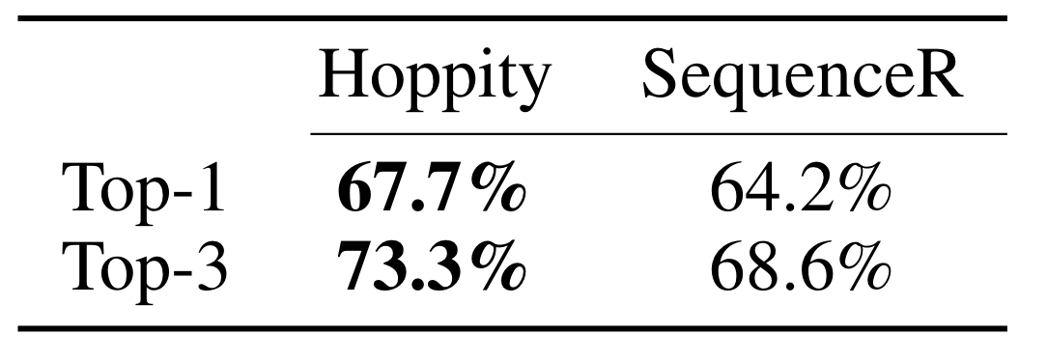
Baselines - Sequence Model
SequenceR: Sequence-to-Sequence Learning for End-to-End Program Repair, Chen et al.
Notes:
Next we compared to SequenceR: a translation based model that predicts a fixed sequence of tokens when given a buggy line in the source code
Here we adapt Hoppity by providing the location to both models.
To make a fair comparison, we train SequenceR to predict the same information as our model. That is, predict the edit operation, value, etc. rather than predicting a string of raw text token by token.
Our increase in accuracy illustrates the benefits of a structure aware graph representation over a representation using textual tokens.

Slide 29
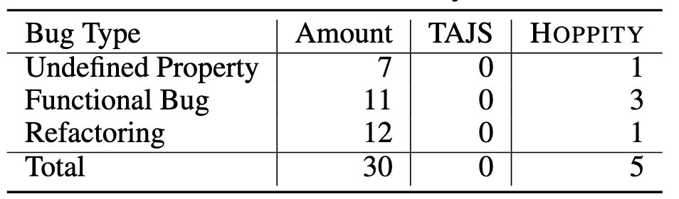
Baselines - TAJS
Notes:
We also compare our work to a traditional static analysis tool that does not use deep learning.
We could not do an automated large scale study on TAJS as it requires setup time on each project due to its many command line options and ability to target different run-time environments.
So, we picked 30 random points from our test set to manually analyze using TAJS. Of these 30, seven were undefined property bugs, 11 were functional bugs, and 12 were refactorings.
While functional bugs and refactoring modifications are beyond TAJS, undefined property bugs are well in its scope. TAJS wasn’t able to find these bugs as it raised many other false alarms in unrelated parts of the code and suspended the analysis. So, to further aid TAJS we removed large parts of the code that did not include the bug. When we did this, TAJS was able to detect 2 of the undefined property bugs.
Of the 5 bugs that hoppity detected, the model was able to predict the correct fix on 4 of them. We found that our Deep Learning approach was superior in terms of setup effort and performance.

Slide 30

Thank you!
hoppity.seas.upenn.edu
edinella@seas.upenn.edu

