Slide 1
Symbolically Executing Mobile Apps: The Good, the Bad, and the Ugly
Mayur Naik
Georgia Tech
Joint work with Saswat Anand and Hongseok Yang

Slide 2
What are Mobile Apps?
Programs that run on mobile devices with advanced computing ability and Internet connectivity
Smart-phones (IPhone, Android, Windows Phone, …)
Tablets (IPad, Amazon Kindle Fire, …)

Slide 3
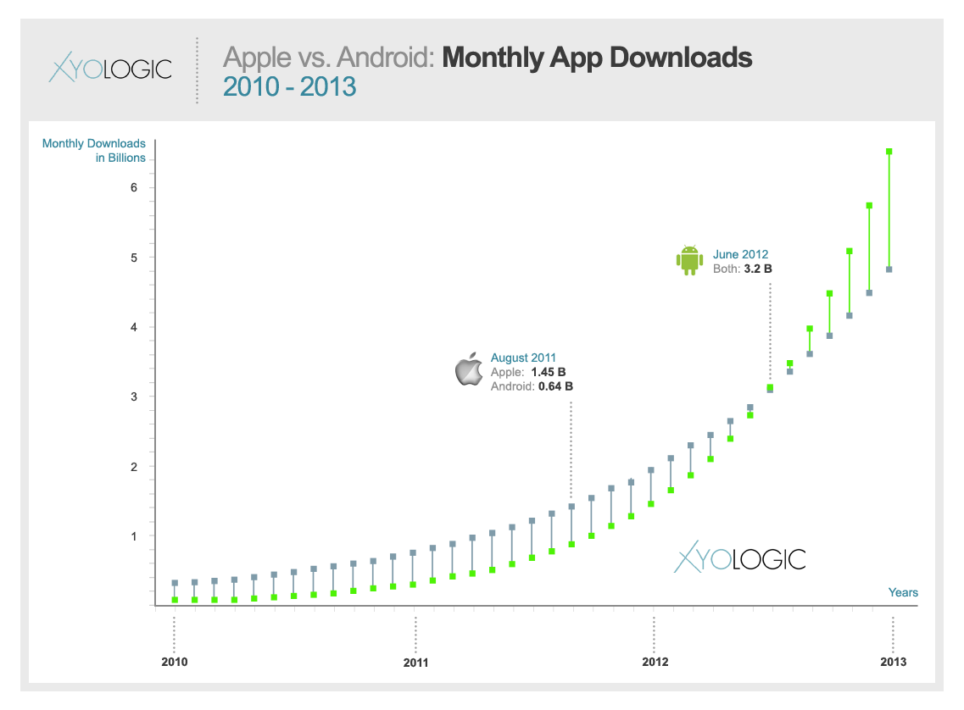
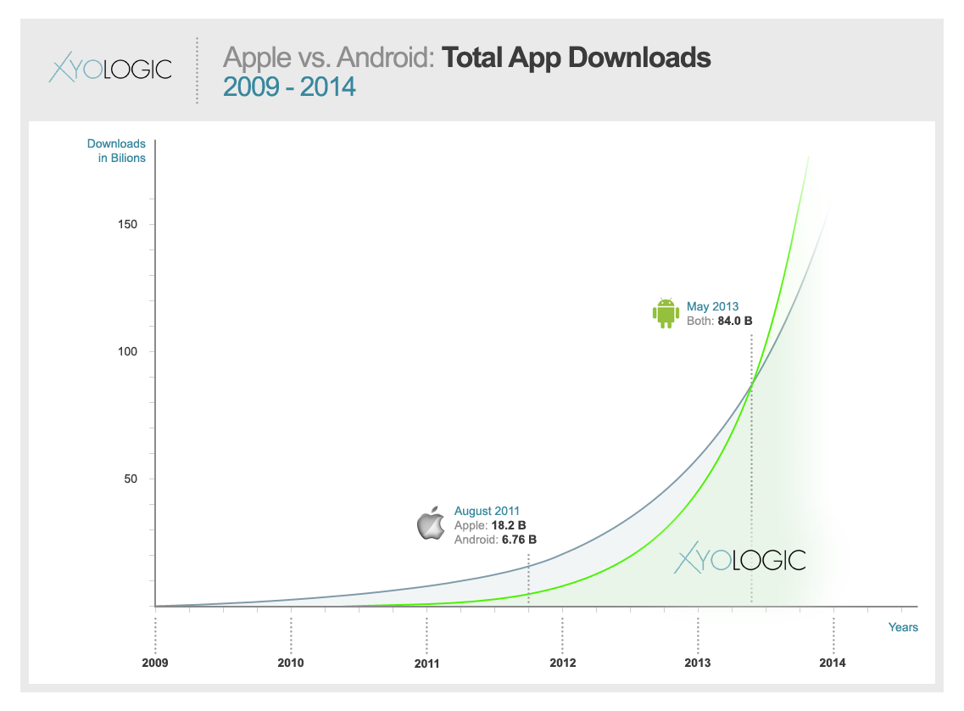
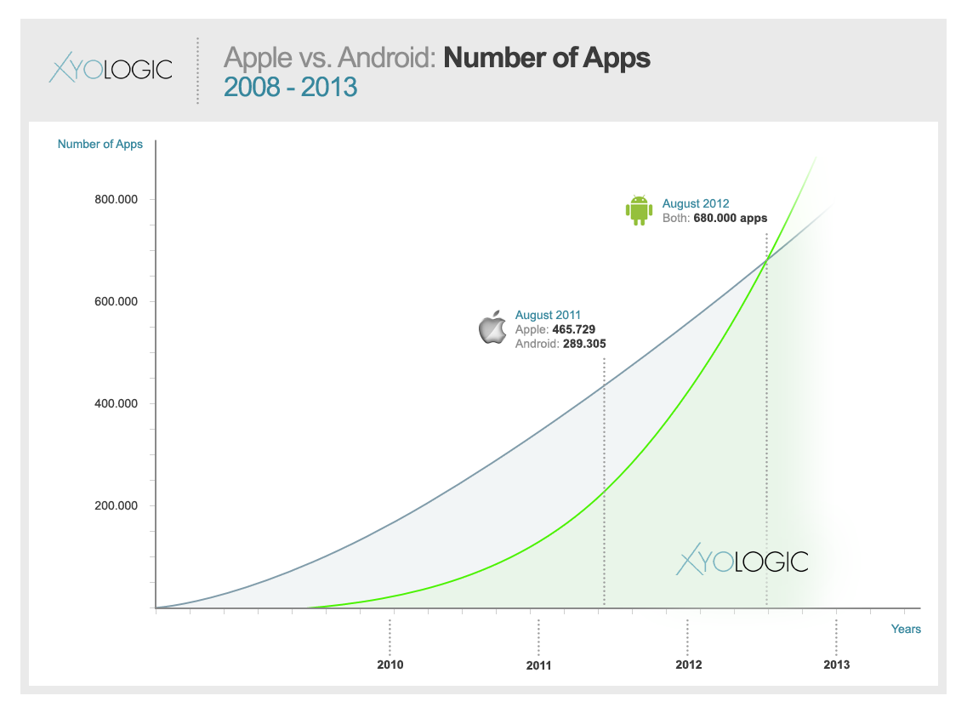
The Rise of Mobile Apps

Slide 4




New Software Engineering Challenges
Reliability
Security
Performance
Development and Testing
Pre-deployment Certification
Post-deployment Adaptation

Slide 5


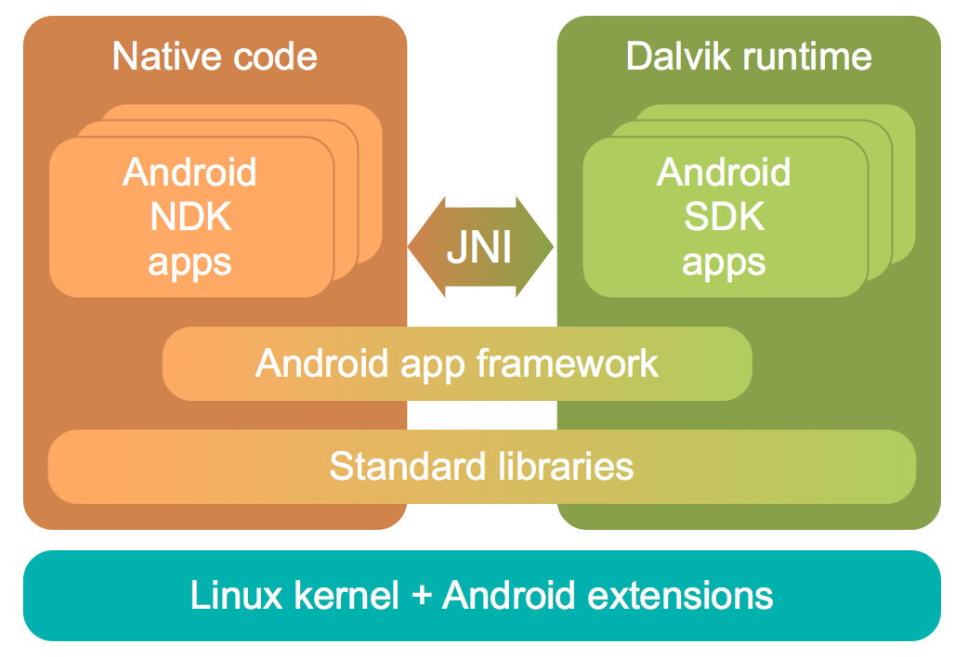




Mobile App Reliability
The Context: Software interacting in complex ways with its environment
IPC
User Interfaces
Framework
Databases
Permissions
Asynchrony
Concurrency
The Problem: Automatically generate tests for high coverage of software

Slide 6
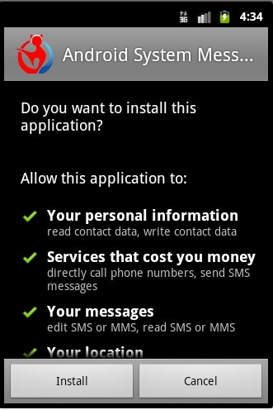
Mobile App Security
The Context: Untrusted software with access to users’ sensitive data and the Internet
2011 Mobile Threat Report Lookout™ Mobile Security
0.5 to 1 million Android users affected by malware in first half of 2011
3 out of 10 Android owners likely to face web-based threat each year
Attackers using ever sophisticated ways to steal data and money
The Problem: Automatically prove conformance of software to security/privacy policies

Slide 7
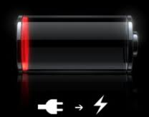




Mobile App Performance
The Context: Software operating in a resource-constrained and dynamic environment
…. …… offload ………… …….. ……….. resume …..
…. …... …..
offload
………… …….. …….....
resume
The Problem: Automatically and dynamically adapt software to available resources

Slide 8
A Fundamental Problem
How to automatically and efficiently generate a relevant set of program inputs?

Slide 9
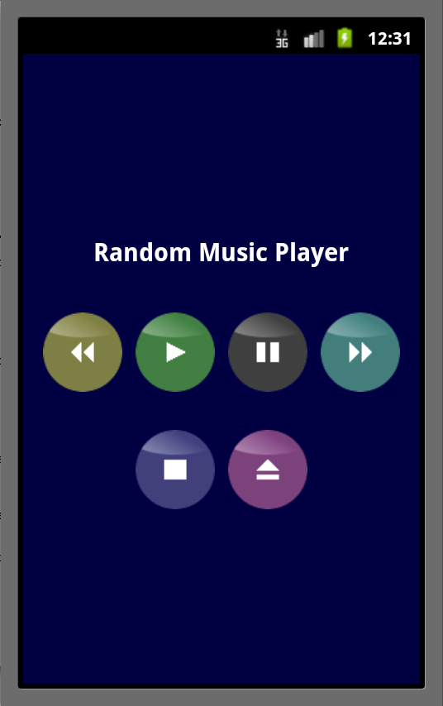
Example: Music Player App
public class MainActivity extends Activity implements OnClickListener {
public void onCreate(Bundle bundle) {
Button buttons = new Button[] { play, pause, skip, rewind, stop, eject };
for (Button b : buttons) b. setOnClickListener(this);
}
public void onClick(View target) {
if (target == play)
startService(new Intent(ACTION_PLAY)); else if (target == pause)
startService(new Intent(ACTION_PAUSE));
else if (target == skip)
startService(new Intent(ACTION_SKIP));
else if (target == rewind)
startService(new Intent(ACTION_REWIND));
else if (target == stop)
startService(new Intent(ACTION_STOP));
else if (target == eject)
showUrlDialog(); }

Slide 10
Example: Music Player App
public class MainActivity extends Activity implements OnClickListener {
public void onCreate(Bundle bundle) {
Button buttons = new Button[] { play, pause, skip, rewind, stop, eject };
for (Button b : buttons) b. setOnClickListener(this);
}
public void onClick(View target) {
if (target == play)
startService(new Intent(ACTION_PLAY)); else if (target == pause)
startService(new Intent(ACTION_PAUSE));
else if (target == skip)
startService(new Intent(ACTION_SKIP));
else if (target == rewind)
startService(new Intent(ACTION_REWIND));
else if (target == stop)
startService(new Intent(ACTION_STOP));
else if (target == eject)
showUrlDialog(); }
Tap(136.0,351.0)
tap(136, 351)

Slide 11
Example: Music Player App
public class MainActivity extends Activity implements OnClickListener {
public void onCreate(Bundle bundle) {
Button buttons = new Button[] { play, pause, skip, rewind, stop, eject };
for (Button b : buttons) b. setOnClickListener(this);
}
public void onClick(View target) {
if (target == play)
startService(new Intent(ACTION_PLAY)); else if (target == pause)
startService(new Intent(ACTION_PAUSE));
else if (target == skip)
startService(new Intent(ACTION_SKIP));
else if (target == rewind)
startService(new Intent(ACTION_REWIND));
else if (target == stop)
startService(new Intent(ACTION_STOP));
else if (target == eject)
showUrlDialog(); }
Tap(136.0,351.0)
tap(248, 351)

Slide 12
Example: Music Player App
public class MainActivity extends Activity implements OnClickListener {
public void onCreate(Bundle bundle) {
Button buttons = new Button[] { play, pause, skip, rewind, stop, eject };
for (Button b : buttons) b. setOnClickListener(this);
}
public void onClick(View target) {
if (target == play)
startService(new Intent(ACTION_PLAY)); else if (target == pause)
startService(new Intent(ACTION_PAUSE));
else if (target == skip)
startService(new Intent(ACTION_SKIP));
else if (target == rewind)
startService(new Intent(ACTION_REWIND));
else if (target == stop)
startService(new Intent(ACTION_STOP));
else if (target == eject)
showUrlDialog(); }
Tap(136.0,351.0)
tap(360, 351)

Slide 13
Example: Music Player App
public class MainActivity extends Activity implements OnClickListener {
public void onCreate(Bundle bundle) {
Button buttons = new Button[] { play, pause, skip, rewind, stop, eject };
for (Button b : buttons) b. setOnClickListener(this);
}
public void onClick(View target) {
if (target == play)
startService(new Intent(ACTION_PLAY)); else if (target == pause)
startService(new Intent(ACTION_PAUSE));
else if (target == skip)
startService(new Intent(ACTION_SKIP));
else if (target == rewind)
startService(new Intent(ACTION_REWIND));
else if (target == stop)
startService(new Intent(ACTION_STOP));
else if (target == eject)
showUrlDialog(); }
Tap(136.0,351.0)
tap(24, 351)

Slide 14
Example: Music Player App
public class MainActivity extends Activity implements OnClickListener {
public void onCreate(Bundle bundle) {
Button buttons = new Button[] { play, pause, skip, rewind, stop, eject };
for (Button b : buttons) b. setOnClickListener(this);
}
public void onClick(View target) {
if (target == play)
startService(new Intent(ACTION_PLAY)); else if (target == pause)
startService(new Intent(ACTION_PAUSE));
else if (target == skip)
startService(new Intent(ACTION_SKIP));
else if (target == rewind)
startService(new Intent(ACTION_REWIND));
else if (target == stop)
startService(new Intent(ACTION_STOP));
else if (target == eject)
showUrlDialog(); }
Tap(136.0,351.0)
tap(136, 493)

Slide 15
Example: Music Player App
public class MainActivity extends Activity implements OnClickListener {
public void onCreate(Bundle bundle) {
Button buttons = new Button[] { play, pause, skip, rewind, stop, eject };
for (Button b : buttons) b. setOnClickListener(this);
}
public void onClick(View target) {
if (target == play)
startService(new Intent(ACTION_PLAY)); else if (target == pause)
startService(new Intent(ACTION_PAUSE));
else if (target == skip)
startService(new Intent(ACTION_SKIP));
else if (target == rewind)
startService(new Intent(ACTION_REWIND));
else if (target == stop)
startService(new Intent(ACTION_STOP));
else if (target == eject)
showUrlDialog(); }
Tap(136.0,351.0)
tap(305, 544)

Slide 16
Example: Music Player App
public void onClick(View target) {
if (target == play)
startService(new Intent(ACTION_PLAY)); else if (target == pause)
startService(new Intent(ACTION_PAUSE));
else if (target == skip)
startService(new Intent(ACTION_SKIP));
else if (target == rewind)
startService(new Intent(ACTION_REWIND));
else if (target == stop)
startService(new Intent(ACTION_STOP));
else if (target == eject)
showUrlDialog(); }
How to generate these inputs automatically?
Tap(136.0,351.0)

Slide 17
Our Solution: Dynamic Symbolic Execution
1: 2:
Run program on concrete input
Accumulate path constraint C₁ ∧ … ∧ C_{n} over symbolic input
For each C_{i}: solve C₁ ∧ … ∧ !C_{i} to generate new input; repeat
tap(int x, int y)
if (x>2 && x<4) { if (y>1 && y<3)
s1 else s2 } else s3
(x>2 && x<4) (y>1 && y<3)
(x>2 && x<4)
tap(1, 5)
tap(3, 5)
tap(3, 2)
F1 !(x>2 && x<4)
Executes s3 Generation 0 Run
T1 (x>2 && x<4) F2 !(y>1 && y<3)
Executes s2 Generation 1 Run
T1 (x>2 && x<4) T2 (y>1 && y<3)
Executes s1 Generation 2 Run

Slide 18
Example: Music Player App
public void onClick(View target) {
if (target == play)
startService(new Intent(ACTION_PLAY)); else if (target == pause)
startService(new Intent(ACTION_PAUSE));
else if (target == skip)
startService(new Intent(ACTION_SKIP));
else if (target == rewind)
startService(new Intent(ACTION_REWIND));
else if (target == stop)
startService(new Intent(ACTION_STOP));
else if (target == eject)
showUrlDialog(); }
Where to inject x and y?
Where to generate constraints on x and y?

Slide 19
Example: Music Player App

Slide 20
Example: Music Player App
Injects x and y here
boolean dispatchEvent(Event e) { float x = e.getX(), y = e.getY(); for (int i = children.length - 1; i >= 0; i--) { View child = children[i]; if (child.contains(x, y)) if (child.dispatchEvent(e)) return true; } return false; } boolean contains(float x, float y) { return x >= left && x < right && y >= top && y < bottom; }
Generates constraints on x and y here

Slide 21
Example: Generation 0 Runs
Injects x and y here
❖
boolean dispatchEvent(Event e) { float x = e.getX(), y = e.getY(); for (int i = children.length - 1; i >= 0; i--) { View child = children[i]; if (child.contains(x, y)) if (child.dispatchEvent(e)) return true; } return false; } boolean contains(float x, float y) { return x >= left && x < right && y >= top && y < bottom; }
Generates constraints on x and y here

Slide 22
Example: Generation 1 Runs
Injects x and y here
boolean dispatchEvent(Event e) { float x = e.getX(), y = e.getY(); for (int i = children.length - 1; i >= 0; i--) { View child = children[i]; if (child.contains(x, y)) if (child.dispatchEvent(e)) return true; } return false; } boolean contains(float x, float y) { return x >= left && x < right && y >= top && y < bottom; }
❖
Generates constraints on x and y here

Slide 23
Example: Generation 2 Runs
Injects x and y here
boolean dispatchEvent(Event e) { float x = e.getX(), y = e.getY(); for (int i = children.length - 1; i >= 0; i--) { View child = children[i]; if (child.contains(x, y)) if (child.dispatchEvent(e)) return true; } return false; } boolean contains(float x, float y) { return x >= left && x < right && y >= top && y < bottom; }
❖
❖
❖
Generates constraints on x and y here

Slide 24
Example: Generation 3 Runs
Injects x and y here
boolean dispatchEvent(Event e) { float x = e.getX(), y = e.getY(); for (int i = children.length - 1; i >= 0; i--) { View child = children[i]; if (child.contains(x, y)) if (child.dispatchEvent(e)) return true; } return false; } boolean contains(float x, float y) { return x >= left && x < right && y >= top && y < bottom; }
❖
❖
❖
Generates constraints on x and y here

Slide 25
Example: Generation 4 Runs
Injects x and y here
boolean dispatchEvent(Event e) { float x = e.getX(), y = e.getY(); for (int i = children.length - 1; i >= 0; i--) { View child = children[i]; if (child.contains(x, y)) if (child.dispatchEvent(e)) return true; } return false; } boolean contains(float x, float y) { return x >= left && x < right && y >= top && y < bottom; }
❖
❖
❖
Generates constraints on x and y here

Slide 26
The Story So Far …
Single-Step DART: Clicks on each widget once
Fully automatic and general-purpose
Sufficient to instrument only framework, not apps
No need of GUI model unlike work on GUI testing
Applicable to not only framework-defined widgets but also app-defined ones
Portable to other GUI frameworks with little effort
Time for a Demo!

Slide 27
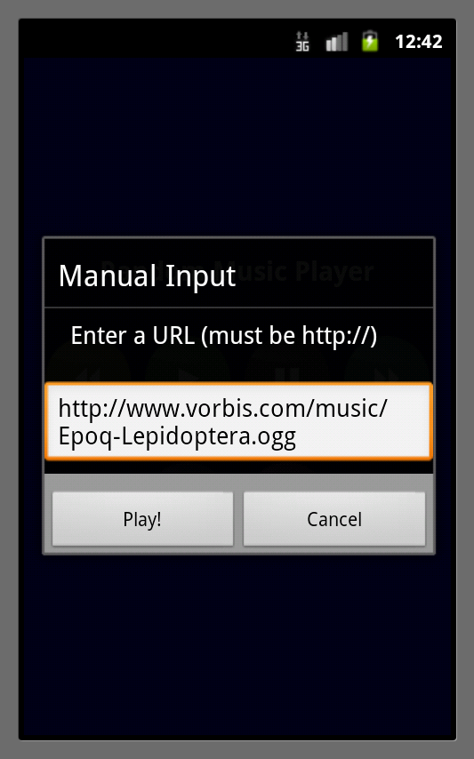
Next: Multi-Step DART

Slide 28
Reactive Programs
Programs that react possibly indefinitely to events from environment
Reactive programs are ubiquitous
Stream programs, web servers, embedded programs
Even APIs and GUIs are reactive programs
React to API calls or user actions

Slide 29
Mobile Apps as Reactive Programs
Input to app is a possibly infinite event sequence
Each event can be:
Motion event (x-coord, y-coord, time)
Key event (ASCII key code)
Broadcast event (incoming phone call, SMS message, etc.)
App has single UI thread that loops indefinitely and handles each event serially in order
Event handling may change app’s state, which in turn may affect handling of future events

Slide 30
A Calculus for Reactive Programs
Abstract Syntax:
P ::= int g1, …, gn; void f(int v) { s } s ::= g = a | s1; s2 | if (b) then s1 else s2 a and b are int and bool exprs over g1, …, gn, v
Semantics:
Input is a sequence of ints [i1, …, ik]
Start with all gi = 0 and call f(i1), f(i2), …, f(ik) serially in order

Slide 31
Testing Reactive Programs
Given reactive program P and bound k >= 0, which branches in P are reachable by input sequences of length <= k?
Example: int g; void f(int v) { if (g == 42) assert else g = v } Assertion is not reachable with k <= 1, but is reachable with k = 2, on any input sequence [42, *].

Slide 32
Testing Reactive Programs
Given reactive program P and bound k >= 0, which branches in P are reachable by input sequences of length <= k?
Naïve Solution: DART(P, k) Computes set of inputs I each of length k such that each (feasible) path in P is taken on some input in I
Problem: DART suffers from path explosion

Slide 33
Our Solution
Iteratively compute sets of increasingly longer input sequences, by alternately applying two operations: EXTEND and PRUNE
{[]} = Δ₀ =
where Δ_{k} and Π_{k} are input sequences of length k
Relative Completeness: If DART(P, k) produces an input that reaches a branch in P, then Π₀ U … U Π_{k} also contains an input that reaches it
Π₀
EXTEND
Δ₁
PRUNE
Π₁
EXTEND
Δ₂
PRUNE
Π₂
...

Slide 34
The EXTEND Operation
EXTEND
PRUNE
EXTEND
PRUNE
...
{[]} = Δ₀ = Π₀ Δ₁ Π₁ Δ₂ Π₂
Does single-step DART on each sequence in Π_{k-1} to give sequences in Δ_{k}
Example: void f(int v) { if (g == 42) assert else g = v }
EXTEND({ [] }) = { [0] } EXTEND({ [0] }) = { [0,0], [42,0] }

Slide 35
The PRUNE Operation
EXTEND
PRUNE
EXTEND
PRUNE
...
{[]} = Δ₀ = Π₀ Δ₁ Π₁ Δ₂ Π₂
Removes sequences in Δ_{k} that are redundant with respect to sequences in Π₀ U … U Π_{k}
Identified two patterns common in mobile apps, called read-only and independence

Slide 36
PRUNE Pattern #1: Read-Only Events
If set of memory locations written in last event of an input sequence is empty, then prune that sequence

Slide 37
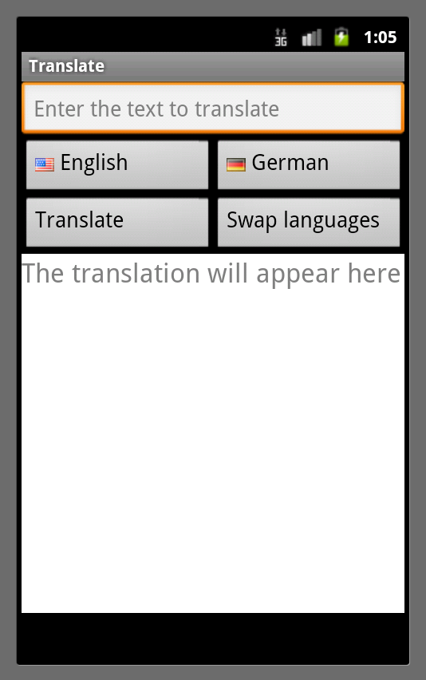
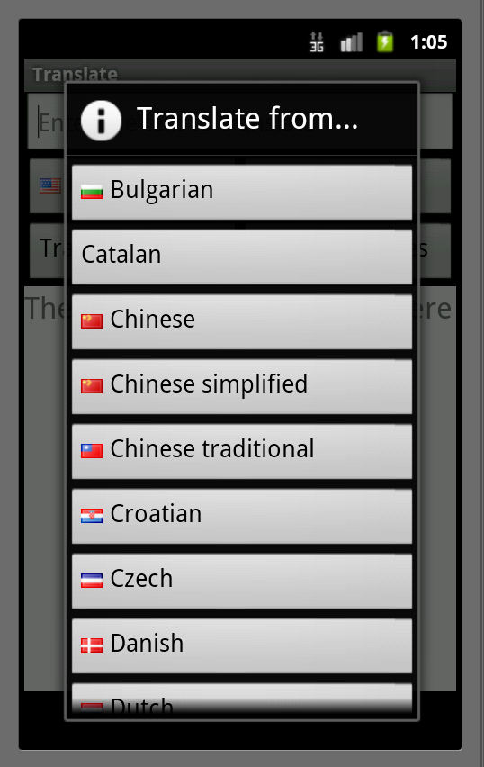
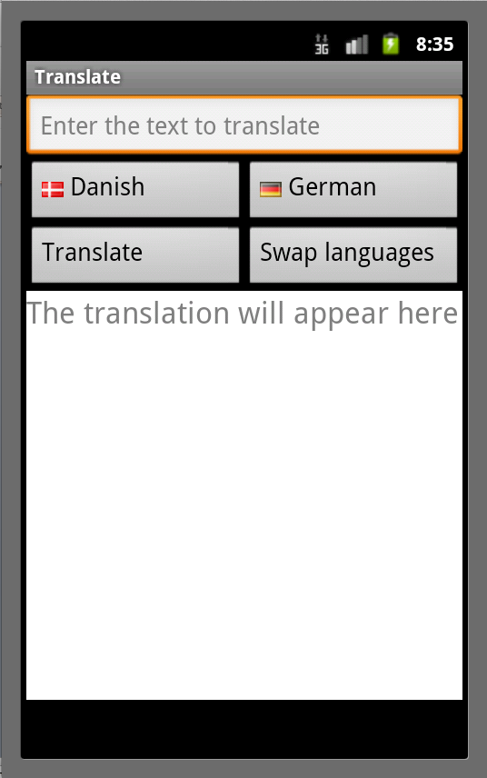
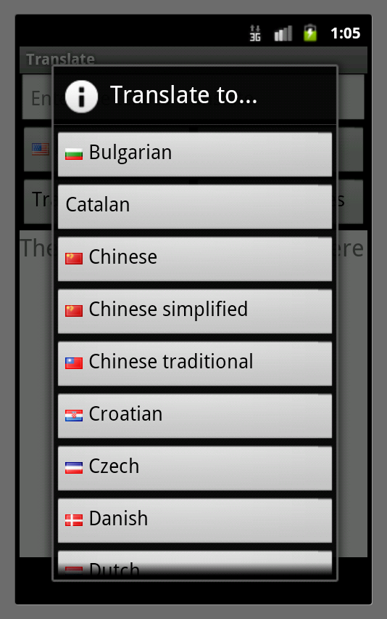
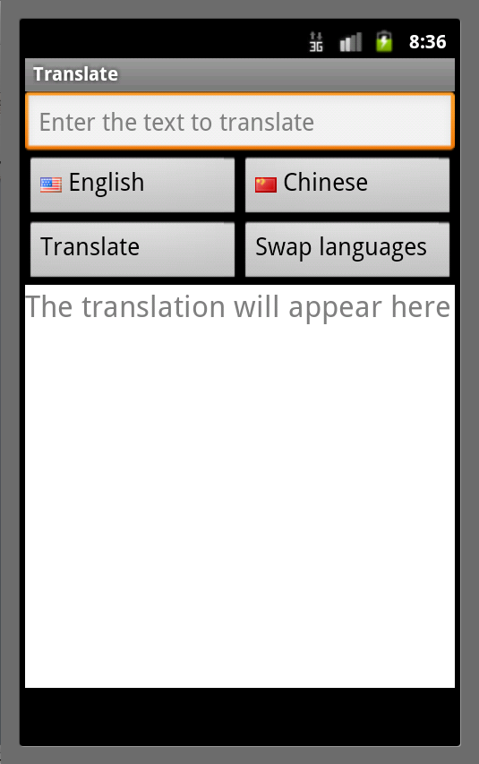
PRUNE Pattern #2: Independent Events

Slide 38
PRUNE Pattern #2: Independent Events
If input sequences π₁ and π₂ of same length:
follow symbolic paths p; q; r and p; r; q
there is no race on any memory location between segments q and r in π₁
there is no race on any memory location between segments r and q in π₂
then prune either π₁ or π₂

Slide 39
Lessons Learned

Slide 40
Path Divergence
Results from missed propagation of symbolic values in uninstrumented code
Examples of uninstrumented code: primarily native (C/C++) code, but also occasionally Java code (e.g., object serialization code)
Surprisingly, none due to non-determinism, despite widespread use of asynchronous message passing in Android framework

Slide 41
Path Divergence: Lessons Learnt
Unanalyzable parts are common in real programs
Divergence is your friend: Served as beacon of bugs in our implementation
But debugging is painful: need tools to localize its cause; see [Anand & Harrold, ASE’11]
~ 0% today in our implementation for Android (compared to ~ 40% for SAGE)

Slide 42
Ongoing Work: Finding Opaque Code Effects
Given analysis A and program P with set of opaque methods M, which results of analysis A on program P may be affected by which methods in M?
Key goal: reduce human burden of method models
Key insights:
Most opaque methods are in heavily reused libraries
=> Reuse models across programs or even analyses
Many analyses are lazy or parts of their results unused
=> Seek models that only affect results that matter

Slide 43
Symbolic Input Values
Which inputs to treat symbolically and where?
Too many => path explosion and path divergence
Too few => loss of coverage
Too early => path divergence from missed propagation in uninstrumented code
Too late => path divergence from lost constraints
Lessons learnt:
Use as few symbolic inputs as possible, but no fewer
Inject them as late as possible, but no later

Slide 44
The Need for Function Summarization
Function summaries are needed to avoid (feasible) path explosion [Godefroid, POPL’07]
Every widget is instance of: class android.graphics.Rect { boolean contains(float x, float y) { return x >= left && x < right && y >= top && y < bottom; } }
Provided manual summary: (R x R) -> { true, false }
❖
❖
❖
❖
❖

Slide 45
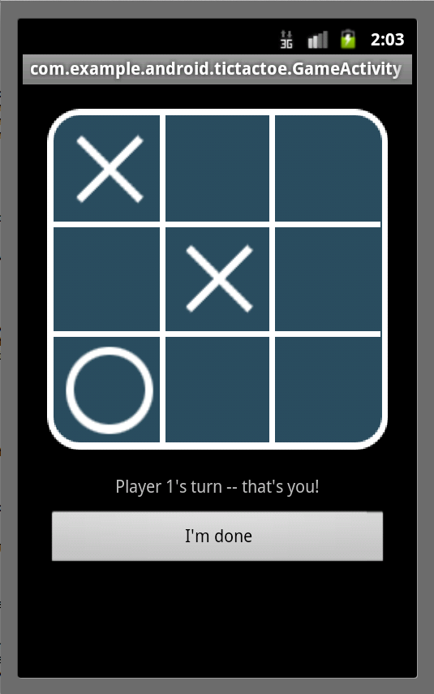
An Example Where it Didn’t Work
App-specific widget selection: class GameActivity { void onTouchEvent(MotionEvent e) { int rawX = (int) e.getX(); int rawY = (int) e.getY(); int x = (rawX – MARGIN) / SIZE; int y = (rawY – MARGIN) / SIZE; if (x >= 0 && x < 3 && y >= 0 & y < 3) int cell = x + 3 * y; … } }
Needs summaries for app- defined functions

Slide 46
The Need for Path-Sensitive Analysis
Path-sensitive analysis is needed to avoid explosion of infeasible paths
Initially tried execution hijacking (no path constraint solving)
But even single-step DART failed to terminate
Classic case of “imprecise analysis is also inefficient”
❖
❖

Slide 47
The Need for Path-Sensitive Analysis
Path-sensitive analysis is needed to avoid explosion of infeasible paths
What about explosion of feasible paths?
Results from certain kinds of features:
Small number of widgets but app-specific selection
Large number of widgets with framework selection
Gestures

Slide 48
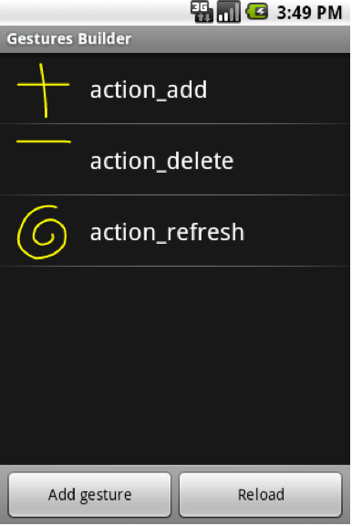
Apps With Gestures
Treating input as sequence of touch events is most primitive level of abstraction
Apps may treat certain timed sequences of touch events as gestures for quick tasks
Fortunately, frameworks provide gestures library
Create gesture abstractions once, akin to function summarization

Slide 49
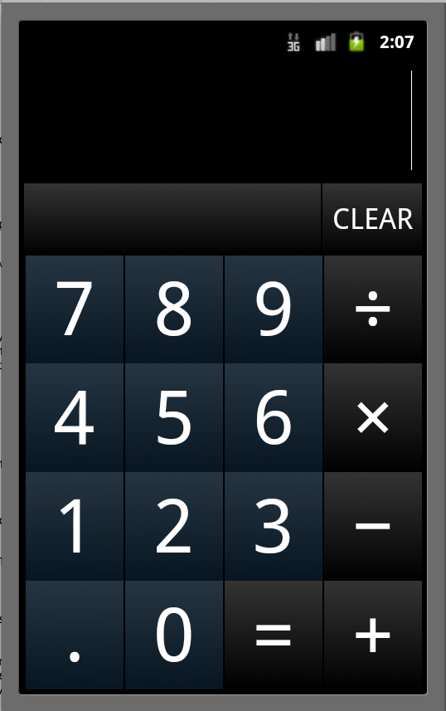
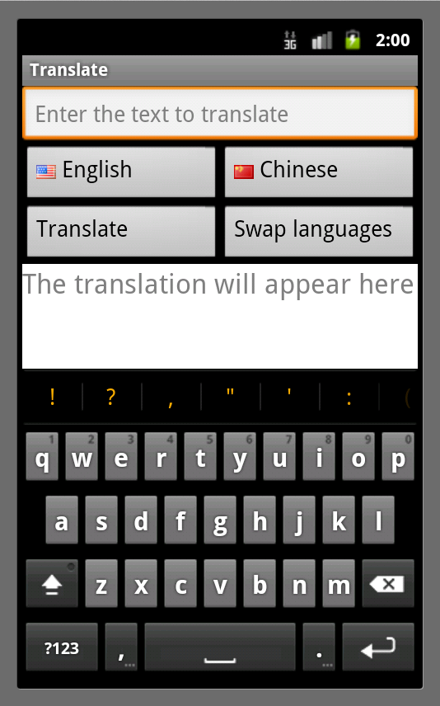
Apps With Many Widgets

Slide 50
Other Path-Explosion Problems
Apps that interact with rich content
Files with structured data (e.g. contacts book), pictures, video clips, etc.
Apps that act based on aspects of environment
Hardware and software features
Apps that need user to login to protected sites

Slide 51
Paths in Apps vs. Framework vs. 3rd Party Libs
App code typically has far fewer paths than framework and third-party libraries
Most clients care only about paths in app code
Called by framework
private void doTranslate() { Language from = (Language) fromButton.getTag(); Language to = (Language) toButton.getTag(); String fromName = from.getShortName(); String toName = to.getShortName(); String input = fromEditText.getText().toString(); String result = translateService.translate(input, fromName, toName); if (result != null) setOutputText(result); else throw new Exception(…); }
Calls 3rd party library

Slide 52
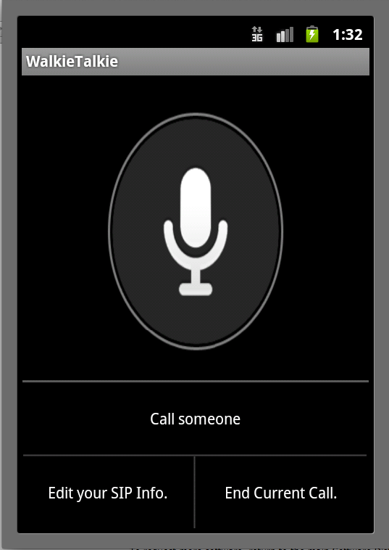

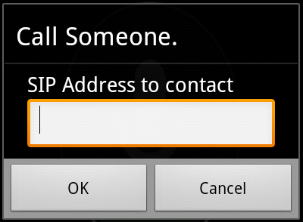
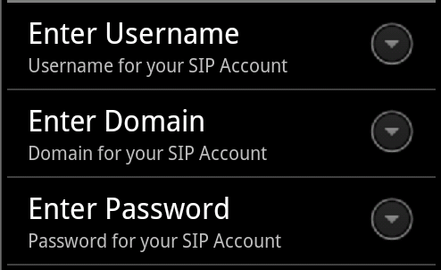
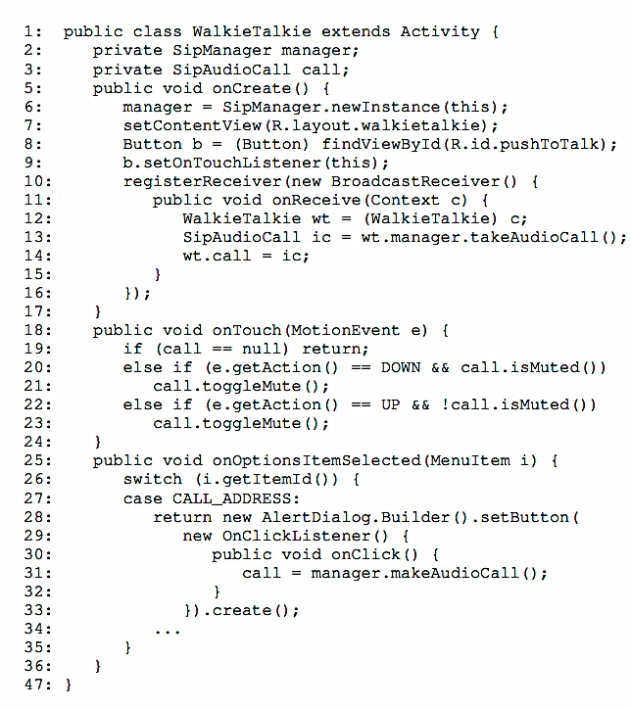






An Example Client: Malware Analysis
Security Policies
Mobile App Binary
STINGER
Software Test Input Generator
App Framework

Slide 53
Targeted Dynamic Symbolic Execution?
Reaching a given branch in app code requires reaching specific branches in framework code
Open problem for general-purpose programs
public void onClick(View target) {
if (target == play)
startService(new Intent(ACTION_PLAY)); else if (target == pause)
startService(new Intent(ACTION_PAUSE));
else if (target == skip)
startService(new Intent(ACTION_SKIP));
else if (target == rewind)
startService(new Intent(ACTION_REWIND));
else if (target == stop)
startService(new Intent(ACTION_STOP));
else if (target == eject)
showUrlDialog(); }
boolean contains(float x, float y) { return x >= left && x < right && y >= top && y < bottom; }

Slide 54
Our Approach (Ongoing Work)
Mixed concrete and symbolic execution
Concrete state: partly real and partly fabricated
Circumvents need to generate rich content
Symbolic state: constraint over fabricated parts
Maintains path sensitivity as far as possible
=> Balances path explosion and path feasibility

Slide 55
Example 1: Music Player App
Fabricate “target”; not used subsequently
public void onClick(View target) {
if (target == play)
startService(new Intent(ACTION_PLAY)); else if (target == pause)
startService(new Intent(ACTION_PAUSE));
else if (target == skip)
startService(new Intent(ACTION_SKIP));
else if (target == rewind)
startService(new Intent(ACTION_REWIND));
else if (target == stop)
startService(new Intent(ACTION_STOP));
else if (target == eject)
showUrlDialog(); }

Slide 56
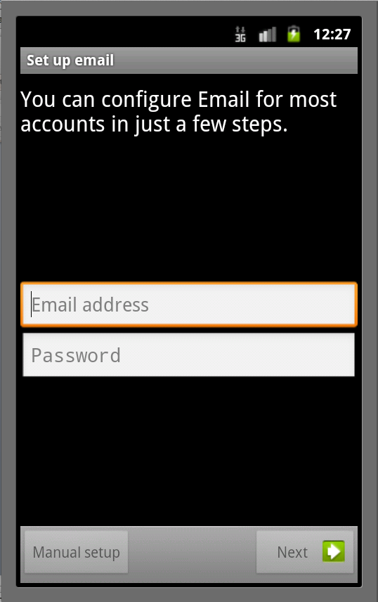
Example 2: Email App
Cursor c = query(Account.ID_PROJECTION);
int numAccounts = c.getCount();
if (numAccounts == 0)
actionNewAccount();
else if (numAccounts == 1) {
c.moveToPosition(0);
long accountId = c.getLong(Account.ID_CONTENT);
actionHandleAccount(accountId);
} else
actionShowAccounts();
Concretely takes this branch
Fabricated to take this branch
public class Cursor {
public boolean moveToPosition(int pos) {
// Check position isn't past end of cursor
int count = getCount();
if (pos >= count) return false;
return true;
}
}
Symbolic state prevents taking this branch: (c.getCount() == 1 ∧ 0 >= c.getCount()) is unsat

Slide 57
Conclusion
Mobile apps stand to revolutionize computing
Unique software engineering challenges
No program analysis techniques/tools exist
Dynamic symbolic execution holds promise
Three ideas: Input pruning, input abstraction, input fabrication

Slide 58
Thank You!

