Slide 1
The Quest for Minimal Program Abstractions
Mayur Naik
Georgia Tech
Ravi Mangal and Xin Zhang (Georgia Tech), Percy Liang (Stanford), Mooly Sagiv (Tel-Aviv Univ), Hongseok Yang (Oxford)

Slide 2
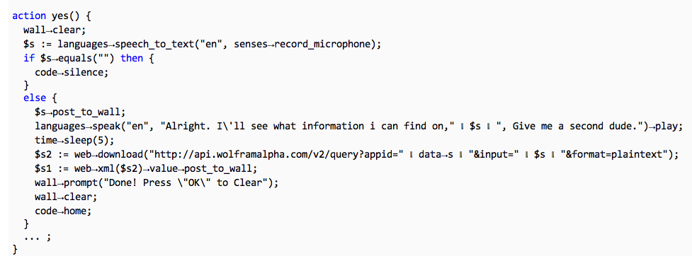





The Static Analysis Problem
program p
static analysis
query q₁
query q₂
X
X
p ² q₁?
p ² q₂?

Slide 3
Static Analysis: 70’s to 90’s
client-oblivious
“Because clients have different precision and scalability needs, future work should identify the client they are addressing …” M. Hind, Pointer Analysis: Haven’t We Solved This Problem Yet?, 2001
program p
abstraction a
query q₁
query q₂
p ² q₁?
p ² q₂?

Slide 4
Static Analysis: 00’s to Present
client-driven
demand-driven points-to analysis Heintze & Tardieu ’01, Guyer & Lin ’03, Sridharan & Bodik ’06, …
CEGAR model checkers: SLAM, BLAST, …
program p
abstraction a
query q₁
query q₂
p ² q₁?
p ² q₂?

Slide 5
Static Analysis: 00’s to Present
client-driven
demand-driven points-to analysis Heintze & Tardieu ’01, Guyer & Lin ’03, Sridharan & Bodik ’06, …
CEGAR model checkers: SLAM, BLAST, …
abstraction a₁
abstraction a₂
q₁
p
q₂
p ² q₁?
p ² q₂?

Slide 6
Our Static Analysis Setting
client-driven + parametric
new search algorithms: testing, machine learning, …
new analysis questions: minimal, impossible, …
0 1 0 0 0
1 0 0 0 1
abstraction a₁
abstraction a₂
q₁
p
q₂
p ² q₁?
p ² q₂?

Slide 7
Example 1: Predicate Abstraction (CEGAR)
Predicates to use in predicate abstraction
0 1 0 0 0
1 0 0 0 1
abstraction a₁
abstraction a₂
q₁
p
q₂
p ² q₁?
p ² q₂?

Slide 8
Example 2: Shape Analysis (TVLA)
Predicates to use as abstraction predicates
0 1 0 0 0
1 0 0 0 1
abstraction a₁
abstraction a₂
q₁
p
q₂
p ² q₁?
p ² q₂?

Slide 9
Example 3: Cloning-based Pointer Analysis
K value to use for each call and each allocation site
0 1 0 0 0
1 0 0 0 1
abstraction a₁
abstraction a₂
q₁
p
q₂
p ² q₁?
p ² q₂?

Slide 10
Problem Statement, 1st Attempt
An efficient algorithm with:
INPUTS:
program p and query q
abstractions A = { a₁, …, a_{n} }
boolean function S(p, q, a)
OUTPUT:
Impossibility: @ a 2 A: S(p, q, a) = true
Proof: a 2 A: S(p, q, a) = true
a
p
_{S}
q
p ` q
p 0 q

Slide 11
Orderings on A
Efficiency Partial Order
a₁ ·_{cost} a₂ , sum of a₁’s bits · sum of a₂’s bits
S(p, q, a₁) runs faster than S(p, q, a₂)
Precision Partial Order
a₁ ·_{prec} a₂ , a₁ is pointwise · a₂
S(p, q, a₁) = true ) S(p, q, a₂) = true

Slide 12
Final Problem Statement
An efficient algorithm with:
INPUTS:
program p and property q
abstractions A = { a₁, …, a_{n} }
boolean function S(p, q, a)
OUTPUT:
Impossibility: @ a 2 A: S(p, q, a) = true
Proof: a 2 A: S(p, q, a) = true
8 a’ 2 A: (a’ · a Æ S(p, q, a’) = true) ) a’ = a
a
p
_{S}
q
p ` q
p 0 q
AND
Minimal Sufficient Abstraction

Slide 13
Final Problem Statement
An efficient algorithm with:
INPUTS:
program p and property q
abstractions A = { a₁, …, a_{n} }
boolean function S(p, q, a)
OUTPUT:
Impossibility: @ a 2 A: S(p, q, a) = true
Proof: a 2 A: S(p, q, a) = true
8 a’ 2 A: (a’ · a Æ S(p, q, a’) = true) ) a’ = a
1111 finest
S(p, q, a)
: S(p, q, a)
0100 minimal
0000 coarsest
AND
Minimal Sufficient Abstraction

Slide 14
Why Minimality?
Empirical lower bounds for static analysis
Efficient to compute
Better for user consumption
analysis imprecision facts
assumptions about missing program parts
Better for machine learning

Slide 15
Why is this Hard in Practice?
|A| exponential in size of p, or even infinite
S(p, q, a) = false for most p, q, a
Different a is minimal for different p, q

Slide 16
Talk Outline
Minimal Abstraction Problem
Two Algorithms:
Abstraction Coarsening [POPL’11]
Abstractions from Tests [POPL’12]
Summary

Slide 17
Talk Outline
Minimal Abstraction Problem
Two Algorithms:
Abstraction Coarsening [POPL’11]
Abstractions from Tests [POPL’12]
Summary

Slide 18
Abstraction Coarsening [POPL’11]
For given p, q: start with finest a, incrementally replace 1’s with 0’s
Two algorithms:
deterministic: ScanCoarsen
randomized: ActiveCoarsen
In practice, use combination of the algorithms
1111 finest
S(p, q, a)
: S(p, q, a)
0100 minimal
0000 coarsest

Slide 19
Algorithm ScanCoarsen
a Ã (1, …, 1)
Loop:
Remove a component from a
Run S(p, q, a)
If :S(p, q, a) then Add component back permanently
Exploits monotonicity of ·_{prec}: Component whose removal causes :S(p, q, a) must exist in minimal abstraction ) Never visits a component more than once

Slide 20
Problem with ScanCoarsen
Takes O(# components) time
# components can be > 10,000 ) > 30 days!
Idea: try to remove a constant fraction of components in each step

Slide 21
Algorithm ActiveCoarsen
a Ã (1, …, 1)
Loop:
Remove each component from a with probability (1 - ®)
Run S(p, q, a)
If :S(p, q, a) then add components back
Else remove components permanently

Slide 22
Performance of ActiveCoarsen
Let: n = total # components
s = # components in largest minimal abstraction
If set probability ® = e^{(-1/s)} then:
ActiveCoarsen outputs minimal abstraction in O(s log n) expected time
Significance: s is small, only log dependence on total # components

Slide 23
Application 1: Pointer Analysis Abstractions
Client: static datarace detector [PLDI’06]
Pointer analysis using k-CFA with heap cloning
Uses call graph, may-alias, thread-escape, and may-happen-in-parallel analyses
 | # components (x 1000) |  | # unproven queries (dataraces) (x 1000)
 | alloc sites | call sites | 0-CFA | 1-CFA | diff | 1-obj | 2-obj | diff
hedc | 1.6 | 7.2 | 21.3 | 17.8 | 3.5 | 17.1 | 16.1 | 1.0
weblech | 2.6 | 12.4 | 27.9 | 8.2 | 19.7 | 8.1 | 5.5 | 2.5
lusearch | 2.9 | 13.9 | 37.6 | 31.9 | 5.7 | 31.4 | 20.9 | 10.5

Slide 24
Experimental Results: All Queries
K-CFA | # components (x 1000) | BasicRefine (x 1000) | ActiveCoarsen
hedc | 8.8 | 7.2 (83%) | 90 (1.0%)
weblech | 15.0 | 12.7 (85%) | 157 (1.0%)
lusearch | 16.8 | 14.9 (88%) | 250 (1.5%)
K-obj | # components (x 1000) | BasicRefine (x 1000) | ActiveCoarsen
hedc | 1.6 | 0.9 (57%) | 37 (2.3%)
weblech | 2.6 | 1.8 (68%) | 48 (1.9%)
lusearch | 2.9 | 2.1 (73%) | 56 (1.9%)

Slide 25
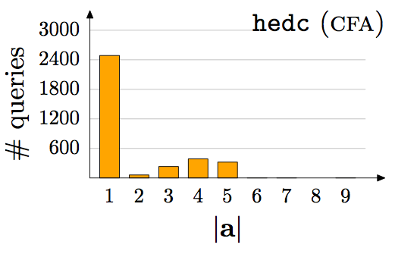
Empirical Results: Per Query

Slide 26
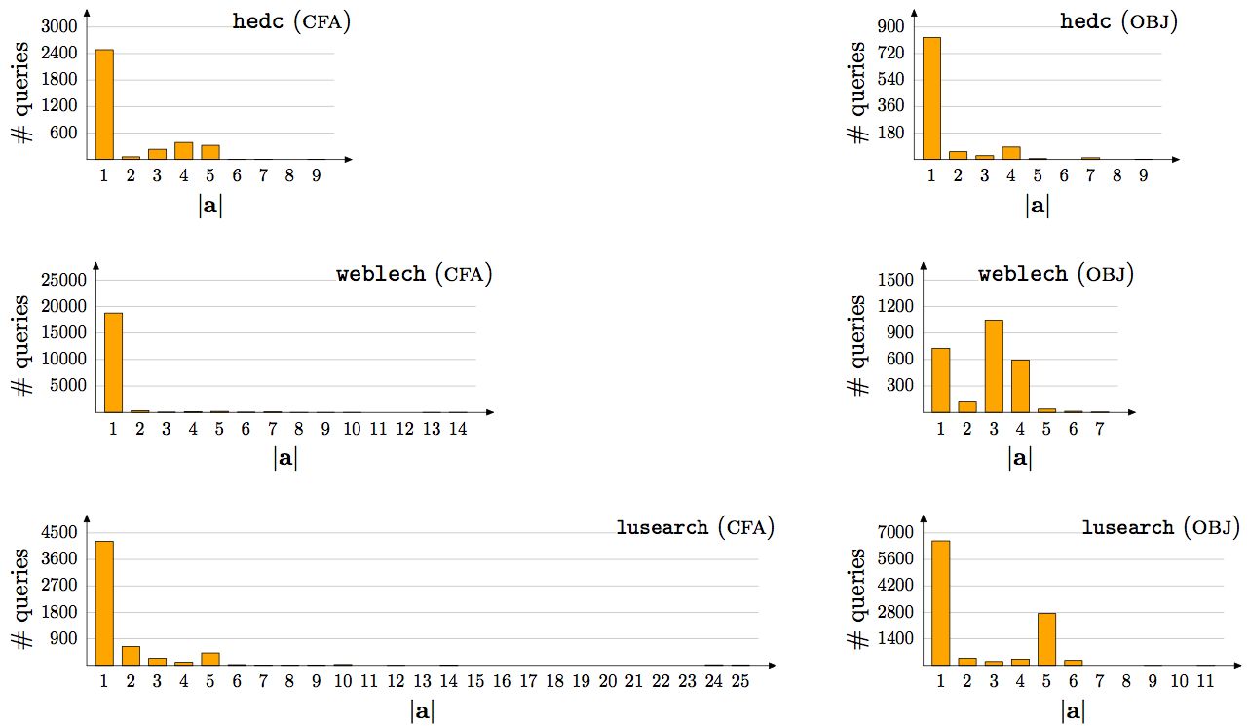
Empirical Results: Per Query, contd.

Slide 27
Application 2: Library Assumptions
The Problem:
Libraries ever-complex to analyze (e.g. native code)
Libraries ever-growing in size and layers
Our Solution:
Completely ignore library code
Each component of abstraction = assumption on different library method
Example: 1 = best-case, 0 = worst-case
Use coarsening to find a minimal assumption
Users confirm or refute reported assumption

Slide 28
Summary: Abstraction Coarsening
Sparse abstractions suffice to prove most queries
Sparsity yields efficient machine learning algorithm
Minimal assumptions more practical application of coarsening than minimal abstractions
Limitations: runs static analysis as black-box

Slide 29
Talk Outline
Minimal Abstraction Problem
Two Algorithms:
Abstraction Coarsening [POPL’11]
Abstractions from Tests [POPL’12]
Summary

Slide 30
Talk Outline
Minimal Abstraction Problem
Two Algorithms:
Abstraction Coarsening [POPL’11]
Abstractions from Tests [POPL’12]
Summary

Slide 31

Abstractions From Tests [POPL’12]
dynamic analysis
p, q
0 1 0 0 0
and minimal!
static analysis
p ² q?

Slide 32
Combining Dynamic and Static Analysis
Previous work:
Counterexamples: query is false on some input
suffices if most queries are expected to be false
Likely invariants: a query true on some inputs is likely true on all inputs [Ernst 2001]
Our approach:
Proofs: a query true on some inputs is likely true on all inputs and for likely the same reason!

Slide 33
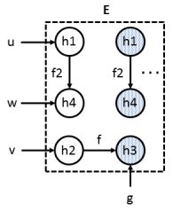

Example: Thread-Escape Analysis
// u, v, w are local variables
// g is a global variable
// start() spawns new thread
for (i = 0; i < N; i++) {
u = new h1;
v = new h2;
g = new h3;
v.f = g;
w = new h4;
u.f2 = w;
pc: w.id = i;
u.start();
}
h1 h2 h3 h4
L L L L
local(pc, w)?

Slide 34
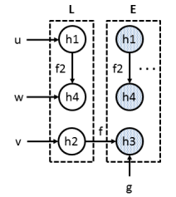
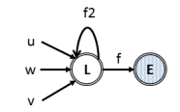
Example: Thread-Escape Analysis
// u, v, w are local variables
// g is a global variable
// start() spawns new thread
for (i = 0; i < N; i++) {
u = new h1;
v = new h2;
g = new h3;
v.f = g;
w = new h4;
u.f2 = w;
pc: w.id = i;
u.start();
}
h1 h2 h3 h4
L L E L
local(pc, w)?
but not minimal

Slide 35
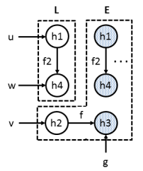
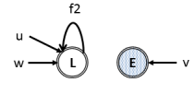
Example: Thread-Escape Analysis
// u, v, w are local variables
// g is a global variable
// start() spawns new thread
for (i = 0; i < N; i++) {
u = new h1;
v = new h2;
g = new h3;
v.f = g;
w = new h4;
u.f2 = w;
pc: w.id = i;
u.start();
}
h1 h2 h3 h4
L E E L
local(pc, w)?
and minimal!

Slide 36
Benchmarks
 | classes |  | bytecodes (x 1000) |  | alloc. sites (x 1000)
 | app | total | app | total
hedc | 44 | 355 | 16 | 161 | 1.6
weblech | 57 | 579 | 20 | 237 | 2.6
lusearch | 229 | 648 | 100 | 273 | 2.9
sunflow | 164 | 1,018 | 117 | 480 | 5.2
avrora | 1,159 | 1,525 | 223 | 316 | 4.9
hsqldb | 199 | 837 | 221 | 491 | 4.6

Slide 37
Precision

Slide 38
Running Time
 | pre-process time | dynamic analysis |  | static analysis time (serial)
 |  | time | #events
hedc | 18s | 6s | 0.6M | 38s
weblech | 33s | 8s | 1.5M | 74s
lusearch | 27s | 31s | 11M | 8m
sunflow | 46s | 8m | 375M | 74m
avrora | 36s | 32s | 11M | 41m
hsqldb | 44s | 35s | 25M | 86m

Slide 39
Running Time (sec.) CDFs

Slide 40
Running Time (sec.) CDFs

Slide 41
CDF of Number of Alloc. Sites in L

Slide 42
CDF of Number of Alloc. Sites in L

Slide 43
CDF of Number of Queries per Group

Slide 44
CDF of Number of Queries per Group

Slide 45
Summary: Abstractions from Tests
If a query is simple, we can find why it holds by observing a few execution traces
A methodology to use dynamic analysis to obtain necessary condition for proving queries
If static analysis succeeds, then also sufficient condition => minimality!
Testing is a growing trend in verification
Limitation: needs small tests with good coverage

Slide 46
Talk Outline
Minimal Abstraction Problem
Two Algorithms:
Abstraction Coarsening [POPL’11]
Abstractions from Tests [POPL’12]
Summary

Slide 47
Talk Outline
Minimal Abstraction Problem
Two Algorithms:
Abstraction Coarsening [POPL’11]
Abstractions from Tests [POPL’12]
Summary

Slide 48
Overview of Our Approaches
Approach | Minimality? | Completeness? | Generic?
Coarsening [POPL’11] | Yes | Yes | Yes
Testing [POPL’12] | Yes | No | No
Naïve Refine [POPL’11] | No | Yes | Yes
Refine+Prune [PLDI’11] | No | Yes | Yes
Backward Refine (ongoing work) | Yes | Yes | No
Provenance Refine (ongoing work) | Yes | Yes | Yes

Slide 49
Key Takeaways
New questions: minimality, impossibility, …
New applications: lower bounds, lib assumptions, …
New techniques: search algorithms, abstractions, …
New tools: meta-analysis, parallelism, …

Slide 50
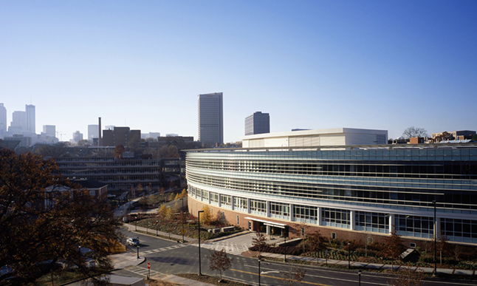
Thank You!
Come visit us in beautiful Atlanta!
http://pag.gatech.edu/

