Slide 1

Scalable Statistical
Bug Isolation
Ben Liblit, Mayur Naik, Alice Zheng,
Alex Aiken, and Michael Jordan
University of Wisconsin, Stanford University, and UC Berkeley

Slide 2
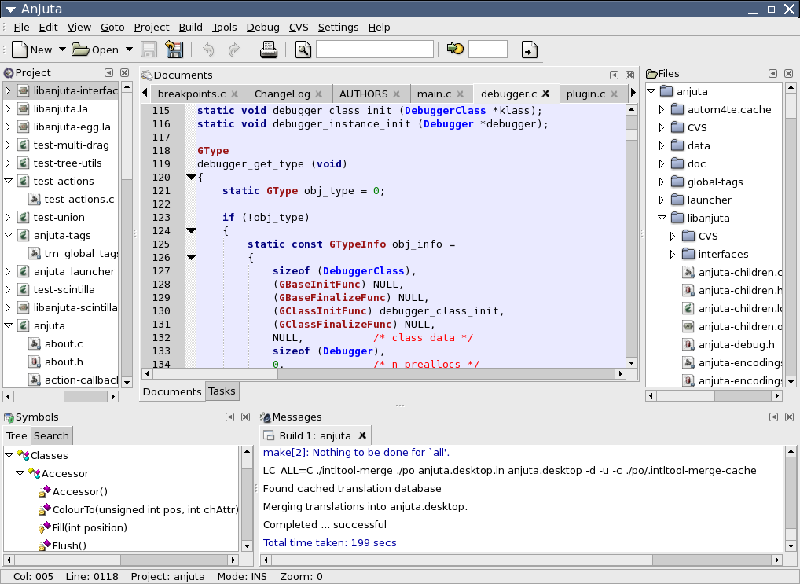




Post-Deployment Monitoring

Slide 3
Goal: Measure Reality
Where is the black box for software?
  Crash reporting systems are a start
Actual runs are a vast resource
  Number of real runs >> number of testing runs
  Real-world executions are most important
This talk: post-deployment bug hunting
  Mining feedback data for causes of failure
Notes:
Users define what matters most.
Ad-Aware: 1,827,650 downloads last week
more than 3 per second
5439 during this talk
3 hours to outnumber 30,000 Microsoft developers

Slide 4
What Should We Measure?
Function return values
Control flow decisions
Minima & maxima
Value relationships
Pointer regions
Reference counts
Temporal relationships
err = fetch(file, &obj);
if (!err && count < size)
list[count++] = obj;
else
unref(obj);
In other words,
lots of things

Slide 5
Our Model of Behavior
Any interesting behavior is expressible as a predicate P on program state at a particular program point.
Count how often “P observed true” and “P observed” using sparse but fair random samples of complete behavior.
Notes:
Given enough runs, samples ≈ reality
Common events seen most often
Rare events seen at proportionate rate

Slide 6
Bug Isolation Architecture
Predicates
Program
Source
Shipping
Application
Sampler

Compiler
€
ƒ
‚
ƒ
€
Statistical
Debugging

Counts
& ☺/☹
Top bugs with
likely causes
Notes:
Note: no programmer annotation required! Just pick which instrumentation schemes to activate.
Not exhaustive
very little data collected for each run
treating many runs as a single run

Slide 7
Find Causes of Bugs
Gather information about many predicates
  298,482 predicates in bc
  857,384 predicates in Rhythmbox
Most are not predictive of anything
How do we find the useful bug predictors?
  Data is incomplete, noisy, irreproducible, …

Slide 8
Look For Statistical Trends
How likely is failure when P happens?
F(P) = # of failures where P observed true
S(P) = # of successes where P observed true
F(P)
F(P) + S(P)
Failure(P) =
Notes:
We’re throwing out some information here by ignoring the actual count for P

Slide 9
Good Start, But Not Enough
if (f == NULL) {
x = 0;
*f;
}
Failure(f == NULL) = 1.0
Failure(x == 0) = 1.0
Predicate x == 0 is an innocent bystander
  Program is already doomed

Slide 10
Context
What is the background chance of failure regardless of P’s truth or falsehood?
F(P observed) = # of failures observing P
S(P observed) = # of successes observing P
F(P observed)
F(P observed) + S(P observed)
Context(P) =
Notes:
We’re throwing out some information here by ignoring the actual count for P

Slide 11
Isolate the Predictive Value of P
Does P being true increase the chance of failure over the background rate?
Increase(P) = Failure(P) – Context(P)
(a form of likelihood ratio testing)

Slide 12
Increase() Isolates the Predictor
if (f == NULL) {
x = 0;
*f;
}
Increase(f == NULL) = 1.0
Increase(x == 0) = 0.0

Slide 13
Isolating a Single Bug in bc
void more_arrays ()
{
…
/* Copy the old arrays. */
for (indx = 1; indx < old_count; indx++)
arrays[indx] = old_ary[indx];
/* Initialize the new elements. */
for (; indx < v_count; indx++)
arrays[indx] = NULL;
…
}
#1: indx > scale
#1: indx > scale
#2: indx > use_math
#1: indx > scale
#2: indx > use_math
#3: indx > opterr
#4: indx > next_func
#5: indx > i_base

Slide 14
It Works!
…for programs with just one bug.
Need to deal with multiple, unknown bugs
Redundant predictors are a major problem
Goal: Isolate the best predictor for each bug, with no prior knowledge of the number of bugs.

Slide 15
Multiple Bugs: Some Issues
A bug may have many redundant predictors
  Only need one, provided it is a good one
Bugs occur on vastly different scales
  Predictors for common bugs may dominate, hiding predictors of less common problems

Slide 16
Guide to Visualization
Multiple interesting & useful predicate metrics
Graphical representation helps reveal trends
Increase(P)
error bound
Context(P)
S(P)
log(F(P) + S(P))

Slide 17
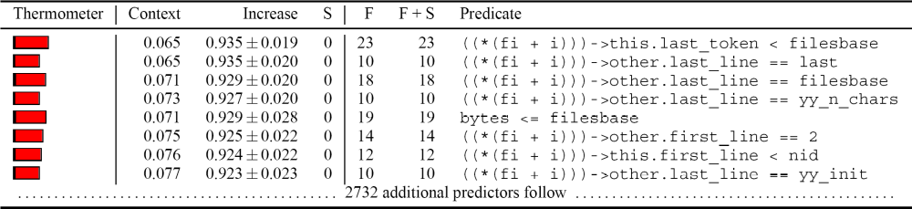
Bad Idea #1: Rank by Increase(P)
High Increase() but very few failing runs!
These are all sub-bug predictors
  Each covers one special case of a larger bug
Redundancy is clearly a problem

Slide 18
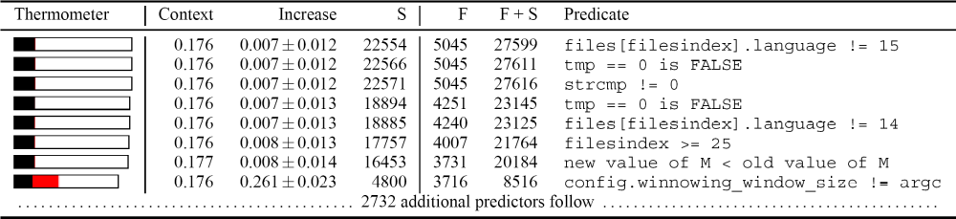
Bad Idea #2: Rank by F(P)
Many failing runs but low Increase()!
Tend to be super-bug predictors
  Each covers several bugs, plus lots of junk

Slide 19
A Helpful Analogy
In the language of information retrieval
  Increase(P) has high precision, low recall
  F(P) has high recall, low precision
Standard solution:
  Take the harmonic mean of both
  Rewards high scores in both dimensions

Slide 20
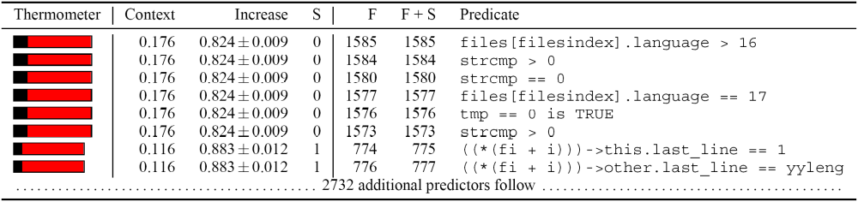
Rank by Harmonic Mean
It works!
  Large increase, many failures, few or no successes
But redundancy is still a problem

Slide 21
Redundancy Elimination
One predictor for a bug is interesting
  Additional predictors are a distraction
  Want to explain each failure once
Similar to minimum set-cover problem
  Cover all failed runs with subset of predicates
  Greedy selection using harmonic ranking

Slide 22
Simulated Iterative Bug Fixing
Rank all predicates under consideration
Select the top-ranked predicate P
Add P to bug predictor list
Discard P and all runs where P was true
  Simulates fixing the bug predicted by P
  Reduces rank of similar predicates
Repeat until out of failures or predicates

Slide 23
Simulated Iterative Bug Fixing
Rank all predicates under consideration
Select the top-ranked predicate P
Add P to bug predictor list
Discard P and all runs where P was true
  Simulates fixing the bug predicted by P
  Reduces rank of similar predicates
Repeat until out of failures or predicates

Slide 24
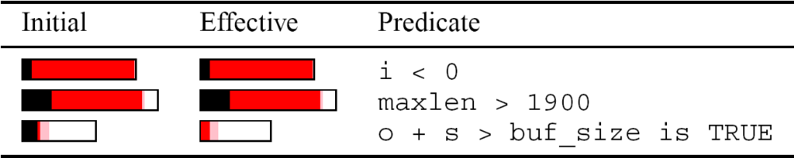
Experimental Results: exif
3 bug predictors from 156,476 initial predicates
Each predicate identifies a distinct crashing bug
All bugs found quickly using analysis results

Slide 25
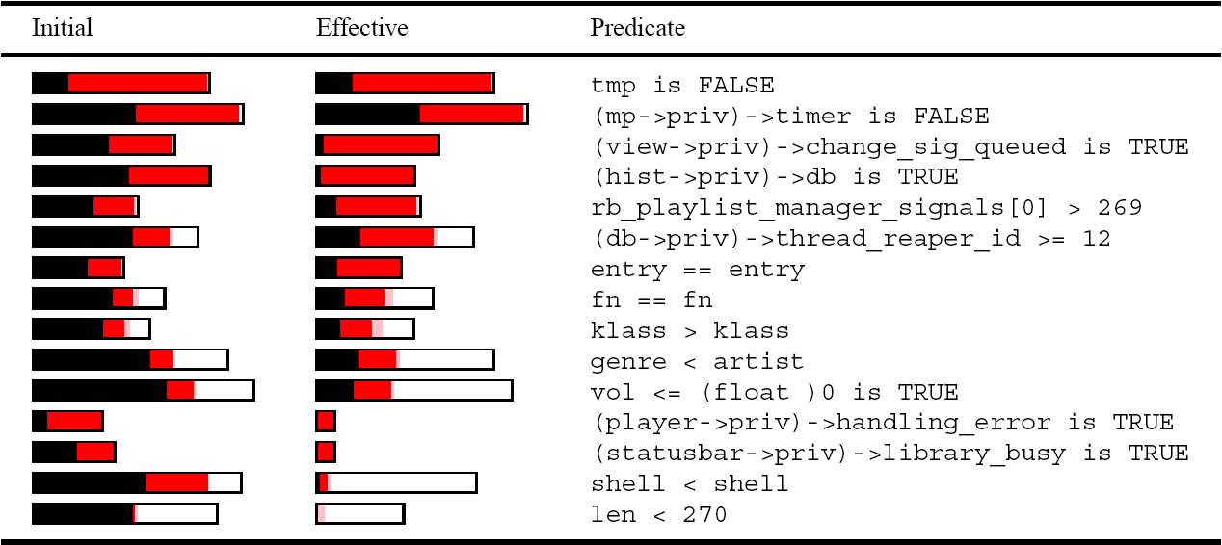
Experimental Results: Rhythmbox
15 bug predictors from 857,384 initial predicates
Found and fixed several crashing bugs

Slide 26
Lessons Learned
Can learn a lot from actual executions
  Users are running buggy code anyway
  We should capture some of that information
Crash reporting is a good start, but…
  Pre-crash behavior can be important
  Successful runs reveal correct behavior
  Stack alone is not enough for 50% of bugs

Slide 27
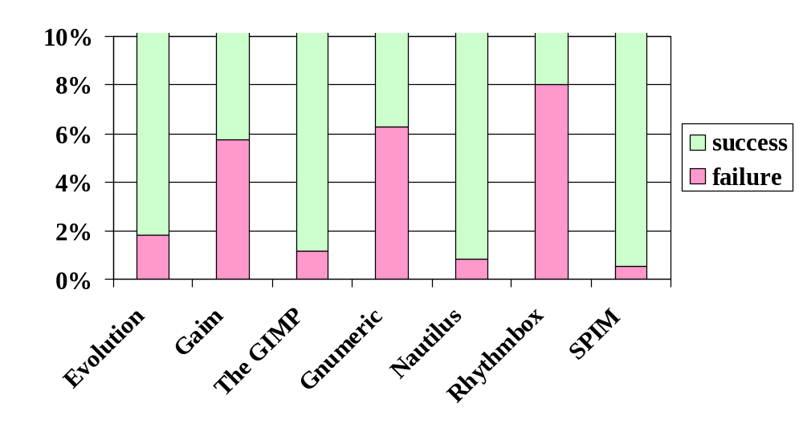
Public Deployment in Progress

Slide 28
Join the Cause!
The Cooperative Bug Isolation Project
http://www.cs.wisc.edu/cbi/
Notes:
Performance
Chilimbi and Hauswirth: ASPLOS ’04
3-6%

Slide 29
How Many Runs Are Needed?
 | Failing Runs For Bug #n
 | #1 | #2 | #3 | #4 | #5 | #6 | #9
Moss | 18 | 10 | 32 | 12 | 21 | 11 | 20
ccrypt | 26
bc | 40
Rhythmbox | 22 | 35
exif | 28 | 12 | 13

Slide 30
How Many Runs Are Needed?
 | Total Runs For Bug #n
 | #1 | #2 | #3 | #4 | #5 | #6 | #9
Moss | 500 | 3K | 2K | 800 | 300 | 1K | 600
ccrypt | 200
bc | 200
Rhythmbox | 300 | 100
exif | 2K | 300 | 21K

