Slide 1

User-Guided Program Reasoning using Bayesian Inference
Mukund Raghothaman · Sulekha Kulkarni · Kihong Heo · Mayur Naik
University of Pennsylvania

Slide 2
Static Analyzers
Automatic bug-finding tools
The ideal static analyzer:
Identifies the most serious bugs
Produces no false alarms
Scales to very large codebases
Astrée
Microsoft
Windows Device Drivers
Airbus
Avionics Software
Synopsis
Enterprise Applications
Facebook
Mobile Applications

Slide 3


Heartbleed
Buffer over‑read bug in OpenSSL’s Heartbeat implementation
Introduced in 2011, discovered in 2014
Estimated to affect nearly 66% of all web servers
Why did static analysis tools not discover the Heartbleed bug?

Slide 4
Approximations in Static Analysis
Challenge #1: Most analysis questions are undecidable So, analysis tools are only approximately correct
Challenge #2: Tools must scale to large programs So, analysis designers make aggressive tradeoffs
“… can be difficult to do without introducing large numbers of false positives, or scaling performance exponentially poorly. In this case, balancing these and other factors in the analysis design caused us to miss the defect.”
―Coverity, On Detecting Heartbleed with Static Analysis, 2014
Alarms |  | Relevant
 |  | Yes | No
Reported | Yes | True positive | False positive
 | No | False negative | True negative
“Unsound”
“Incomplete”
Notes:
TODO: Add contributions slide. Artifact evaluation stamp on contribution slide.

Slide 5
Our Contribution
A new way to improve analysis accuracy by leveraging user feedback
Step 1: View derivation graph as a Bayesian network
Step 2: Rank alarms based on confidence values
Step 3: Generalize from feedback using conditional probabilities

Slide 6




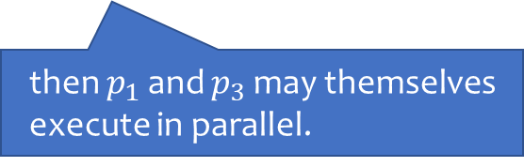
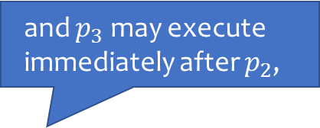
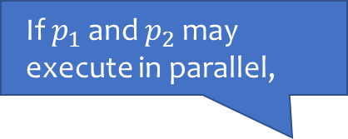
Example Analysis: Datarace Detection
If $p_{1}$ and $p_{2}$ may execute in parallel,
and $p_{3}$ may execute immediately after $p_{2}$,
R | par($p_{1}$, $p_{3}$) | :- par($p_{1}$, $p_{2}$), next($p_{2}$, $p_{3}$).
then $p_{1}$ and $p_{3}$ may themselves execute in parallel.
Example of deduction rule in Datalog
par(L₁, L₂)
next(L₂, L₃)
⋮
x = y + 1; // L₁
⋮
⋮
z = y + 1; // L₂
z = z + 1; // L₃
⋮
R
par(L₁, L₃)

Slide 7
Applying the Analysis …
Start with input tuples
par(L₁, L₂)
next(L₂, L₃)
R
R
Apply rules to derive new tuples
next(L₃, L₂)
par(L₁, L₃)
next(L₃, L₄)
alias(L₁, L₃)
R
Stop when nothing new can be concluded
R′
par(L₁, L₄)
alias(L₁, L₄)
race(L₁, L₃)
R′
race(L₁, L₄)

Slide 8


Applying the Analysis …
“Possible datarace on field ‘isPasv’ between lines Connection.java:191 (Read) and Connection.java:106 (Write)”
Checker Of Races and Deadlocks: Popular static analysis tool for Java
(Naik et al PLDI 2006)
Highly concurrent open source FTP server
[150 kLOC]
522 alarms
75 true positives
447 false positives

Slide 9

How do False Alarms Arise?
This rule causes incompleteness!
R | par($p_{1}$, $p_{3}$) | :- par($p_{1}$, $p_{2}$), next($p_{2}$, $p_{3}$).
⋮
x = x + 1; // L₁
⋮
⋮
if (numThreads == 1 /* L₂ */) {
x = x + 1; // L₃
}
⋮
✓
par(L₁, L₂)
next(L₂, L₃)
✓
R
par(L₁, L₃)
✘

Slide 10
How do False Alarms Arise?
Incorrect intermediate conclusions lead to false alarms downstream
Traditional solution:
Refine the analysis, use more elaborate rules
Requires domain expertise
Makes analysis computationally expensive
Effectiveness depends on program and on coding idioms

Slide 11
Our Observation
Alarms share root causes
Therefore, they are correlated in their ground truth
par(L₁, L₂)
next(L₂, L₃)
R
R
next(L₃, L₂)
par(L₁, L₃)
next(L₃, L₄)
par(L₁, L₃)
alias(L₁, L₃)
R
R′
par(L₁, L₄)
par(L₁, L₄)
alias(L₁, L₄)
race(L₁, L₃)
R′
race(L₁, L₃)
race(L₁, L₄)
race(L₁, L₄)

Slide 12
Central Idea
Construct probabilistic model by introspective reasoning
Assign subjective belief values to alarms by marginal inference
User can focus attention on alarms with high confidence
Update belief values based on user feedback

Slide 13





#include <stdi
int main() {
int x = ⋯;
int *y = &x;
*y = ⋯;
}
Feedback
✔ …
✘ …
✘ …
Program to be analyzed
Analysis
❶
❷
Marginal Inference
Bayesian Network
…
…
…
Ranked alarms
How do we extract this probabilistic model?
How do we make marginal inference scale?
$$\text{Pr}⁡(\text{a})$$
$$\text{Pr}⁡(\text{a}∣¬\text{a}\text{1})$$
$$\text{Pr}⁡(\text{a}∣¬{\text{a}}_{\text{1}},¬{\text{a}}_{\text{2}})$$
$$\text{Pr}(\text{a}∣¬{\text{a}}_{\text{1}},¬{\text{a}}_{\text{2}},{\text{a}}_{\text{3}})$$
👍
a₁
a₂
a₃
0.993
0.779
0.046
👎
👎

Slide 14
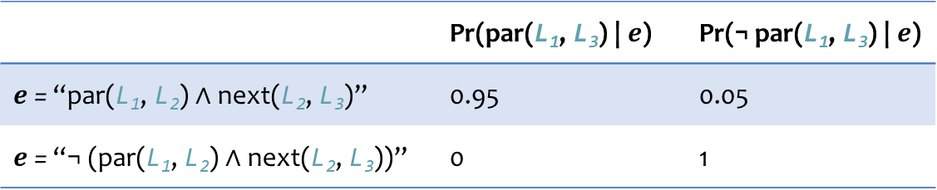
A Probabilistic Model of Alarms
This rule causes incompleteness!
R | par($p_{1}$, $p_{3}$) | :- par($p_{1}$, $p_{2}$), next($p_{2}$, $p_{3}$).
Quantifies incompleteness
par(L₁, L₂)
next(L₂, L₃)
“Even if both par(L₁, L₂) and next(L₂, L₃) hold, we only believe par(L₁, L₃) with confidence 0.95.”
“Even if both par(L₁, L₂) and next(L₂, L₃) hold, we only believe par(L₁, L₃) with confidence 0.95.”
R
par(L₁, L₃)
 | Pr(par(L₁, L₃) | $e$) | Pr(¬ par(L₁, L₃) | $e$)
$e$ = “par(L₁, L₂) ∧ next(L₂, L₃)” | 0.95 | 0.05
$e$ = “¬ (par(L₁, L₂) ∧ next(L₂, L₃))” | 0 | 1
Notes:
There are many ways one can measure the “incompleteness” of a rule. With a large corpus of labelled data, one could find out how often the rule misfires. Without training data, one could give a subjective estimate of its reliability: in fact, this is what we do in our experiments. With a corpus of labelled alarms, we could use expectation-maximization to come up with so-called maximum likelihood estimates.

Slide 15
A Probabilistic Model of Alarms
Joint probability distribution over ground truth of all tuples induced by factoring:
Pr(race(L₁, L₄), ¬ par(L₁, L₄), alias(L₁, L₄), …)
= Pr(race(L₁, L₄) | ¬ par(L₁, L₄), alias(L₁, L₄))
× Pr(¬ par(L₁, L₄) | ⋯)
× Pr(alias(L₁, L₄))
× ⋯
[Factor ❶]
[Factor ❷]
[Factor ❸]
par(L₁, L₂)
next(L₂, L₃)
R
R
Each tuple treated as a Boolean-valued random variable
next(L₃, L₂)
par(L₁, L₃)
next(L₃, L₄)
Factor ❷
alias(L₁, L₃)
R
R′
par(L₁, L₄)
alias(L₁, L₄)
Factor ❸
race(L₁, L₃)
R′
race(L₁, L₄)
Factor ❶

Slide 16
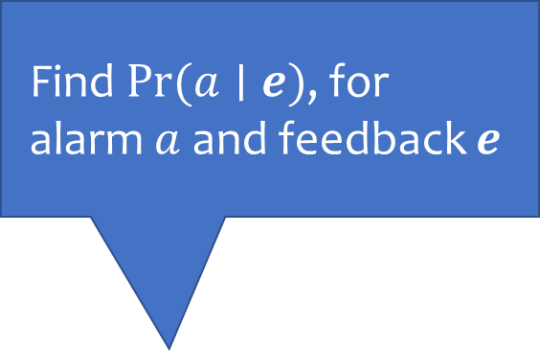
#include <stdi
int main() {
int x = ⋯;
int *y = &x;
*y = ⋯;
}
Feedback
✔ …
✘ …
✘ …
Program to be analyzed
Analysis
❶
❷
Marginal Inference
Bayesian Network
Find $Pr⁡(a∣e)$, for alarm $a$ and feedback $e$
…
…
…
Ranked alarms
How do we extract this probabilistic model?
How do we make marginal inference scale?
$$\text{Pr}⁡(\text{a})$$
$$\text{Pr}⁡(\text{a}∣¬\text{a}\text{1})$$
$$\text{Pr}⁡(\text{a}∣¬{\text{a}}_{\text{1}},¬{\text{a}}_{\text{2}})$$
$$\text{Pr}(\text{a}∣¬{\text{a}}_{\text{1}},¬{\text{a}}_{\text{2}},{\text{a}}_{\text{3}})$$
👍
a₁
a₂
a₃
0.993
0.779
0.046
👎
👎

Slide 17
Scaling Marginal Inference
Exact inference is #P‑complete
Which inference algorithm to use?
Variable elimination vs.
Gibbs sampling vs.
Loopy belief propagation
Which inference algorithm to use?
Variable elimination vs.
Gibbs sampling vs.
Loopy belief propagation
Optimization #1: Eliminate tuples which are not involved in the derivation of any alarm
Optimization #2: Collapse linear sequences of derivations by eagerly performing variable elimination
Which inference algorithm to use?
Variable elimination vs.
Gibbs sampling vs.
Loopy belief propagation
Optimization #1: Eliminate tuples which are not involved in the derivation of any alarm
Which inference algorithm to use?
Variable elimination vs.
Gibbs sampling vs.
Loopy belief propagation
Which inference algorithm to use?
Variable elimination vs.
Gibbs sampling vs.
Loopy belief propagation
Speedups of 482×
Large number of samples needed

Slide 18

Experimental Evaluation
Implemented in a tool named Bingo
Analysis 1: Datarace analysis for Java programs
Analysis 2: Taint analysis for Android apps
Suite of 16 benchmarks: Dacapo and Android malware
40K—616KLOC
Notes:
Datarace: 102 rules, 102 relations, 58 input relations, 44 output relations
Taint: 62 rules, 77 relations, 52 input relations, 25 output relations
Used an off-the-shelf marginal inference engine, LibDAI

Slide 19
Effectiveness of Ranking
Hundreds of alarms, tens of true positives
With Bingo, the user needs to inspect 69% fewer false alarms
Datarace
Taint
Dramatic reductions in inspection burden
Notes:
44% fewer alarms than Base-C
58% fewer alarms than Base-R

Slide 20
Discovering New Bugs
Alarms |  | Relevant
 |  | Yes | No
Reported | Yes | True positive | False positive
 | No | False negative | True negative
“Unsound”
“Incomplete”
Tools often sacrifice recall for improved precision

Slide 21
Discovering New Bugs Bingo vs. precise unsound analyses
 | Chord, soundy¹ |  | Chord, unsound |  |  | Bingo
 | Total | True | Total | True | Missed | Last true rank
Jspider | 257 | 9 | 52 | 5 | 4 | 20
Weblech | 30 | 6 | 7 | 4 | 2 | 11
FTP | 522 | 75 | 211 | 36 | 39 | 103
HEDC | 152 | 12 | 55 | 6 | 6 | 67
Avrora | 978 | 29 | 9 | 4 | 25 | 410
LUIndex | 940 | 2 | 494 | 2 | 0 | 14
Sunflow | 958 | 171 | 506 | 94 | 77 | 838
Xalan | 1870 | 75 | 80 | 52 | 23 | 273
Total | 5707 | 379 | 1414 | 203 | 176 | 1736
Discover 87% more bugs by inspecting 23% more alarms
Precision: 4.6%
Precision: 14%
Recall: 54%
¹Livshits et al., In Defense of Soundiness: A Manifesto, 2015

Slide 22
Conclusion
Bayesian, human-in-the-loop system to increase the effective accuracy of static analyses
Exploits the observation that alarms are correlated
Expects the analysis to be written in a deductive style
What’s in the paper:
How to extract probabilistic models
Lots of engineering optimizations
Extensive experimental results Sophisticated analyses + large codebases

Slide 23
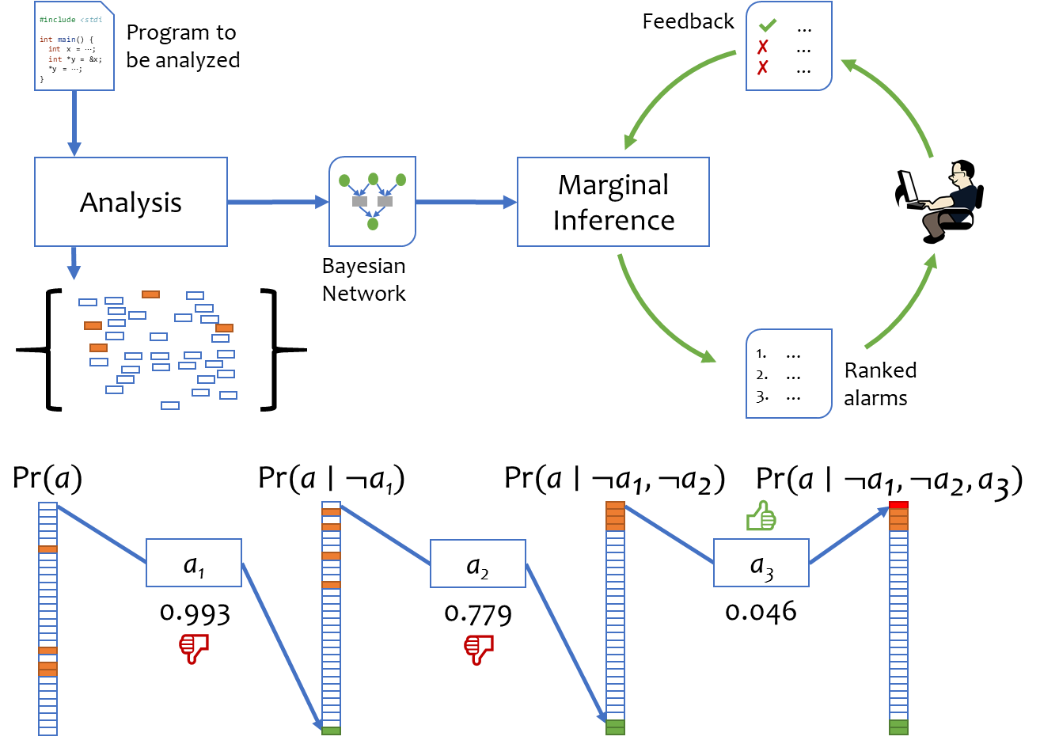
User-Guided Program Reasoning using Bayesian Inference
Mukund Raghothaman · Sulekha Kulkarni · Kihong Heo · Mayur Naik University of Pennsylvania
Static analysis alarms |  | Relevant
 |  | Yes | No
Reported | Yes | True positive | False positive
 | No | False negative | True negative
What we will discuss
A framework for interactive alarm ranking
A method to generalize from user feedback
How to improve effective analysis accuracy
Experiments
Tool targeting arbitrary analyses in Datalog
Datarace analysis on Dacapo benchmarks
Taint analysis on Android apps
40K—600KLOC
58% reduction in alarm inspection load

Slide 24
Derivation graph may have cycles at fixpoint
Bayesian networks are required to be acyclic
Challenge: Eliminate constraints so that cycles disappear
Requirements:
Preserve derivability
Keep as many constraints as possible
Derivation graph may have cycles at fixpoint
Bayesian networks are required to be acyclic
Challenge: Eliminate constraints so that cycles disappear
Requirements:
Preserve derivability
Keep as many constraints as possible
par(L₁, L₂)
par(L₁, L₂)
next(L₂, L₃)
R
R
next(L₃, L₂)
par(L₁, L₃)
next(L₃, L₄)
par(L₁, L₃)
alias(L₁, L₃)
R
R′
par(L₁, L₄)
alias(L₁, L₄)
Timestamp-based algorithm based on the naive Datalog evaluator
race(L₁, L₃)
R′
The maximum acyclic subgraph problem is NP-complete!
race(L₁, L₄)

Slide 25
Effectiveness of Our Approach

Slide 26
Effectiveness of Our Approach

Slide 27

Future Work
Better probabilistic models
Better solver technology
#include <stdi
int main() {
int x = ⋯;
int *y = &x;
*y = ⋯;
}
Program to be analyzed
Feedback
✔ …
✘ …
✘ …
Analysis
Marginal Inference
Bayesian Network
Incremental analysis techniques
…
…
…
Ranked alarms

